Slide 1
Expert Content
Strategy Guide
Post Close Home Purchase Anniversary

Slide 2
Post Close Purchase Anniversary
Emails, user notifications
Borrower participants will receive a thank you once a purchase loan is funded. It sends the borrowers an additional 4 emails over the course of one year with touchpoints at 1, 3, 6, and 12 months. A separate thank you email for first-time homebuyers and the agents, a 6-month check-in reminder for the contact owner to review for refinancing opportunities, make this campaign easily configured to elevate your organization’s post-close experience. Further customize the campaign with integrations like gifting services.
*All communications should be reviewed prior to initiating the journey.

Slide 3
Journey Map Notes:
Co-borrower is cc’d on all borrower emails in this campaign.
Additional yearly anniversary emails can easily be added should it align with your strategy.

Slide 4
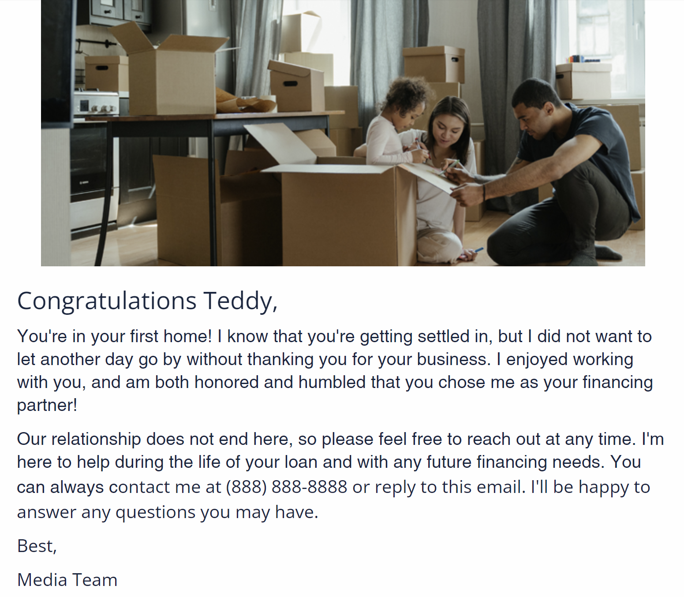
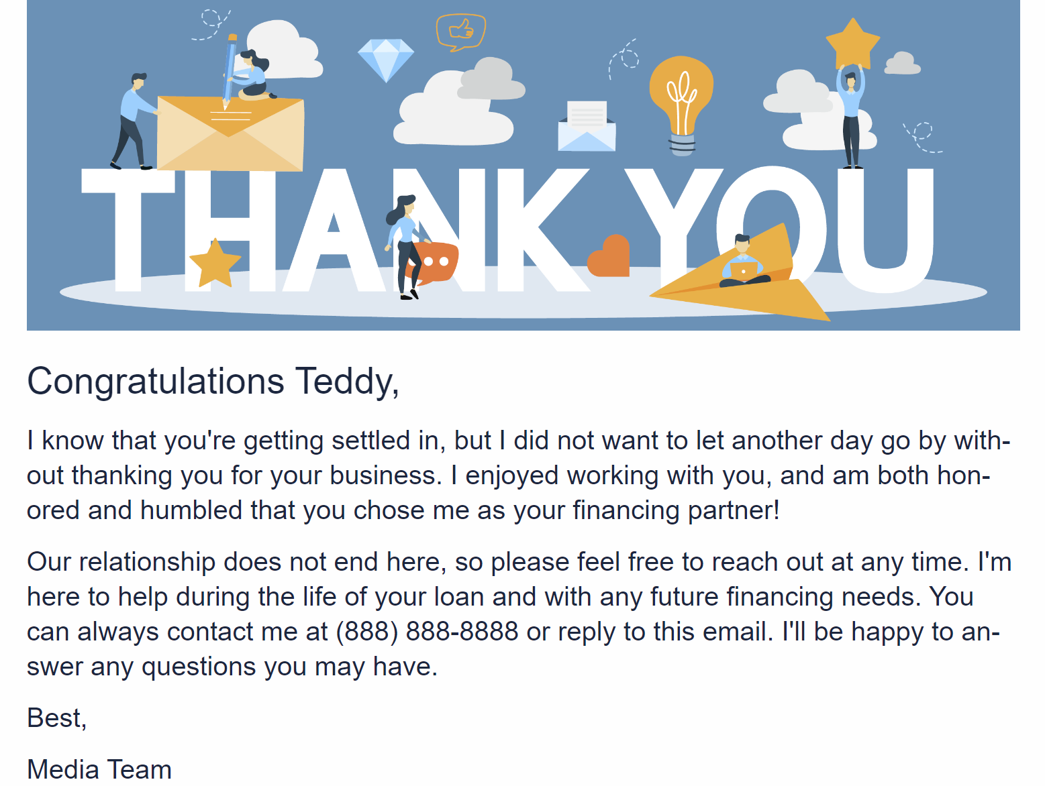
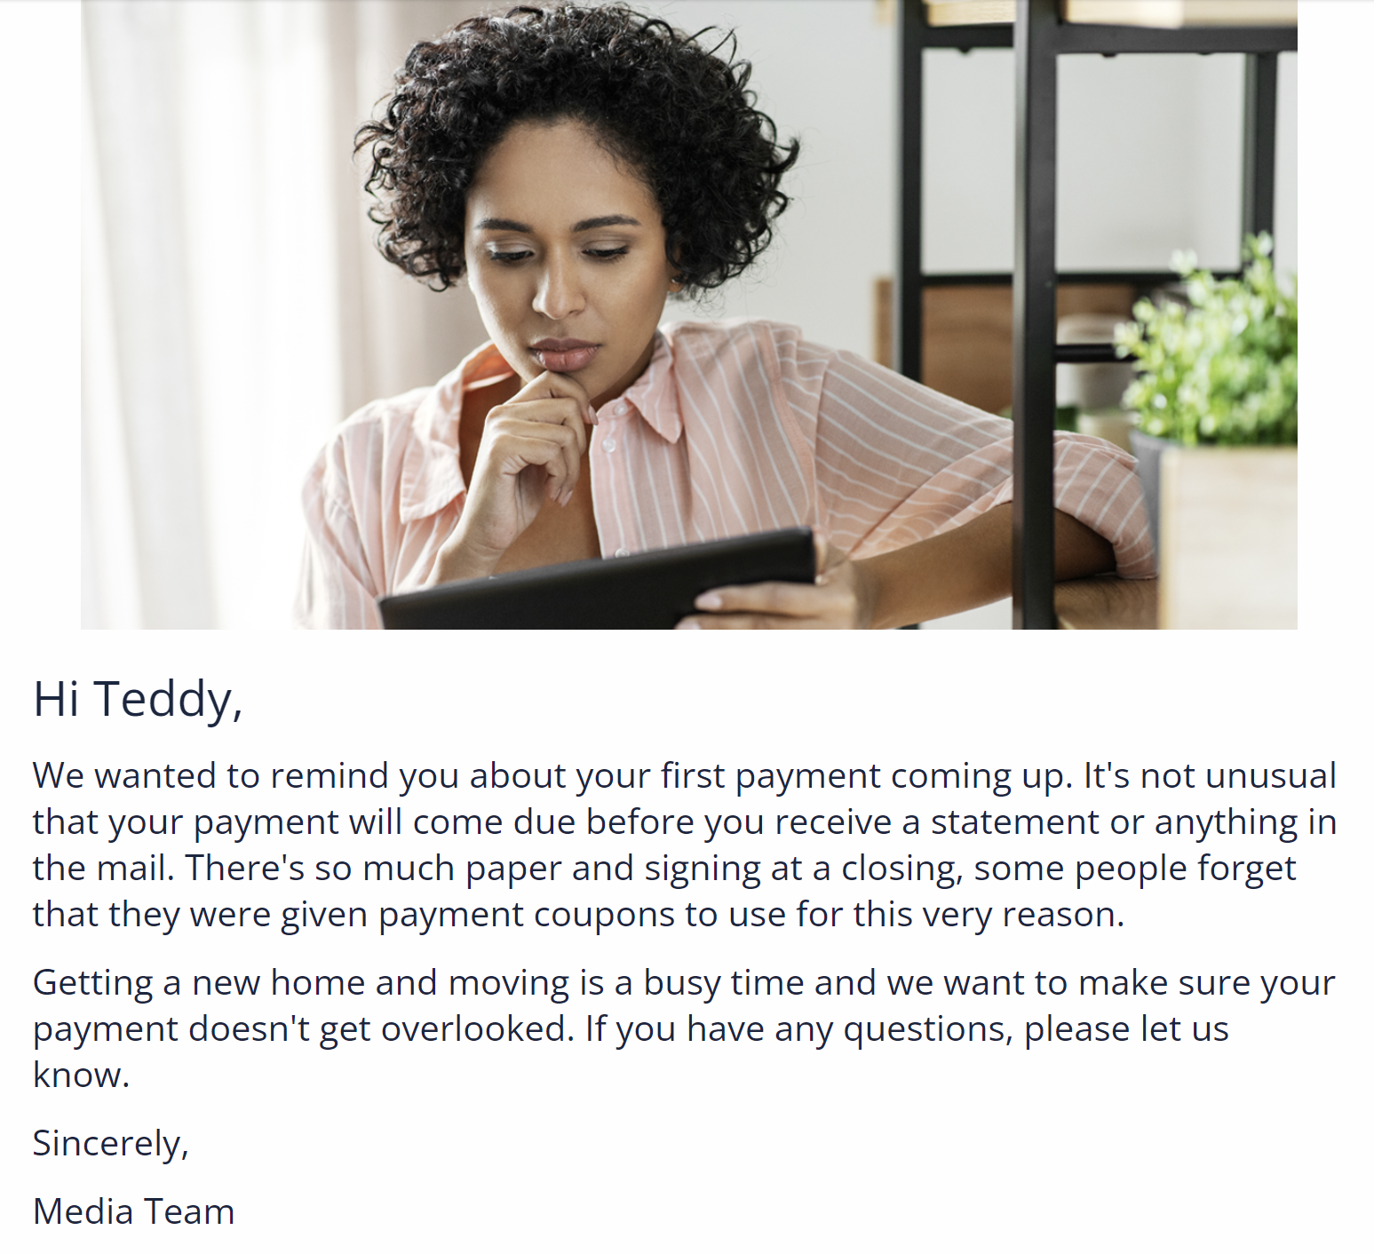
Post Close Purchase Anniversary
Email Names:
Post Close - Thank You!
Post Close - FTHB Congrats!
Post Close - Payment Reminder

Slide 5
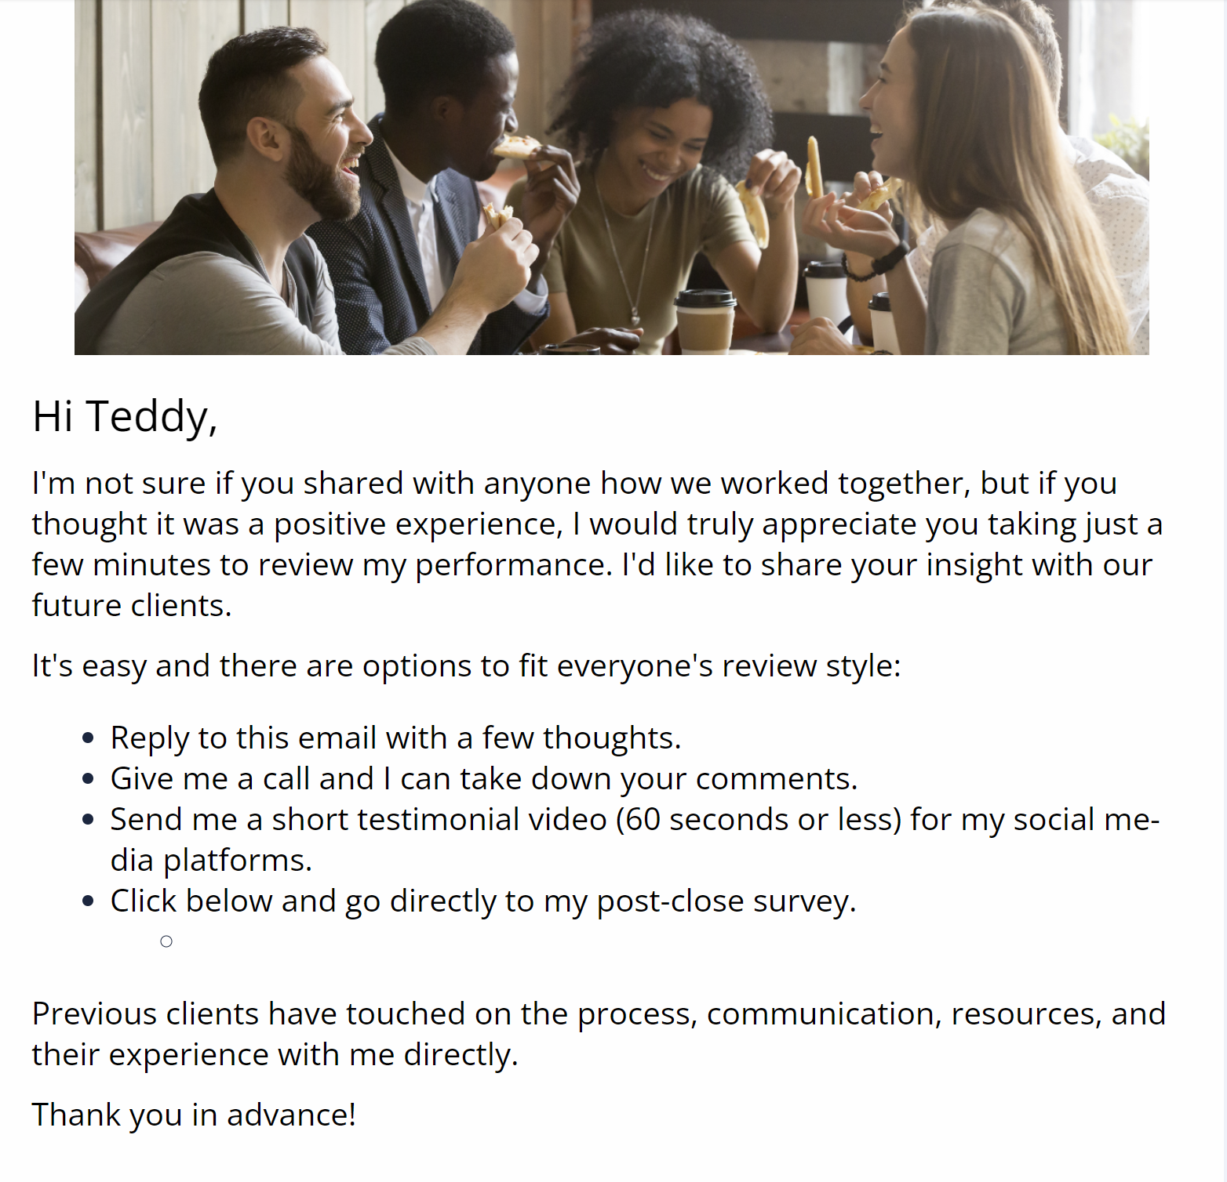
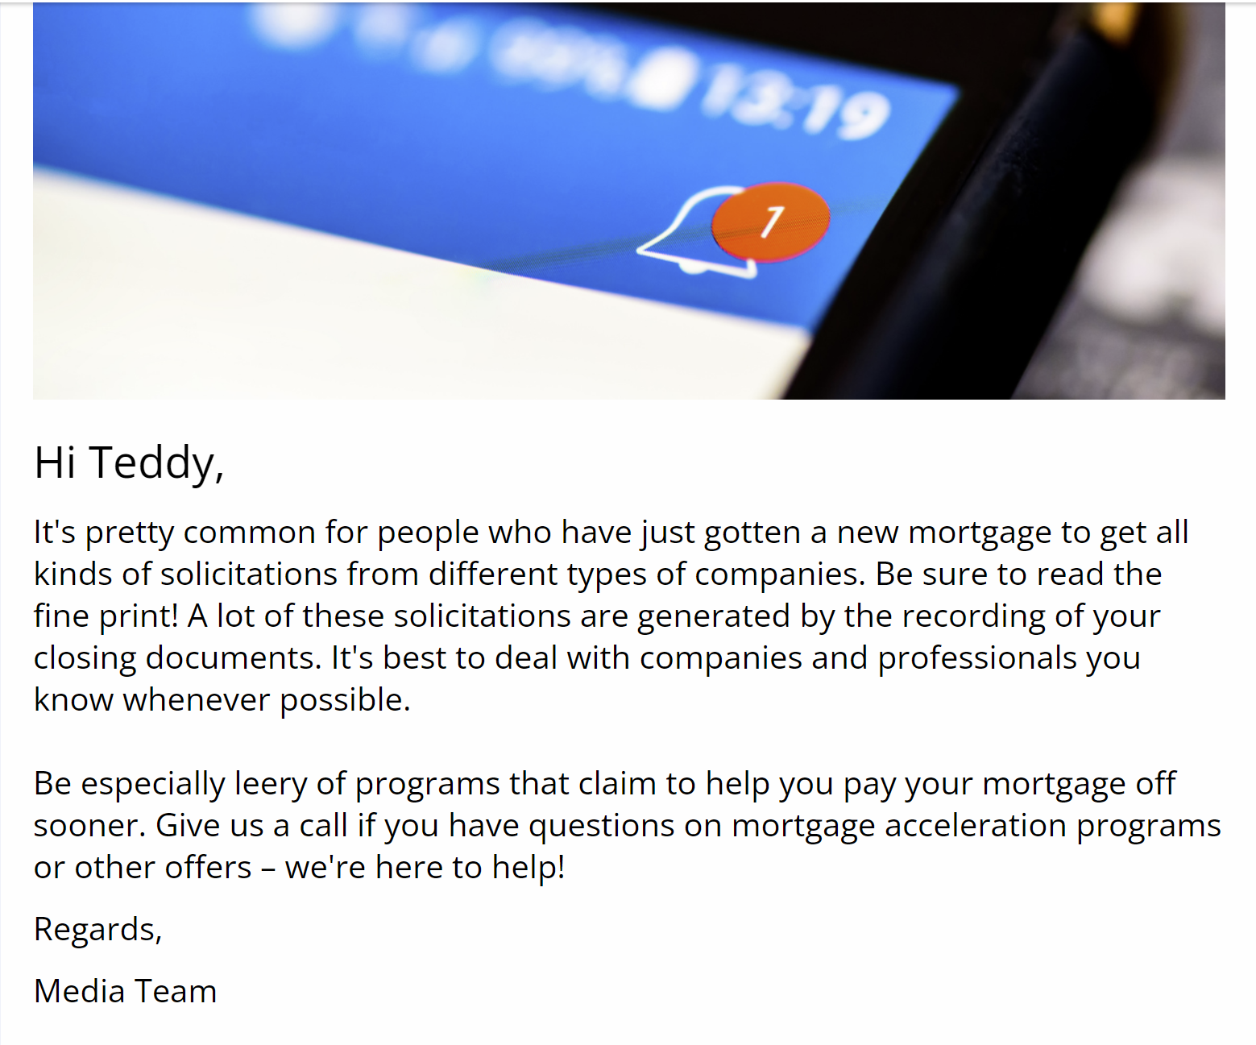
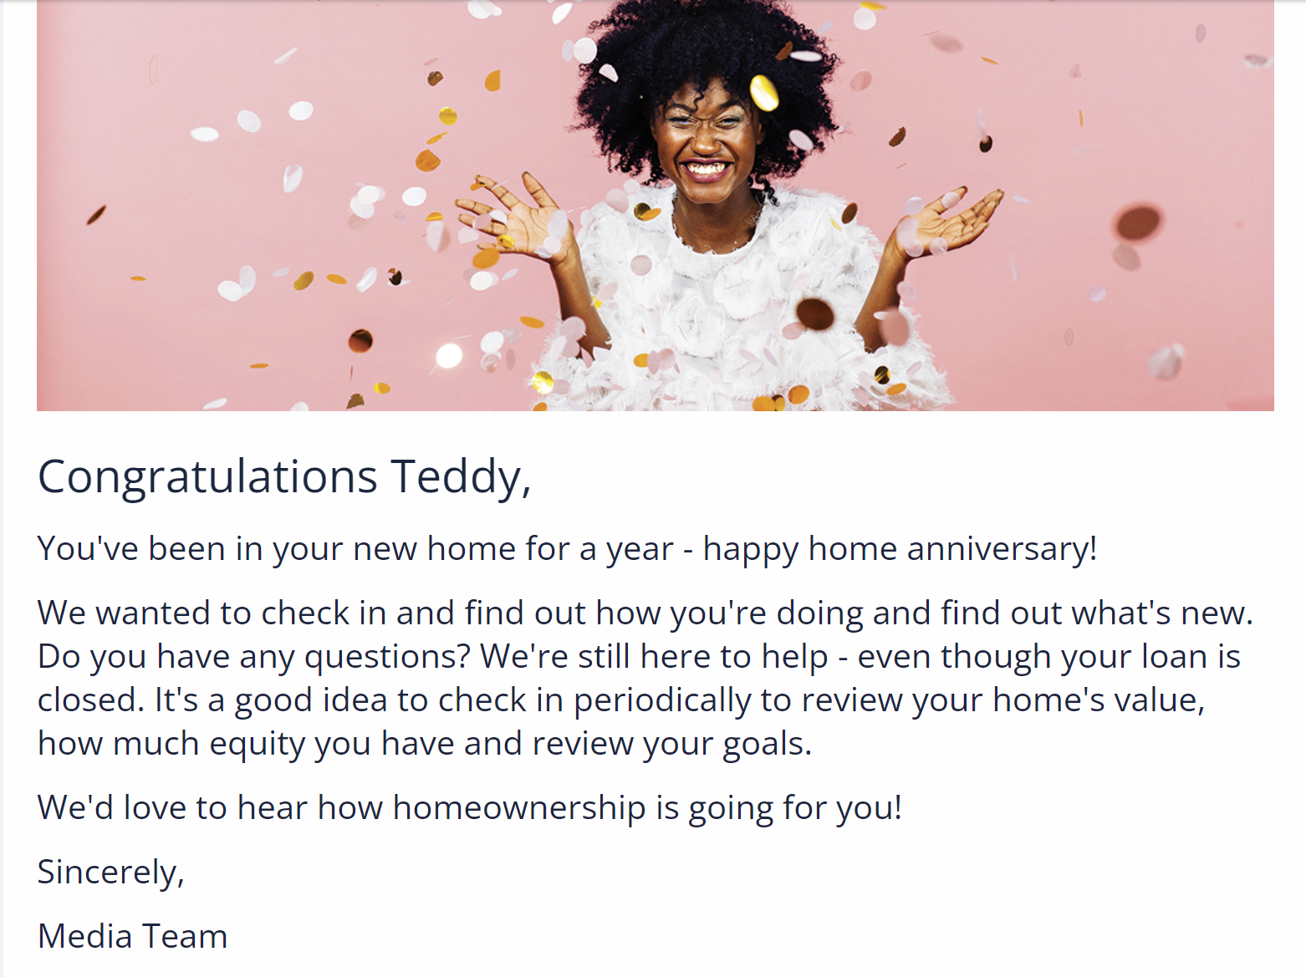
Post Close Purchase Anniversary
Email Names:
Post Close - Testimonial Request
Post Close - Attracting Attention?
Post Close - Happy Home Anniversary!

Slide 6
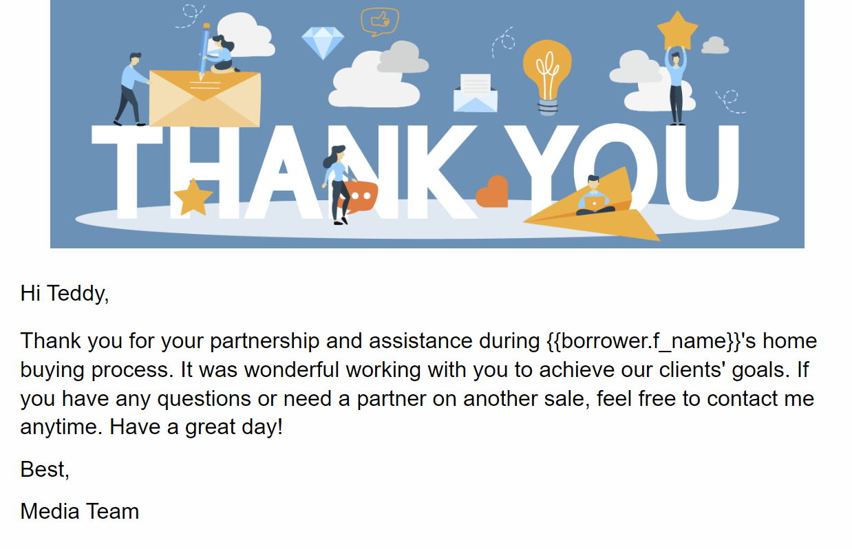
Post Close Purchase Anniversary
Email Names:
Post Close - Agent Thank You

