Slide 1
Pre-Qualified Journey
Pre-qualified mortgage journey to retain prospects, educate on the process, and encourage loan application.

Slide 2
Wireframe Overview

Slide 3
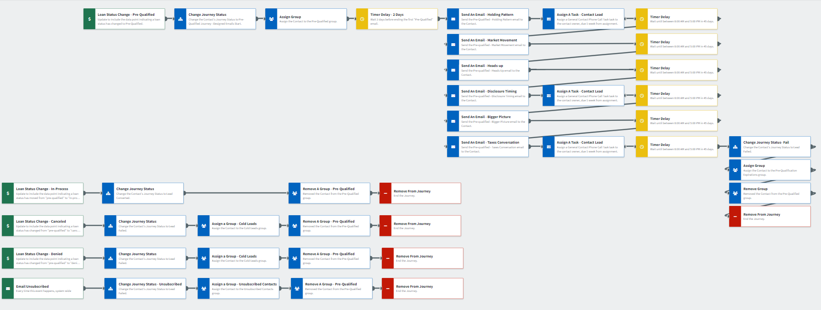
Pre-Qualified Journey
Notes:
Onboard clients through a loan status change to “pre-qualified”, educate them with six friendly emails educating clients on the loan process and market, and track campaign success through pre-set journey statuses. If necessary, adjustments can be made to the wireframe and email content.

Slide 4
Email Samples

Slide 5
