Slide 1
Expert Content
Strategy Guide
Pre-Qualified Journey
April 2025

Slide 2
Pre-Qualified Journey
Communication types: Email, SMS, and User Notifications
Leverage this pre-qualified journey to retain prospective borrowers, educate them on the loan process, and encourage loan application completion. The journey begins when a loan status changes to pre-qualified. Specific statuses of the onramps and offramps should be updated to match your organization’s loan status naming conventions.
*All communications should be reviewed prior to initiating the journey.

Slide 3
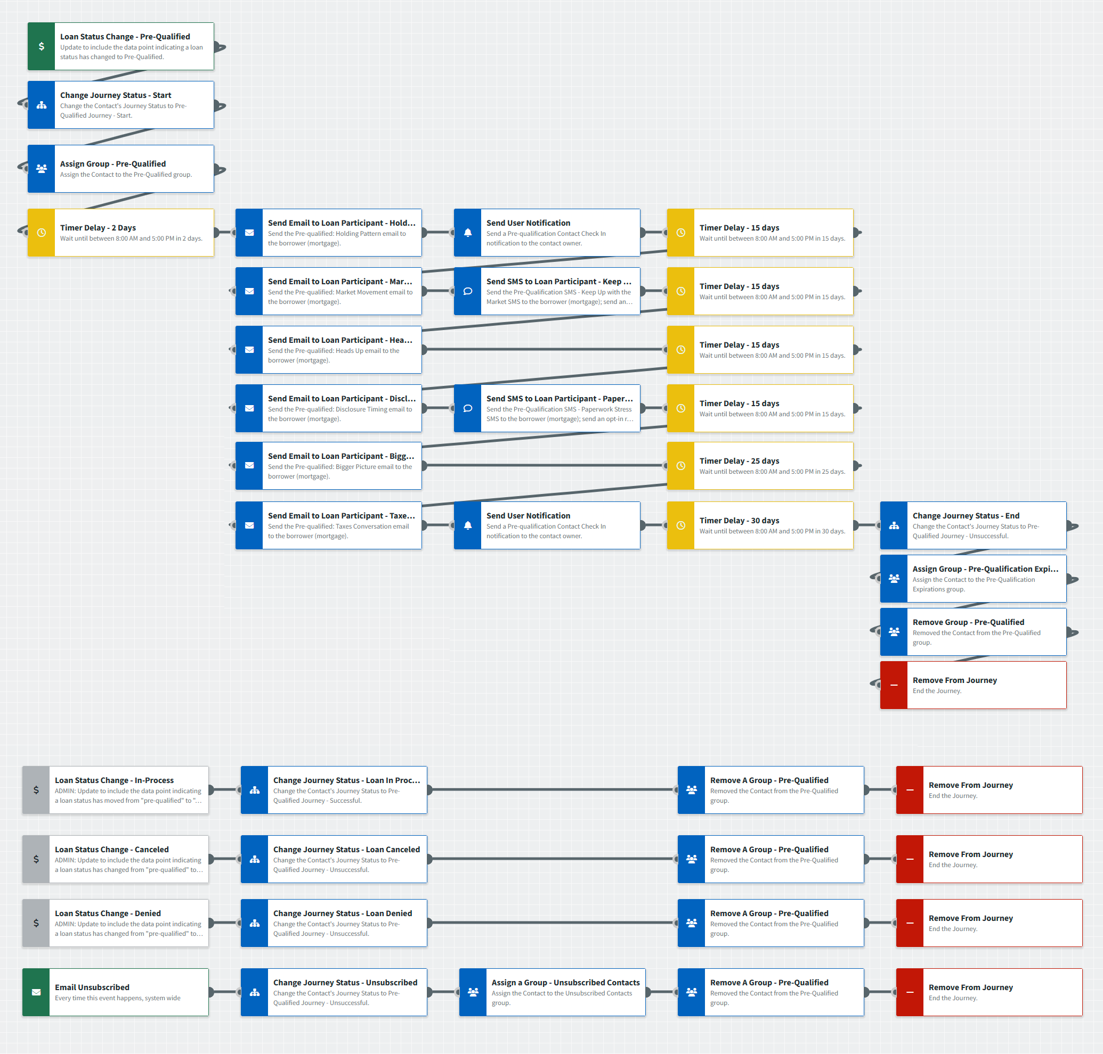
Pre-Qualified Journey
Journey Notes:
Keep emails that work for your organization, swap with custom, or add these emails to your existing campaigns.
Focused View Outcomes or Contact Group triggers can also be added to bring contacts onto the journey or offramp them. For example, an onramp trigger of Contact Group Assigned (Pre-Qualified) may be best for organizations without a point-of-sale integration.

Slide 4
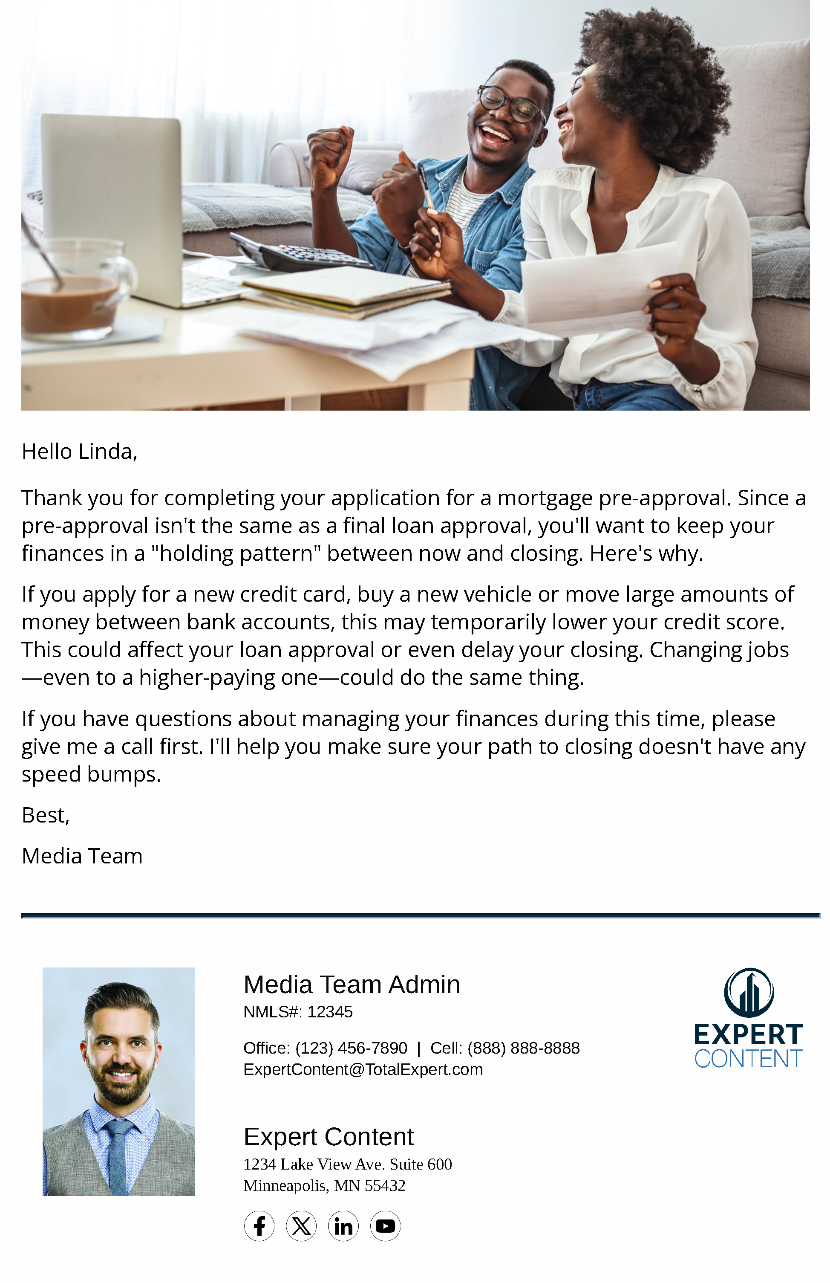
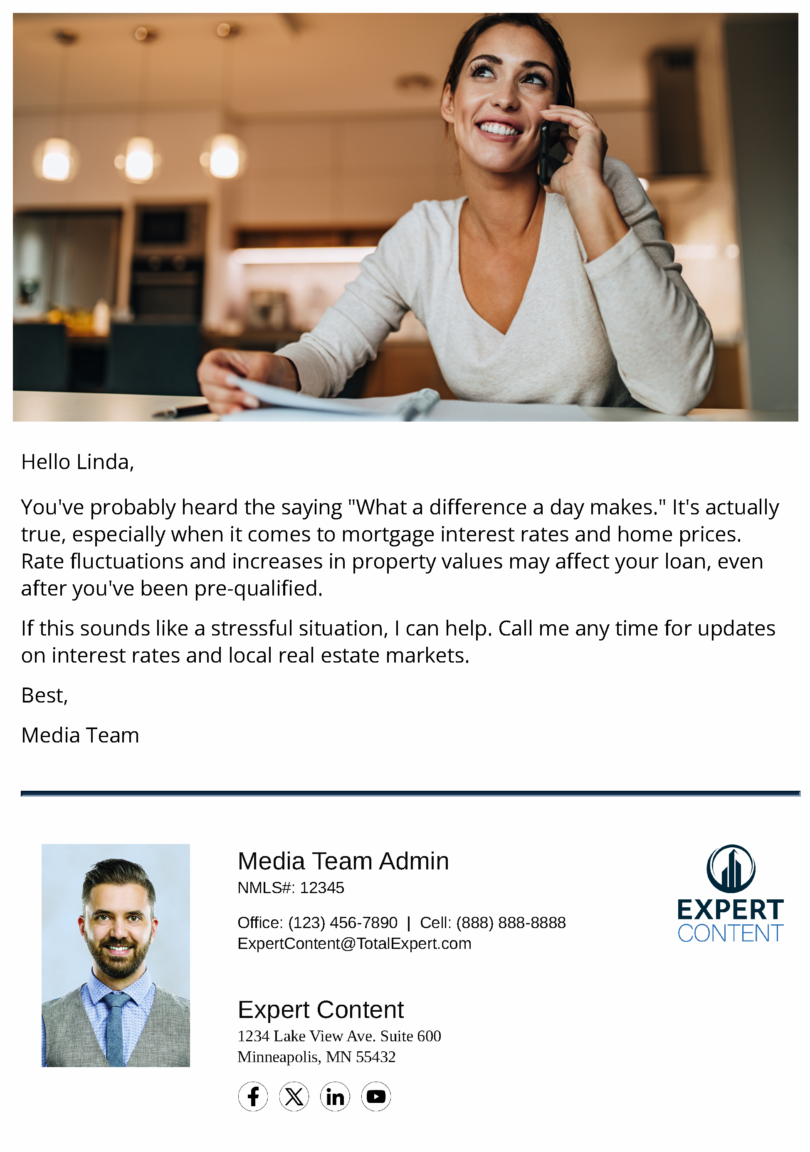
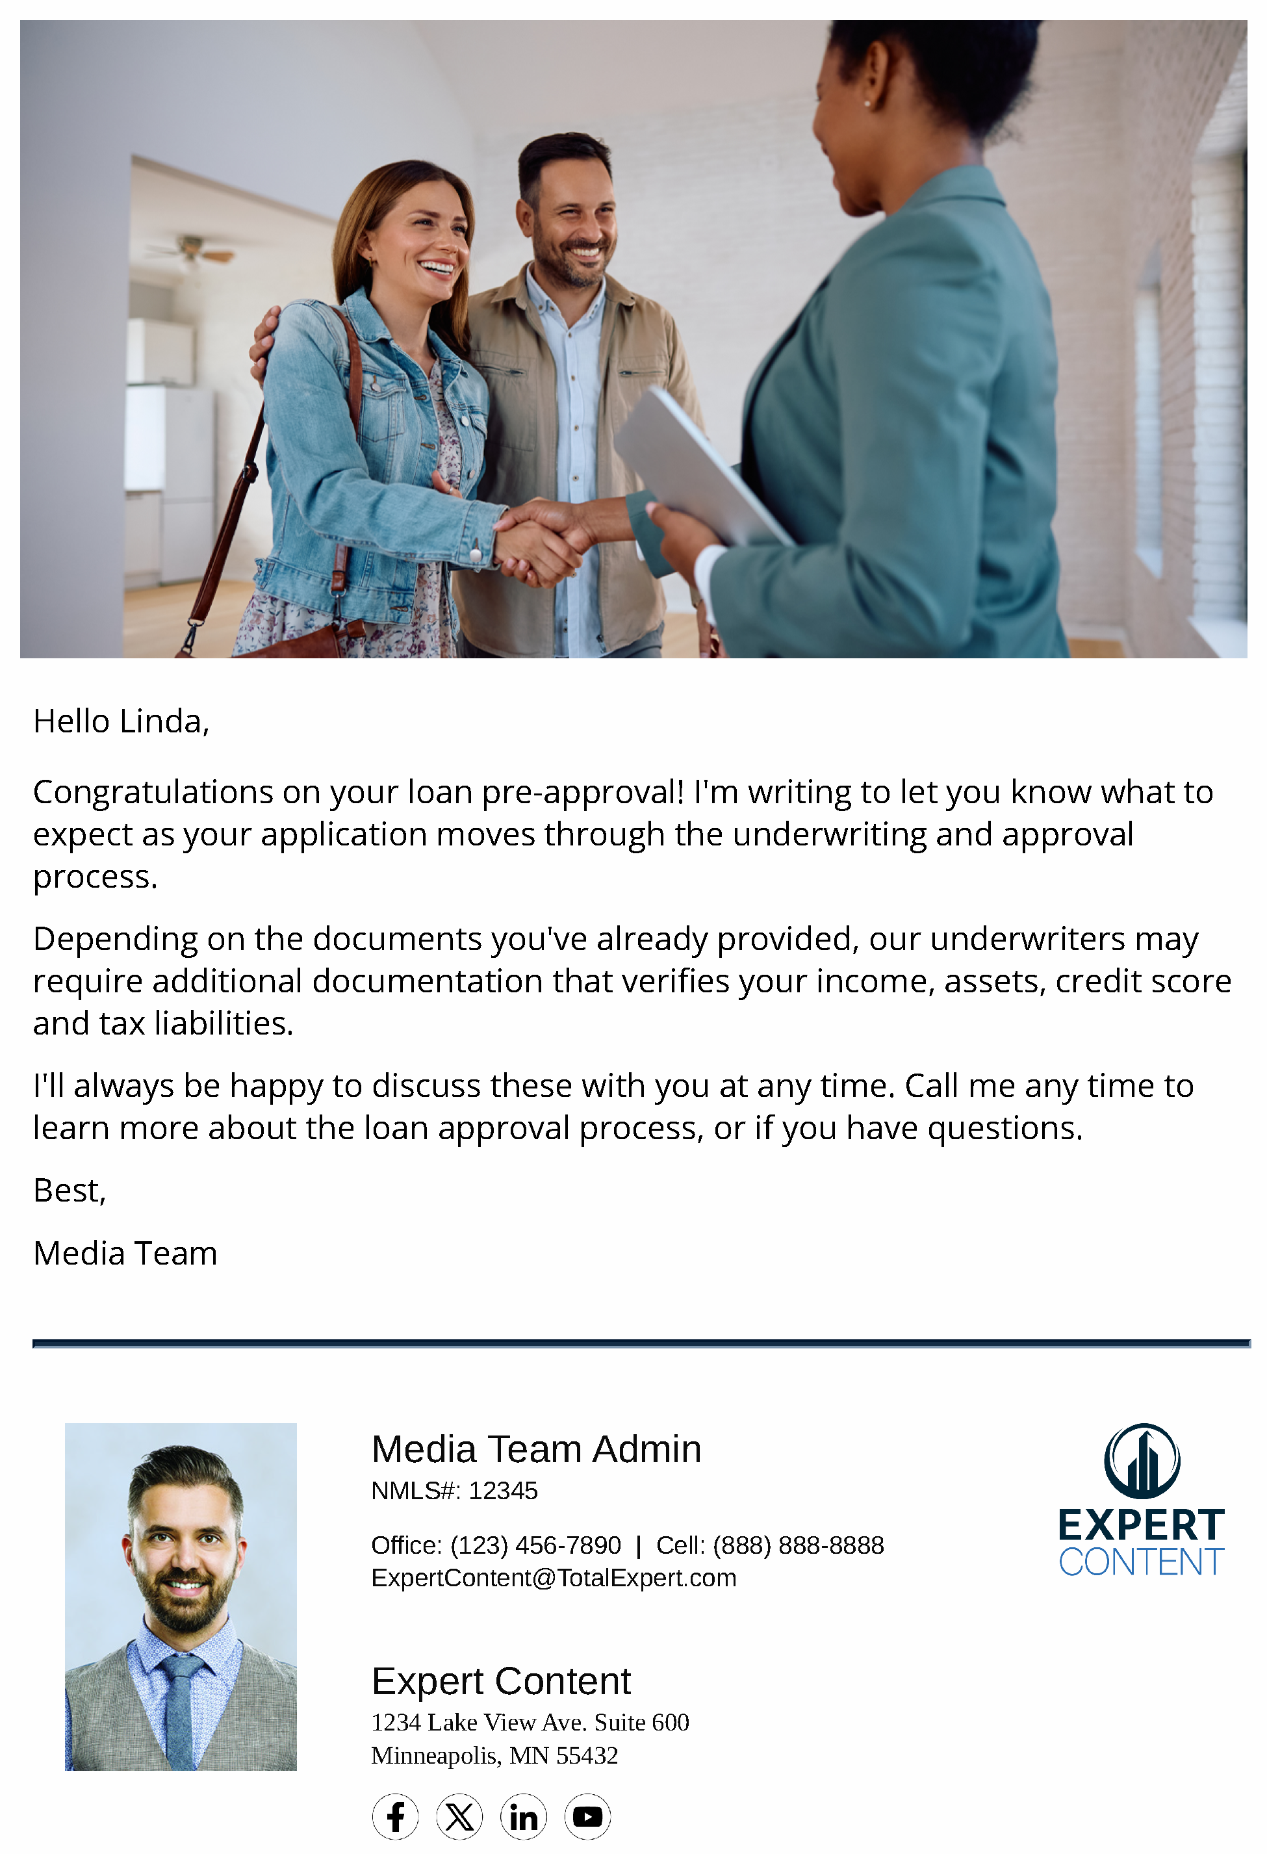
Pre-Qualified Journey
Email Subject Line:
You’re pre-approved! Here’s what to expect next.
A day can really make a difference...
A friendly heads-up regarding your mortgage application.
Notes:
This page should be used for JOURNEY EMAILS (duplicate as needed)

Slide 5
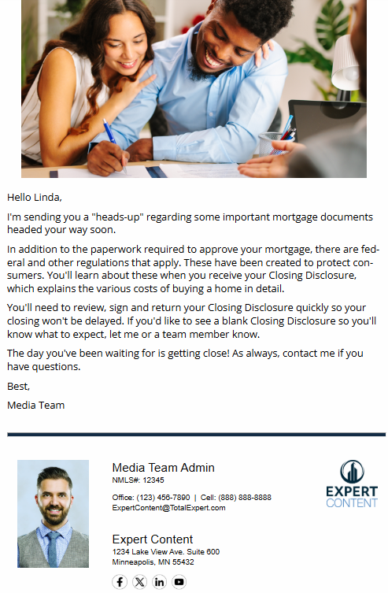
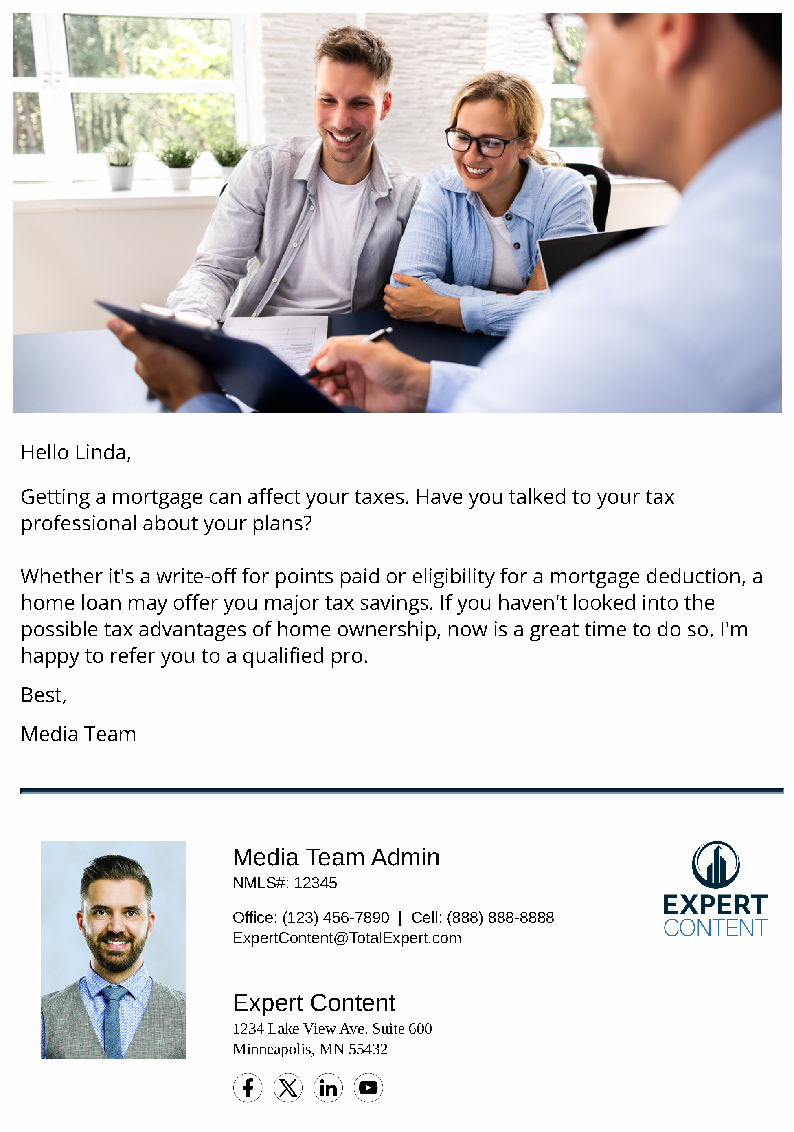
Pre-Qualified Journey
Email Subject Line:
We’re almost ready to close!
Now's a great time to talk about the big picture.
Is it time for a homeowner’s tax checkup?
Notes:
This page should be used for JOURNEY EMAILS (duplicate as needed)

Slide 6
Pre-Qualified Journey
User Notification: Pre-qualification Contact Check In
Your contact is on the pre-qualified journey. Call to check in on {{contact.f_name}} {{contact.l_name}} at {{contact.phone_cell}}. Visit their contact details for more context on where they are in the homebuying journey.
SMS: Pre-Qualification SMS - Keep Up with the Market
Hi {{contact.f_name}}. Are you too busy to keep up with mortgage interest rates? The solution's simple...give me a call. I'll share the latest news about property values and interest rate changes, and any other market changes that may affect your loan.
SMS: Pre-Qualification SMS - Paperwork Stress
As you may know, there's lots of paperwork involved with a mortgage, but don't let it stress you. I'll help you keep track of documents, explain anything that's confusing, and keep you on schedule for an on-time closing. Questions? Call me at {{sender.phone_cell}}!
Notes:
This page should be used for Tasks, User Notifications, and SMS templates (duplicate as needed)

