Slide 1
Expert Content
Strategy Guide
Purchase In-Process Journey

Slide 2
Purchase In-Process Journey
Email series
The Purchase In-Process journey is a series of emails that are triggered by events within the LOS that initiate communication to the borrower and the borrower’s real estate agent. These communications are for various milestones that are reached in the loan approval process.
Total Expert customers who leverage text messaging may also choose to leverage this functionality within the existing wireframe.
*All communications should be reviewed prior to initiating the journey.

Slide 3
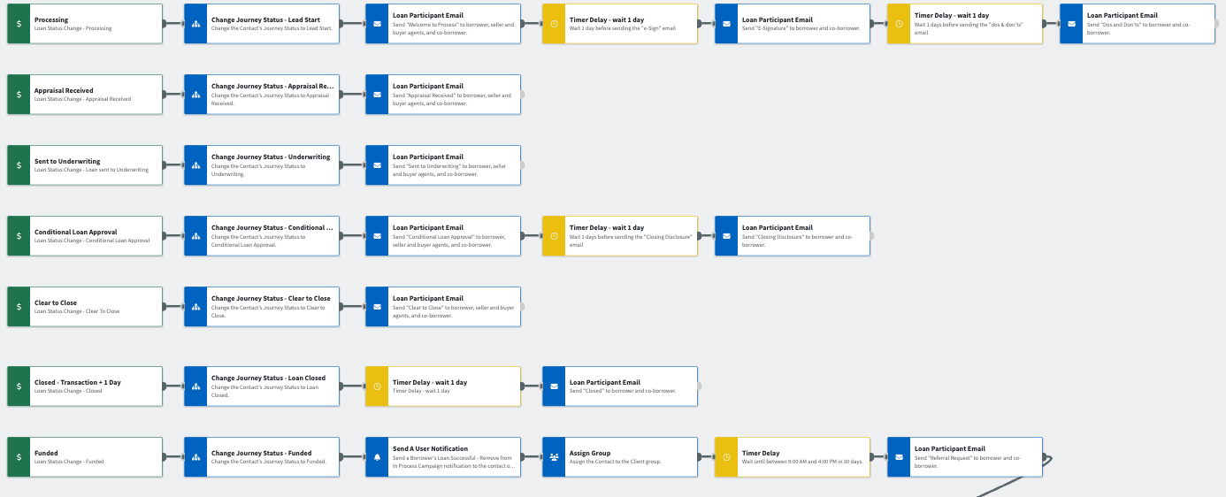
Journey Wireframe Notes:
Keep emails that work for your organization, swap with custom, or add these emails to your existing campaigns.
Adjust onramps with organization specific groups and Focused View outcomes.

Slide 4
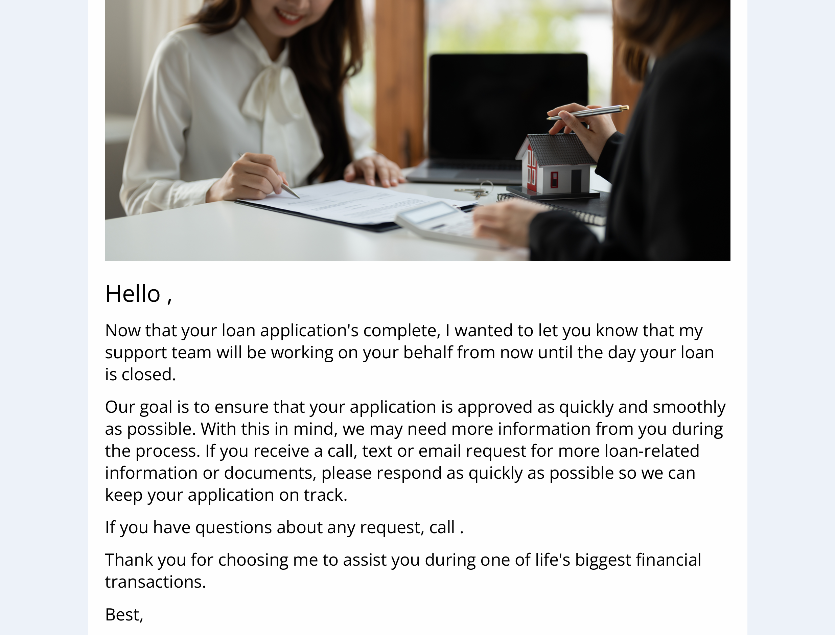
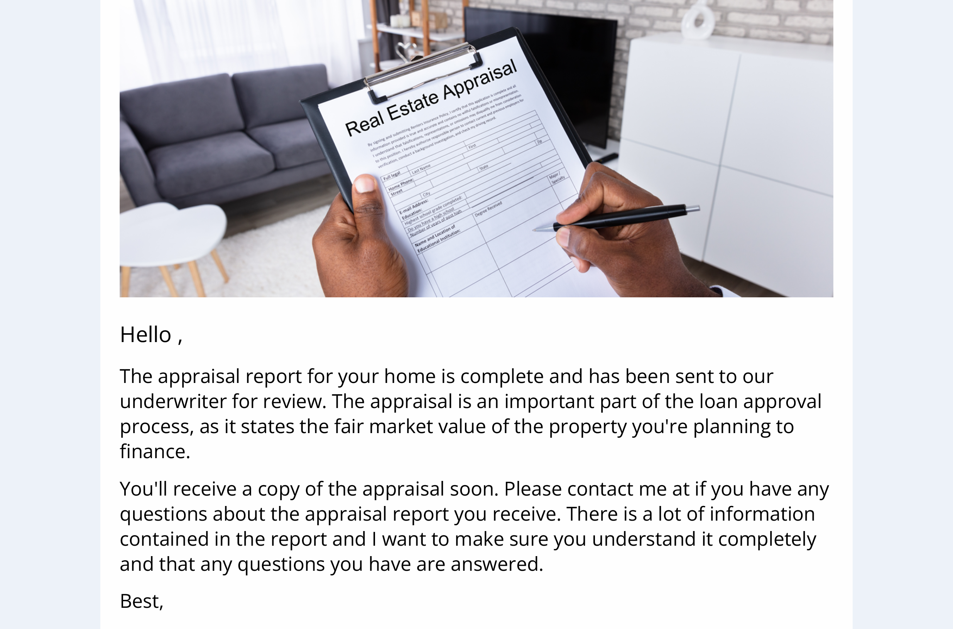
Purchase In-Process Journey
Email Subject:
Thank you for trusting us!
Your home appraisal’s ready to review
Your loan’s been submitted to underwriting
Some financial Dos and Don’ts to remember

Slide 5
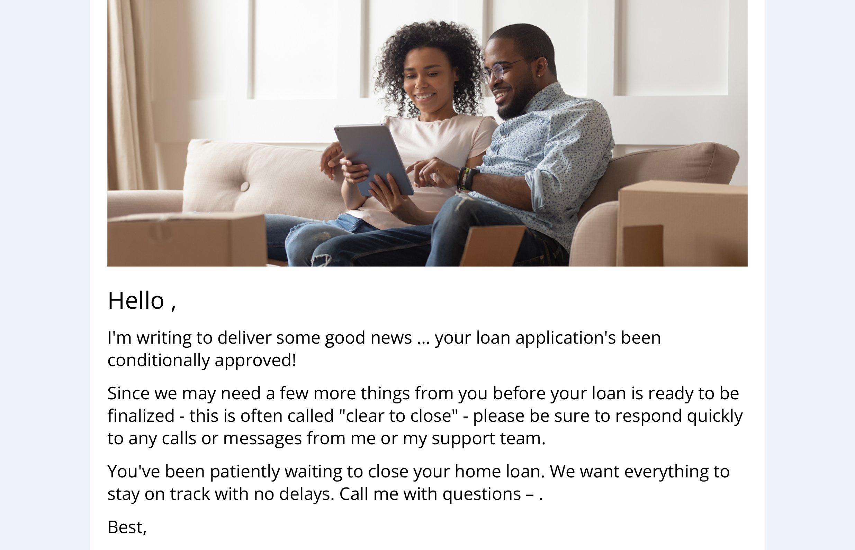
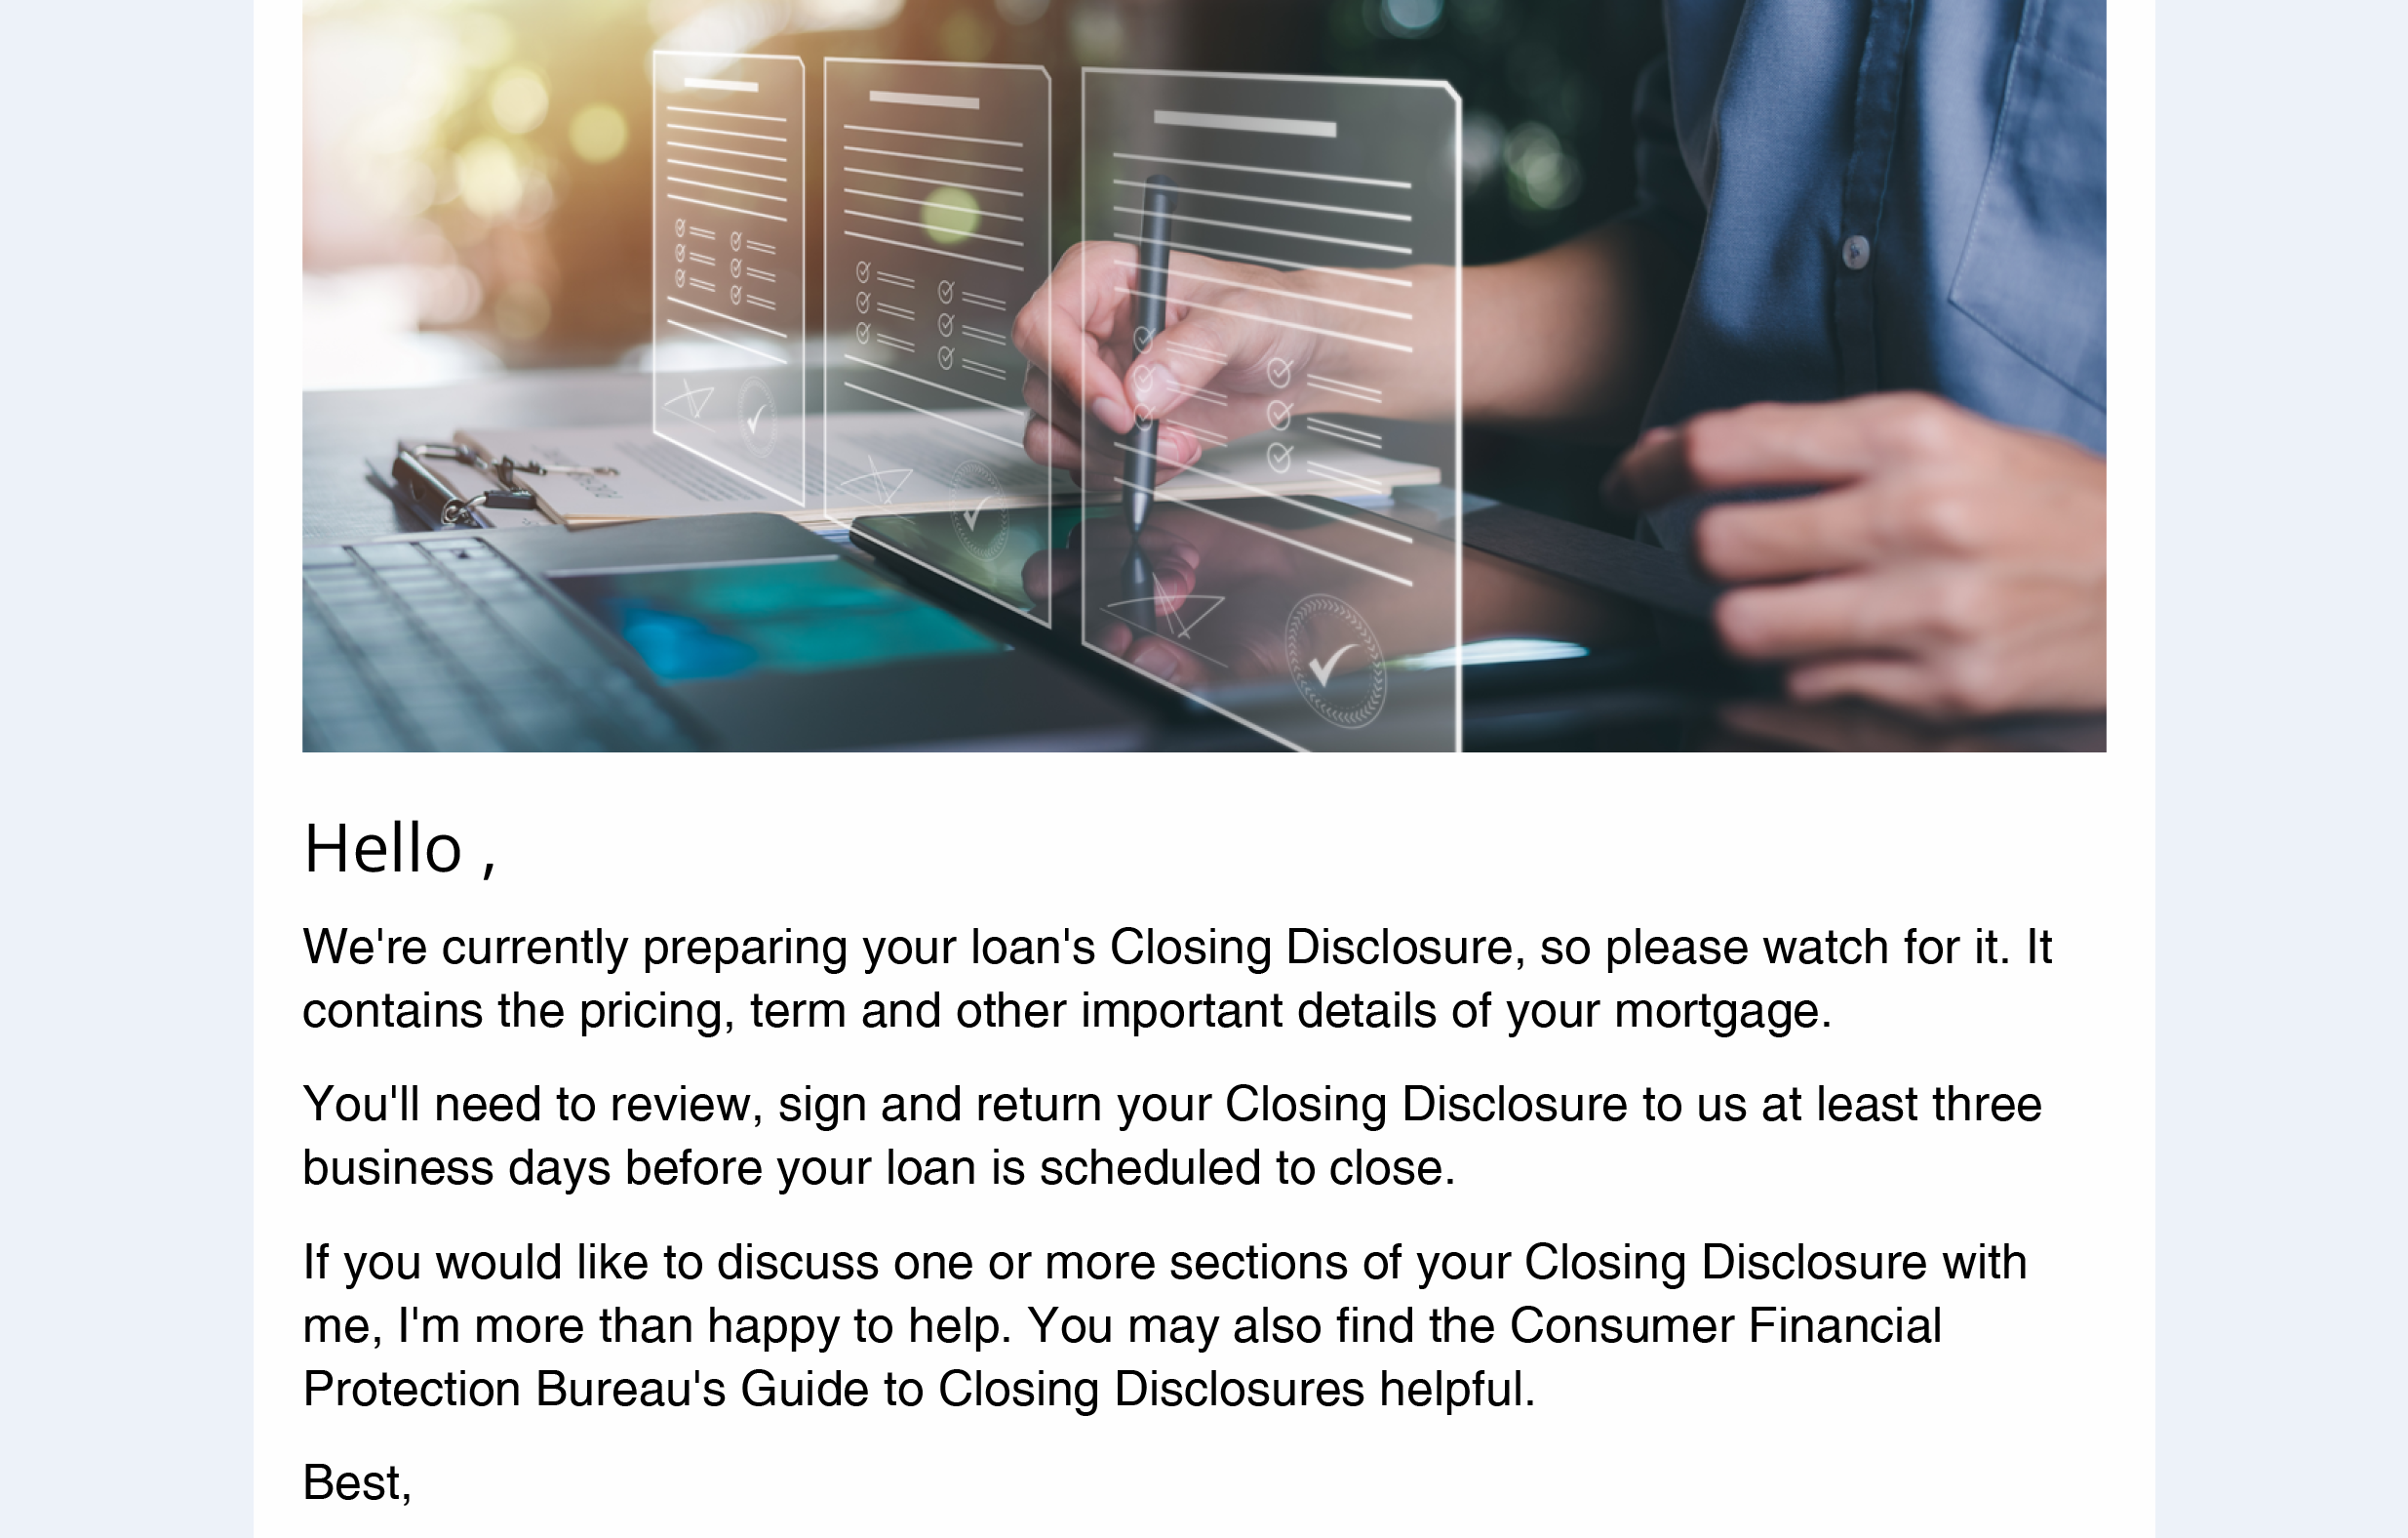
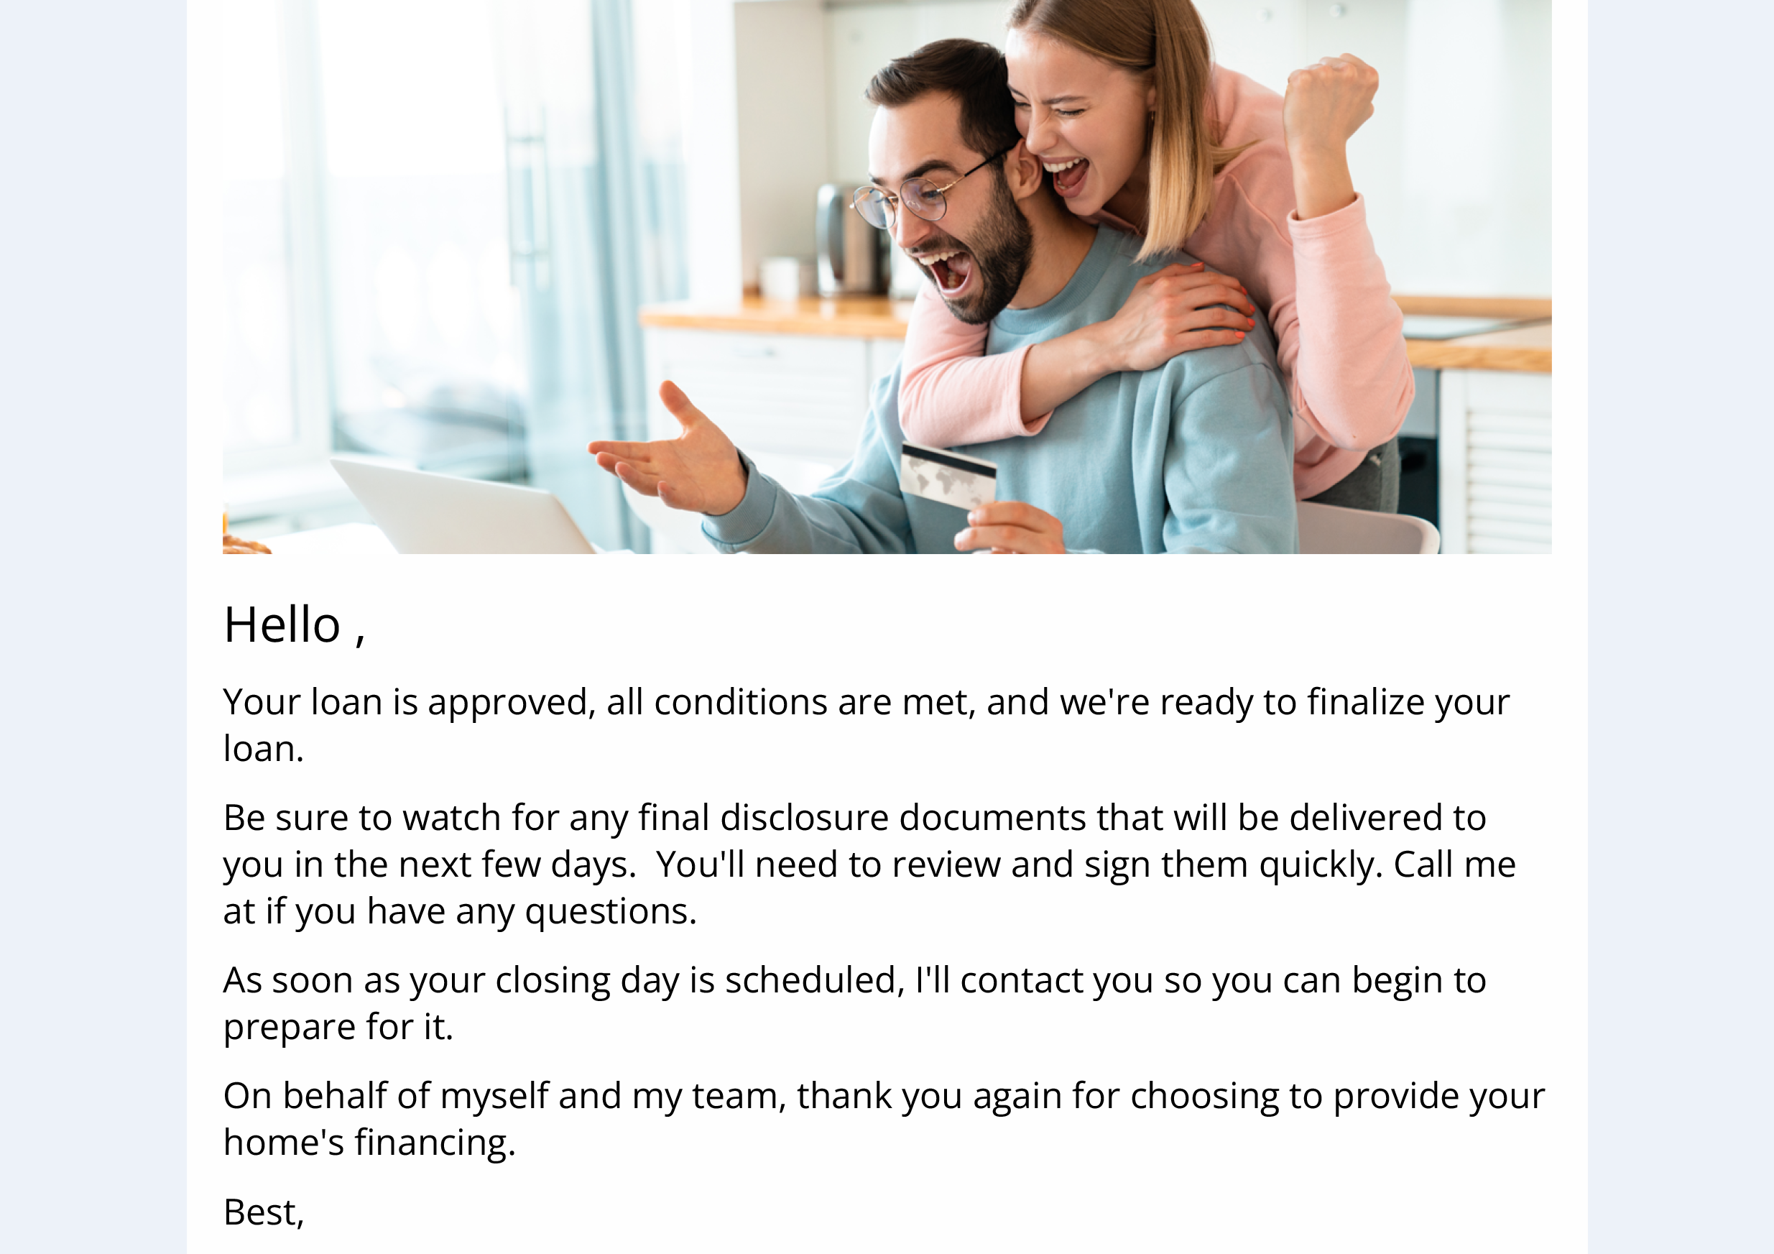
Purchase In-Process Journey
Email Subject:
You’re a big step closer to closing
Your electronic signature options explained
Important documents headed your way
Congratulations! We’re clear to close!

