Slide 1
Expert Content
Strategy Guide
Loan Officer Recruiting

Slide 2
Loan Officer Recruiting
Emails and suggested talking points
This journey can be configured to meet the needs of each customer’s recruiting strategy. There are four pre-built email templates with areas to customize by lender as well as 4 suggested email talking points. These communications are designed to educate a loan officer recruit on your organization, its processes/technology, and the benefits of working for your company.
Customers with loan officer recruitment data can configure this journey to trigger on integrations connected to TE. Focused View Outcomes can also be configured to trigger this journey depending on the organization’s specific workflows.
Journey status change components are included but statuses will need created and configured throughout the wireframe based on customer’s needs.
*All communications should be reviewed prior to initiating the journey.

Slide 3
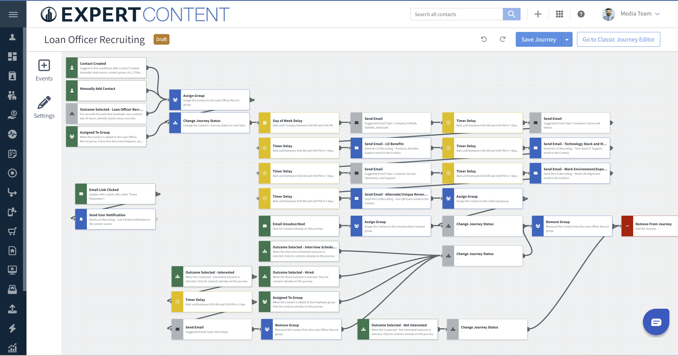
Journey Map Notes:
Keep emails that work for your organization, swap with custom, or add these emails to existing campaigns.
Grey components are to be configured by customers. Grey email components include suggested topics.
Adjust onramps with organization specific groups and Focused View outcomes.

Slide 4
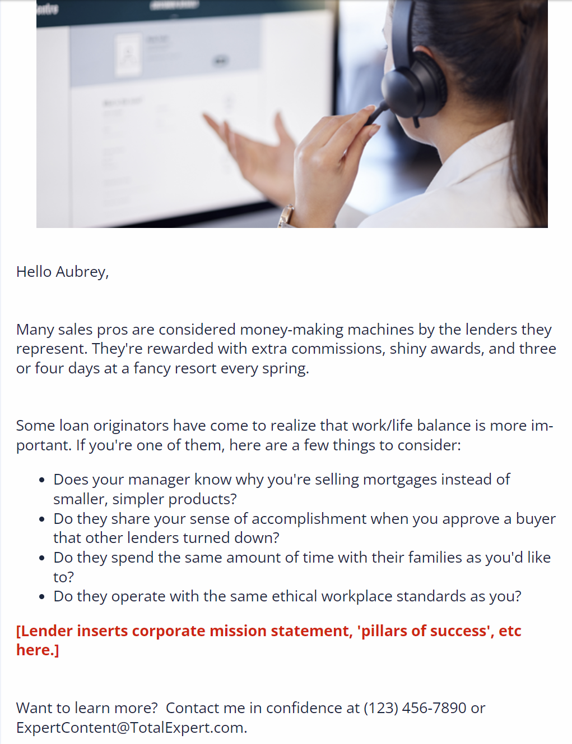
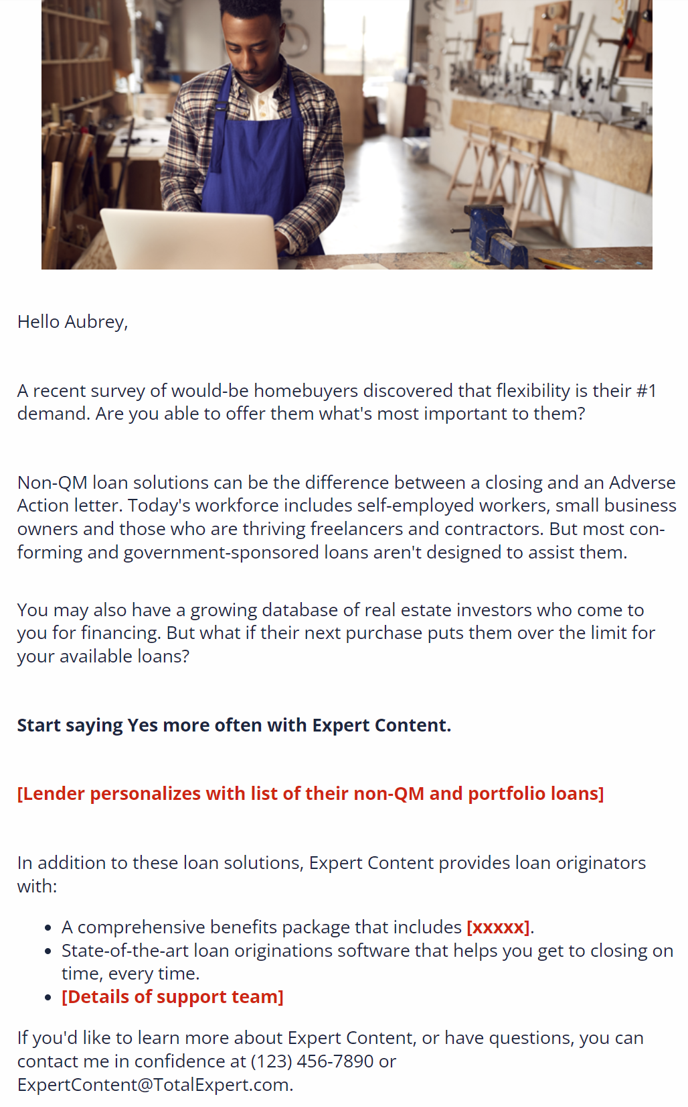
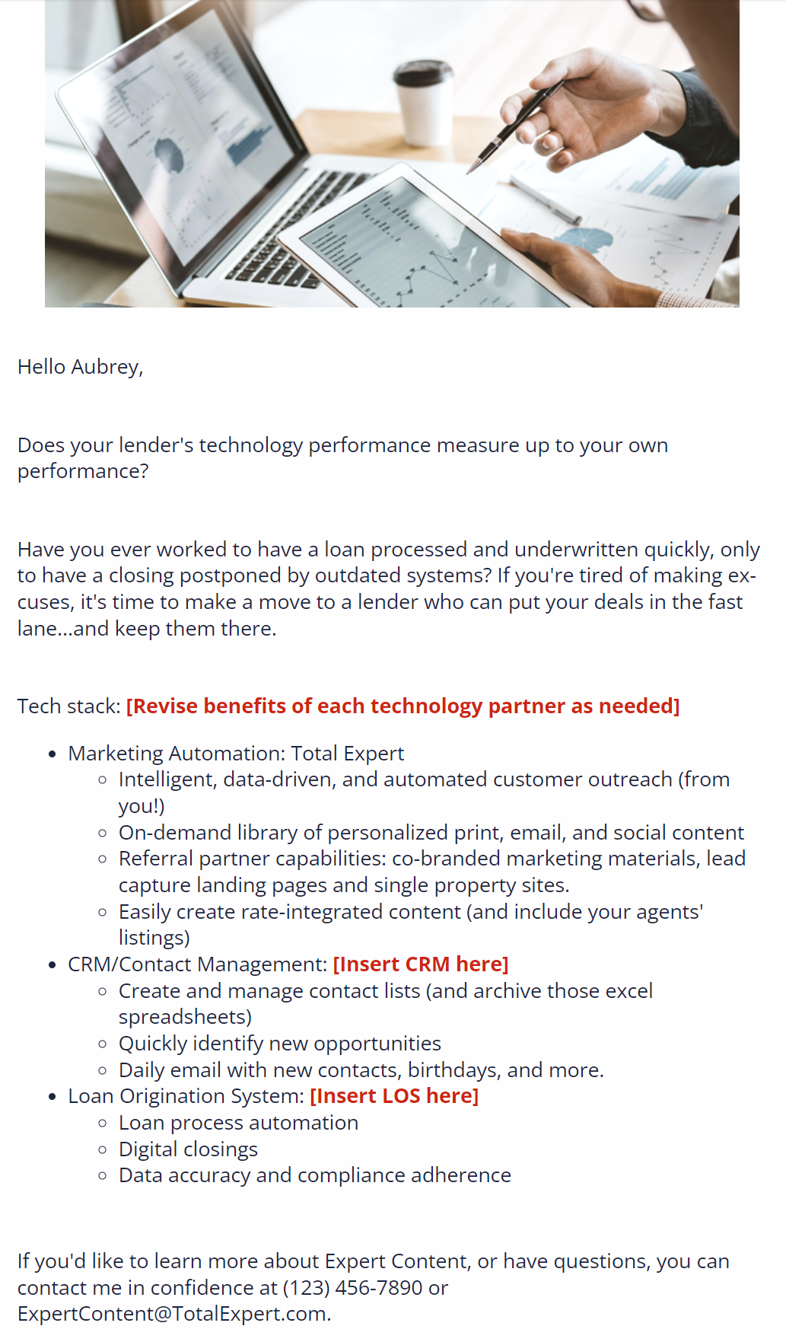
Loan Officer Recruiting
Email Subject:
LO Recruiting - Work/Life Alignment (SL: The best sales jobs aren’t all about sales.)
LO Recruiting - non-QM loans (SL: Do you have the right loans for more of your customers?)
LO Recruiting - Tech Stack/IT Support (SL: The best loans aren’t the best if they don’t close on time.)
LO Recruiting - Products, Benefits, Support (SL: Has your career hit a speed bump?)
Notes:
This page should be used for JOURNEY EMAILS (duplicate as needed)

Slide 5
Loan Officer Recruiting
Additional suggested email topics included in wireframe:
Company outlook, stability, goals
Customer service, operations, and support
Company culture and values
Next steps for interested candidates
Notes:
This page should be used for JOURNEY EMAILS (duplicate as needed)

