Slide 1
Expert Content
Strategy Guide
Refinance In-Process Journey

Slide 2
Refinance In-Process Journey
Emails
The Refinance In-Process journey is a series of emails that are triggered by events within the LOS that initiate communications to the borrower. These communications are for various milestones that are reached in the loan approval process for a refinance.
Total Expert customers who leverage text messaging may also choose to leverage this functionality within the existing wireframe.
*All communications should be reviewed prior to initiating the journey.

Slide 3
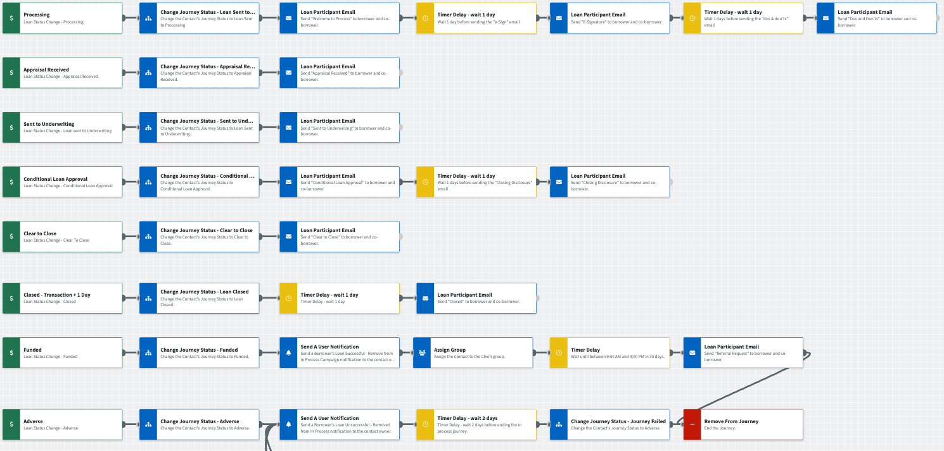
Journey Map Notes:
Keep emails that work for your organization, swap with custom, or add these emails to your existing campaigns.
Adjust onramps with organization specific groups and Focused View outcomes.

Slide 4
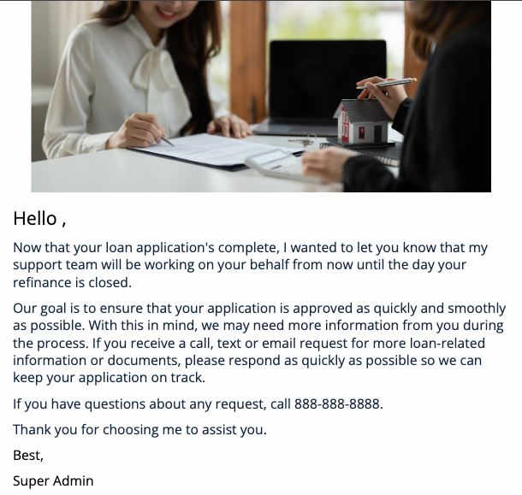
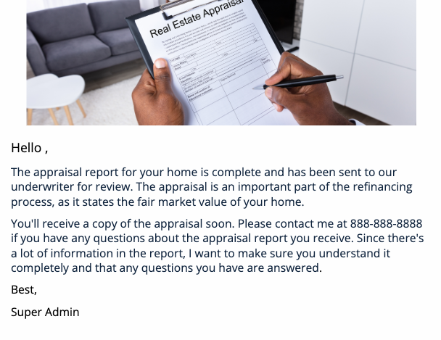
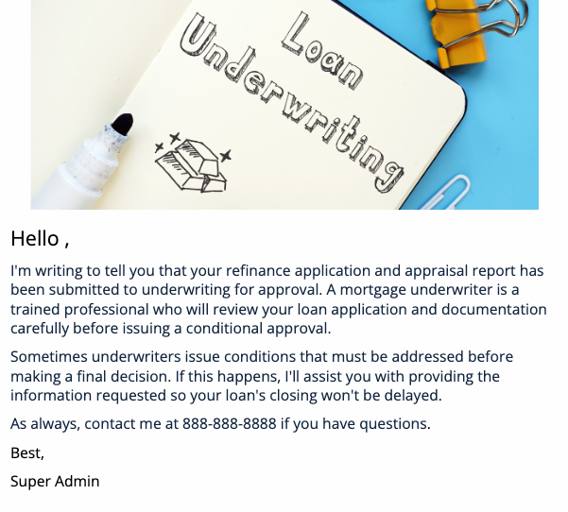
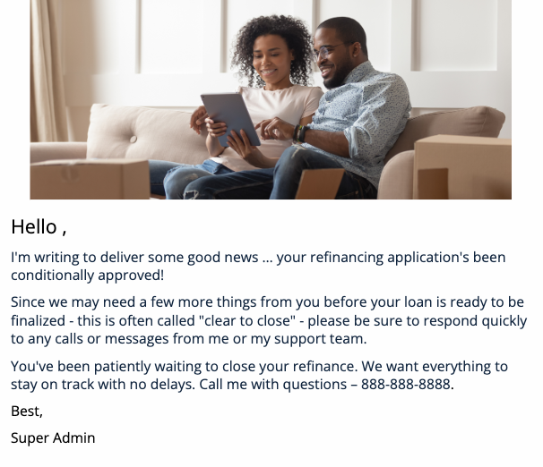
Refinance In-Process Journey
Email Subject:
Welcome to the Process
Appraisal Received
Sent To Underwriting
Conditional Loan Approval
Notes:
This page should be used for JOURNEY EMAILS (duplicate as needed)

Slide 5
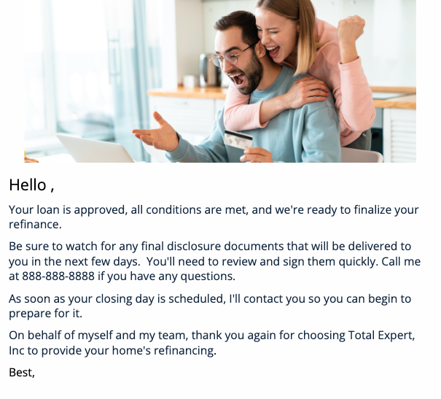
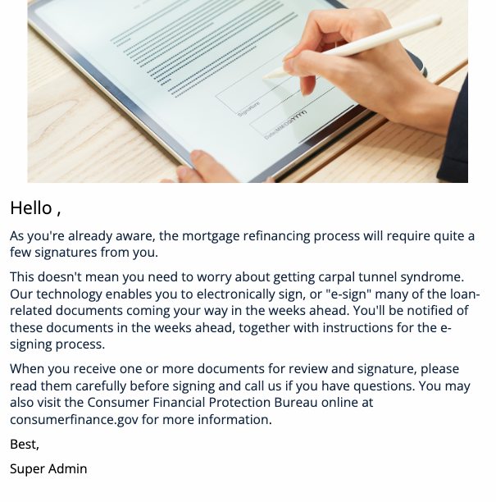
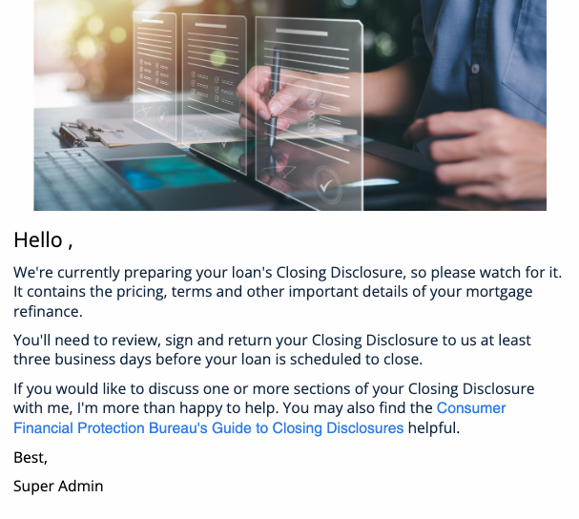
Refinance In-Process Journey
Email Subject:
Clear To Close!
E-Signatures
Closing Disclosure
Your Loan Has Closed
Notes:
This page should be used for JOURNEY EMAILS (duplicate as needed)

