Slide 1
Expert Content
Strategy Guide
Self Serve Templates
January 2026

Slide 2
Expert Content Templates
Print Flyers, Postcards, Greeting Cards, Door Hangers, Brochures, Yard Signs, Sign Riders, Social Media
The Expert Content library includes self-service templates for admins to create-your-own content. Pre-filled Expert Content is built from these templates and can be configured based on the individual layout’s options. Contact blocks, disclaimers, and branding elements are dynamic to the end user.
Many templates include some admin-level configuration options such as:
Logos: on or off, logo positioning, logo variations (e.g. horizontal/stacked, color/black/white), QR codes
Colors: font color, color blocks, background colors
Imagery: replace imagery within a dedicated space, replacing full background images
Text: replace text in dedicate space (e.g. CTA, header, subheader, paragraph)
Editability: allow or disallow end user editability of specific elements
Disclaimers: additional or override disclaimer options to allow admins to enter dynamic disclaimers or include verbiage on a one-off basis.
Template types include:
Various configurable layouts for single-sided print flyers
Various configurable layouts for postcards in specific sizing; additional “static” options in all sizes
Vertical and horizontal greeting cards
Various configurable layouts for door hangers,
Various configurable layouts for yard signs and sign riders in specific sizing; additional “static” options in all sizes
Bifold and trifold brochures
Social Media templates including event, testimonials, and upload-your-own design

Slide 3
Print Flyers

Slide 4

Self Serve Print Flyers
1 – Ability to switch logo on/off, adjust logo background color
2 – Fill to fit headline/sub-headline, change text color
3 – Background color default is brand primary color
4 – Font default color is brand secondary color
5 – Font default color is brand primary color
6 – Editable CTA
7 – Upload image
Single and cobranded versions available
1
2
3
4
7
5
6

Slide 5
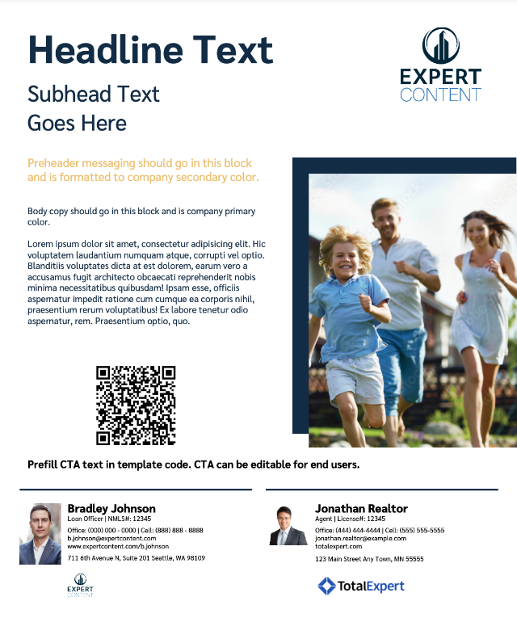
Self Serve Print Flyers
1 – Ability to switch logo on/off, adjust logo background color
2 – Fill to fit headline/sub-headline, change text color
3 – background color default is brand primary color
4 – Font default color is brand secondary color
5 – Font default color is brand primary color
6 – Editable CTA
7 – Upload image
8 – Editable image block – QR code will populate from user profile
Single and cobranded versions available
1
2
3
4
7
5
8
6

Slide 6
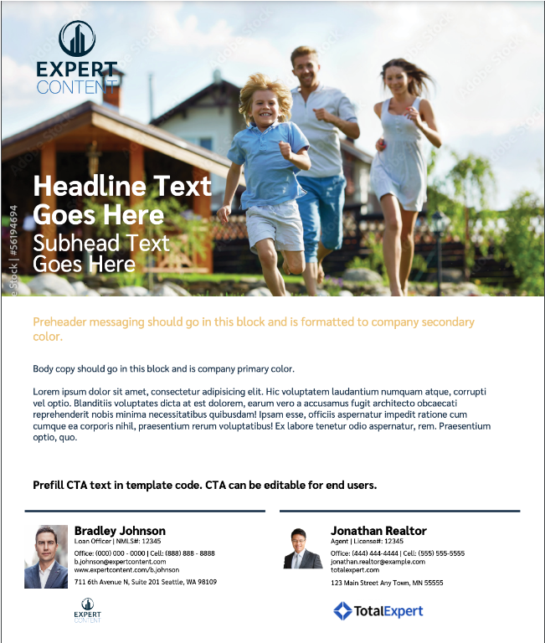
Self Serve Print Flyers
1 – Ability to switch logo on/off, adjust logo background color
2 – Fill to fit headline/sub-headline, change text color
3 – Upload image
4 – Font default color is brand secondary color
5 – Font default color is brand primary color
6 – Editable CTA
Single and cobranded versions available
1
3
2
4
5
6

Slide 7
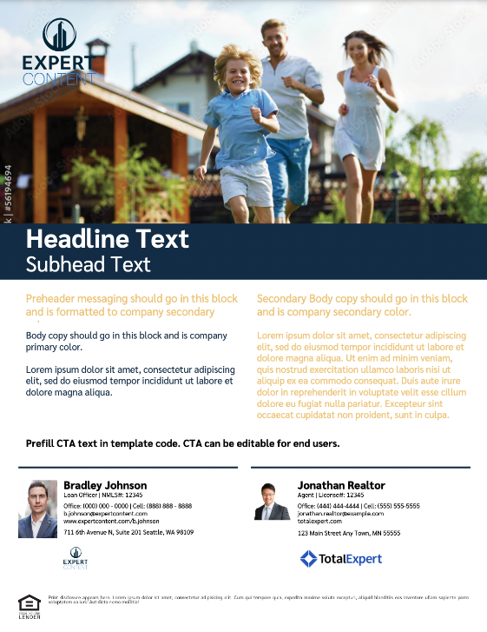
Self Serve Print Flyers
1 – Ability to switch logo on/off, adjust logo background color
2 – Fill to fit headline/sub-headline, change text color
3 – Upload image
4 – Font default color is brand secondary color
5 – Font default color is brand primary color
6 – Editable CTA
Single and cobranded versions available
1
3
2
4
5
6

Slide 8
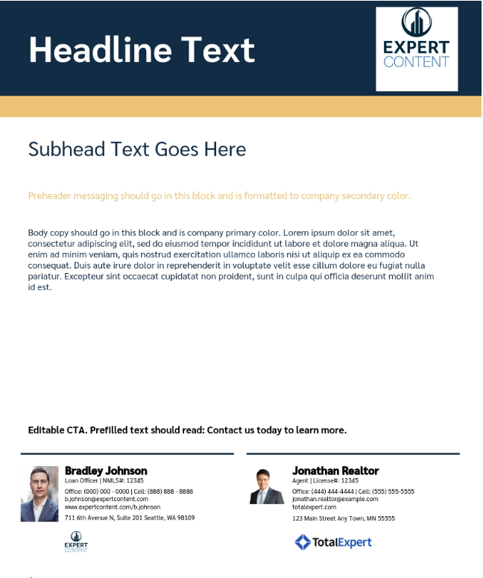
Self Serve Print Flyers
1 – Ability to switch logo on/off, adjust logo background color
2 – Fill to fit headline/sub-headline, change text color
3 – Default to brand primary color
4 – Default to brand secondary color
5 – Font default color is brand secondary color
6 – Font default color is brand primary color
7 – Editable CTA
Single and cobranded versions available
2
1
3
4
5
6
7

Slide 9
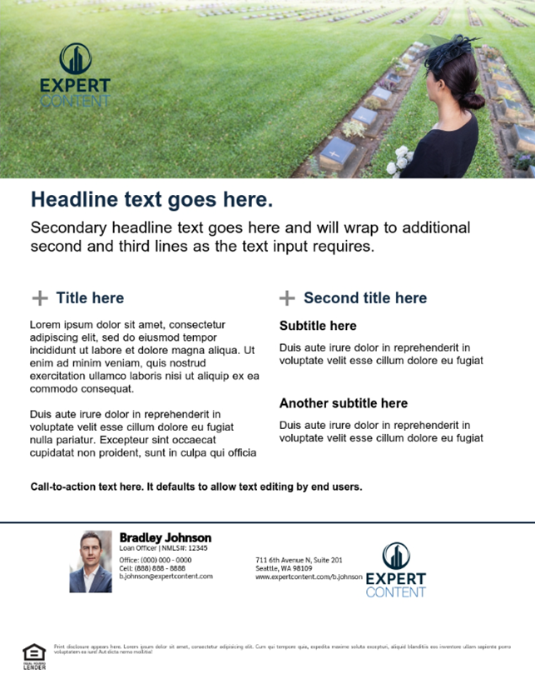
Self Serve Print Flyers
1 – Ability to switch logo on/off, adjust logo background color
2 – Upload image
3 – Fill to fit headline/sub-headline, change text color
4 – Font default color is brand primary color
5 – Font default color is brand primary color
6 – Editable CTA
Single and cobranded versions available
1
2
3
4
5
6

Slide 10

Self Serve Print Flyers
1 – Ability to switch logo on/off, adjust logo background color
2 – Dynamic user information
3 – Upload image
4 – Fill to fit headline/sub-headline, change text color
5 – Editable CTA
Single and cobranded versions available
1
2
3
4
5

Slide 11

Self Serve Print Flyers
1 – Ability to switch logo on/off, adjust logo background color
2 – Upload image
3 – Fill to fit headline/sub-headline, change text color
4 – Background color default is brand primary color, change text color
5 – Background color default is brand secondary color, change text color
6 – Editable CTA
Single and cobranded versions available
1
2
3
4
5
6

Slide 12
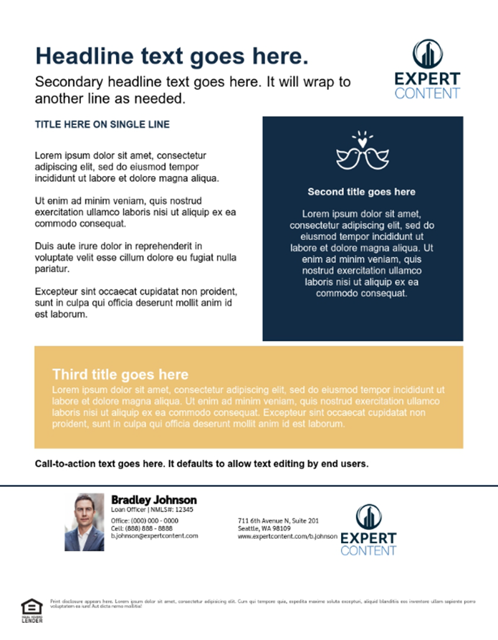
Self Serve Print Flyers
1 – Ability to switch logo on/off, adjust logo background color
2 – Fill to fit headline/sub-headline, change text color
3 – Upload icon image
4 – Background color default is brand primary color, change text color
5 – Background color default is brand secondary color, change text color
6 – Editable CTA
Single and cobranded versions available
2
1
3
4
5
6

Slide 13

Self Serve Print Flyers
1 – Ability to switch logo on/off, adjust logo background color
2 – Upload image
3 – Fill to fit headline/sub-headline, change text color
4 – Background color default is brand secondary color, change text color
5 – Editable CTA
Single and cobranded versions available
3
1
2
4
5

Slide 14


Self Serve Print Flyers
1 – Upload image, will replace entire background image of the full 8.5”x11” flyer
1
1

Slide 15
Postcards

Slide 16
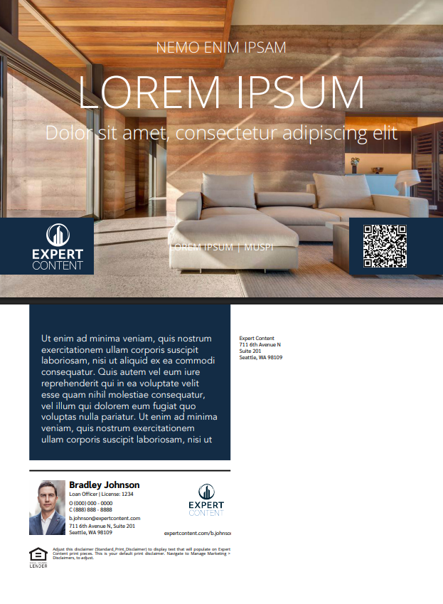
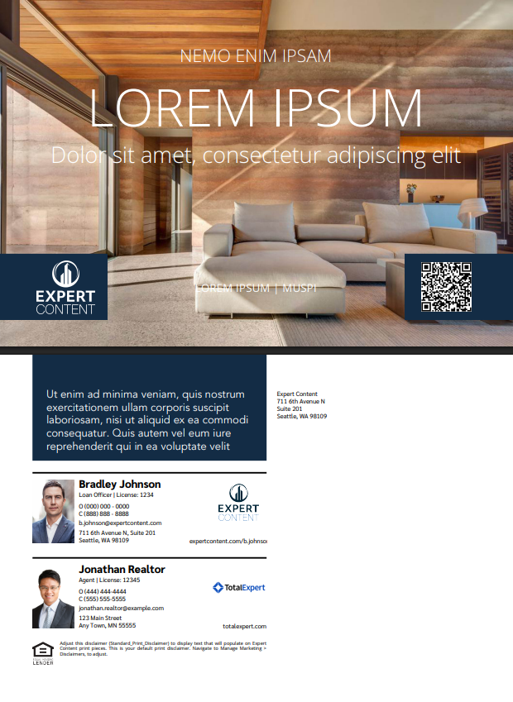
EDDM: 9”x6.25”
Direct & Non-Direct Mail: 9”x6”
1 – Switch logo on/off, adjust logo background color, use logo variations from branding, editability option
2 – Upload background image(s), editability option
3 – QR code variation, switch on/off, editability option
4 - Fill to fit text elements, change text color, editability option
5 – Color block default is brand primary color; change color, turn all color blocks on/off
6 – Return address default text, leave blank, editability option
Functionality is the same for single and cobranded versions
4
2
1
3
5
6
2

Slide 17
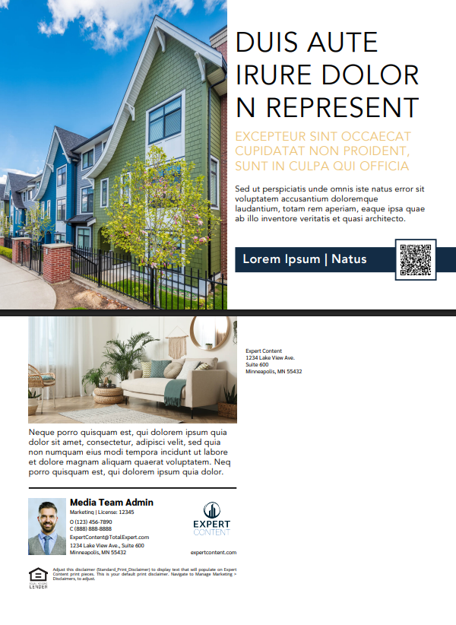
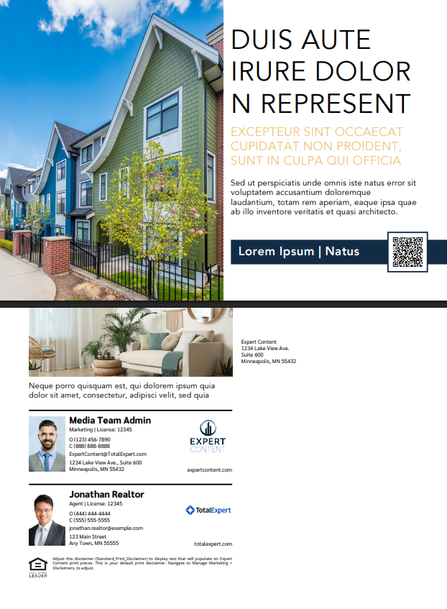
EDDM: 9”x6.25”
Direct & Non-Direct Mail: 9”x6”
2
1 – Upload image(s), editability option
2 - Fill to fit text elements, change text color, editability option
3 – QR code variation, switch on/off, editability option
4 – Color block default is brand primary color; change color, turn all color blocks on/off
5 – Return address default text, leave blank, editability option
Functionality is the same for single and cobranded versions
4
3
1
5
2

Slide 18
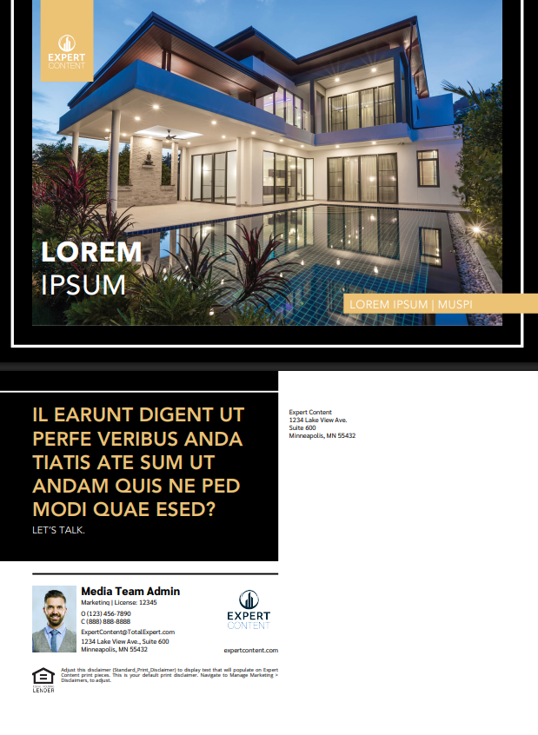
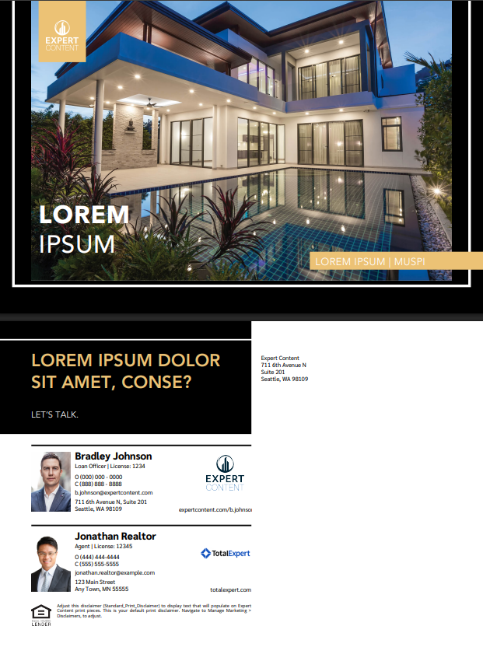
EDDM: 9”x6.25”
Direct & Non-Direct Mail: 9”x6”
1 – Switch logo on/off, adjust logo background color, use logo variations from branding, editability option
2 – Upload image(s), editability option
3 - Fill to fit text elements, change text color, editability option
4 – Front color blocks default to secondary; change color
5 – Turn color blocks on/off (removes front secondary color blocks and back black block)
6 – Background color defaults to black; change color. Border color defaults to white; change color.
7 – Return address default text, leave blank, editability option
Functionality is the same for single and cobranded versions
2
1
3
4
5
6
7
2

Slide 19
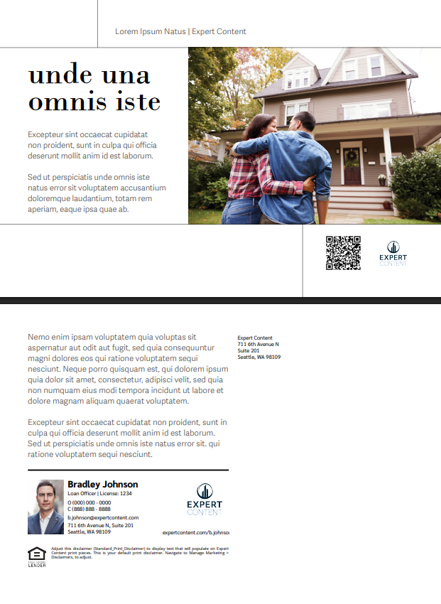
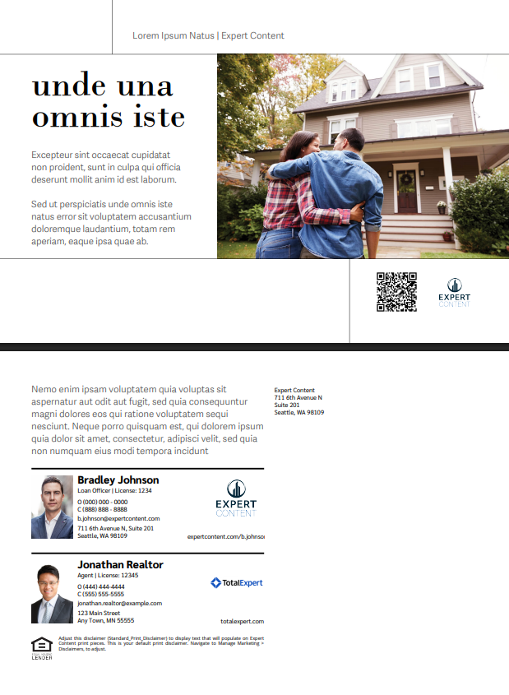
EDDM: 9”x6.25”
Direct & Non-Direct Mail: 9”x6”
2
1 – Switch logo on/off, adjust logo background color, use logo variations from branding, editability option
2 – Upload image(s), editability option
3 - Fill to fit text elements, change text color, editability option
4 – QR code variation, switch on/off, editability option
5 – Return address default text, leave blank, editability option
Functionality is the same for single and cobranded versions
3
4
1
5
2

Slide 20
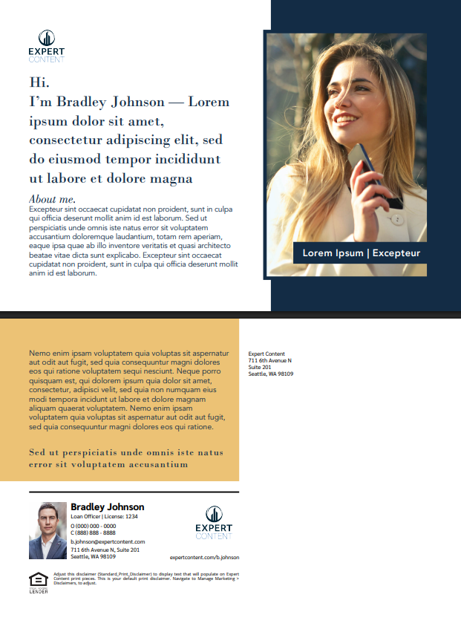

EDDM: 9”x6.25”
Direct & Non-Direct Mail: 9”x6”
1
2
1 – Switch logo on/off, adjust logo background color, use logo variations from branding, editability option
2 – Upload image(s), editability option
3 - Fill to fit text elements, change text color, editability option
4 – Front color blocks default to secondary; change color, turn color blocks on/off
5 – Return address default text, leave blank, editability option
Functionality is the same for single and cobranded versions
3
4
5
2

Slide 21
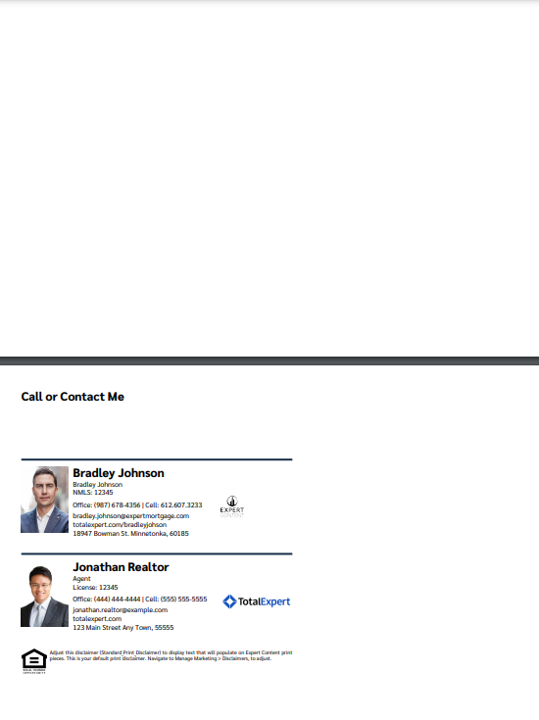
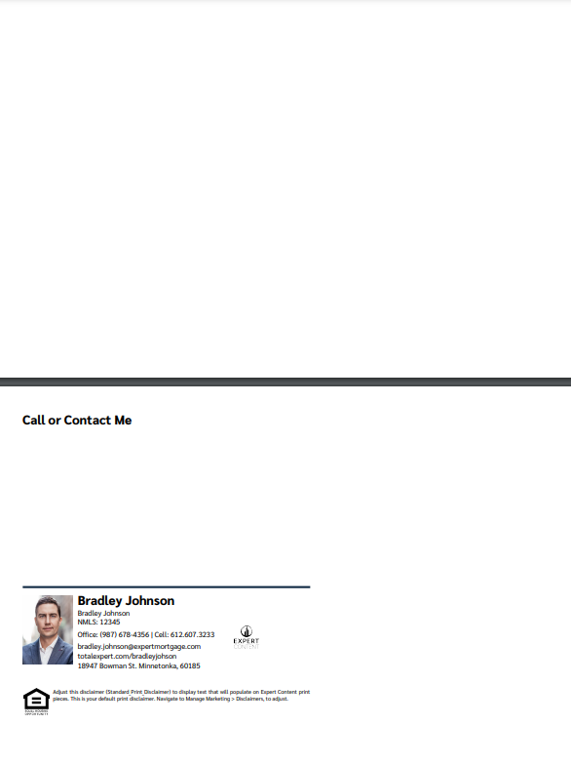
Direct & Non-Direct Mail Postcards: 8.5”x5.5”
2
2
1 – Editable CTA
2 – Upload image
1
1

Slide 22
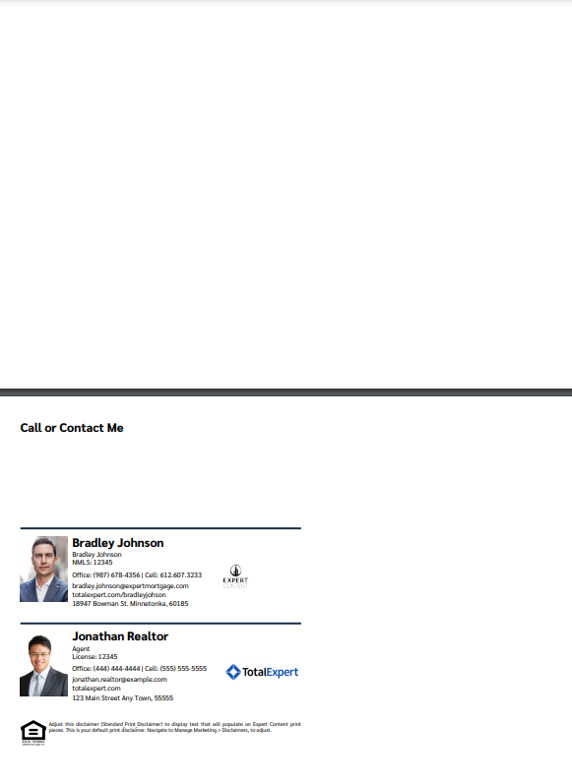
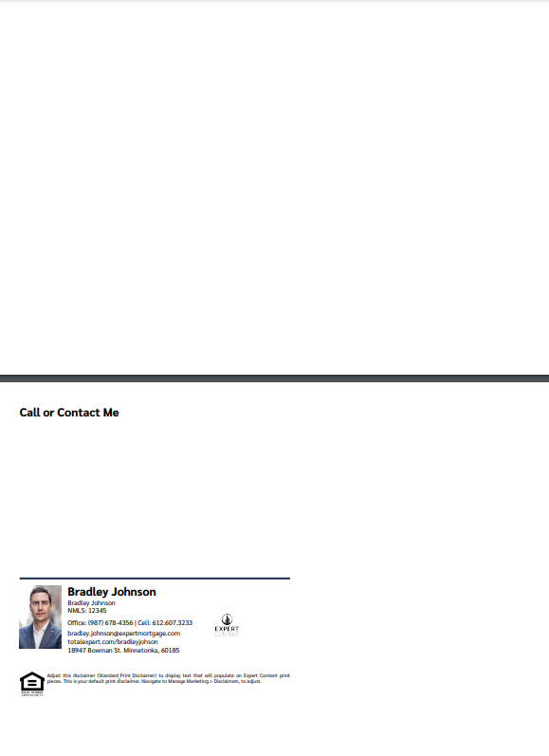
Direct & Non-Direct Mail Postcards: 9”x6”
2
2
1 – Editable CTA
2 – Upload image
1
1

Slide 23
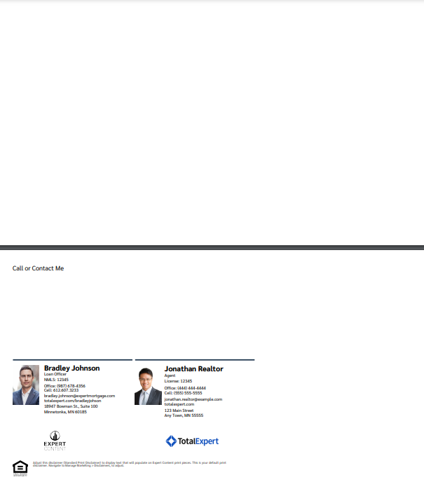
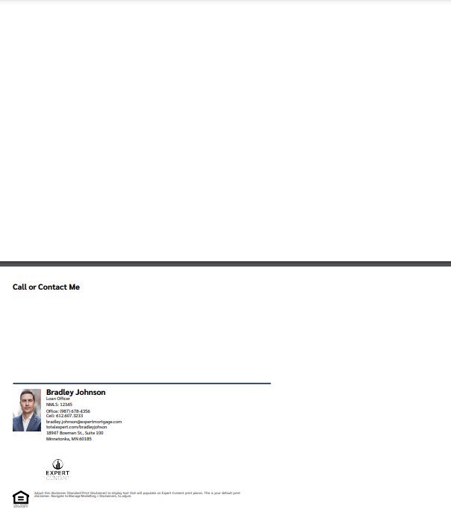
EDDM Postcards: 11”x6.25”
2
2
1 – Editable CTA
2 – Upload image
1
1

Slide 24
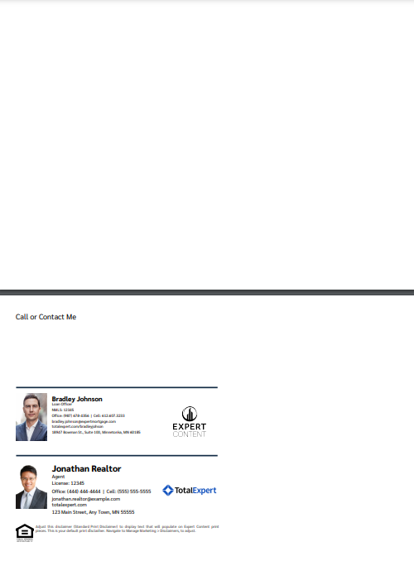
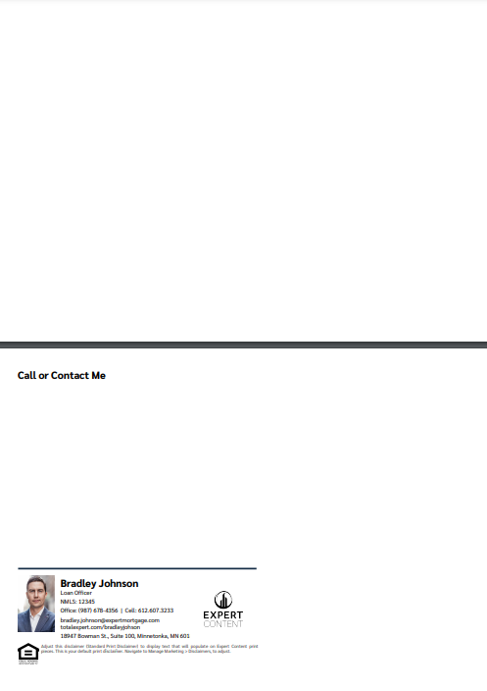
EDDM Postcards: 9”x6.25”
2
2
1 – Editable CTA
2 – Upload image
1
1

Slide 25
Greeting Cards

Slide 26



Horizontal Greeting Cards
1 – Editable greeting
2 – Upload image
1
2
Outside
Inside
Envelope

Slide 27


Vertical Greeting Cards
2
Envelope
Outside
1
1 – Editable greeting
2 – Upload image
Inside

Slide 28
Door Hangers

Slide 29
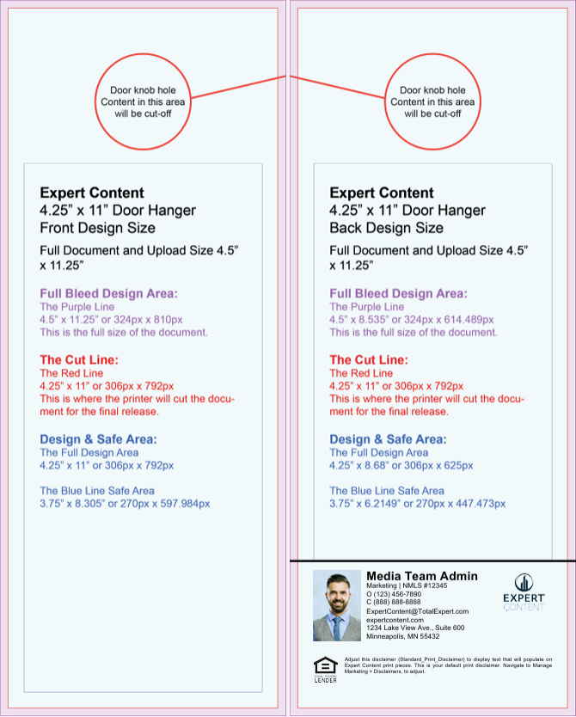
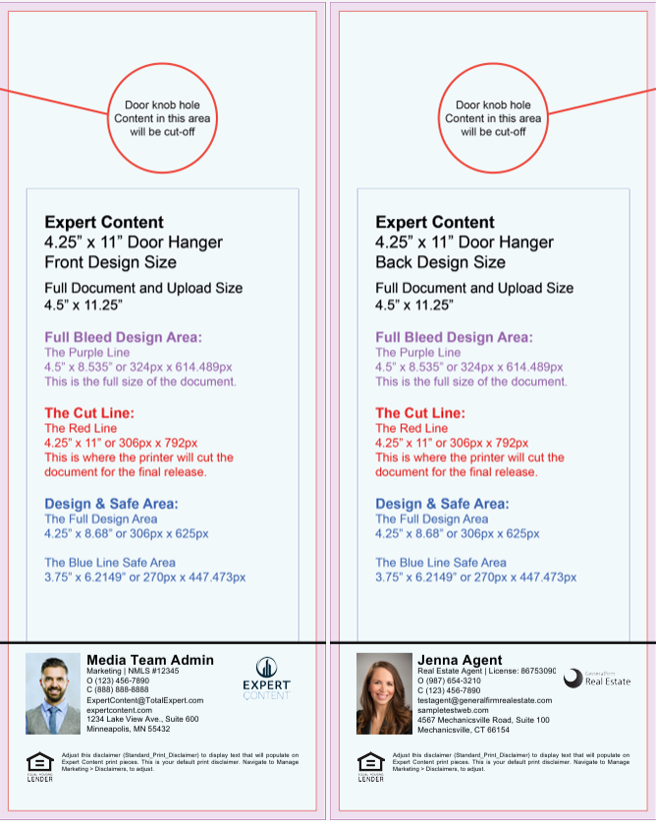
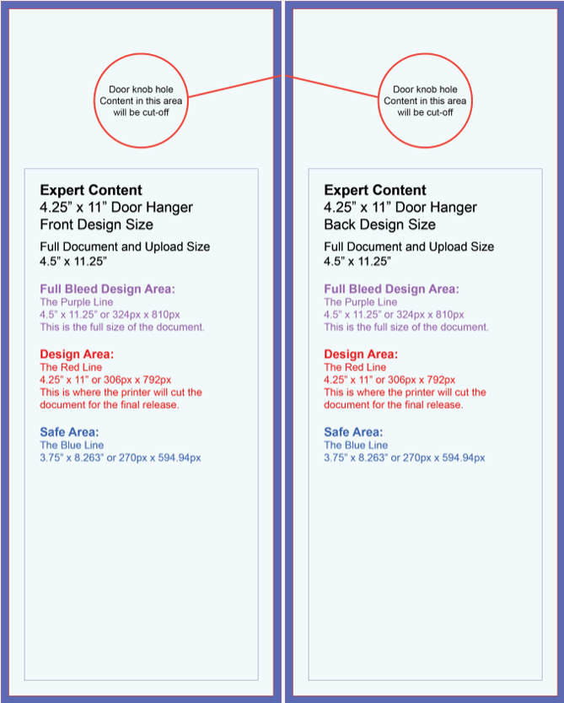
Door Hanger Templates 1249
These templates include only the dynamic contact block. Admins upload two background images with finished artwork for the front and back, with space left for the contact area on single or cobranded variations. The printer will cut the door hanger area. The blue line indicates the safest area for important information but the full background image is required for upload.

Slide 30

Door Hanger Layout 1250
2
1 – Logo presence, adjust logo background color, logo variations from branding setup, editability
2 – Upload background image(s), editability
3 – Override profile image, editability
4 – QR code variation, presence, editability
5 - Fill to fit text elements, change text color (text element toggles are managed separately*)
6 – Color block defaults are brand primary color (blue) and secondary color (yellow); change color, turn all color blocks on/off
*Text editability is toggled on a page-by-page basis.
3
6
5
6
5
1
4

Slide 31
Door Hanger Layout 1251
1
1
1 – Upload background image(s), editability
2 – Override image, editability
3 - Fill to fit text elements, change text color (text element toggles are managed separately*)
4 – Color block default is brand primary color (blue); change color, turn all color blocks on/off
*Text editability is toggled on a page-by-page basis.
2
3
4
3
3

Slide 32
Door Hanger Layout 1252
2
2
2
1 – Logo presence, adjust logo background color, logo variations from branding setup, editability
2 – Change color, turn all color blocks on/off;
Alternatively: toggle color blocks off to upload background image(s), editability
3 – Override image, editability
4 – Fill to fit text elements, change text color (text element toggles are managed separately*)
*Text editability is toggled on a page-by-page basis.
4
4
3
1

Slide 33
Door Hanger Layout 1253
2
1 – Logo presence, adjust logo background color, logo variations from branding setup, editability
2 – Change background color
Alternatively: toggle color off to upload background image(s), editability
3 – Override image(s), editability
4 – QR code variation, presence, editability
5 - Fill to fit text elements, change text color (text element toggles are managed separately*)
*Text editability is toggled on a page-by-page basis.
1
5
3
5
1
4

Slide 34
Door Hanger Layout 1254
2
1 – Change color, turn color blocks on/off
2 – Upload background image(s), editability
3 – Override image, editability
4 – Fill to fit text elements, change text color (text element toggles are managed separately*)
*Text editability is toggled on a page-by-page basis.
3
3
1
4
4

Slide 35
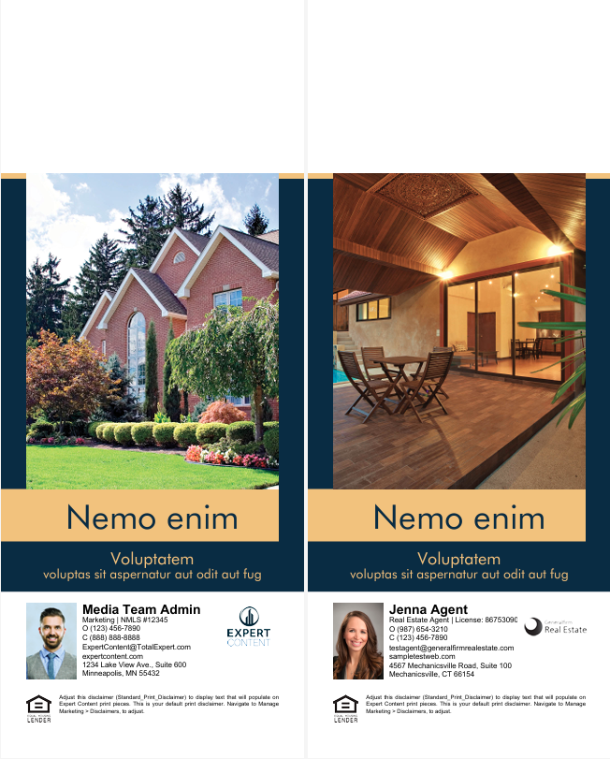
Door Hanger Layout 1255
1 – Color block defaults are brand primary color (blue) and secondary color (yellow); change color, turn all color blocks on/off
2 – Upload background image(s), editability
3 – Override image(s), editability
4 – Fill to fit text elements, change text color (text element toggles are managed separately*)
*Text editability is toggled on a page-by-page basis.
A MLS integrated version is available and can be found in the MLS Listing & Mortgage Rate Asset guide.
Media name: EC - Listing Door Hanger CB - 1255
2
3
3
1
1
4
4

Slide 36
Door Hanger Layout 1256
2
1 – Logo presence, adjust logo background color, logo variations from branding setup, editability
2 – Change background color
Alternatively: toggle color off to upload background image(s), editability
3 – Override image(s), editability
4 - Fill to fit text elements, change text color (text element toggles are managed separately*)
*Text editability is toggled on a page-by-page basis.
1
4
3
4

Slide 37
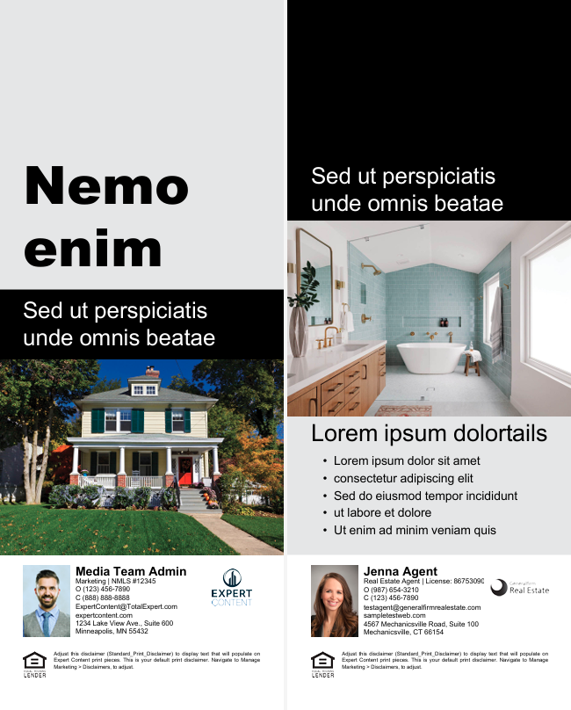
Door Hanger Layout 1257
1 – Change color, turn all color blocks on/off;
Alternatively: toggle color blocks off to upload background image(s), editability
2 – Override image, editability
3 – Fill to fit text elements, change text color (text element toggles are managed separately*)
*Text editability is toggled on a page-by-page basis.
A MLS integrated version is available and can be found in the MLS Listing & Mortgage Rate Asset guide.
Media name: EC - Listing Door Hanger CB - 1257
1
1
3
3
2
1
2
3

Slide 38
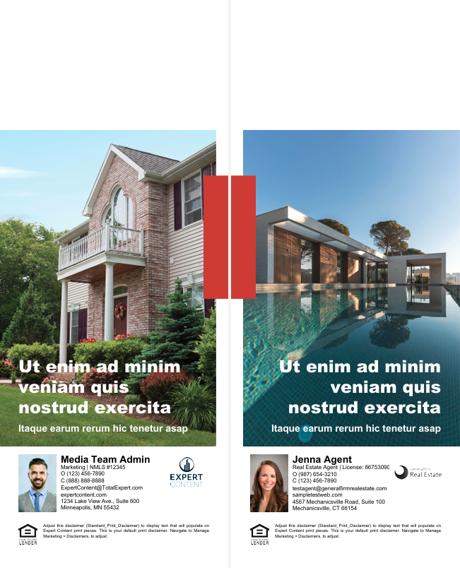
Door Hanger Layout 1258
2
1 – Change color, turn color blocks on/off
2 – Upload background image(s), editability
3 – Override image, editability
4 – Fill to fit text elements, change text color (text element toggles are managed separately*)
*Text editability is toggled on a page-by-page basis.
3
3
1
4
4

Slide 39
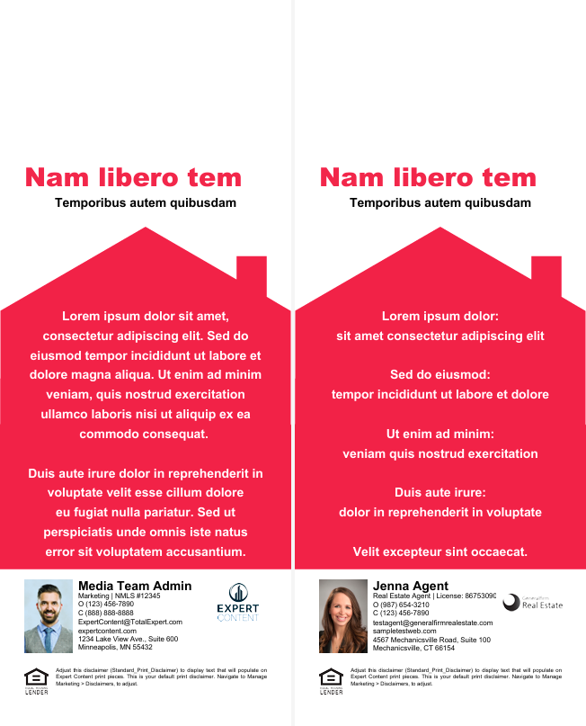
Door Hanger Layout 1259
2
1 – Home element: change color, presence
2 – Upload background image(s), editability
3 – Fill to fit text elements, change text color (text element toggles are managed separately*)
*Text editability is toggled on a page-by-page basis.
3
1
3
3

Slide 40
Brochures

Slide 41
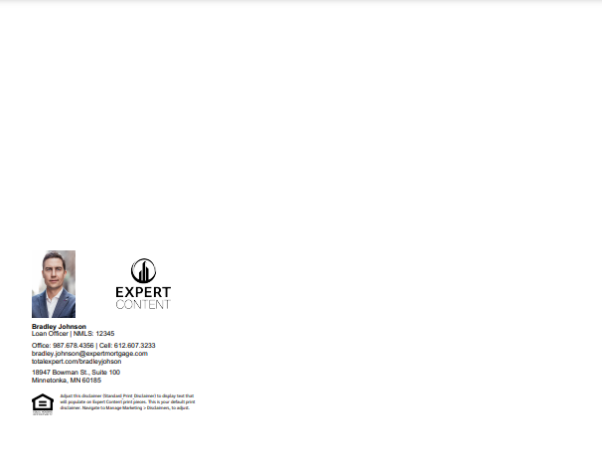
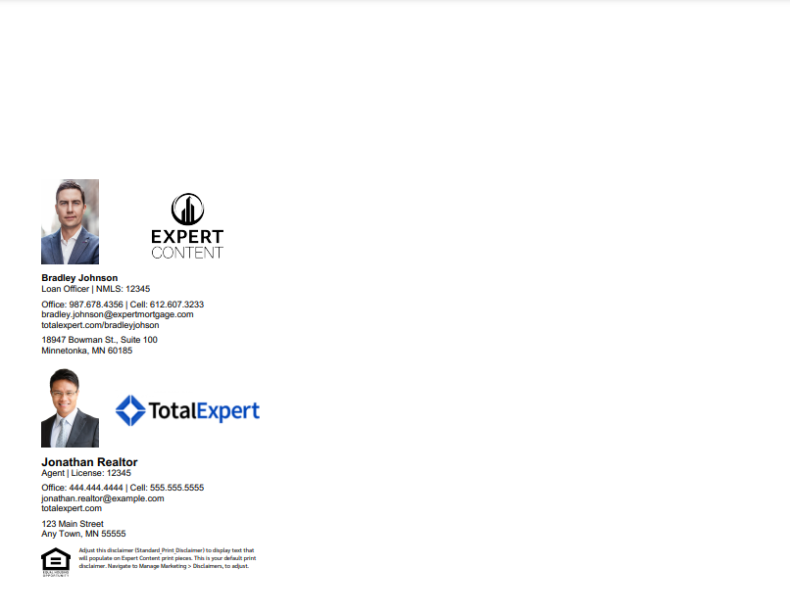
Bifold Brochures
Bifold Brochures include only the dynamic contact block. Admins upload two background images with finished artwork for the front and back, with space left for the contact area. Once printed, they will be folded in half. There are single and co-branded versions of this template with the contact block place on the back when printed and folded.

Slide 42


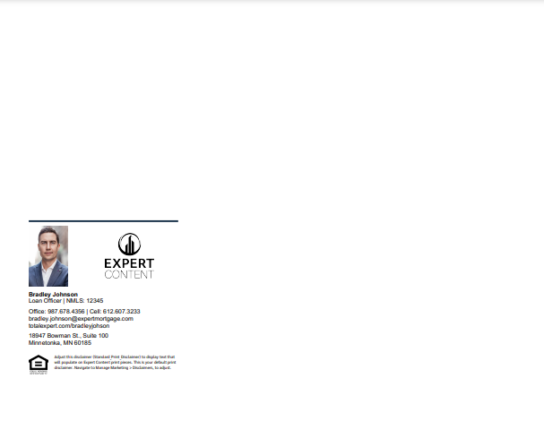
Trifold Brochures – single branded
Trifold Option A
Trifold Option B
Trifold Option C
Trifold Brochures include only the dynamic contact block. Admins upload two background images with finished artwork for the front and back, with space left for the contact area. Once printed, they will be folded in thirds. Three single branded templates are provided where the contact block is placed on different sections of the folded brochure.

Slide 43


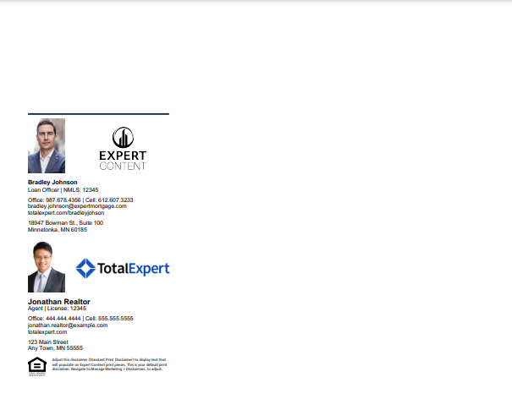
Trifold Brochures – cobranded
Trifold Option A
Trifold Option B
Trifold Option C
Trifold Brochures include only the dynamic contact block. Admins upload two background images with finished artwork for the front and back, with space left for the contact area. Once printed, they will be folded in thirds. Three cobranded templates are provided where the contact block is placed on different sections of the folded brochure.

Slide 44
Yard Signs

Slide 45
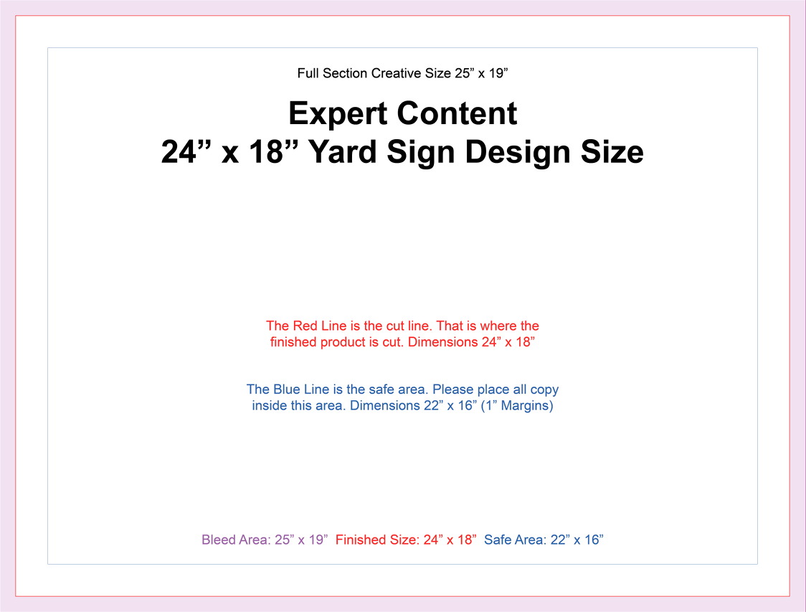
Yard Sign Template 24”x18” 1278
1 – Upload background image(s), editability
*Toggles control both the back and front of each design.
1

Slide 46
Yard Sign Template 30”x18” 1283
1 – Upload background image(s), editability
*Toggles control both the back and front of each design.
1

Slide 47
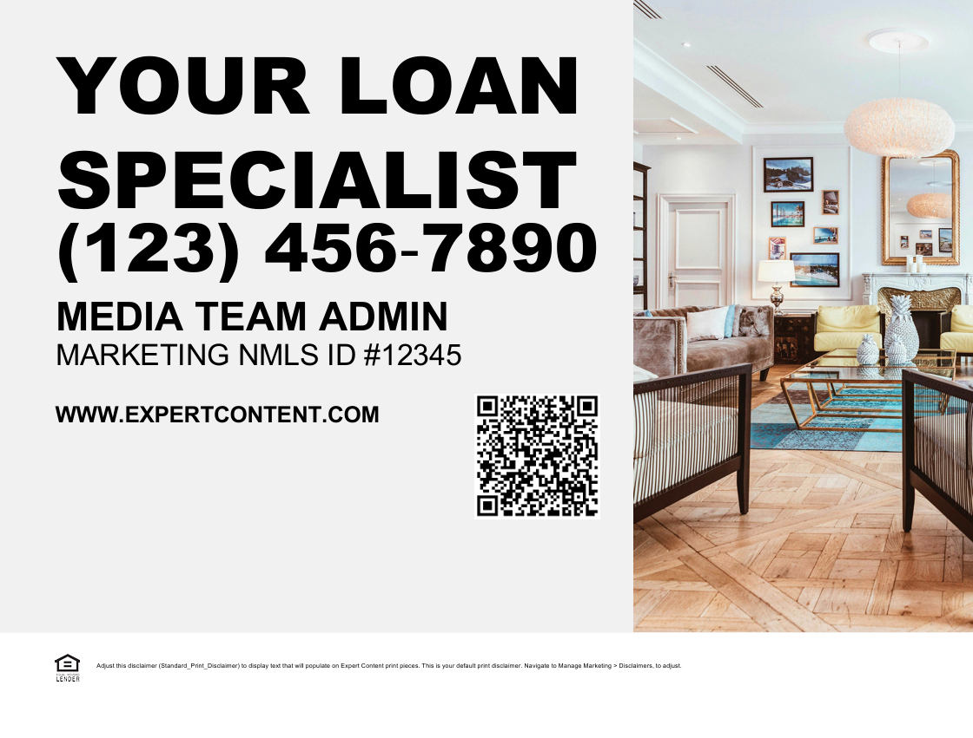
Yard Sign Layout 1279
2
1
1 – Upload design image, editability
2 – Upload background image(s), editability
3 – QR code variation, presence, editability
4 – Color block default is light grey; change color, turn color blocks on/off
5 - Fill to fit text elements, change text color (defaults: first and last name, title, NMLS, office phone, and website)
*Toggles control both the back and front of each design.
5
3
4

Slide 48

Yard Sign Layout 1280
1 – Logo presence, adjust logo background color, logo variations from branding setup, editability
2 – Upload background image(s), editability
3 – Override profile image, editability
4 – QR code variation, presence, editability
5 – Color block default is teal; change color, turn color blocks on/off
6 - Fill to fit text elements, change text color (defaults: first and last name, title, NMLS, office phone, email address, and website)
*Toggles control both the back and front of each design.
2
1
3
6
4
5

Slide 49
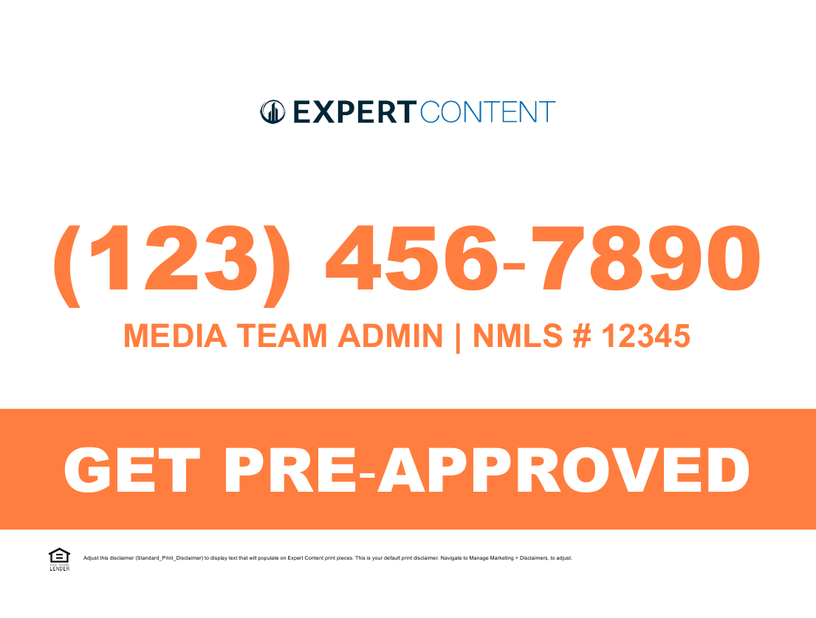
Yard Sign Layout 1281
1 – Logo presence, adjust logo background color, logo variations from branding setup, editability
2 – Upload background image(s), editability
3 – Color block default is orange; change color, turn color blocks on/off
4 - Fill to fit text elements, change text color (defaults: first and last name, NMLS, and office phone)
*Toggles control both the back and front of each design.
2
1
4
3
4

Slide 50

Yard Sign Layout 1282
4
1 – Logo presence, adjust logo background color, logo variations from branding setup, editability
2 – Upload background image(s), editability
3 – Override profile image, editability
4 – QR code variation, presence, editability
5 - Fill to fit text elements, change text color (defaults: first and last name, title, NMLS, office phone, website, and email address)
6 – Color block defaults are black; change color, turn color blocks on/off
*Toggles control both the back and front of each design.
1
3
5
5
2

Slide 51
Sign Riders

Slide 52
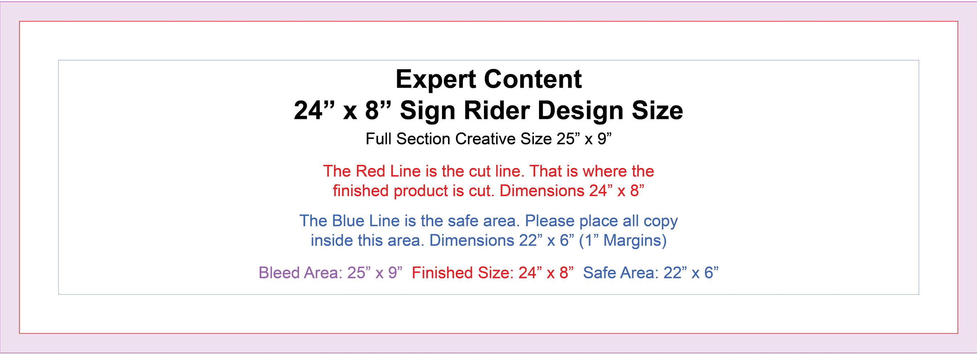
Sign Rider Template 1273
1
1 – Upload background image(s), editability
*Toggles control both the back and front of each design.

Slide 53

Sign Rider Template 1284
1
1 – Upload background image(s), editability
*Toggles control both the back and front of each design.

Slide 54

Sign Rider Layout 1274
2
3
1
5
4
1 – Logo presence, adjust logo background color, logo variations from branding setup, editability
2 – Upload background image(s), editability
3 – Override profile image, editability
4 – QR code variation, presence, editability
5 - Fill to fit text elements, change text color (defaults: first and last name, title, NMLS, and office phone)
*Toggles control both the back and front of each design.

Slide 55

Sign Rider Layout 1275
1
2
3
3
1 – Upload background image(s), editability
2 – Fill to fit text elements, change text color (defaults: first and last name, title, NMLS, office phone and website)
3 – Color block defaults are black; change color, turn color blocks on/off
*Toggles control both the back and front of each design.

Slide 56

Sign Rider Layout 1276
2
3
4
1
5
1 – Logo presence, adjust logo background color, logo variations from branding setup, editability
2 – Upload background image(s), editability
3 – QR code variation, presence, editability
4 - Fill to fit text elements, change text color (defaults: first and last name, title, NMLS, and office phone)
5 – Color block defaults are black; change color, turn color blocks on/off
*Toggles control both the back and front of each design.

Slide 57

Sign Rider Layout 1277
1
2
1 – Upload background image(s), editability
2 - Fill to fit text elements, change text color (defaults: office phone and NMLS)
*Toggles control both the back and front of each design.

Slide 58
Social Media

Slide 59

Social Media Self Serve
1 – Ability to switch logo on/off, adjust logo background color
2 – Fully editable CTA and headline
3 – Color blocks are brand secondary color
4 – Editable fields
5 – Upload image
6 – Transparent, none, white, black disclaimer block
1
2
3
4
5
6

Slide 60
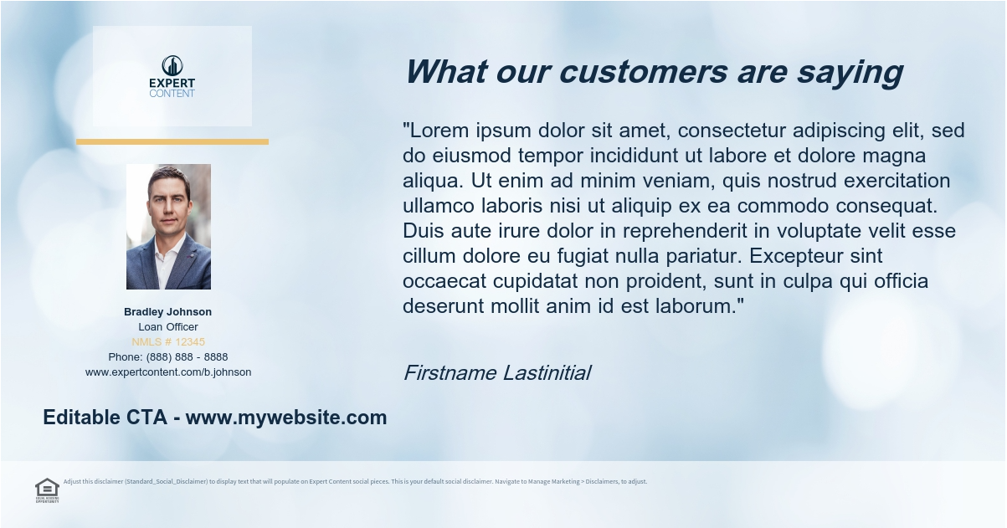
Social Media Self Serve
1 – Ability to switch logo on/off, adjust logo background color
2 – Fully editable CTA and headline
3 – Color blocks are brand secondary color
4 – Editable fields
5 – Upload image
6 – Transparent, none, white, black disclaimer block
1
4
3
5
2
6

Slide 61
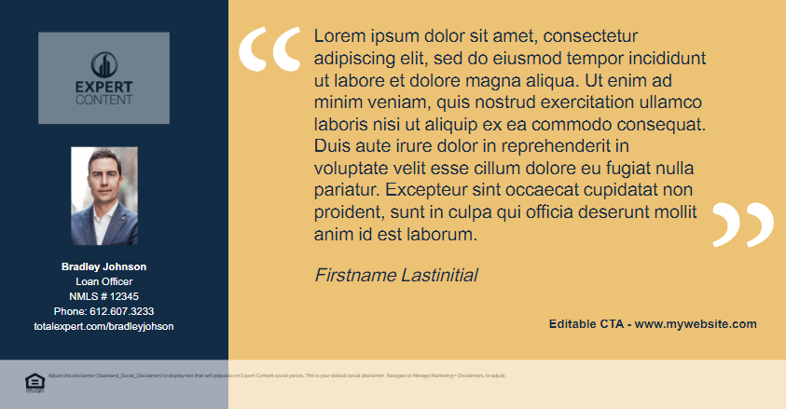
Social Media Self Serve
1 – Ability to switch logo on/off, adjust logo background color
2 – Fully editable CTA
3 – Color blocks are brand colors
4 – Editable fields
5 – Transparent, none, white, black disclaimer block
1
4
3
5
2
5

Slide 62

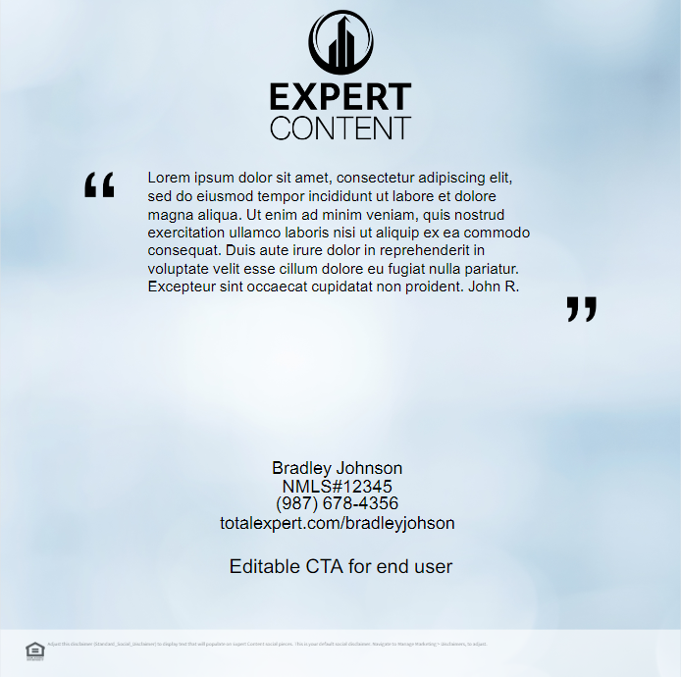
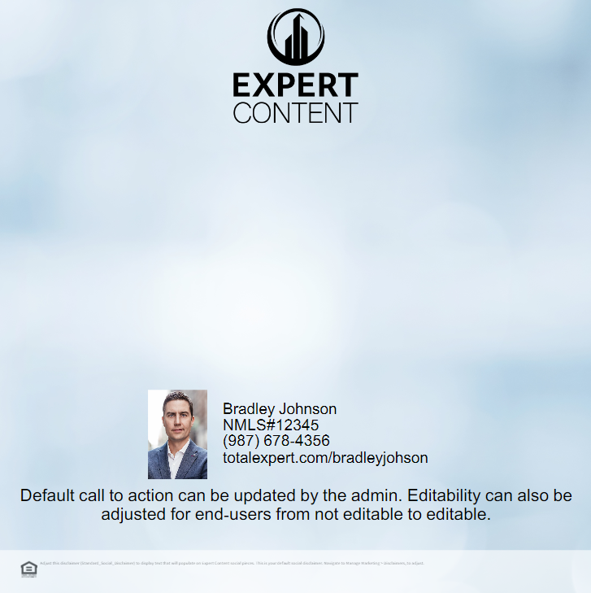
Square Social Templates 1067-1069
1
1
1
2
3
3
3
2
2
2
4
4
4
Square Social Template – 1067
Square Social Template – Testimonial – 1068
Square Social Template – Headshot and Contact Info - 1069
1 – Ability to switch logo on/off,
2 – Editable CTA/text
3 – Upload image
4 – Transparent, none, white, black disclaimer block

Slide 63

Horizontal Social Template 0727
1 – Logo presence, adjust logo background color, logo variations from branding setup, editability
2 – Upload background image(s), editability
3 – Call-to-action text, editability and presence
4 – Transparent, none, white, black disclaimer block; font color; set maximum and minimum font size; toggle presence of compliance elements
1
2
3
4

Slide 64

Vertical 4:5 Social Template 1081
1 – Logo presence, adjust logo background color, logo variations from branding setup, editability
2 – Upload background image(s), editability
3 – Call-to-action text, editability and presence
4 – Transparent, none, white, black disclaimer block; font color; set maximum and minimum font size; toggle presence of compliance elements
1
3
2
4

