Slide 1
Expert Content
Strategy Guide
Self Serve Templates

Slide 2
Expert Content Templates
Print Flyers, Postcards, Greeting Cards, Brochures, Social Media
The Expert Content library includes self-service templates for admins to create-your-own content. Pre-filled Expert Content is built from these templates and can be configured based on the individual layout’s options. Contact blocks, disclaimers, and branding elements are dynamic to the end user. Many templates include admin-level configuration options such as switching the brand logo on or off, logo positioning, swapping imagery within the dedicated space, replacing full background images, default text and/or default CTA text, and providing end users access to edit call-to-actions (CTA). All templates include additional or override disclaimer options to allow admins to enter dynamic disclaimers or include verbiage on a one-off basis.
Templates include:
Various layouts for single sided print flyers
Multiple sizing options for postcards in direct-mail, non-direct mail, and EDDM shipping
Vertical and Horizontal Greeting Cards
Social Media templates including Event, Testimonials, and upload-your-own design

Slide 3
Self Serve Print Flyers
1 – Ability to switch logo on/off, adjust logo background color
2 – Fill to fit headline/sub-headline, change text color
3 – Background color default is brand primary color
4 – Font default color is brand secondary color
5 – Font default color is brand primary color
6 – Editable CTA
7 – Upload image
Single and cobranded versions available
1
2
3
4
7
5
6

Slide 4
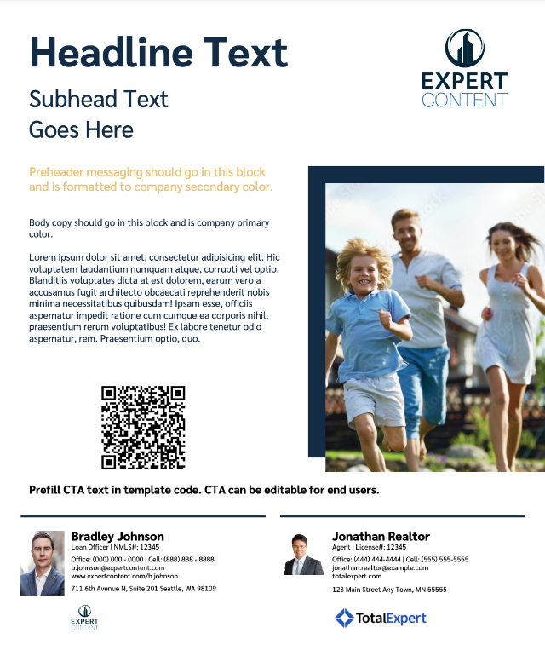
Self Serve Print Flyers
1 – Ability to switch logo on/off, adjust logo background color
2 – Fill to fit headline/sub-headline, change text color
3 – BG color default is brand primary color
4 – Font default color is brand secondary color
5 – Font default color is brand primary color
6 – Editable CTA
7 – Upload image
8 – Editable image block – QR code will populate from user profile
Single and cobranded versions available
1
2
3
4
7
5
8
6

Slide 5
Self Serve Print Flyers
1 – Ability to switch logo on/off, adjust logo background color
2 – Fill to fit headline/sub-headline, change text color
3 – Upload image
4 – Font default color is brand secondary color
5 – Font default color is brand primary color
6 – Editable CTA
Single and cobranded versions available
1
3
2
4
5
6

Slide 6
Self Serve Print Flyers
1 – Ability to switch logo on/off, adjust logo background color
2 – Fill to fit headline/sub-headline, change text color
3 – Upload image
4 – Font default color is brand secondary color
5 – Font default color is brand primary color
6 – Editable CTA
Single and cobranded versions available
1
3
2
4
5
6

Slide 7
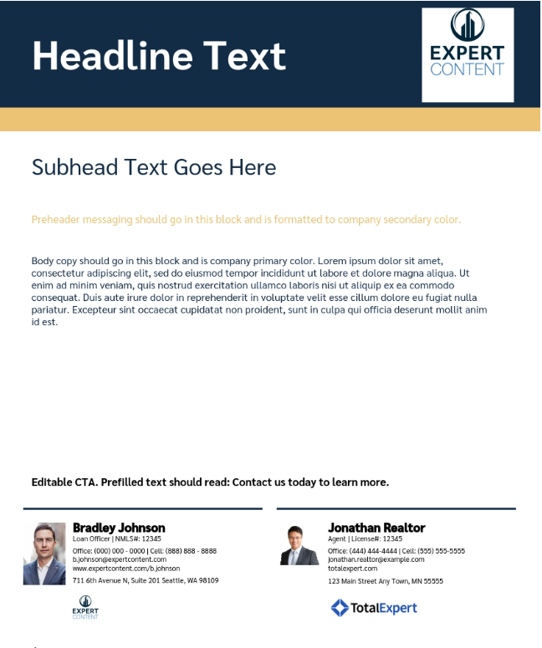
Self Serve Print Flyers
1 – Ability to switch logo on/off, adjust logo background color
2 – Fill to fit headline/sub-headline, change text color
3 – Default to brand primary color
4 – Default to brand secondary color
5 – Font default color is brand secondary color
6 – Font default color is brand primary color
7 – Editable CTA
Single and cobranded versions available
2
1
3
4
5
6
7

Slide 8
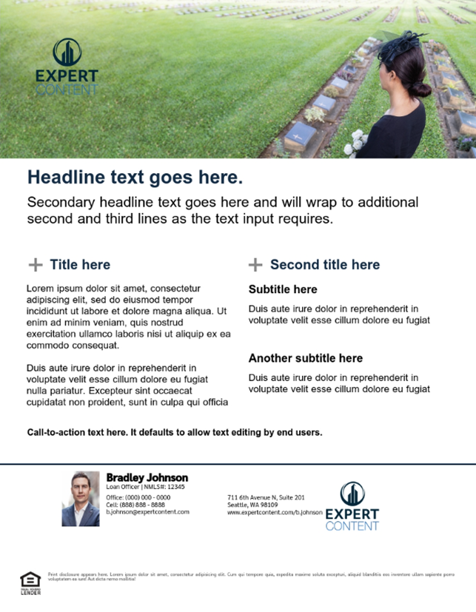
Self Serve Print Flyers
1 – Ability to switch logo on/off, adjust logo background color
2 – Upload image
3 – Fill to fit headline/sub-headline, change text color
4 – Font default color is brand primary color
5 – Font default color is brand primary color
6 – Editable CTA
Single and cobranded versions available
1
2
3
4
5
6

Slide 9
Self Serve Print Flyers
1 – Ability to switch logo on/off, adjust logo background color
2 – Dynamic user information
3 – Upload image
4 – Fill to fit headline/sub-headline, change text color
5 – Editable CTA
Single and cobranded versions available
1
2
3
4
5

Slide 10
Self Serve Print Flyers
1 – Ability to switch logo on/off, adjust logo background color
2 – Upload image
3 – Fill to fit headline/sub-headline, change text color
4 – Background color default is brand primary color, change text color
5 – Background color default is brand secondary color, change text color
6 – Editable CTA
Single and cobranded versions available
1
2
3
4
5
6

Slide 11
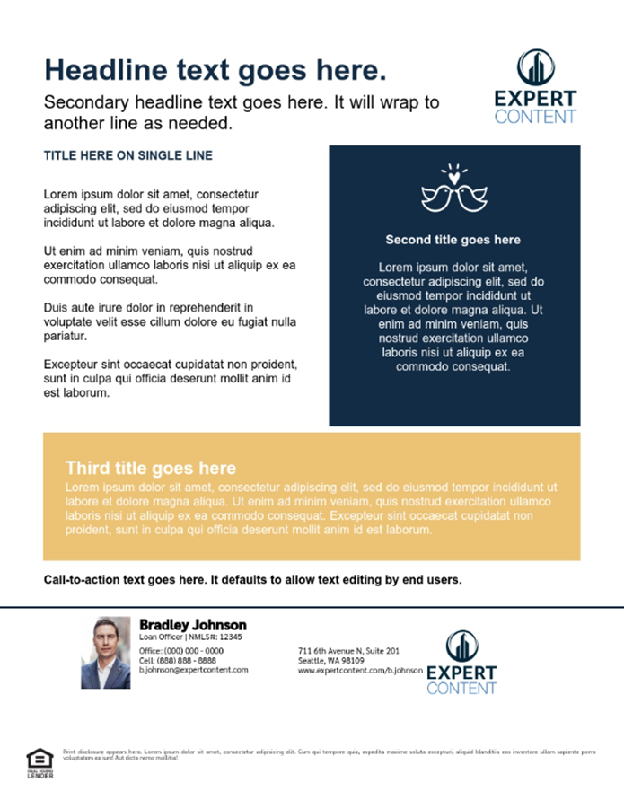
Self Serve Print Flyers
1 – Ability to switch logo on/off, adjust logo background color
2 – Fill to fit headline/sub-headline, change text color
3 – Upload icon image
4 – Background color default is brand primary color, change text color
5 – Background color default is brand secondary color, change text color
6 – Editable CTA
Single and cobranded versions available
2
1
3
4
5
6

Slide 12
Self Serve Print Flyers
1 – Ability to switch logo on/off, adjust logo background color
2 – Upload image
3 – Fill to fit headline/sub-headline, change text color
4 – Background color default is brand secondary color, change text color
5 – Editable CTA
Single and cobranded versions available
3
1
2
4
5

Slide 13
Self Serve Print Flyers
1 – Upload image, will replace entire background image of the full 8.5”x11” flyer
1
1

Slide 14
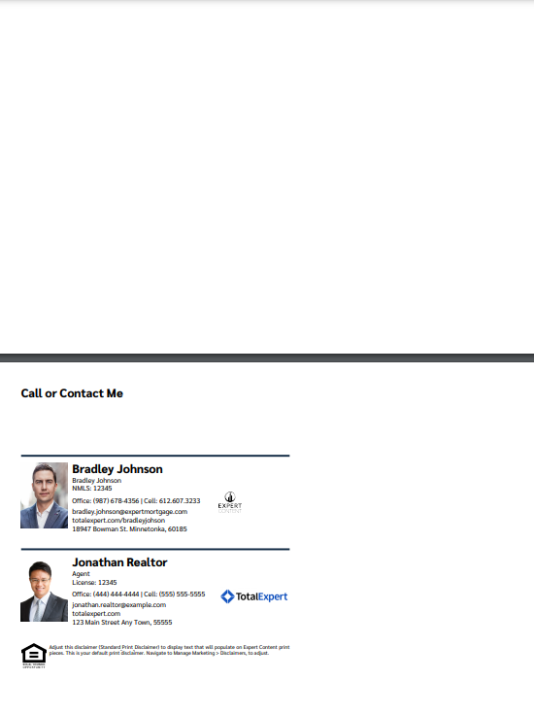
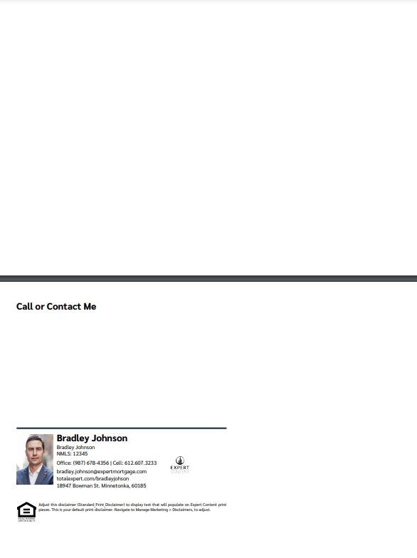
Direct & Non-Direct Mail Postcards: 8.5”x5.5”
2
2
1 – Editable CTA
2 – Upload image
1
1

Slide 15
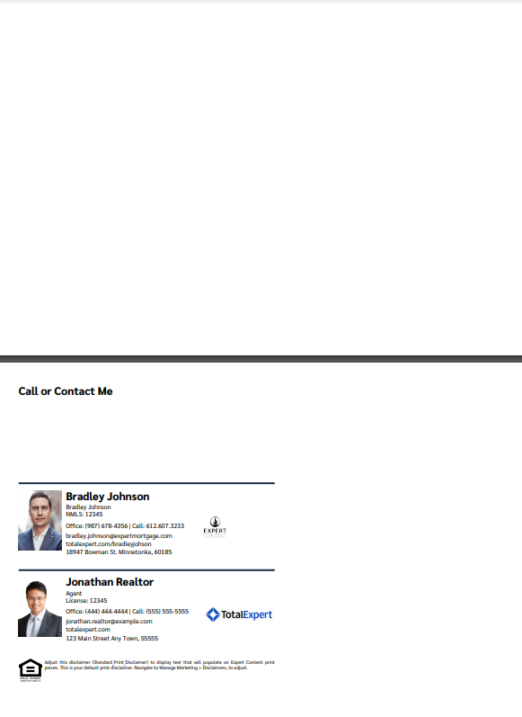
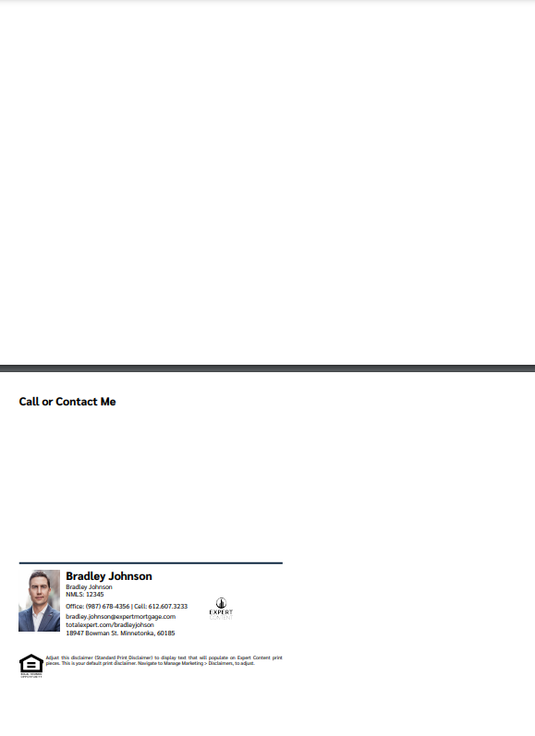
Direct & Non-Direct Mail Postcards: 9”x6”
2
2
1 – Editable CTA
2 – Upload image
1
1

Slide 16
EDDM Postcards: 11”x6.25”
2
2
1 – Editable CTA
2 – Upload image
1
1

Slide 17
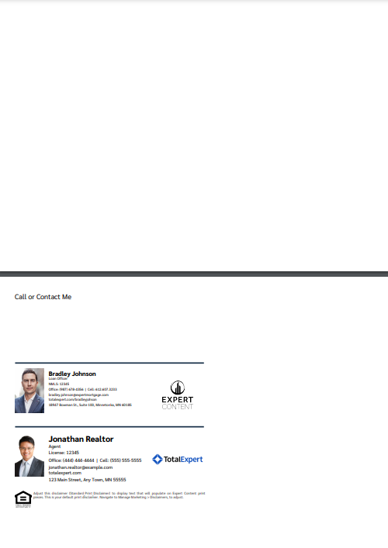
EDDM Postcards: 9”x6.25”
2
2
1 – Editable CTA
2 – Upload image
1
1

Slide 18
Horizontal Greeting Cards
1 – Editable greeting
2 – Upload image
1
2
Outside
Inside
Envelope

Slide 19
Vertical Greeting Cards
2
Envelope
Outside
1
1 – Editable greeting
2 – Upload image
Inside

Slide 20
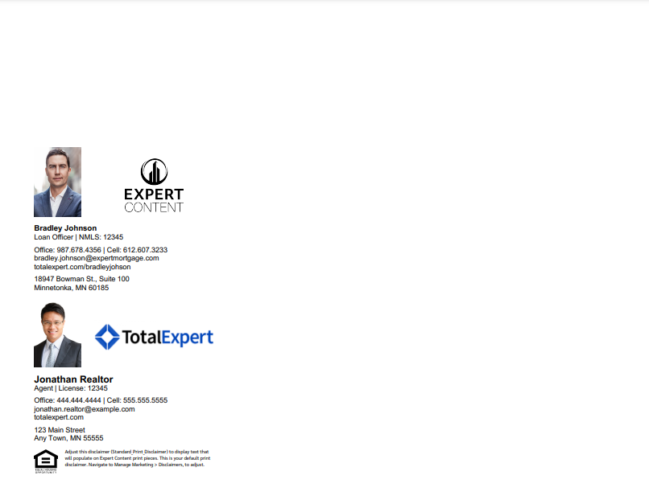
Bifold Brochures
Bifold Brochures include only the dynamic contact block. Admins upload two background images with finished artwork for the front and back, with space left for the contact area. Once printed, they will be folded in half. There are single and co-branded versions of this template with the contact block place on the back when printed and folded.

Slide 21
Trifold Brochures – single branded
Trifold Option A
Trifold Option B
Trifold Option C
Trifold Brochures include only the dynamic contact block. Admins upload two background images with finished artwork for the front and back, with space left for the contact area. Once printed, they will be folded in thirds. Three single branded templates are provided where the contact block is placed on different sections of the folded brochure.

Slide 22
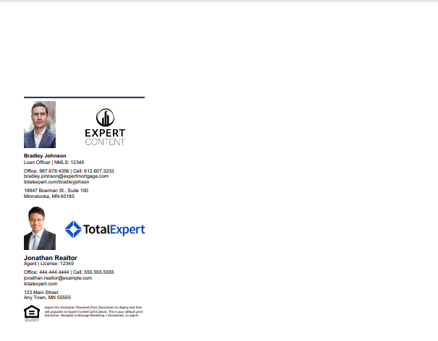
Trifold Brochures – cobranded
Trifold Option A
Trifold Option B
Trifold Option C
Trifold Brochures include only the dynamic contact block. Admins upload two background images with finished artwork for the front and back, with space left for the contact area. Once printed, they will be folded in thirds. Three cobranded templates are provided where the contact block is placed on different sections of the folded brochure.

Slide 23
Social Media Self Serve
1 – Ability to switch logo on/off, adjust logo background color
2 – Fully editable CTA and headline
3 – Color blocks are brand secondary color
4 – Editable fields
5 – Upload image
6 – Transparent, none, white, black disclaimer block
1
2
3
4
5
6

Slide 24
Social Media Self Serve
1 – Ability to switch logo on/off, adjust logo background color
2 – Fully editable CTA and headline
3 – Color blocks are brand secondary color
4 – Editable fields
5 – Upload image
6 – Transparent, none, white, black disclaimer block
1
4
3
5
2
6

Slide 25
Social Media Self Serve
1 – Ability to switch logo on/off, adjust logo background color
2 – Fully editable CTA
3 – Color blocks are brand colors
4 – Editable fields
5 – Transparent, none, white, black disclaimer block
1
4
3
5
2
5

Slide 26
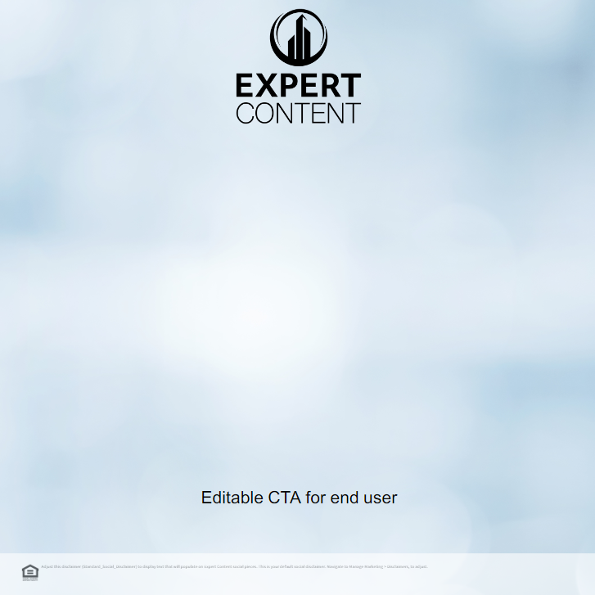
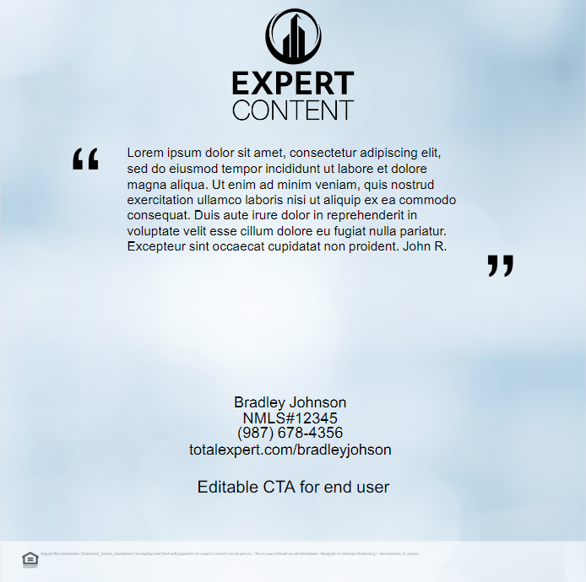
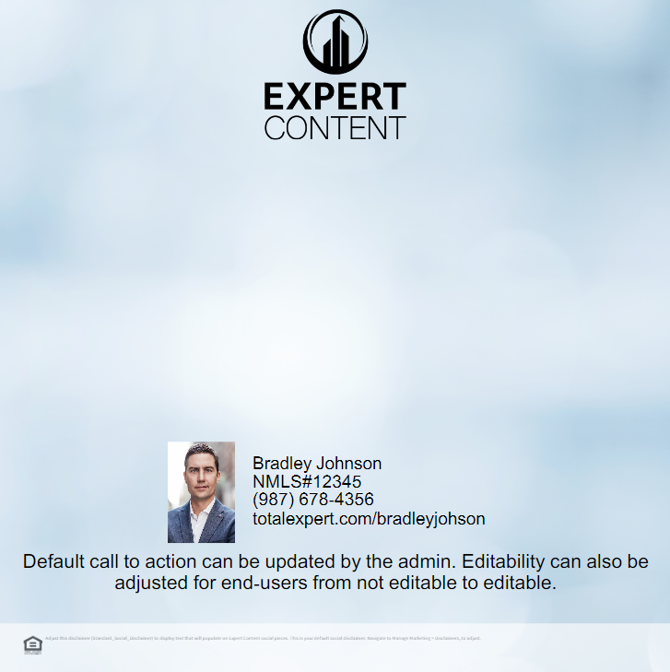
Social Media Self Serve
1
1
1
2
3
3
3
2
2
2
4
4
4
1 – Ability to switch logo on/off,
2 – Editable CTA/text
3 – Upload image
4 – Transparent, none, white, black disclaimer block

Slide 27
Self Serve Social Media
1 – Ability to switch logo on/off, logo positioning
2 – Fully editable CTA
3 – Upload image
4 – Transparent, none, white, black disclaimer block
1
3
2
4

Slide 28
Self Serve Social Media
1 – Upload image
1

