Slide 1
Expert Content
Strategy Guide
Social Media Videos

Slide 2
Social Media Videos
Short-form Social Media Videos (MP4)
Leverage these short (<15s) videos to engage with followers across different social platforms. Most videos can be leveraged for various events and situations. Admins may choose to publish them for a single use by limiting edits to the post message and links. Or, allow end users to leverage the videos for different scenarios by allowing editing and providing recommended uses and messaging. The following strategy guide gives some suggestions for admins on when and how to position these videos to end users.
*All communications should be reviewed. Note: these videos are not dynamically branded and do not contain disclaimers or EHO/EHL logos. These videos cannot be duplicated in the same manner as other Expert Content templates.

Slide 3
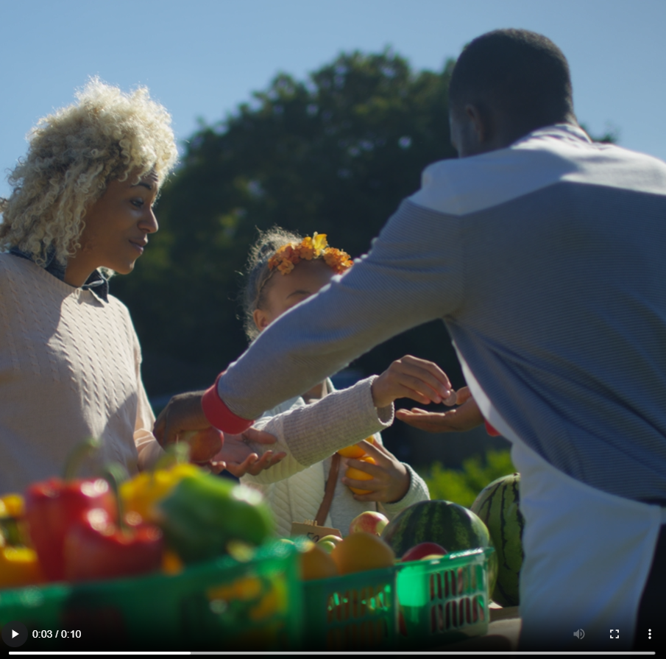
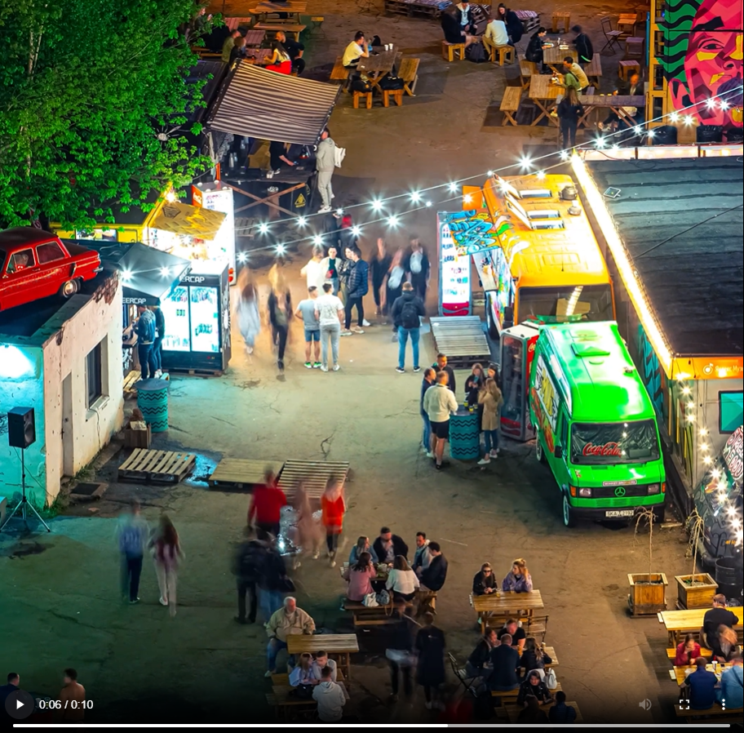
Social Media
“Moving In”
Leverage this video to create an emotional connection with potential clients about the benefits of homeownership, key services, personalized loan options that meet the family’s needs, or making the homebuying process stress-free. Include a call-to-action to reach out for a consultation or to learn more about loan options.
“Farmer’s Market”
Use key words like “grow”, “ground”, and “pick” to connect the imagery to homeownership and create a parallel between choosing the right produce and the right loan officer, home, or product. This video can also be used by both loan officers and real estate agents to highlight local farmer’s markets near an open house, or to connect with the user at their local market.
“Food Trucks”
Using key words like “variety”, “choices”, and “preference”, create a parallel to selecting the right loan officer, home, or loan product. This video can also be used by both loan officers and real estate agents to highlight local food truck events near an open house, or to connect with the user at their local food truck events.
“Carnival Fair”
Leverage this video to create an emotional connection with potential clients about the “ups and downs” of the homebuying process. A call-to-action could encourage viewers to reach out to their trusted “operator” of the homebuying journey. This can also be used by loan officers and real estate agents to connect at their upcoming local fair, festival, or carnival.
Notes:
This page should be used for Social Media (duplicate as needed)

Slide 4
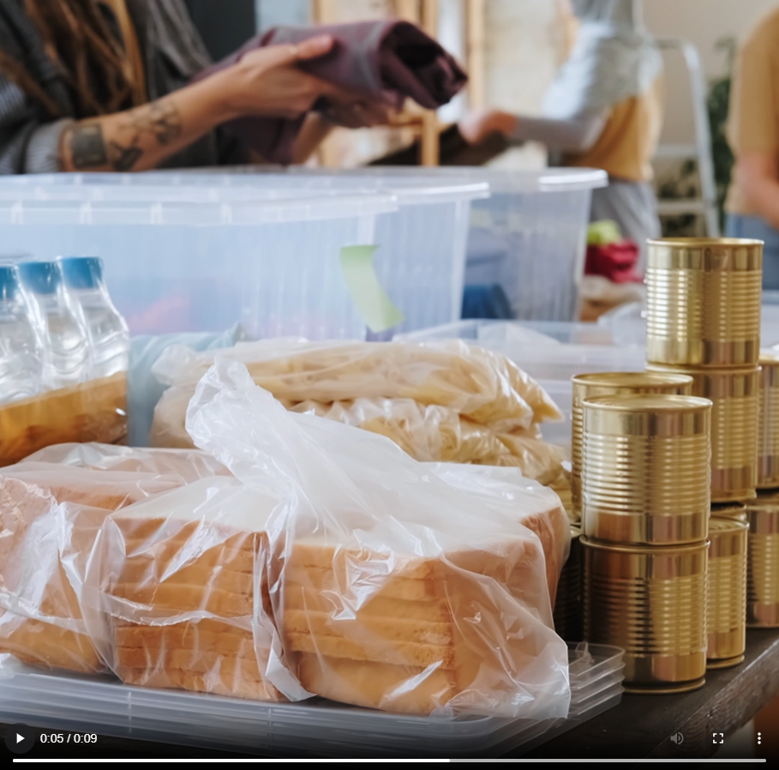
Social Media
“Volunteer Cleaning”
Forge an emotional connection with viewers by showcasing commitment to the community. Whether highlighting a user’s involvement in local volunteer events or other initiatives, this video emphasizes a larger, positive impact. A call-to-action could invite viewers to join the event, learn more about community engagement, or introduce them to a user’s services.
“Volunteer Donations”
Forge an emotional connection with viewers by showcasing commitment to the community. Whether highlighting a user’s involvement in local volunteer events or other initiatives, this video emphasizes a larger, positive impact. A call-to-action could invite viewers to join the event, learn more about community engagement, or introduce them to a user’s services.
“Open House”
Generate excitement with viewers about beginning the homebuying journey. Discuss the importance of identifying must-haves, wishes, and deal-breakers before touring homes. This video can also help foster co-marketing relationships with real estate partners by promoting their upcoming open houses. Leverage to highlight how the partnership will benefit and guide the buyer through the process.
“Lunch and Learn”
Leverage this video to create awareness of upcoming events such as first-time homebuyer seminars, lunch-and-learns, or other educational sessions hosted by the user or partner. Include a call-to-action for the viewer to register through the provided link or to inquire about more details. Marketing these events helps solidify users and partners as experts in the homebuying journey.
Notes:
This page should be used for Social Media (duplicate as needed)

Slide 5
Social Media
“Chinese New Year”
Connect with potential clients and viewers on a cultural level and convey themes of renewal, prosperity, and new beginnings. Or simply celebrate the New Year with your existing followers. Should a call-to-action be added, consider a phrase such as “This New Year, celebrate new beginnings with the right mortgage” (or your dream home).
“Happy Holidays”
Bring a sense of joy to viewers and followers with this Happy Holidays video. Encourage potential clients to reach out with a call-to-action including phrases such as “Wishing you peace, joy, and the keys to your new home”. Include messaging about being a trusted partner and turning homeownership into a reason for celebration this holiday season.
Notes:
This page should be used for Social Media (duplicate as needed)

Slide 6
Journey Map Notes:
Keep emails that work for your organization, swap with custom, or add these emails to your existing campaigns.
Adjust onramps with organization specific groups and Focused View outcomes.

Slide 7
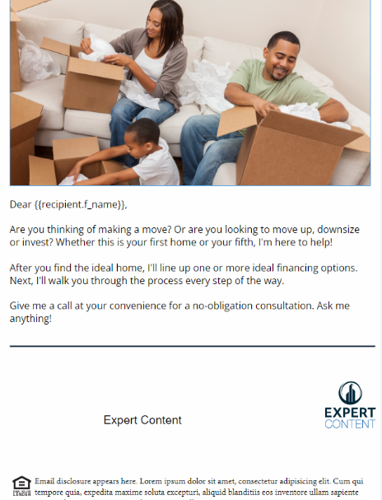
Campaign Name
Email Subject:
Email Title Goes Here
Notes:
This page should be used for JOURNEY EMAILS (duplicate as needed)

Slide 8
Print Flyers
Notes:
This page should be used for Print Flyers (duplicate as needed)

Slide 9
Postcards
Notes:
This page should be used for Postcards (duplicate as needed)

Slide 10
Campaign Name
Task: task snippet name
Content here.
User Notification: notification snippet name
Content here.
SMS: SMS snippet name
Content here.
Notes:
This page should be used for Tasks, User Notifications, and SMS templates (duplicate as needed)

