Slide 1
Expert Content
Strategy Guide
CI: Equity
April 2026

Slide 2
CI: Equity
Email, SMS, User Notifications
Use customer intelligence alerts to inform customers about their home equity and the potential benefits of accessing it. If the contact has mortgage insurance (MI) on their most recent loan, there’s a path offering them the opportunity to remove it. The journey incorporates estimated equity dollar amount and segments contacts based on equity percentage thresholds.
For customers who wish to limit the number of times a contact can onboard this journey, leverage occurrence limits in the onboarding trigger. Find additional email options in the email gallery or leverage the HELOC Opportunities journey and reconfigure it to onboard contacts after they’ve been through this initial equity campaign.
*All communications should be reviewed prior to initiating the journey.

Slide 3
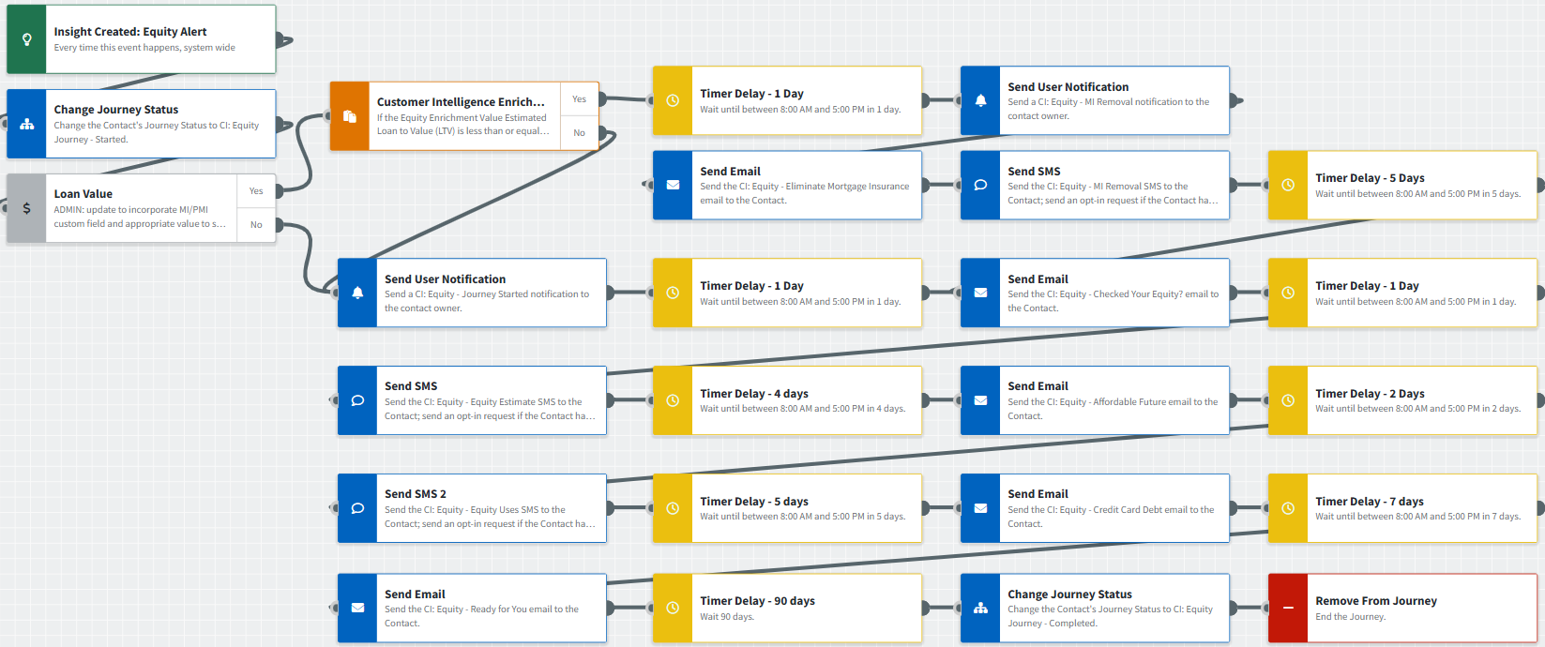
Journey Map Notes:
Keep emails that work for your organization, swap with custom, pull from the email gallery, or add these emails to your existing campaigns.
Adjust onramps with organization specific groups and Focused View outcomes.
Adjust occurrence limits to reduce the number of times a contact can onboard this journey. Leverage email received conditions or journey event fired configurations to add contacts to a different path or journey such as CI: HELOC opportunities.

Slide 4
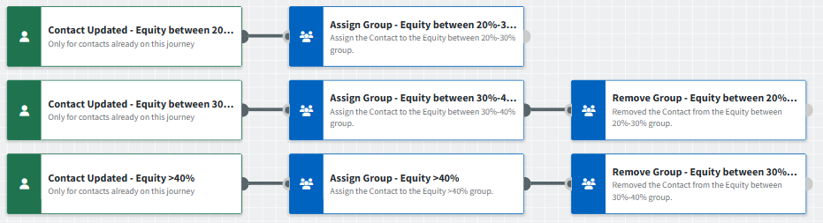
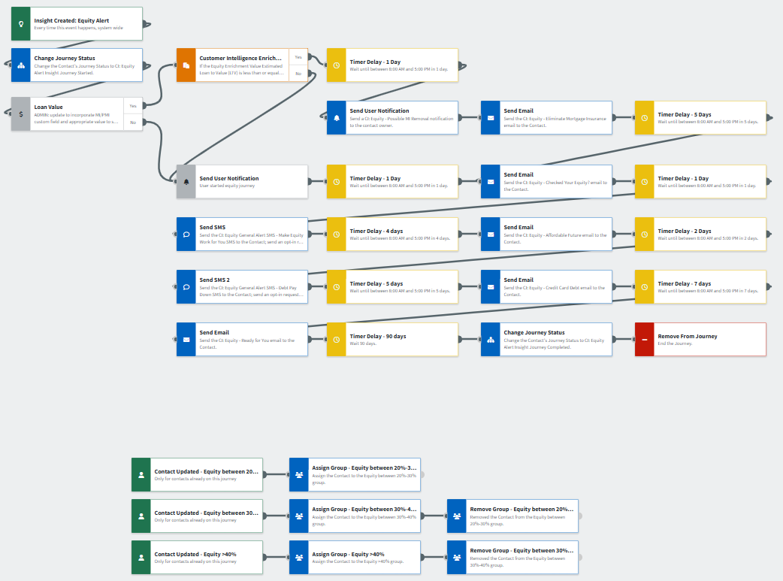
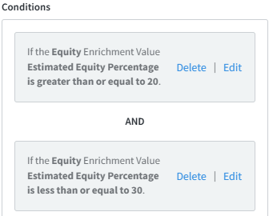
Journey Map Notes:
Contacts are segmented using Contact Groups to easily identify equity percentage thresholds. This can be used to filter in campaign builder or other areas of the platform where groups are available. It can also be used to segment contacts on journeys to market specific products.
Adjust thresholds by updating the trigger conditions and then updating group names to match. You can also add more thresholds to identify opportunities above 40% equity.

Slide 5

CI: Equity
Email Subject Line: Have you checked your home’s equity lately?
Hello {{recipient.f_name}},
I'm writing with an update about one of your biggest assets...your home. Do you know how much equity you have today? It may be a lot more than you realize.
Home equity: what it is, what you can do with it
Determining your home's equity is simple math. Subtract your mortgage balance from your home's current market value (this could be more than the price you originally paid). The difference provides you with an estimate of your equity.
Hate math? Don't worry, I've done it for you.
I obtained an estimate of your home's current equity and it adds up to around ${{recipient.enriched.equity.estimated_equity_dollars | formatNumber }}.
You can tap into some of this equity to finance whatever you like, either as a line of credit or a loan.
I'll be sending you details of these options soon, but if you can't wait, call me at {{sender.phone_cell}}.
Notes:
This page should be used for JOURNEY EMAILS (duplicate as needed)

Slide 6

CI: Equity
Email Subject Line: The future's more affordable with home equity
Hi {{recipient.f_name}},
I have some news about your home equity options...and I think you'll like them. You may even LOVE them.
Here's the good news. Our records show that you may have a sizeable amount of equity in your home.
A current estimate of your home equity comes to around ${{recipient.enriched.equity.estimated_equity_dollars | formatNumber }}.
Pretty cool, huh?
Think of what you could do with some of these funds...
Make your home more comfortable with some renovations or improvements.
Replace aging heating or cooling systems, so you're more comfortable all year round.
Add an extra bathroom. No more waiting in line!
Add a guest bedroom so weekend visitors don't have to sleep on the sofa.
Build a tiny home, she-shed or man cave for better downtime.
No matter what you choose, you'll be more comfortable while increasing your home's value.
If you'd like to have a conversation about how you can leverage your existing equity, please contact me today.
Notes:
This page should be used for JOURNEY EMAILS (duplicate as needed)

Slide 7

CI: Equity
Email Subject Line: How home equity can help you tame inflation
Hello {{recipient.f_name}},
I'm writing to introduce some options you may have for taking control of your finances, especially if you have some credit card debt you'd like to see gone.
How to kick high interest rates to the curb.
When inflation hits, many consumers end up using their credit cards to cope with rising prices, especially when there's too much month left at the end of the money.
If you're currently working to pay off some credit card balances, your equity could be your secret weapon...one that will help you save.
Tell your home it's payback time.
You can use a portion of your home's equity to consolidate and pay off high-interest credit debt, plus other loan balances. The choice is yours!
Go for a home equity line of credit, home equity loan or cash-out refinance. Each puts you in control of your money so you can pay off debts and keep more of your monthly income.
Call me at {{sender.phone_cell}} so I can present you with a personalized plan to eliminate debt.
Notes:
This page should be used for JOURNEY EMAILS (duplicate as needed)

Slide 8

CI: Equity
Email Subject Line: Your home equity's ready when you are
Hello {{recipient.f_name}},
If you've had a chance to check out the emails I've sent recently, you already know how your equity can help you get ahead. But if you still have questions or are unsure, I'm here to help.
While equity-based lines of credit and loans are smart ways to banish high-interest debt, finance remodeling projects or even buy a second property, that's just a few options.
Is it time to be your own boss?
Home equity funds can help you expand your existing business, create a side hustle, and even launch yourself as a full-time entrepreneur.
Consider your home's equity as your secret weapon. It's a stash you can access 24/7.
If you have questions about your equity options, or want to get started, call me at {{sender.phone_cell}}.
Notes:
This page should be used for JOURNEY EMAILS (duplicate as needed)

Slide 9

CI: Equity
Email Subject Line: Find out if you're done paying mortgage insurance
Hi {{recipient.f_name}},
Looking for new ways to keep more of your money? You may be able to cancel your mortgage insurance (MI).
I recently reviewed your home financing, and it looks like this is a possibility. Either you've repaid at least 20% of your mortgage, or your home's appraised value has risen to where you now have over 20% equity. Eliminating your mortgage insurance payment may bring substantial monthly savings.
One smart way to do this is to refinance your current mortgage. In addition to eliminating mortgage insurance, you can change the term (the length of your mortgage).
A shorter loan term may save you considerable money on the amount of interest you pay.
A longer term can lower your monthly payments if you're feeling a bit squeezed.
Contact me today to learn about your options. Let's see how much money you may be able to save.
Notes:
This page should be used for JOURNEY EMAILS (duplicate as needed)

Slide 10
CI: Equity
SMS: CI: Equity - Equity Estimate
Hi {{recipient.f_name}}, this is {{sender.f_name}} with {{sender.company}}. If you’ve thought about tapping into the equity in your home, let’s connect! I can provide you with an equity estimate that you could potentially put to use. Call me at {{sender.phone_cell}} or reply to this message to chat!
SMS: CI: Equity - Equity Uses
Hi {{recipient.f_name}}, did you know that you could use the equity in your home to pay down high-interest debt, add to your emergency fund, or even renovate your home? Reply to this message to learn more about your equity-based options or call {{sender.phone_cell}} if you have questions.
SMS: CI: Equity - MI Removal
Hi {{recipient.f_name}}, this is {{sender.f_name}} with {{sender.company}}. You may have enough equity to eliminate your MI! Give me a call at {{sender.phone_cell}} if you are interested in potential savings on your mortgage.
Notes:
This page should be used for Tasks, User Notifications, and SMS templates (duplicate as needed)

Slide 11
CI: Equity
User Notification: CI: Equity - Remove Mortgage Insurance
The contact below has triggered an equity alert and shows their LTV is less than or equal to 80%. It appears this contact also had mortgage insurance on their most recent loan, it may be time to connect with them about removing it. Visit their contact record to review more in depth.
Contact name: {{contact.f_name}} {{contact.l_name}}
Contact phone: {{contact.phone}}
User Notification: CI: Equity - Journey Started
The contact below has triggered an equity alert and will receive a series of emails describing the value of tapping into it. Visit their contact record to review more in depth and determine strategy to reach out.
Contact name: {{contact.f_name}} {{contact.l_name}}
Contact phone: {{contact.phone}}
Notes:
This page should be used for Tasks, User Notifications, and SMS templates (duplicate as needed)

