Slide 1
Expert Content
Strategy Guide
CI: Listing
April 2026

Slide 2
CI: Listing
Email, SMS, User Notification
Use customer intelligence alerts to identify contacts who recently listed their home for sale. Engage with them through four emails and two test messages letting them know how a loan officer can help. Briefly discuss why now is the time to start looking at loan options for their next purchase and how the process can be smoother with your help.
*All communications should be reviewed prior to initiating the journey.

Slide 3
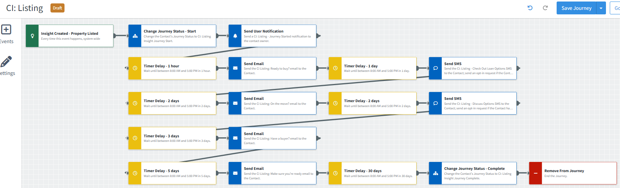
CI: Listing
Journey Map Notes:
Keep emails that work for your organization, swap with custom, pull from the email gallery, or add these emails to your existing campaigns.
Adjust onramps with organization specific groups and Focused View outcomes.
Adjust occurrence limits to reduce the number of times a contact can onboard this journey. Leverage email received conditions or journey event fired configurations to add contacts to a different path or journey.

Slide 4
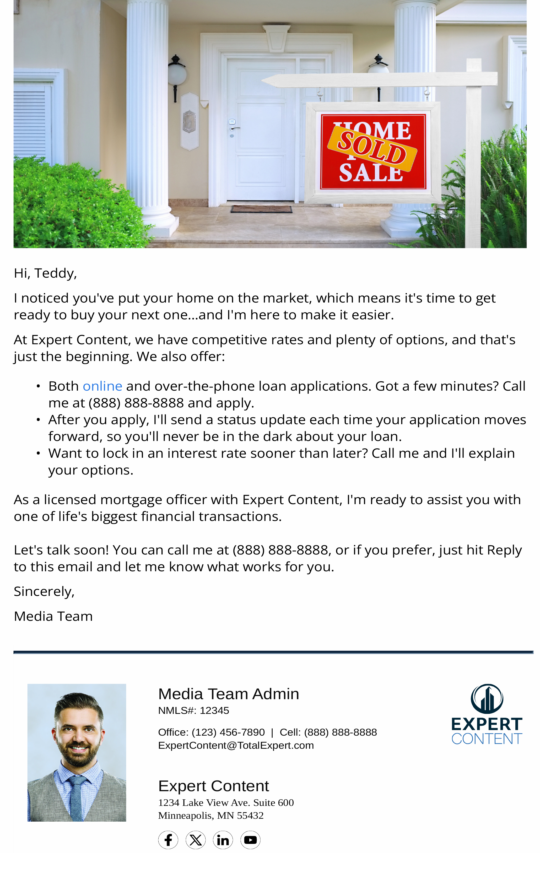
CI: Listing
Email Subject Line: Selling’s Easier When You’re Ready to Buy.
Hi, {{recipient.f_name}},
I noticed you've put your home on the market, which means it's time to get ready to buy your next one…and I'm here to make it easier.
At {{sender.company}}, we have competitive rates and plenty of options, and that's just the beginning. We also offer:
Both online and over-the-phone loan applications. Got a few minutes? Call me at {{sender.phone_cell}} and apply.
After you apply, I'll send a status update each time your application moves forward, so you'll never be in the dark about your loan.
Want to lock in an interest rate sooner than later? Call me and I'll explain your options.
As a licensed mortgage officer with {{sender.company}}, I'm ready to assist you with one of life's biggest financial transactions.
Let's talk soon! You can call me at {{sender.phone_cell}}, or if you prefer, just hit Reply to this email and let me know what works for you.
Sincerely,
{{sender.f_name}}
Notes:
This page should be used for JOURNEY EMAILS (duplicate as needed)

Slide 5

CI: Listing
Email Subject Line: On the move? I’m ready to help.
Hello {{recipient.f_name}},
Selling your home is a big deal, as it means you'll soon be ready to buy your next one. Whether you've found your next home or not, it's easier when you have {{sender.f_name}} on your side.
Make your next move easier with my help.
We're ready to help you apply for your next home's financing right now. This means you'll be ready to make an offer the day you find that special home…ahead of other buyers.
Call {{sender.phone_cell}} to apply. Not ready to take that step? We're always happy to answer your questions about home financing.
Sincerely,
{{sender.f_name}}
Notes:
This page should be used for JOURNEY EMAILS (duplicate as needed)

Slide 6

CI: Listing
Email Subject Line: Has your home sold yet?
Hello {{recipient.f_name}},
I recently noticed that you've put your home on the market. If you've found a buyer, congrats! If you haven't, I may be able to help.
I can turn window shoppers into serious buyers.
You may have met potential buyers who admitted that they didn't have a mortgage lined up yet. If this happens, I can help you determine if they're serious. Just give them my number and tell them to ask me for a loan pre-qualification.
A loan pre-qual is fast, free, and separates the serious buyers from those who won't qualify for a mortgage. And if you haven't started shopping for your next home, I can provide you with a mortgage pre-qualification, too.
Feel free to contact me for answers to any questions about home financing. I'm here to help.
Sincerely,
{{sender.f_name}}
Notes:
This page should be used for JOURNEY EMAILS (duplicate as needed)

Slide 7

CI: Listing
Email Subject Line: Why moving’s easier with my help.
Hello {{recipient.f_name}},
I recently noticed that you put your home up for sale. Whether you've found your next home or not, it's easier when you have your financing in place.
No matter where you're headed, let's make sure you're ready.
Did you know that I can pre-qualify you for a mortgage in just a day or two, free of charge? This means you'll be ready to make a serious offer when you find that special home. If you'll be competing with other buyers, this can make a big difference.
Or, if you've already found a mortgage, call me and let me locate a better deal. Even a slightly lower interest rate can save you thousands. So can a slightly shorter loan term.
Call {{sender.phone_cell}} to apply. Not ready to take that step? I'll be happy to answer your questions about home financing.
Sincerely,
{{sender.f_name}}
Notes:
This page should be used for JOURNEY EMAILS (duplicate as needed)

Slide 8
CI: Listing
SMS: CI: Listing - Check Out Loan Options
Hi {{recipient.f_name}}, this is {{sender.f_name}} with {{sender.company}}. I noticed you've just put your home on the market, which means it's a great time to check out your loan options for your next home. Call me any time at {{sender.phone_cell}}.
User Notification: CI: Listing - Journey Started
The contact below has triggered a listing alert and will receive a series of emails on how you can help during the sale and/or purchase of a new home. Visit their contact record to review more in depth and determine strategy to reach out.
Contact name: {{contact.f_name}} {{contact.l_name}}
Contact phone: {{contact.phone}}
SMS: CI: Listing - Discuss Options
Hi {{recipient.f_name}}, this is {{sender.f_name}} with {{sender.company}}. I noticed you recently put your home on the market. Let's discuss your loan options for your next home. I think you'll like them! Call {{sender.phone_cell}} to find out more.
Notes:
This page should be used for Tasks, User Notifications, and SMS templates (duplicate as needed)

