Slide 1
Expert Content
Strategy Guide
Cross Sell: Deposit to HELOC
November 2025

Slide 2
Cross Sell: Deposit to HELOC
Communication types: Email and SMS
The Deposit to HELOC Journey identifies existing deposit customers who may benefit from accessing their home’s equity through a Home Equity Line of Credit (HELOC). Coordinated email and SMS touchpoints introduce the advantages of HELOC financing, build awareness of responsible usage, and motivate eligible customers to explore their options.
The journey uses inline conditions to confirm account eligibility, product activity, and timing before activation. Contacts on active onboarding journeys are automatically delayed to ensure seamless engagement across campaigns. Each message emphasizes the flexibility and value of HELOC funds—from home improvements to debt consolidation—reinforcing the organization’s commitment to personalized financial solutions and long-term customer relationships.
*All communications should be reviewed prior to initiating the journey.

Slide 3
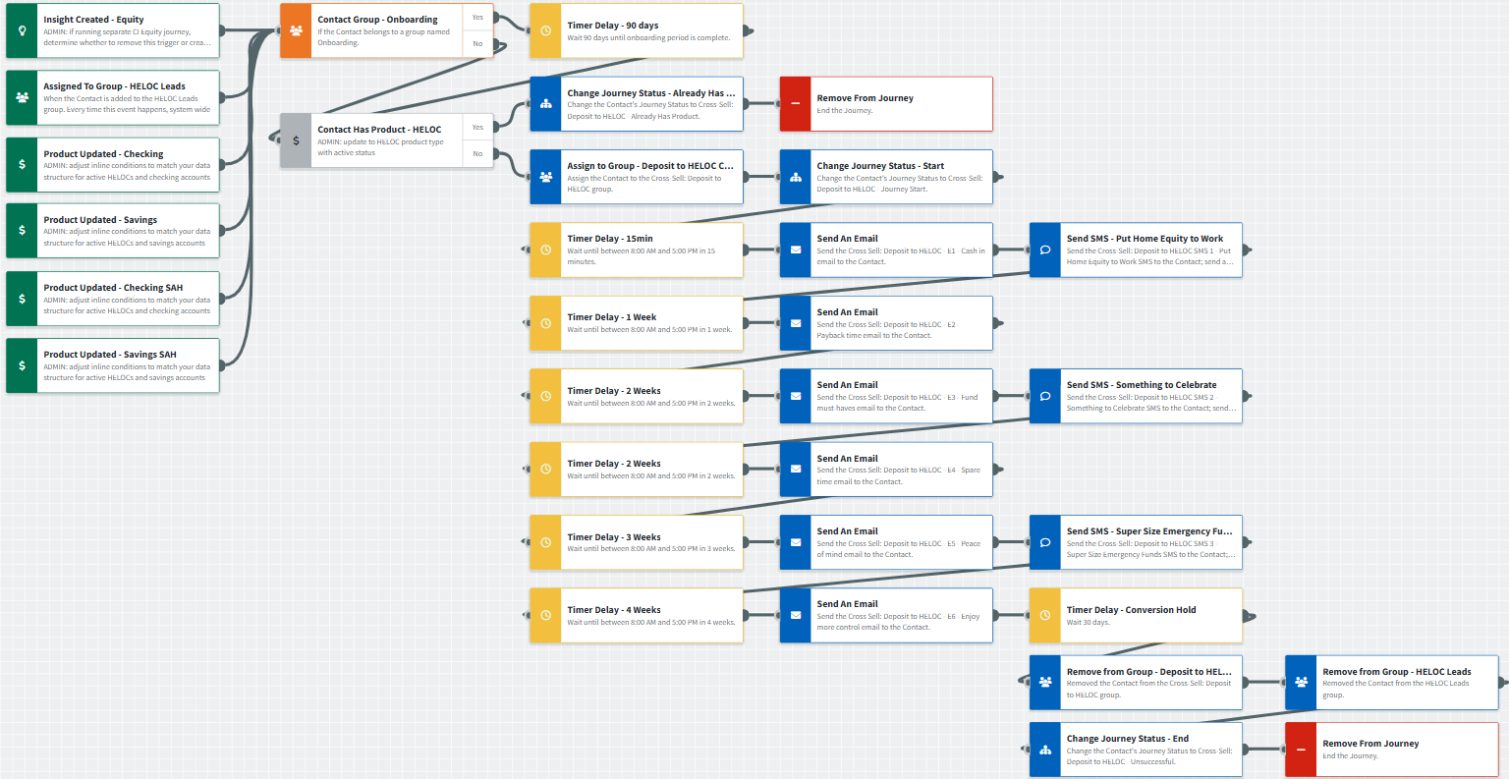
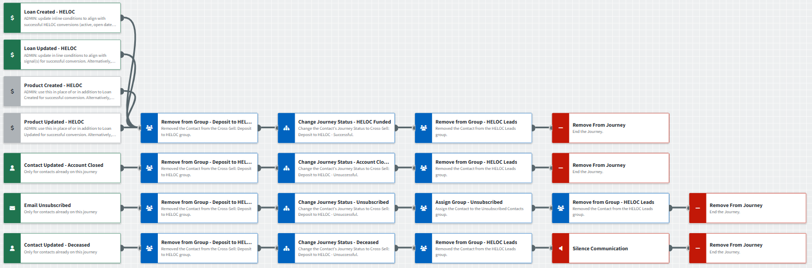
Cross Sell: Deposit to HELOC
Journey Notes:
Inline conditions (e.g., account types, active status, open dates, contact status, and more) must be validated before activation.
Most Recent Loan or Contact has Product inline conditions are used to prevent triggering contacts with a mortgage through your organization.
Contacts automatically exit the journey when a loan or product created/updated signals a successful conversion, or if the account is closed, the contact unsubscribes, or is marked deceased.
Notes:
This page should be used for JOURNEY WIREFRAMES (duplicate as needed)

Slide 4
Cross Sell: Deposit to HELOC
Journey Notes:
Contacts currently on a product onboarding journey are delayed in this cross-sell for 90 days.
Consider using Equity insights to identify customers who may benefit from a HELOC.
Retain or customize the included communications to match your organization’s tone or integrate them into existing campaigns.
Notes:
This page should be used for JOURNEY WIREFRAMES (duplicate as needed)

Slide 5

Cross Sell: Deposit to HELOC
Email Subject Line: How you can cash in on your home's rising value
Hello {{recipient.f_name}},
Thank you for choosing {{sender.company}} for your banking needs. We want to share some good news with you regarding your home's current value.
Homeowners like yourself have recently seen their equity — the amount they've repaid on their mortgage, plus any increase in their home's value — rise rapidly, along with home prices.
Here's the really good news.
You may have considerably more equity in your home than you realize. You can tap into it by setting up a Home Equity Line of Credit (or HELOC) with {{sender.company}}.
A HELOC includes these benefits:
Access larger amounts of funds at a relatively lower rate than unsecured credit.
Finance home renovations, college tuition or other big-ticket items.
Save by using your HELOC funds to pay off high-interest debt.
Keep your HELOC funds available as an emergency fund.
Want to learn more about the amount of equity currently available to you? Call {{sender.phone_office}} or respond to this email to arrange a meeting at a time that's convenient for you.
Notes:
This page should be used for EMAILS (duplicate as needed)

Slide 6

Cross Sell: Deposit to HELOC
Email Subject Line: Tell your home it's payback time.
Hello {{recipient.f_name}},
We're writing with more details about our Home Equity Line of Credit (HELOC) product, so you can decide if it's right for you.
Did you know that you can use HELOC funds for anything? While home repairs are a popular use for HELOC funds, they can also pay for college tuition, or that new car or truck you've been eyeing. You can also keep your HELOC funds as an emergency fund.
Since you may qualify to access up to 85% of your home's equity as a HELOC, you'll have funds to finance anything from home improvements to college tuition. For example, you can add a guest bathroom, bedroom or garage to your home. These are win-wins as they increase your home's comfort levels and its overall value.
Ready to tell your home it's payback time? Call {{sender.phone_office}} to discuss your options, or to apply for your HELOC over the phone.
Notes:
This page should be used for EMAILS (duplicate as needed)

Slide 7

Cross Sell: Deposit to HELOC
Email Subject Line: Fund those must-haves (and dreams) with a HELOC
Hello {{recipient.f_name}},
If you think that a Home Equity Line of Credit (HELOC) can only be used for home renovations, since it's funded with your home's equity...think again.
A HELOC can fund anything you need, want, or have dreamed about for years. Ask yourself: what would make you happier? What would increase your comfort (or fun) levels to new highs? What would improve your family's quality of living?
Here are some popular HELOC purchases:
Adding a back yard office, tiny house, man cave or she-shed.
Turning a basement into a sports bar, gamer's paradise or yoga studio.
Making your dream car (or truck) a reality.
Preparing to beat Bobby Flay with a chef-worthy kitchen.
And since you already have an account with us, managing your HELOC will be fast and simple.
Still have HELOC questions? Ready to apply? We're ready when you are. Call {{sender.phone_office}} or hit Reply to this email.
Notes:
This page should be used for EMAILS (duplicate as needed)

Slide 8

Cross Sell: Deposit to HELOC
Email Subject Line: Free up spare time for you and your family
Hello {{recipient.f_name}},
Perhaps you're interested in a Home Equity Line of Credit (HELOC) but haven't had time to check it out. If this is the case, take a break and call {{sender.phone_office}}. We'll discuss how a HELOC can help free up spare time for you and your family.
For example:
If early mornings sometimes turn into bathroom battles, add another bathroom.
Tired of waiting for the bus or train? Hate carpooling? Use a HELOC to finance an additional vehicle.
If breakfast times are crowded because of lack of counter space, renovate your kitchen with time-saving appliances or add a breakfast nook.
Remodel your home office so you'll be undisturbed by other family members. More peace and quiet = more efficiency.
Here at {{sender.company}}, we want to help you create a comfortable, relaxing home. Reply to this email or call {{sender.phone_office}} to discuss what we can do for you.
Notes:
This page should be used for EMAILS (duplicate as needed)

Slide 9

Cross Sell: Deposit to HELOC
Email Subject Line: Your home's equity can provide real peace of mind.
Hello {{recipient.f_name}},
Although many people use their Home Equity Line of Credit (HELOC) for major purchases, there are other options that can provide lasting peace of mind for you and your family.
If you're not planning a major purchase, but want to be prepared for the unexpected, a HELOC can be your 24/7 source of emergency funds.
For years, you've worked hard to invest in home ownership. A HELOC makes it simple for you to take full advantage of its rewards.
Call {{sender.phone_office}} to learn more or click below to apply.
Notes:
This page should be used for EMAILS (duplicate as needed)

Slide 10

Cross Sell: Deposit to HELOC
Email Subject Line: Enjoy more control of your assets with a HELOC
Hello {{recipient.f_name}},
At {{sender.company}}, we specialize in helping our customers get more out of home ownership. As your Home Equity Line of Credit (HELOC) specialist, we want to check in to see if you have questions about equity-based lending.
Everyone at {{sender.company}} appreciates your loyalty. Providing you with financial options that give you more control of your assets is important to us. A HELOC can help make this happen.
Call {{sender.phone_office}} to discuss your financial future.
Notes:
This page should be used for EMAILS (duplicate as needed)

Slide 11
Cross Sell: Deposit to HELOC
Cross-Sell: Deposit to HELOC SMS 1
A Home Equity Line of Credit from {{sender.company}} can put you in the driver’s seat, whether you’re eyeing a motorcycle or bass boat. Let’s talk about what’s on your wish list today!
Cross-Sell: Deposit to HELOC SMS 2
Hi {{contact_f_name}} this is {{sender.company}}. We have some exciting news about the equity available in your home and how to make it work for you! Let us know when you have time to discuss the details.
Cross-Sell: Deposit to HELOC SMS 3
Hi {{contact_f_name}}, did you know you could use the equity in your home to reach more of your financial goals? Give {{sender.company}} a call today so we can talk about details.
Cross-Sell: Deposit to HELOC SMS 4
A Home Equity Line of Credit (HELOC) from {{sender.company}} can help you stay in control of your budget, even when the unexpected happens. Super-size your source of 24/7 backup funds! Call us at {{sender.phone_office}} to learn more.
Notes:
This page should be used for TASKS, USER NOTIFICATIONS, AND SMS TEMPLATES (duplicate as needed)

