Slide 1
Expert Content
Strategy Guide
Event Templates
May 2026

Slide 2
Event Templates
Communication types: Email
Expert Content's event email templates are designed to showcase a variety of events in a visually engaging format, helping financial professionals build community presence, demonstrate thought leadership, and create networking opportunities with prospects, clients, and referral partners. Multiple variations are available in the Email Template Gallery for promoting events such as educational workshops, seminars, community celebrations, networking opportunities, and professional development activities.
Each email template includes imagery placeholders, date/time information, descriptions, and call-to-action buttons. The templates are designed to showcase one or more events, conferences with multiple sessions, or event series, but each template can be modified or used as a base to promote your specific events. Easily update the content for your organization's individual needs including swapping header and email signature blocks, adjusting colors, and adding or removing elements.
Admins can create event emails on behalf of their users and deploy with campaign tools or, allow users to edit and send their own events.

Slide 3
Email Templates
Overview of all available email event template styles and options

Slide 4
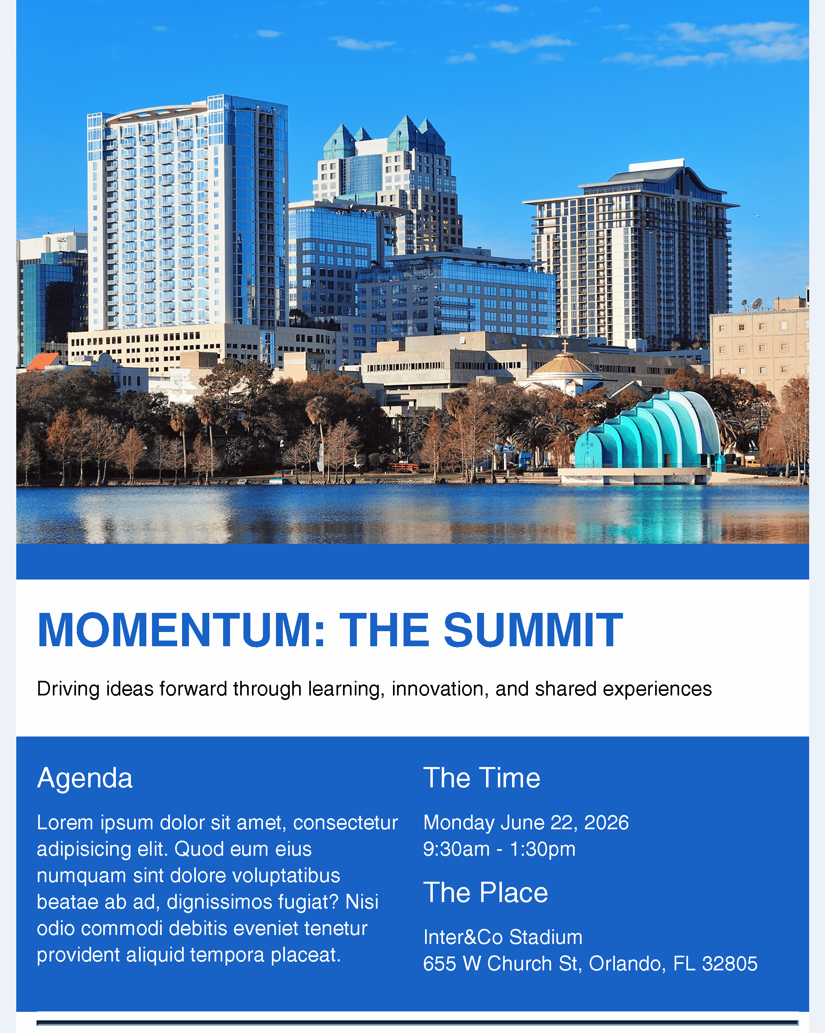

Event Emails
Event Template - Single Event with Agenda
Event Template - Single Event Promotional
Notes:
This page should be used for EMAILS (duplicate as needed)

Slide 5
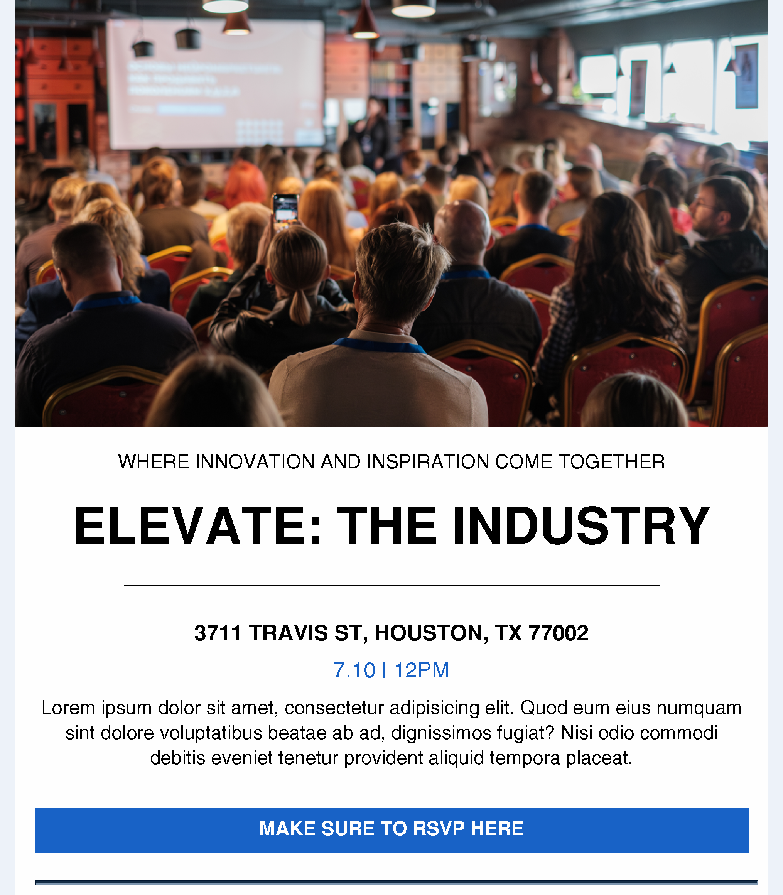
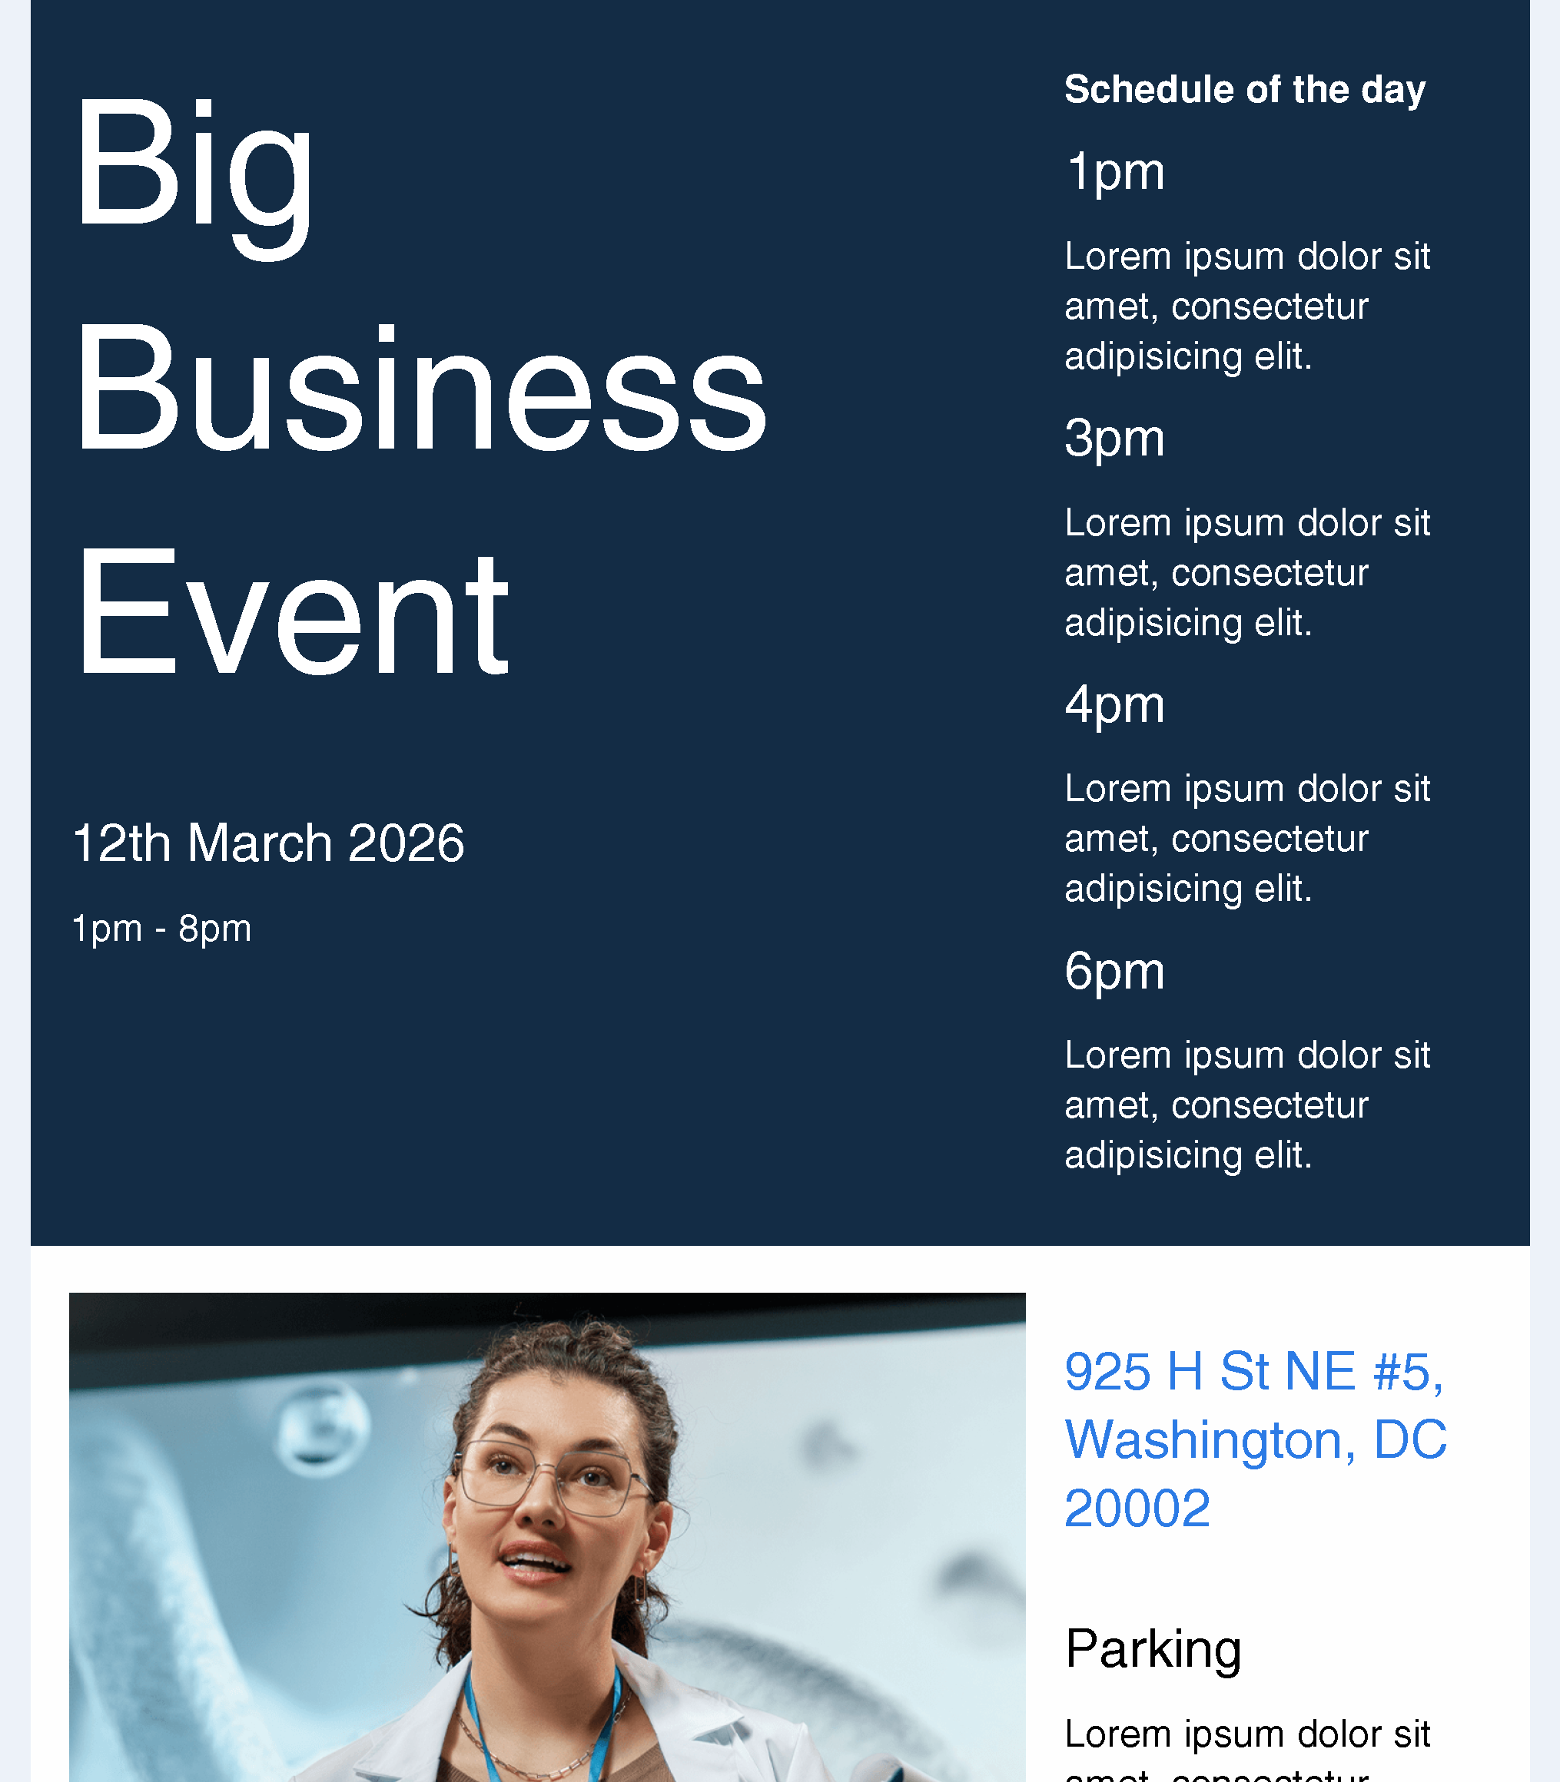
Event Emails
Event Template - Single Event Hero
Event Template - Event Schedule
Notes:
This page should be used for EMAILS (duplicate as needed)

Slide 6
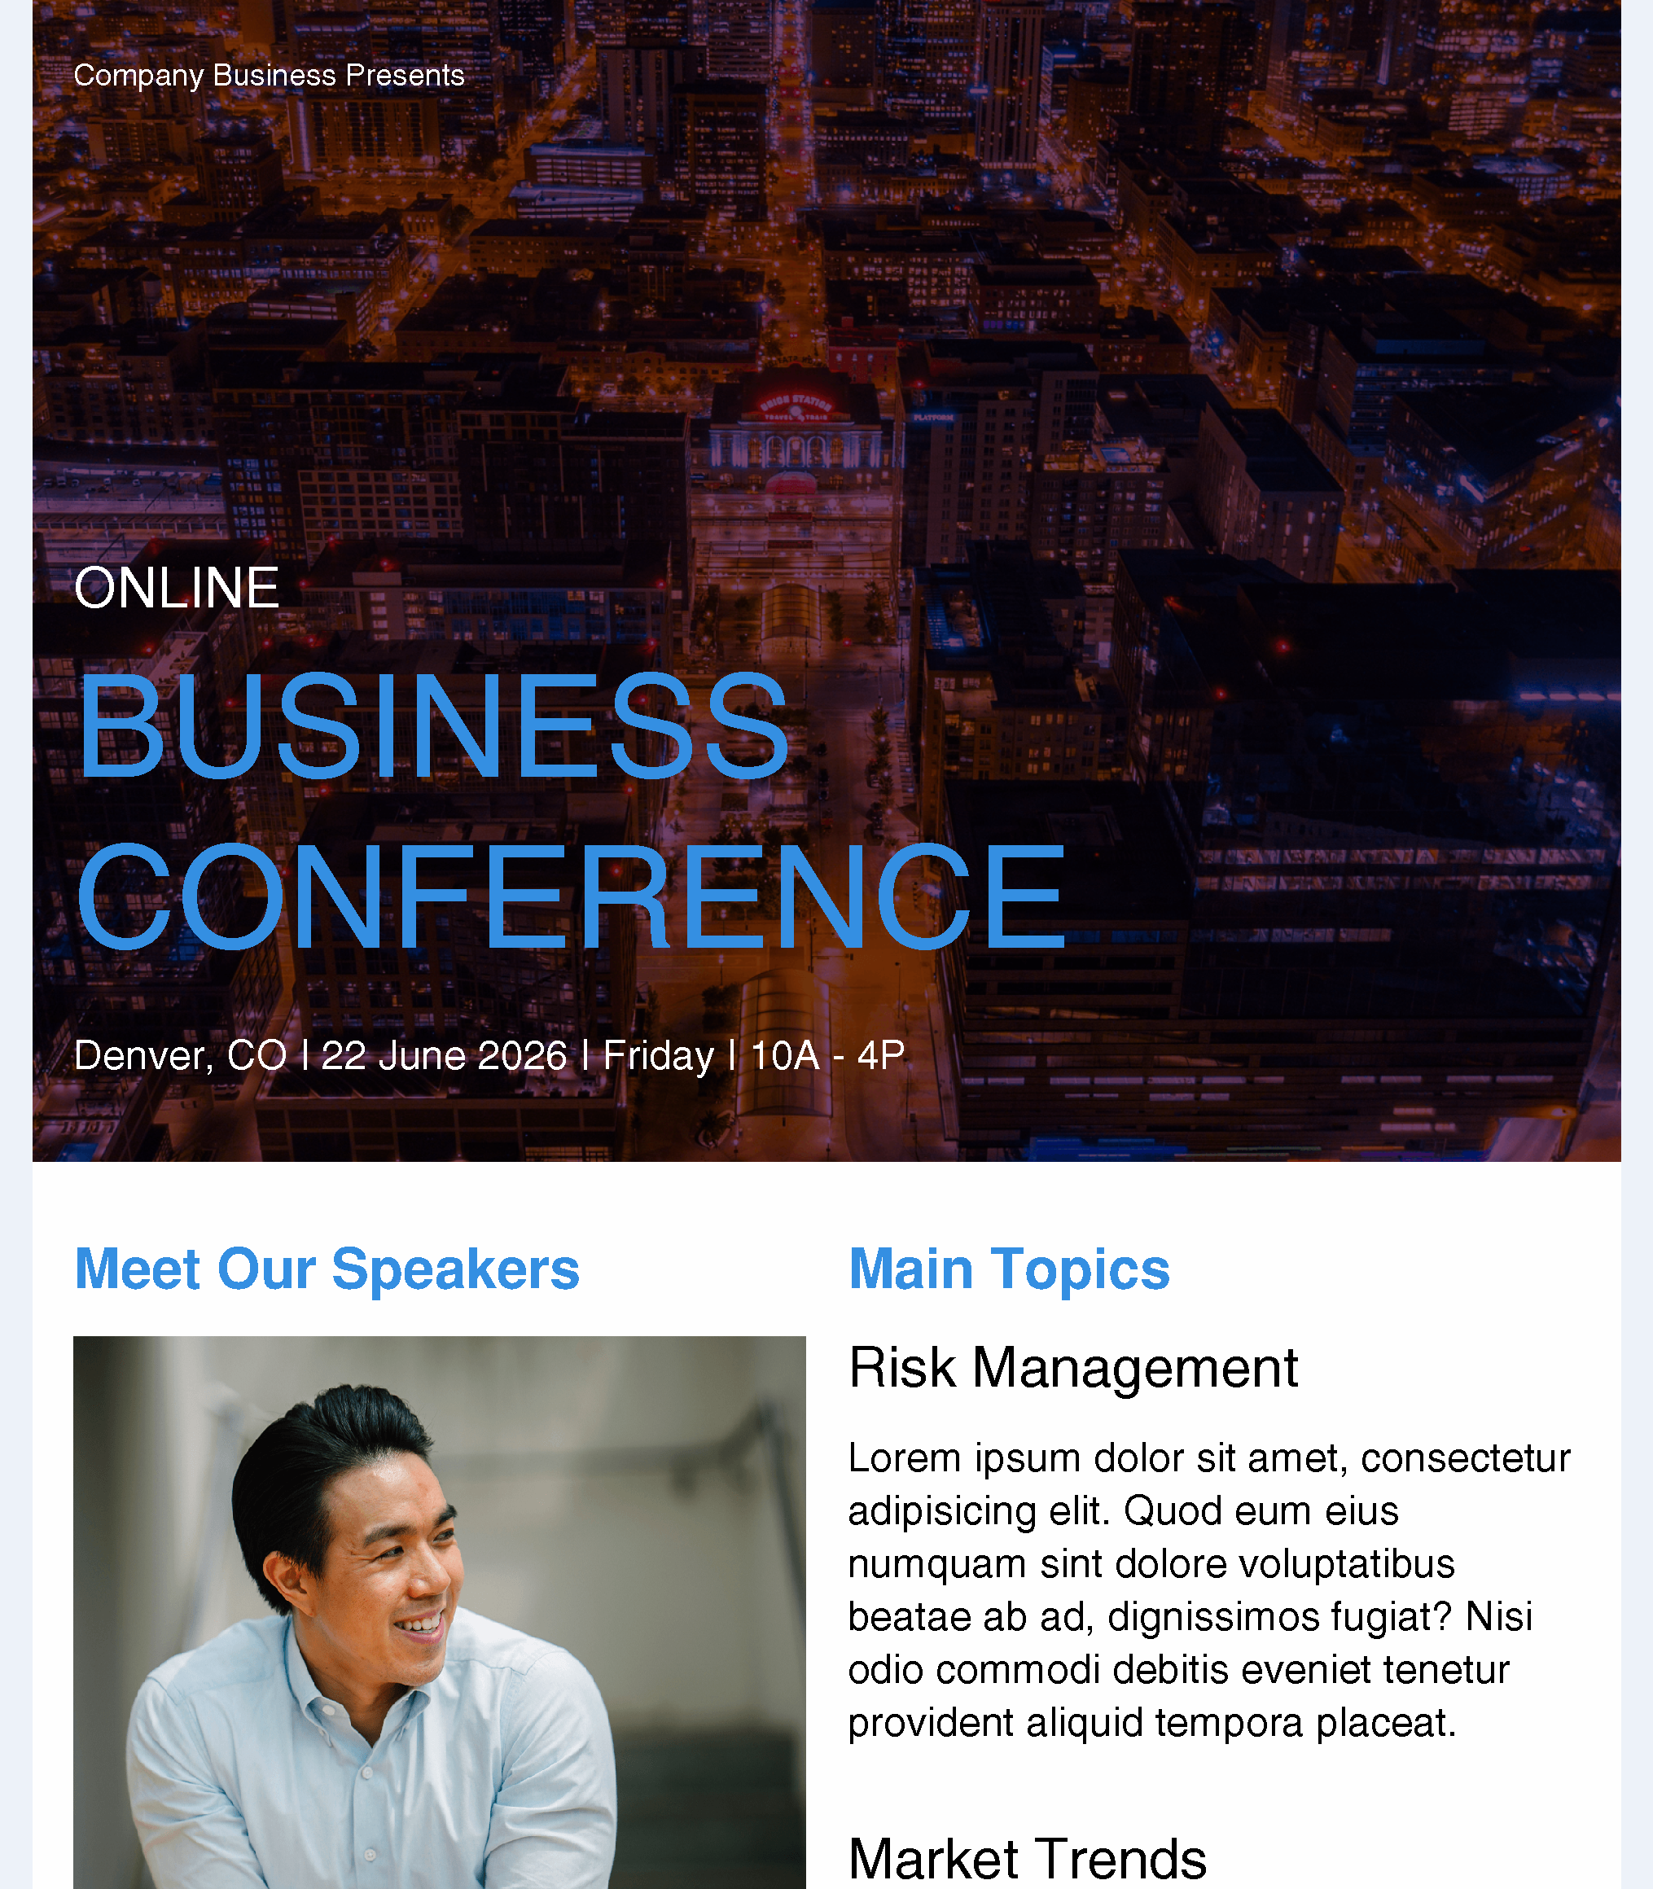
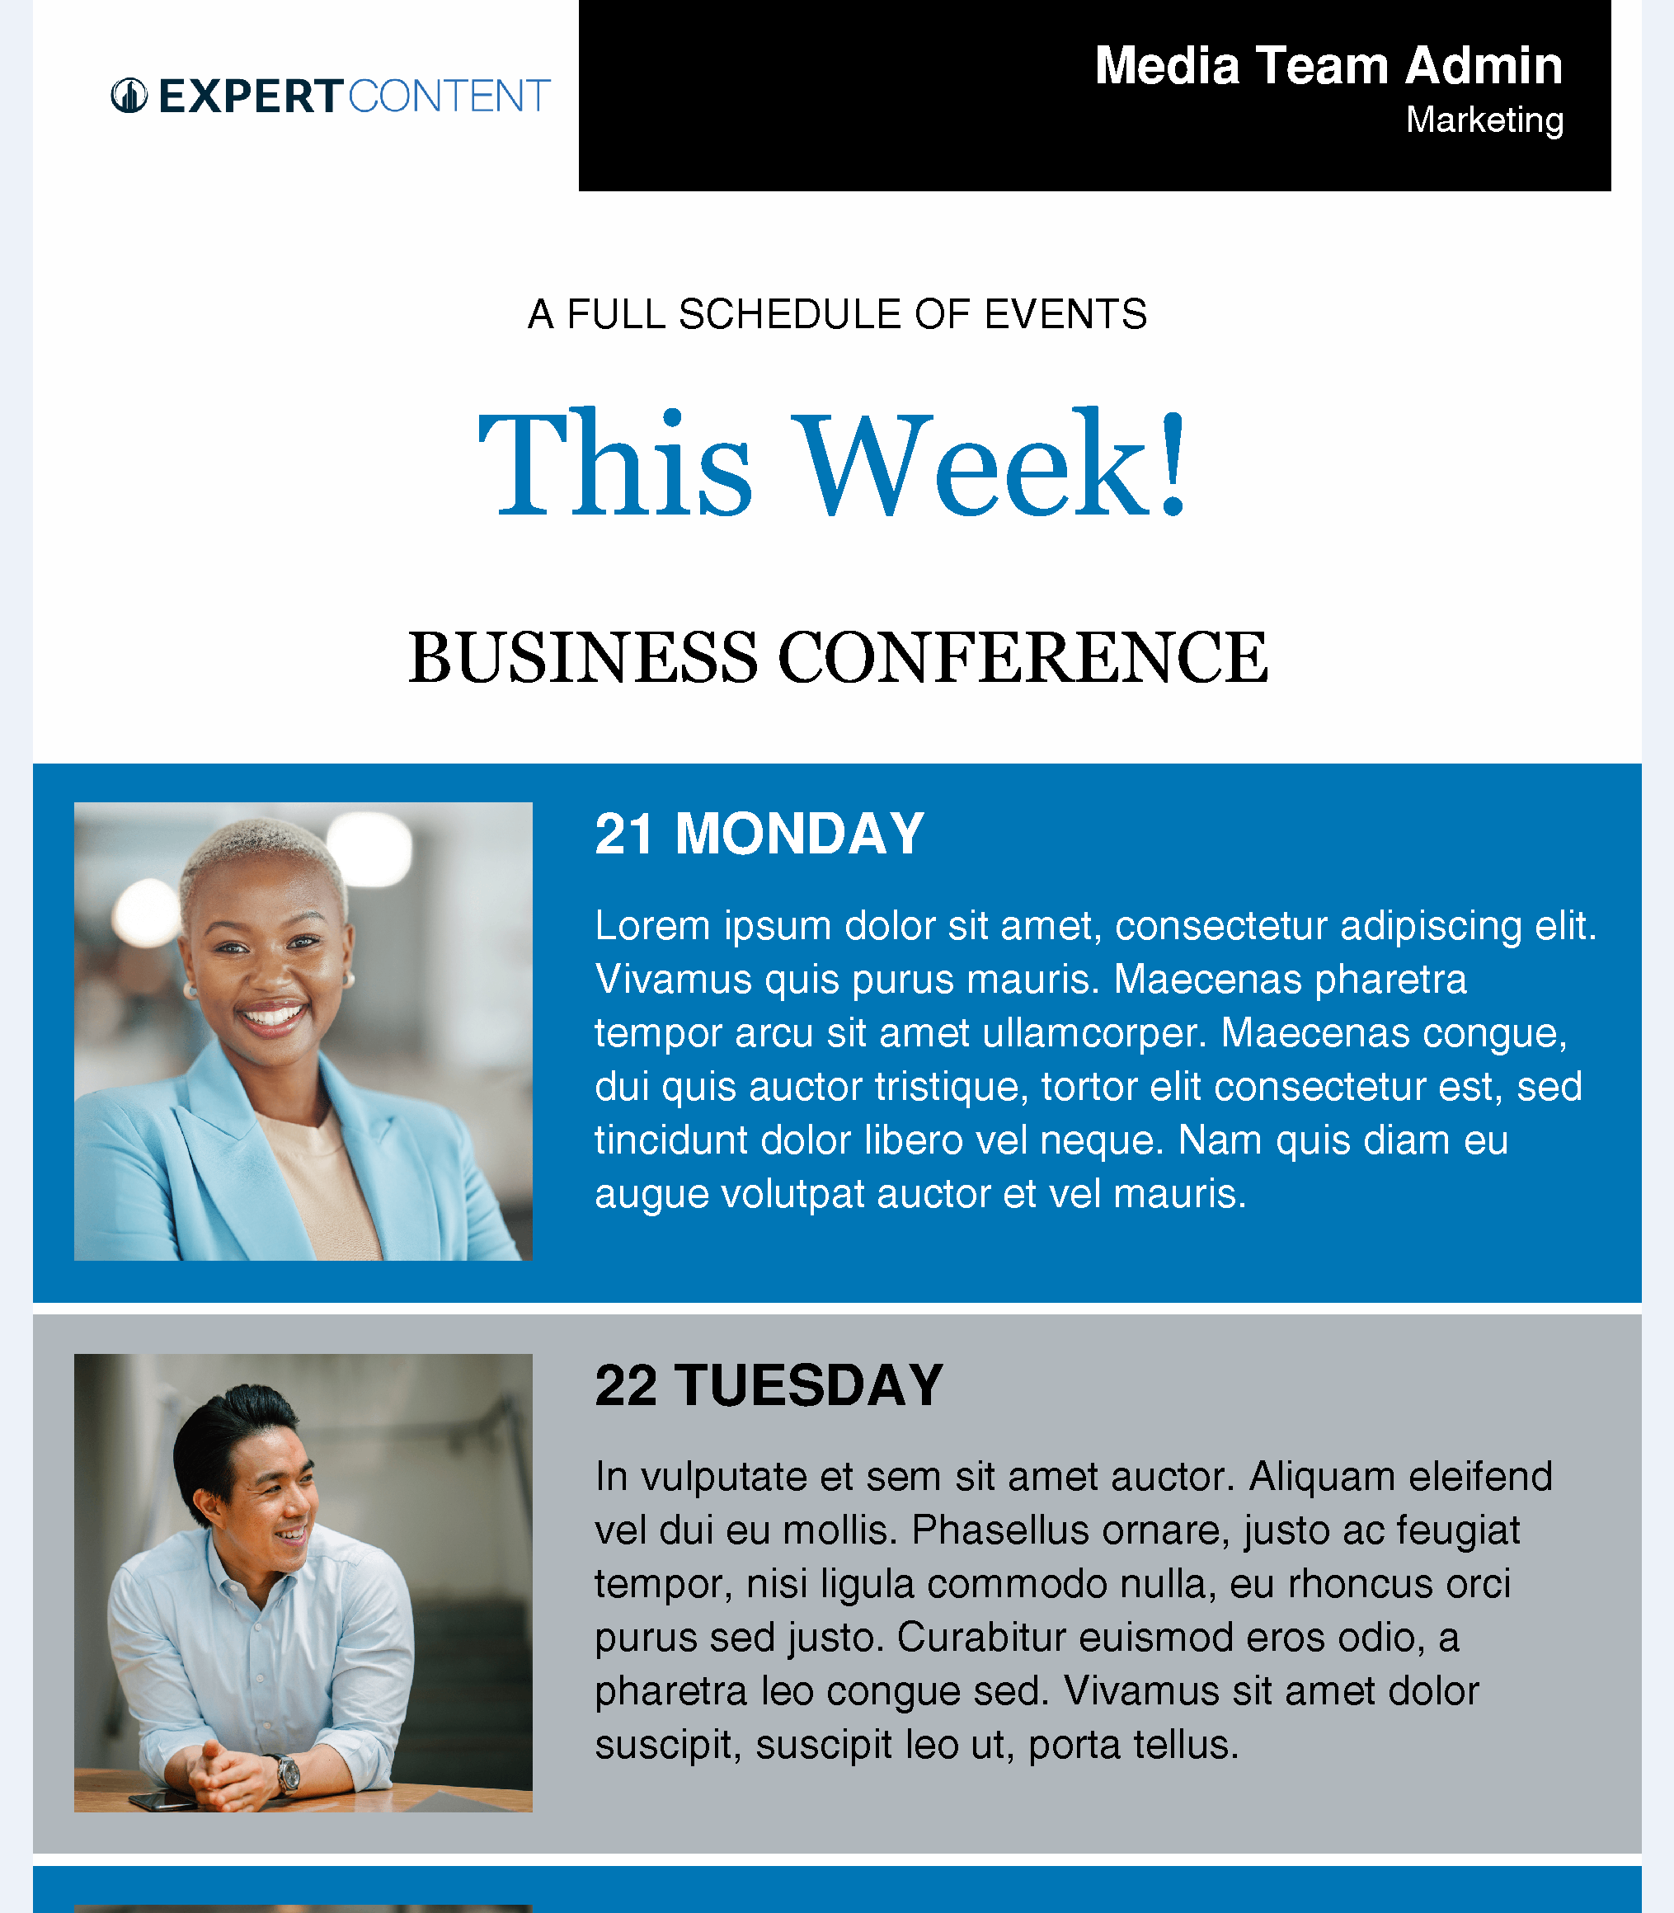
Event Emails
Event Template - Multi-Topic Event
Event Template – Multi-Day or Multiple Events
Notes:
This page should be used for EMAILS (duplicate as needed)

Slide 7


Event Emails
Event Template - Major Event Announcement
Event Template - Multi-Speaker
or Multi-Topic Event
Notes:
This page should be used for EMAILS (duplicate as needed)

Slide 8
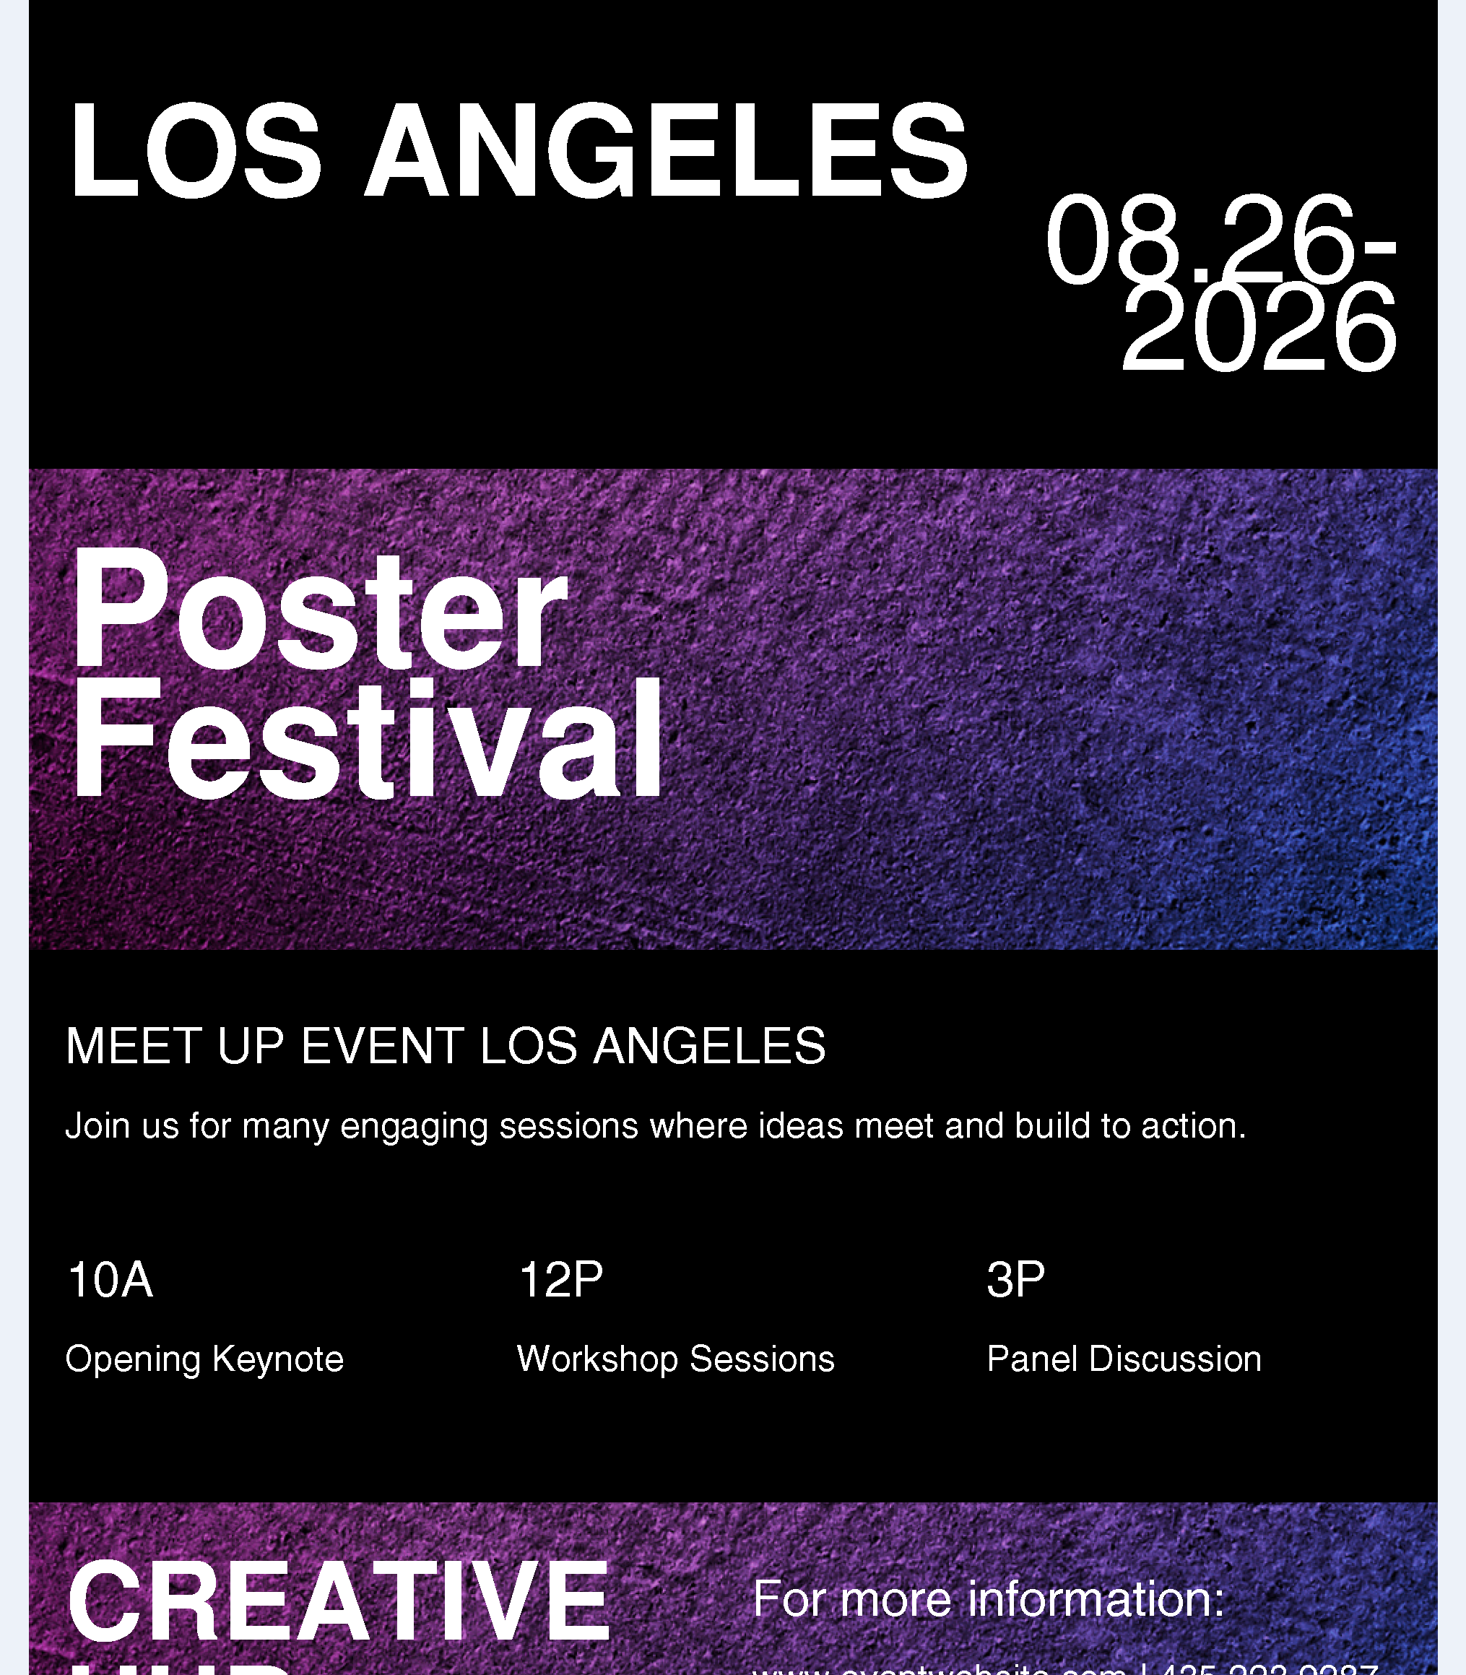
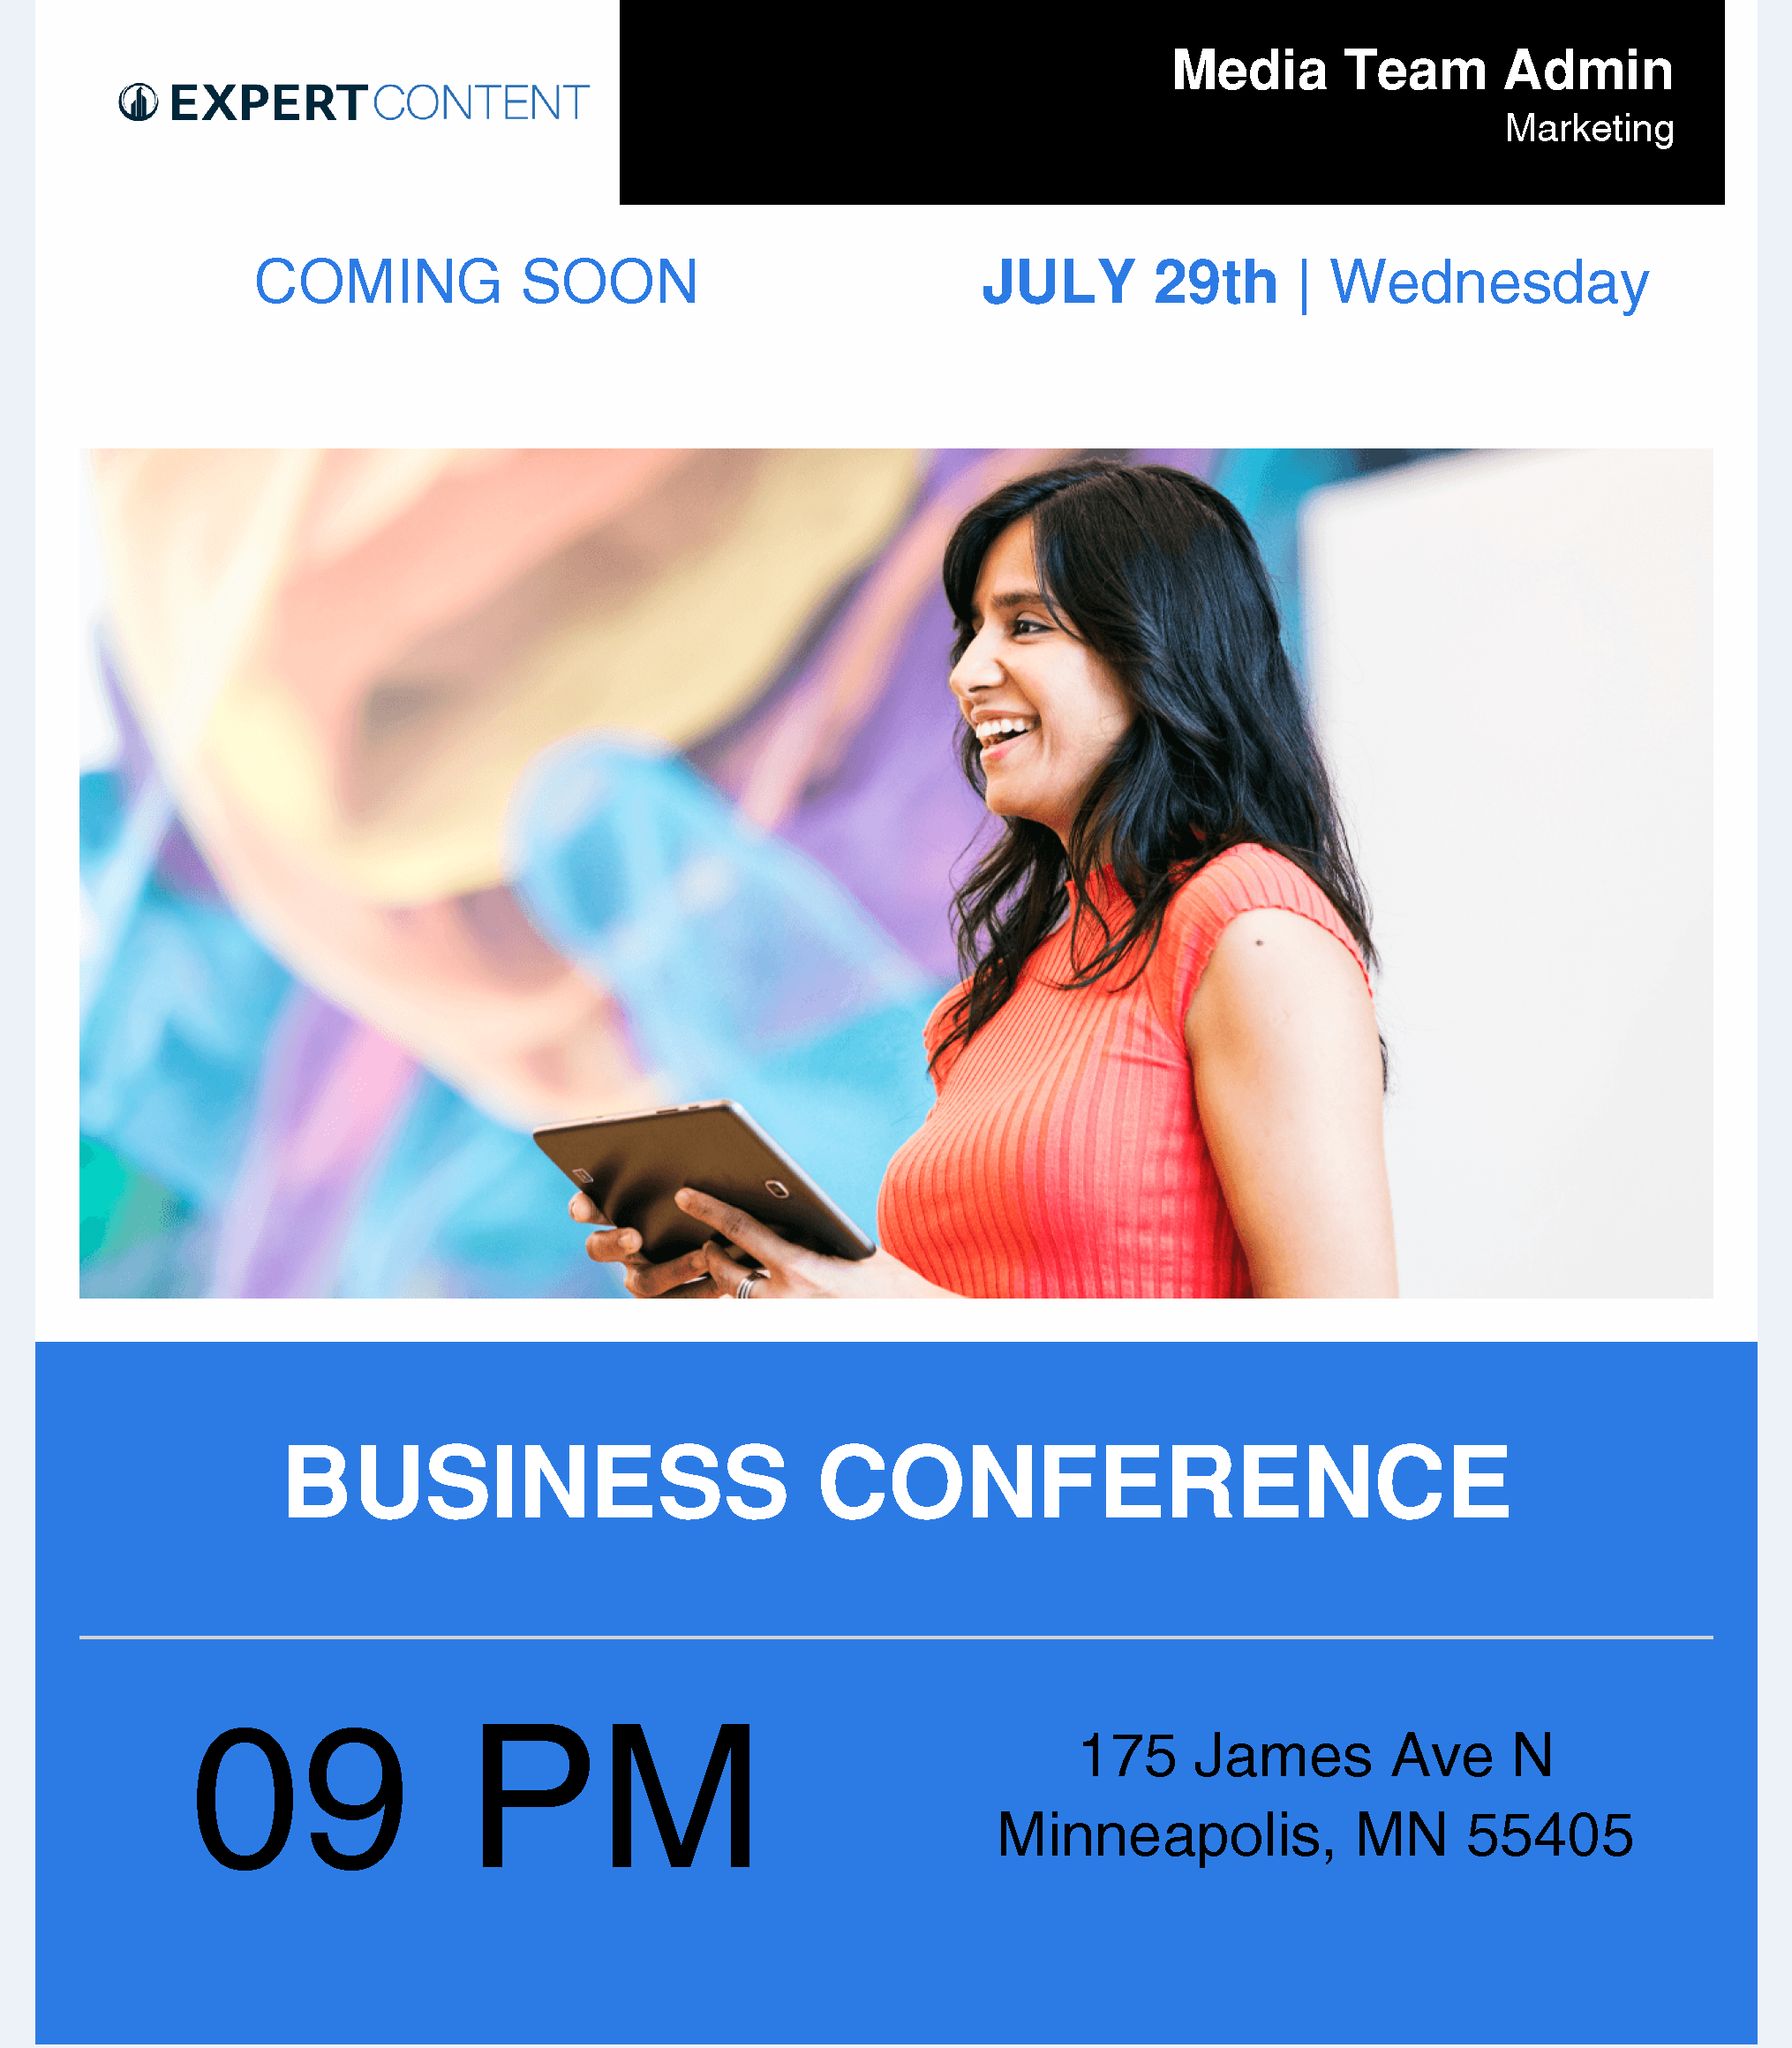
Event Emails
Event Template - Modern Event Announcement
Event Template - Coming Soon Event Teaser
Notes:
This page should be used for EMAILS (duplicate as needed)

Slide 9
Email Examples
Use cases, template features, customization options, and suggested event types for specific templates.

Slide 10
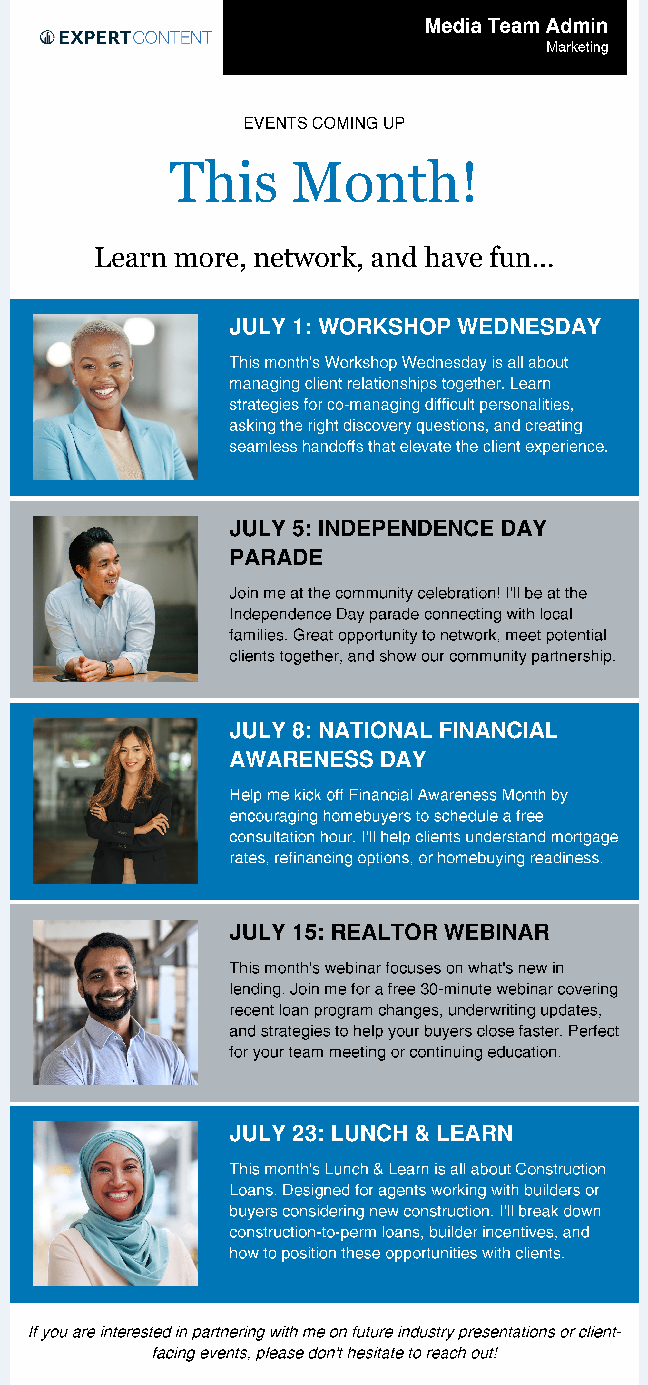
Event Email Examples
Event Template – Multi-Day or Multiple Events
Use Case: Promote multiple events happening within a short timeframe (week or month) where you want to showcase a variety of opportunities in a scannable, organized format. Ideal for active professionals hosting regular events or organizations with packed calendars.
Template Features & Customization:
Header Section: Customizable "This Month!" or "This Week!" headline with tagline and timeframe context
Repeating Event Blocks: Stackable event rows, each featuring:
  Professional headshot or event-related imagery
  Date/day identifier with customizable accent color bar
  Event title/name
  Event description with key details and benefits
Alternating Background Colors: Visual separation between events (can be customized to match branding)
Consistent Layout: Uniform structure makes it easy to scan multiple events quickly
Footer Messaging: Optional closing text for additional context or call-to-action
Flexible Event Count: Add or remove event blocks based on your calendar (typically 3-6 events work best)
When to Use:
Monthly or weekly event roundups for active networkers or educators
Showcasing a diverse event calendar (workshops, webinars, community events, networking)
Targeting audiences who appreciate having multiple attendance options
Building awareness of ongoing educational or community engagement programs
Establishing yourself as an active, involved professional with regular touchpoints
Real estate agents, loan officers, or financial advisors hosting multiple client education sessions
Notes:
This page should be used for EMAILS (duplicate as needed)

Slide 11

Event Email Examples
Event Template - Single Event Promotional
Use Case: Promote standalone networking events, workshops, conferences, summits, or professional development opportunities where you want to highlight one main event with detailed information.
Template Features & Customization:
Event Title: Prominent header with customizable color accent to match your event theme or branding (e.g., green for networking events, neutral tones for professional conferences)
Hero Image: Large featured image placeholder - replace with event-specific imagery that sets the tone (casual networking, formal conference, etc.)
Event Description: Detailed section for event overview and key messaging
Two-Column Details Layout: Date/time and location in left column; RSVP incentives, registration details, or attendance perks in right column
CTA Button: Clear call-to-action for registration or RSVP - adjust button text and color to match your branding
When to Use:
Single-day events requiring detailed promotional information
Events where location and timing details are critical
Situations where you want to emphasize special registration incentives or early bird perks
Networking events, lunch-and-learns, workshops, or professional conferences
Notes:
This page should be used for EMAILS (duplicate as needed)

Slide 12

Event Email Examples
Event Template - Multi-Speaker or Multi-Topic Event
Use Case: Promote educational workshops, seminars, or multi-session events that feature multiple speakers or hosts and require a detailed agenda or schedule breakdown.
Template Features & Customization:
Event Title & Date: Large, bold header with customizable colors and date callout in the upper right corner
Event Overview: Brief description section in the header area to set context and expectations
Location Section ("THE PLACE"): Address, venue name, and detailed event description with speaker/host headshot and credentials
Schedule Section ("THE TIME"): Day-by-day or hour-by-hour agenda breakdown with session topics and timing
Multiple Speaker/Host Areas: Two featured professional headshots with names and titles/roles
Color Blocking: Alternating background colors to separate sections and create visual interest
Flexible Layout: Sections can be customized with different color schemes to match branding or event themes
When to Use:
Multi-day conferences or seminars with detailed schedules
Educational workshops featuring multiple presenters or co-hosts
Events requiring clear agenda communication (time blocks, session topics)
Professional development programs with structured curriculums
First-time homebuyer classes, mortgage education seminars, or financial literacy workshops
Notes:
This page should be used for EMAILS (duplicate as needed)

Slide 13

Event Email Examples
Event Template - Single Event Promotional
Use Case: Promote high-impact, single events where visual storytelling and atmosphere are key to driving attendance. Ideal for conferences, major workshops, or signature events that benefit from dramatic imagery.
Template Features & Customization:
Full-Width Hero Image: Large, impactful header image that sets the tone and showcases event atmosphere, venue, or audience engagement
Event Tagline: Customizable subtitle or value proposition below the hero image
Event Title: Bold, prominent headline with customizable typography and color
Location & Date/Time: Clearly displayed venue address and event timing with accent color options
Event Description: Substantial text area for detailed event information, benefits, speakers, topics covered, or what attendees will gain
Additional Details: Space for logistics like refreshments, parking, what to bring, or registration incentives
CTA Button: Full-width call-to-action button with customizable text and color
Clean, Centered Layout: Streamlined design puts focus on content without competing visual elements
When to Use:
Flagship events or signature programs that need strong visual appeal
Educational workshops requiring detailed description of content and benefits
Industry conferences or networking events with compelling venue/atmosphere imagery
Events targeting specific audiences (first-time homebuyers, real estate professionals, investors)
Situations where the event image tells an important story about scale, professionalism, or community
Notes:
This page should be used for EMAILS (duplicate as needed)

