Slide 1
Expert Content
Strategy Guide
HELOC Onboarding
November 2025

Slide 2
HELOC Onboarding
Communication types: Email and SMS
The HELOC Onboarding Journey welcomes new customers and guides them through every step of setting up and activating their home equity line of credit (HELOC). Over a 60-day period following funding, coordinated email and SMS touchpoints help borrowers understand account features, activate their debit cards, and begin using their HELOC funds confidently.
Early communications focus on debit card delivery and activation, followed by education on online banking tools, eStatements, and responsible HELOC utilization. Each message builds trust and engagement while reinforcing the organization’s commitment to service, security, and convenience.
*All communications should be reviewed prior to initiating the journey.

Slide 3
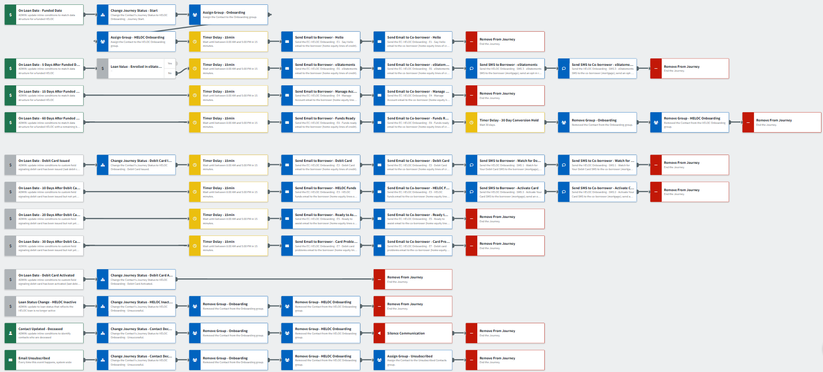
HELOC Onboarding
General Info Communications
Debit Card Communications
Offramps
Journey Notes:
There are three sections in this journey: General Info (account setup, eStatements, etc.), Debit Card Issuance and Activation, and Offramps/Conversion Tracking.
Two groups are applied at the start of the journey to ensure coordination across the journey library:
“Onboarding” – delays cross-sell campaigns triggered by new account creation.
“HELOC Onboarding” - enables offramps to target specific contacts for accurate conversion reporting.
Notes:
This page should be used for JOURNEY WIREFRAMES (duplicate as needed)

Slide 4
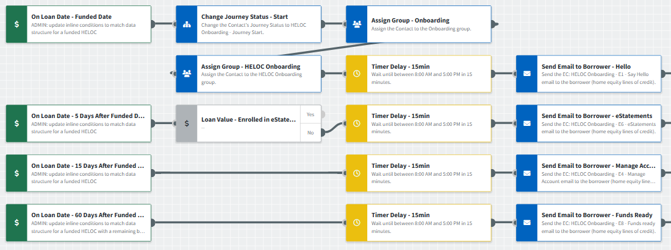
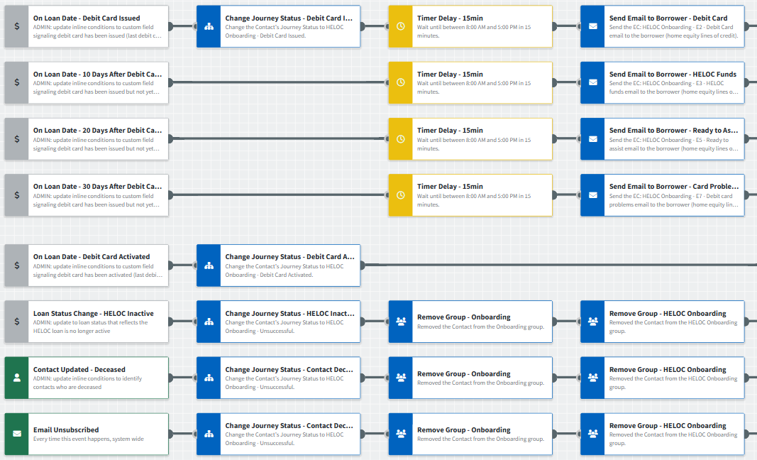
HELOC Onboarding
Journey Notes:
Retain or customize the provided emails to match your organization’s tone, or integrate them into existing onboarding campaigns.
For organizations issuing HELOC debit cards, the middle section of the journey supports card delivery and activation; all other communications apply universally.
Validate inline conditions before activation, including Debit Card Issued and Activated dates, active loan statuses, and valid loan/funded date ranges.
Contacts automatically exit the journey if the HELOC becomes inactive, the contact is marked deceased, or the borrower unsubscribes.
Notes:
This page should be used for JOURNEY WIREFRAMES (duplicate as needed)

Slide 5
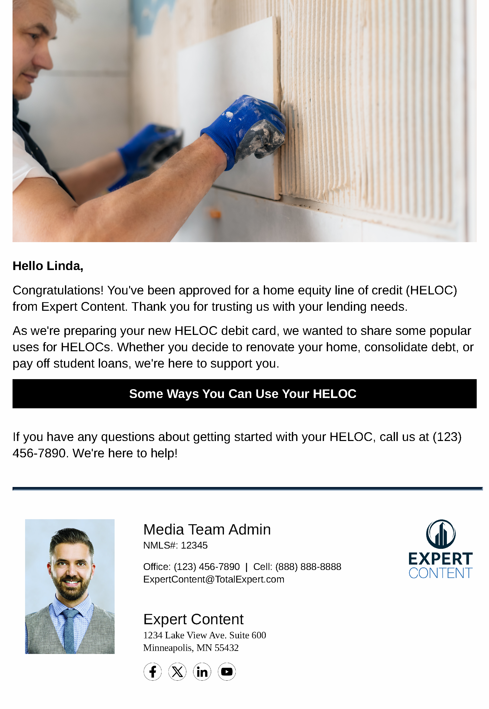
HELOC Onboarding
Email Subject Line: Say Hello to Your {{sender.company}} HELOC
Hello {{recipient.f_name}},
Congratulations! You've been approved for a home equity line of credit (HELOC) from {{sender.company}}. Thank you for trusting us with your lending needs.
As we're preparing your new HELOC debit card, we wanted to share some popular uses for HELOCs. Whether you decide to renovate your home, consolidate debt, or pay off student loans, we're here to support you.
Some Ways You Can Use Your HELOC
If you have any questions about getting started with your HELOC, call us at {{sender.phone_office}}. We're here to help!
Notes:
This page should be used for EMAILS (duplicate as needed)

Slide 6

HELOC Onboarding
Email Subject Line: Your {{sender.company}} HELOC Debit Card Is on the Way
Hi {{recipient.f_name}},
Congratulations on opening your {{sender.company}} HELOC account.
We wanted to remind you to watch your mail for your new HELOC debit card as it should arrive soon. While you're waiting, you can learn how to activate and use your card through the link below.
How to Activate Your New HELOC Debit Card
Please feel free to contact us if you have questions. You can also contact us online, visit your local {{sender.company}} branch, or speak with one of our HELOC specialists by calling {{sender.phone_office}}.
Notes:
This page should be used for EMAILS (duplicate as needed)

Slide 7
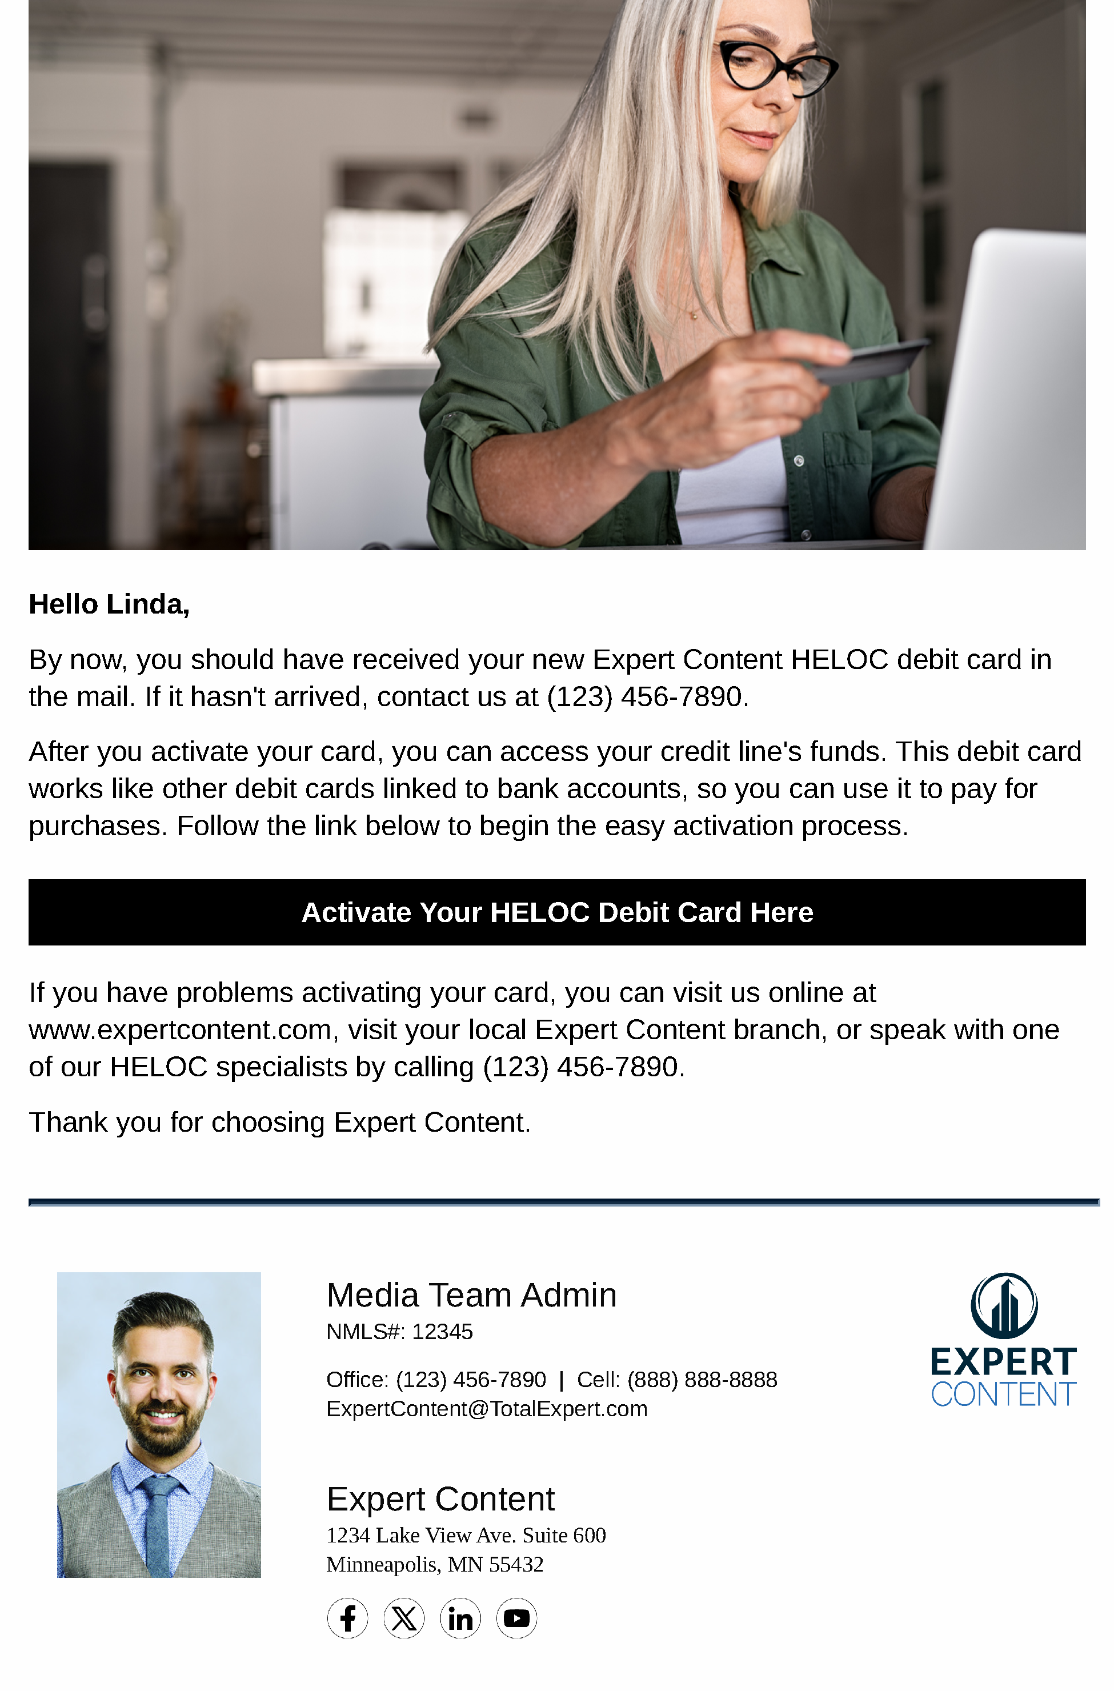
HELOC Onboarding
Email Subject Line: You're just one step away from accessing your HELOC funds
Hello {{recipient.f_name}},
By now, you should have received your new {{sender.company}} HELOC debit card in the mail. If it hasn't arrived, contact us at {{sender.phone_office}}.
After you activate your card, you can access your credit line's funds. This debit card works like other debit cards linked to bank accounts, so you can use it to pay for purchases. Follow the link below to begin the easy activation process.
Activate Your HELOC Debit Card Here
If you have problems activating your card, you can visit us online at {{sender.website}}, visit your local {{sender.company}} branch, or speak with one of our HELOC specialists by calling {{sender.phone_office}}.
Thank you for choosing {{sender.company}}.
Notes:
This page should be used for EMAILS (duplicate as needed)

Slide 8
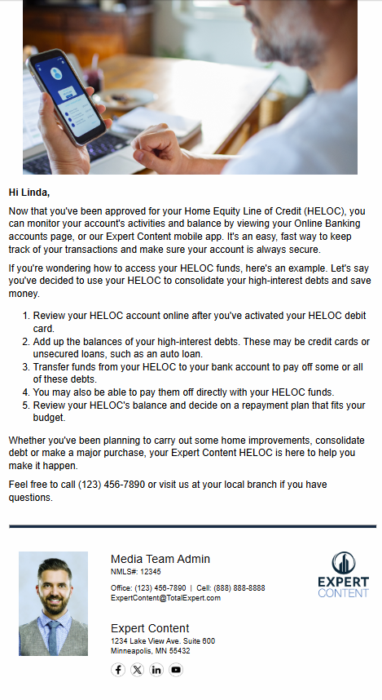
HELOC Onboarding
Email Subject Line: How to Manage Your HELOC Account
Hi {{recipient.f_name}},
Now that you've been approved for your Home Equity Line of Credit (HELOC), you can monitor your account's activities and balance by viewing your Online Banking accounts page, or our {{sender.company}} mobile app. It's an easy, fast way to keep track of your transactions and make sure your account is always secure.
If you're wondering how to access your HELOC funds, here's an example. Let's say you've decided to use your HELOC to consolidate your high-interest debts and save money.
1. Review your HELOC account online after you've activated your HELOC debit card.
2. Add up the balances of your high-interest debts. These may be credit cards or unsecured loans, such as an auto loan.
3. Transfer funds from your HELOC to your bank account to pay off some or all of these debts.
4. You may also be able to pay them off directly with your HELOC funds.
5. Review your HELOC's balance and decide on a repayment plan that fits your budget.
Whether you've been planning to carry out some home improvements, consolidate debt or make a major purchase, your {{sender.company}} HELOC is here to help you make it happen.
Feel free to call {{sender.phone_office}} or visit us at your local branch if you have questions.
Notes:
This page should be used for EMAILS (duplicate as needed)

Slide 9
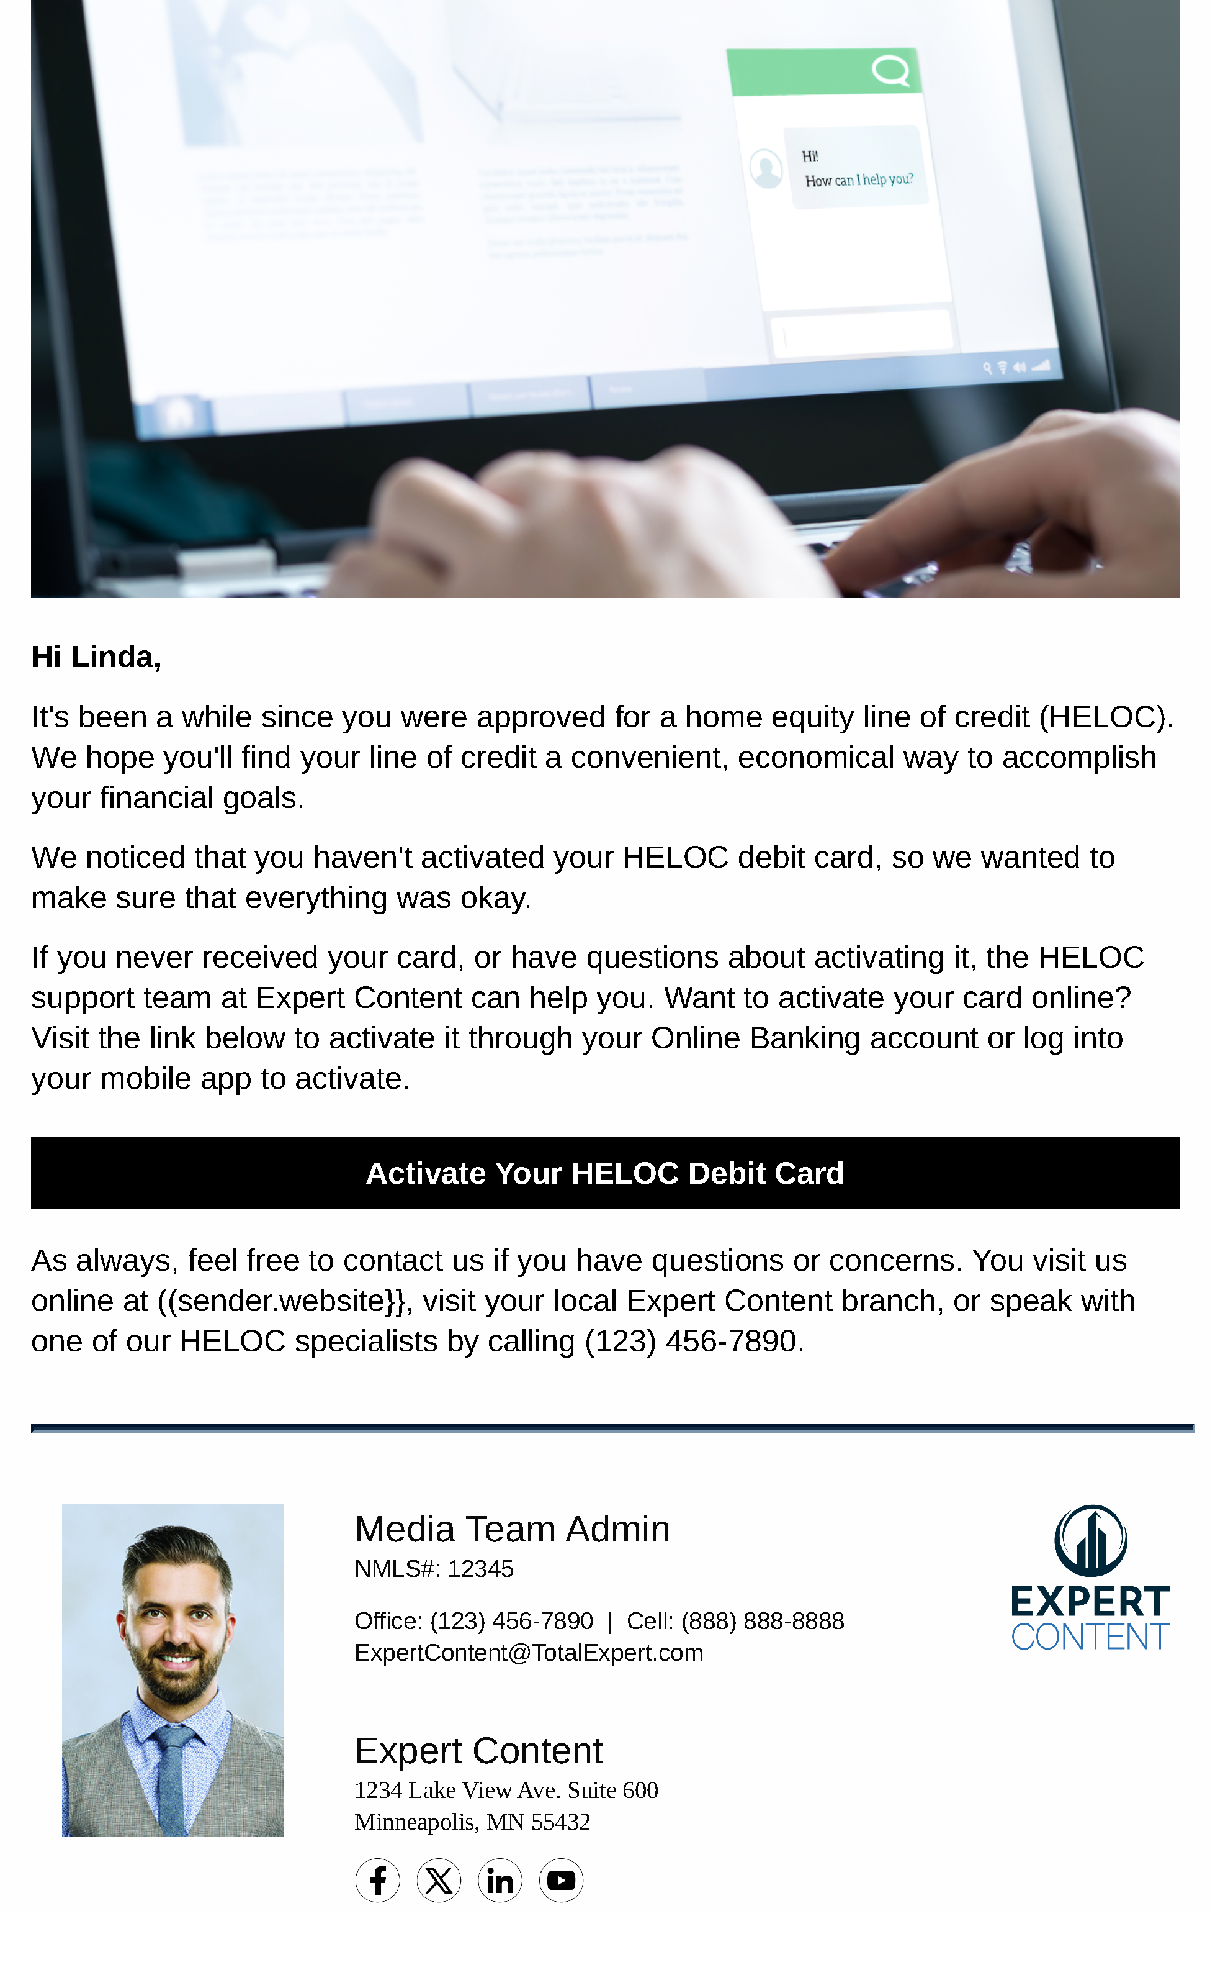
HELOC Onboarding
Email Subject Line: Need Help with Your {{sender.company}} HELOC? We're ready to assist.
Hi {{recipient.f_name}},
It's been a while since you were approved for a home equity line of credit (HELOC). We hope you'll find your line of credit a convenient, economical way to accomplish your financial goals.
We noticed that you haven't activated your HELOC debit card, so we wanted to make sure that everything was okay.
If you never received your card, or have questions about activating it, the HELOC support team at {{sender.company}} can help you. Want to activate your card online? Visit the link below to activate it through your Online Banking account or log into your mobile app to activate.
Activate Your HELOC Debit Card
As always, feel free to contact us if you have questions or concerns. You visit us online at ((sender.website}}, visit your local {{sender.company}} branch, or speak with one of our a Expert Content HELOC specialists by calling (123) 456-7890.
Notes:
This page should be used for EMAILS (duplicate as needed)

Slide 10
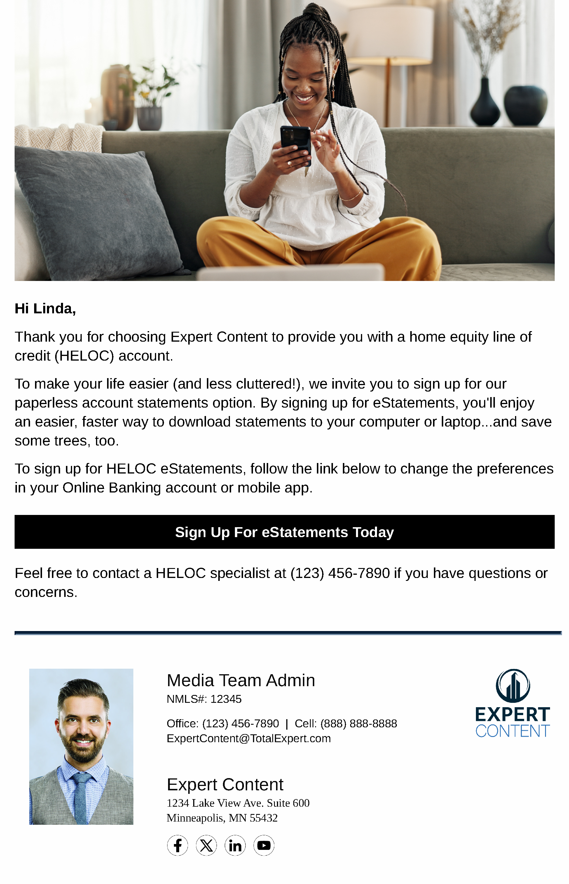
HELOC Onboarding
Email Subject Line: Hate filing? Switch to {{sender.company}} eStatements.
Hi {{recipient.f_name}},
Thank you for choosing {{sender.company}} to provide you with a home equity line of credit (HELOC) account.
To make your life easier (and less cluttered!), we invite you to sign up for our paperless account statements option. By signing up for eStatements, you'll enjoy an easier, faster way to download statements to your computer or laptop...and save some trees, too.
To sign up for HELOC eStatements, follow the link below to change the preferences in your Online Banking account or mobile app.
Sign Up For eStatements Today
Feel free to contact a HELOC specialist at {{sender.phone_office}} if you have questions or concerns.
Notes:
This page should be used for EMAILS (duplicate as needed)

Slide 11
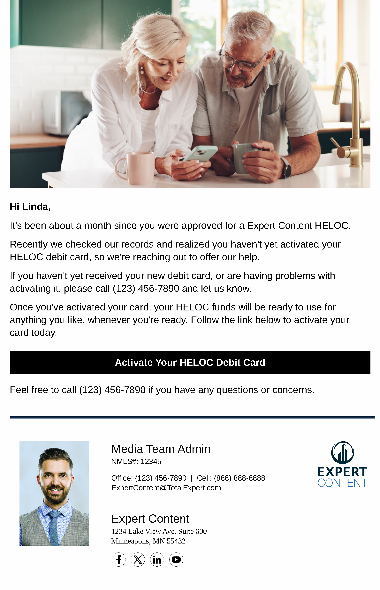
HELOC Onboarding
Email Subject Line: Problems with your HELOC debit card? We're here to help.
Hi {{recipient.f_name}},
It's been about a month since you were approved for a HELOC from {{sender.company}}.
Recently we checked our records and realized you haven't yet activated your HELOC debit card, so we're reaching out to offer our help.
If you haven't yet received your new debit card, or are having problems with activating it, please call {{sender.phone_office}} and let us know.
Once you've activated your card, your HELOC funds will be ready to use for anything you like, whenever you're ready. Follow the link below to activate your card today.
Activate Your HELOC Debit Card
Feel free to call {{sender.phone_office}} if you have any questions or concerns.
Notes:
This page should be used for EMAILS (duplicate as needed)

Slide 12

HELOC Onboarding
Email Subject Line: Your HELOC funds are ready when you are.
Hi {{recipient.f_name}},
Although many people use their {{sender.company}} HELOC to finance home improvement projects, there are many other responsible choices.
Your HELOC line of credit can be used for anything ...it's up to you.
You can use HELOC funds to transform your kitchen, add a guest bath to your home, or consolidate and pay off high-interest debt. You can also use it to buy a new car or truck, finance that vacation you've been postponing, or cover school tuition fees.
To learn more about the many ways you can use your {{sender.company}} HELOC, visit our webpage Learn More About Your HELOC Options.
Learn More About Your HELOC Options
Feel free to contact me at {{sender.phone_office}} if you have any questions.
Notes:
This page should be used for EMAILS (duplicate as needed)

Slide 13
HELOC Onboarding
SMS: HELOC Onboarding - SMS 1 - Watch for Your Debit Card
Remember to watch for your HELOC debit card from {{sender.company}} in the mail. Once your card arrives, we'll be happy to assist you during the activation process.
SMS: HELOC Onboarding - SMS 2 - Activate Your Card
It's time to activate your HELOC debit card! You can now manage your account online and begin using your line of credit to meet your financial goals.
SMS: HELOC Onboarding - SMS 3 - eStatements
Sign up for eStatements from {{sender.company}} for your HELOC debit card today. It’s less clutter, easy to download, and an eco-friendly option!
Notes:
This page should be used for TASKS, USER NOTIFICATIONS, AND SMS TEMPLATES (duplicate as needed)

