Slide 1
Expert Content
Strategy Guide
Customer Intelligence Equity Journey
August 2026

Slide 2
Customer Intelligence Equity
Communication types: Email, SMS, and User Notifications
The Equity journey turns a borrower's growing home equity into a reason to reconnect — helping loan officers stay top-of-mind, deepen relationships, and protect revenue before a borrower looks elsewhere. By surfacing each borrower's estimated equity, it makes the outreach feel personal and timely rather than promotional.
The 25-day campaign reaches borrowers across email and SMS, pairing educational messaging with a clear invitation to talk with their loan officer about their options.
Topics covered:
Emails: Three main products – HELOCs, Home Equity Loans, and Cash-Out Refinances; estimated equity dollars are included in the email content to establish reliability and trust.
SMS: Encourages borrower to check their email for information on current equity amount and the various options available to them.
*All communications should be reviewed prior to initiating the journey.

Slide 3
Customer Intelligence Equity
Campaign Schedule & Execution
Day 1
SMS: You've got equity. Want to take advantage and talk about it?
8:00 AM
Email: Equity value is X, did you know we offer these products to take advantage
9:00 AM
Day 2
Email: Three options:
HELOC. Cashout refi. Home equity loans
9:00 AM
Day 3
SMS: Do you know your options to tap into your home's value?
12:00 PM
Day 6
Email: Do you know what a HELOC is and how it can be used?
8:00 AM
Day 9
Email: Do you know what a home equity loan can do for you?
9:00 AM
Day 10
SMS: Check in to see if borrower reviewed emails, offer another call.
10:00 AM
Day 15
Email: Do you know that cashout refi is also an option?
9:00 AM
Day 25
Email: Final email - are you interested, would you like to schedule time to discuss?
9:00 AM
Total Days
25
Touches
10
Email + SMS
6 + 3
Primary Goal
Leverage Home Equity
Notes:
This page is used for Journey/Campaign schedule overviews

Slide 4
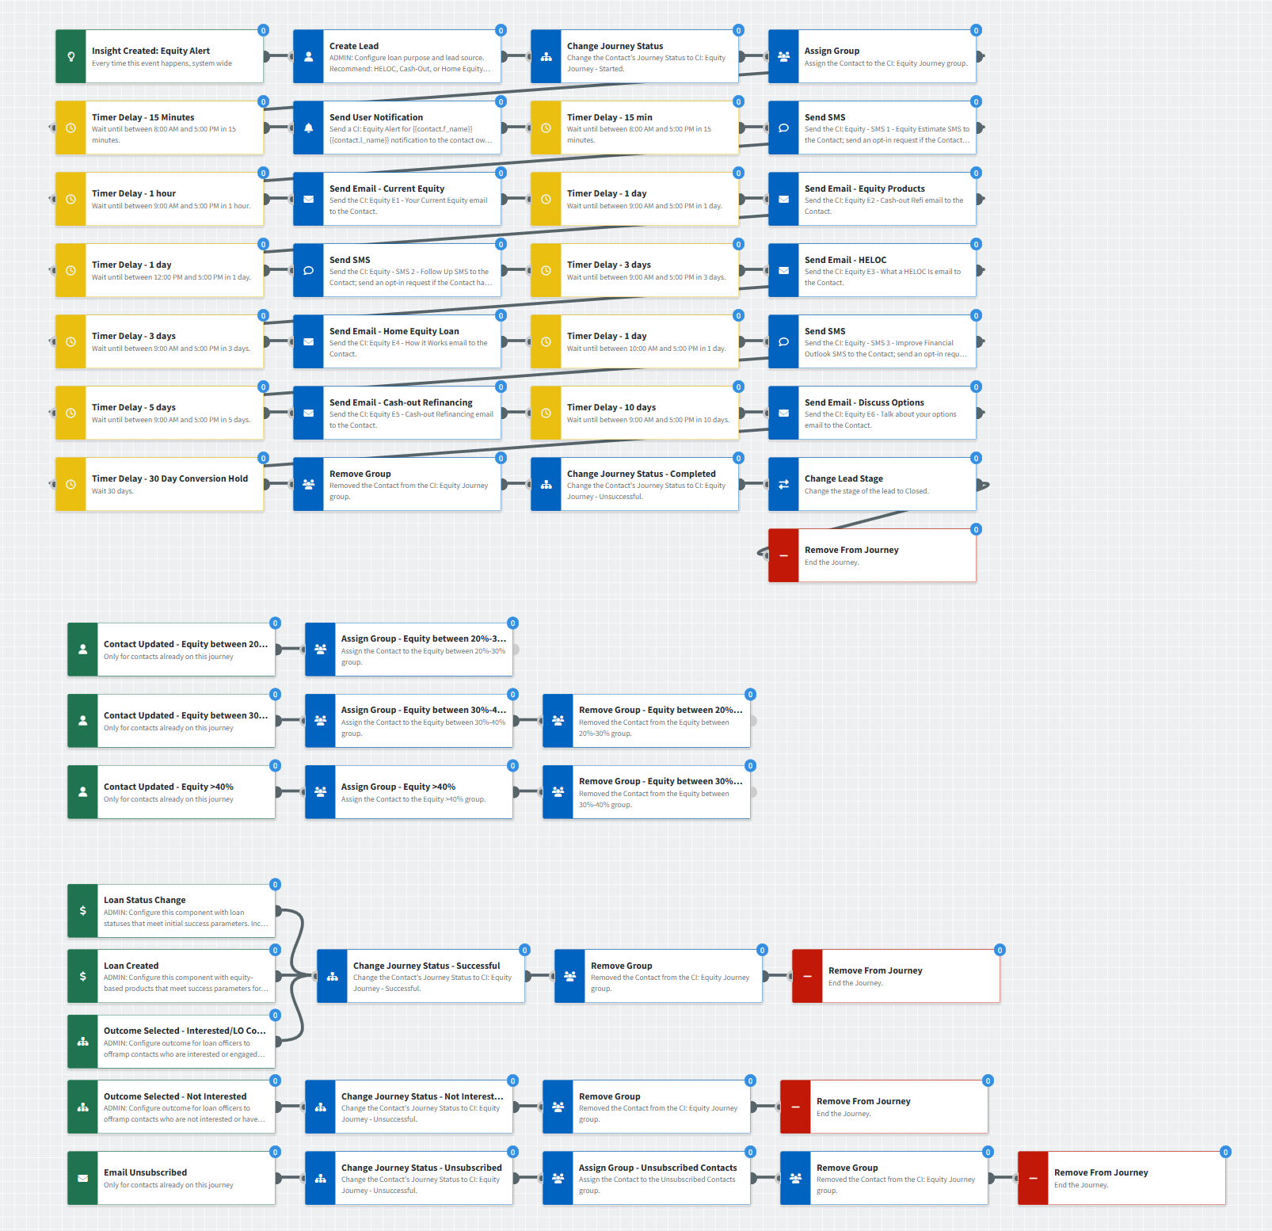
Customer Intelligence Equity
Journey Notes:
Configure onramp triggers: Use Insight Created – Equity Alert with organization-specific inline conditions (servicing status, consent requirements, segment targeting). Consider branches to target high-, medium-, and low-equity holding consumers.
Configure offramp triggers:
  Use Loan Status Change and Loan Created with organization-specific inline conditions (loan purpose, loan status).
  If you have a point-of-sale integration, consider adding an Application Started offramp.
  Train LOs to use Outcomes to remove uninterested contacts.
Customize messaging: Keep emails/SMS that work for your organization, edit to meet your tone, add custom touchpoints to extend the campaign, or layer these into existing campaigns.
  Include HELOC application links from the user’s profile if available.
Timing: Adjust day/time delivery based on your organization’s contact preference (operating hours, day-of-week patterns).
Equity Grouping: Adjust equity percentage groups to fit your organization’s goals for tracking equity.
Notes:
This page should be used for JOURNEY WIREFRAMES (duplicate as needed)

Slide 5

Customer Intelligence Equity
Email Subject Line:
Is it time to have a serious, sit-down talk with your home?
Hello {{recipient.f_name}},
Have you ever thought to yourself: "I've been making mortgage payments for years. This place owes me"?
If you have, it's time to tell your home it's payback time.
Currently your home's equity is about ${{recipient.enriched.equity.estimated_equity_dollars | formatNumber: 0}}.
You can collect by using a percentage of your equity to finance anything, from home renovations to a new car or truck. Equity can also help you consolidate and pay off any high-interest debt.
Call me at {{sender.phone_office}} to learn how I can help you make it happen.
Notes:
This page should be used for EMAILS (duplicate as needed)

Slide 6

Customer Intelligence Equity
Email Subject Line:
What's your favorite equity flavor?
Hi {{recipient.f_name}},
Hope you're doing well!
I recently sent you an update with details of your home's current equity and what it can do for you.
Based on our records, the current estimate of your equity adds up to around ${{recipient.enriched.equity.estimated_equity_dollars | formatNumber: 0}}.
The good news: you can put this equity to work for you in several ways. Simply pick the one that works best for your needs and your budget.
Home equity line of credit (HELOC). This makes funds available 24/7 for up to {{number}} years, so you can withdraw just what you need, when you need it.
Home equity loan. If you know just how much cash you need for a major purchase or project, you may prefer the simplicity of a loan.
Cash-out refinance. In addition to taking cash out, you can customize your new mortgage to a longer or shorter loan term.
No matter what you choose, you'll have plenty of cash to finance big-ticket buys, like home improvements or school tuition. Or you may want to consider debt consolidation.
Call me today at {{sender.phone_office}} to get started, plus answers to your questions.
Notes:
This page should be used for EMAILS (duplicate as needed)

Slide 7

Customer Intelligence Equity
Email Subject Line:
Inside: A better way to finance life's big expenses
Hi {{recipient.f_name}},
Recently I sent you an estimate of your home's equity, which currently adds up to around ${{recipient.enriched.equity.estimated_equity_dollars | formatNumber: 0}}. A certain percentage may be available to you as a line of credit.
If you're not sure how a home equity line of credit (HELOC) works, here are the basics.
After your HELOC is approved, you can withdraw funds for up to {{years}} years. This is called the draw period.
You can finance anything you like with a HELOC during the draw period, at a lower interest rate than unsecured credit. Do some remodeling, cool off in your own backyard pool, or install energy-efficient systems.
HELOC funds can also finance school tuition, consolidate high-interest debts, or help you buy a new vehicle. It's also a smart way to make sure you always have emergency funds available 24/7. No matter what you decide, you're in control!
After your draw period ends, you'll begin to repay the borrowed funds.
If you'd like some detailed estimates, or have questions, call me at {{sender.phone_cell}}. I'm here to help!
Notes:
This page should be used for EMAILS (duplicate as needed)

Slide 8

Customer Intelligence Equity
Email Subject Line:
A simple way to put your home's equity to work
Hi {{recipient.f_name}},
Hope you're doing well! It's been a while since we last connected, and I wanted to share some good news.
Your estimated home equity is currently around ${{recipient.enriched.equity.estimated_equity_dollars | formatNumber: 0}}.
You may qualify to borrow a certain percentage as a home equity loan.
This type of loan can be ideal for:
Financing home repairs or renovations
Paying off higher-interest debt (like credit cards) and freeing up more of your monthly cash flow
Covering a large expense without spending your savings
You'll appreciate the simplicity of a home equity loan. You'll review your repayment schedule before finalizing the loan, and your interest rate won't change...ever.
Want to apply? Got questions? Call me at {{sender.phone_cell}} for an informal chat.
Warmly,
{{sender.f_name}}
Notes:
This page should be used for EMAILS (duplicate as needed)

Slide 9

Customer Intelligence Equity
Email Subject Line:
Is a cash-out refinance right for you?
Hello {{recipient.f_name}},
I hope you're having a good day! I hope you've had a chance to review my recent email regarding your home's equity.
Perhaps you've been considering a home equity line of credit (HELOC) or a home equity loan. However, there's another option that's worth a look, especially if current interest rates make this an attractive option: a cash-out refinance.
This replaces your current mortgage with a new, larger one, and you receive the difference in cash.
People typically use it for:
Home improvements or renovations
Paying off higher-interest debt, like credit cards or personal loans
Financing major expenses, without relying on unsecured credit
Since a refinance replaces your existing mortgage, you'll restart your loan term (or choose a new one, like 30 years). There are also closing costs. However, as long as you refinance to a lower interest rate, the math should still work out in your favor.
Call me at {{sender.phone_cell}} so we can review your options. Ready to apply? Just click here to get started.
Notes:
This page should be used for EMAILS (duplicate as needed)

Slide 10

Customer Intelligence Equity
Email Subject Line:
Ready to compare your equity options?
Hi {{recipient.f_name}},
Over the past few weeks, I've shared details of three ways to put your home's equity to work — a home equity loan, a HELOC, and a cash-out refinance.
Let's spend a few minutes discussing your current and future financial situation. Together, we can decide if any of these options would improve your outlook.
Call me at {{sender.phone_cell}} when it's convenient.
On a personal note, thank you for trusting me with your home's financing. It means a lot, and I'm always happy to help however I can.
Warmly,
{{sender.f_name}}
Notes:
This page should be used for EMAILS (duplicate as needed)

Slide 11
Customer Intelligence Equity
CI: Equity - SMS 1 - Equity Estimate
Hi {{recipient.f_name}}, this is {{sender.f_name}} with {{sender.company}}. Did you know that your investment in your home can help finance bigger purchases, like home remodeling or a new vehicle? I've prepared an equity estimate and will email it to you today.
CI: Equity - SMS 2 - Follow Up
Hi {{recipient.f_name}}, this is {{sender.f_name}} with {{sender.company}}. Yesterday I sent you an email with a current estimate of your home's current equity, plus three options for putting it to work. Need more info? Want to get started? Call me at {{sender.phone_cell}}
CI: Equity - SMS 3 - Improve Financial Outlook
Hi {{recipient.f_name}}, this is {{sender.f_name}} with {{sender.company}}. Have you had time to review the emails I sent recently? They included your current amount of home equity, and how it can help you improve your financial outlook. Text or call me to learn more.
Notes:
This page should be used for TASKS, USER NOTIFICATIONS, AND SMS TEMPLATES (duplicate as needed)

Slide 12
Customer Intelligence Equity
Send User Notification
CI: Equity Alert for {{contact.f_name}} {{contact.l_name}}
The following contact has triggered an equity alert indicating they may be a candidate for an equity-based product. Emails will be sent on your behalf but are more impactful if you reach out directly to them.
Contact name: {{contact.f_name}} {{contact.l_name}}
Contact phone: {{contact.phone_cell}}
Estimated Equity Amount (%): ${{recipient.enriched.equity.estimated_equity_dollars | formatNum}} ({{recipient.enriched.equity.estimated_equity_percentage | formatNum}}%)
Estimated Property Value: ${{recipient.enriched.equity.estimated_property_value | formatNum}}
Estimated Remaining Balance: {{recipient.enriched.equity.estimated_remaining_balance}}
Estimated LTV (change): {{recipient.enriched.equity.estimated_loan_to_value}} ({{recipient.enriched.equity.change_in_ltv}})
Click here to view contact.
Notes:
This page should be used for TASKS, USER NOTIFICATIONS, AND SMS TEMPLATES (duplicate as needed)

