Slide 1
Expert Content
Strategy Guide
Pre-Approval Journey
September 2025

Slide 2
Pre-Approval Journey
Communication types: Email, SMS, and User Notifications
From the moment pre-approval is issued, borrowers receive timely guidance and support through the home search and eventual purchase. This journey delivers consistent engagement, demonstrates value and positions the lender as a trusted advisor. Through emails, SMS, and user notifications, lenders may increase application-to-close conversion rates and deepen borrower relationships. Use this journey alongside the Pre-Qualified Journey within your sales process or consider blending emails into a single experience.
Topics include celebrating approvals, exploring loan options, sharing home-buying strategies, and reminding borrowers about renewal deadlines. This approach not only accelerates the path from pre-approval to purchase but also builds loyalty by showing borrowers that their lender is proactive, supportive, and invested in their long-term success.
*All communications should be reviewed prior to initiating the journey.

Slide 3
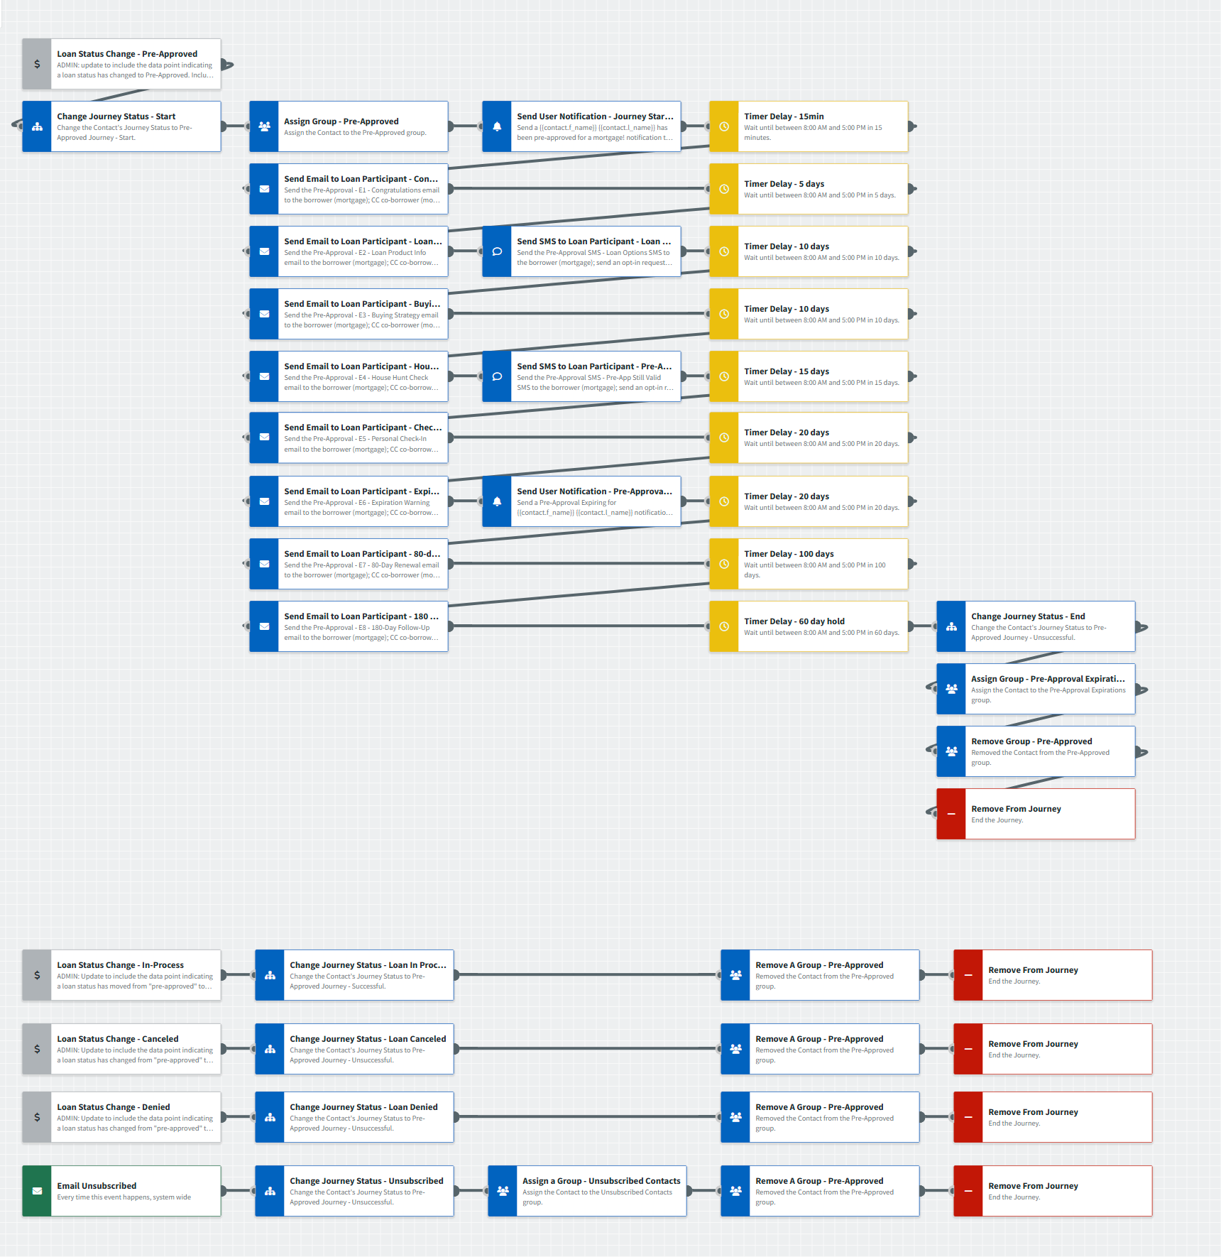
Pre-Approval Journey
Journey Notes:
Keep emails that work for your organization, edit to meet your organization’s tone, swap with custom, or add these emails to your existing campaigns.
  If your organization uses “Pre-Qualified” in place of “Pre-Approval”, consider reviewing the Pre-Qualified Journey or review email messaging to update naming conventions.
Configure trigger and condition components with organization specific inline conditions, contact groups, and Focused View outcomes.
  If your LOS data structure uses loan dates or another method to signal Pre-Approval, swap the Loan Status trigger to a Loan Update trigger and use inline conditions for the correct signal(s).
Notes:
This page should be used for JOURNEY WIREFRAMES (duplicate as needed)

Slide 4
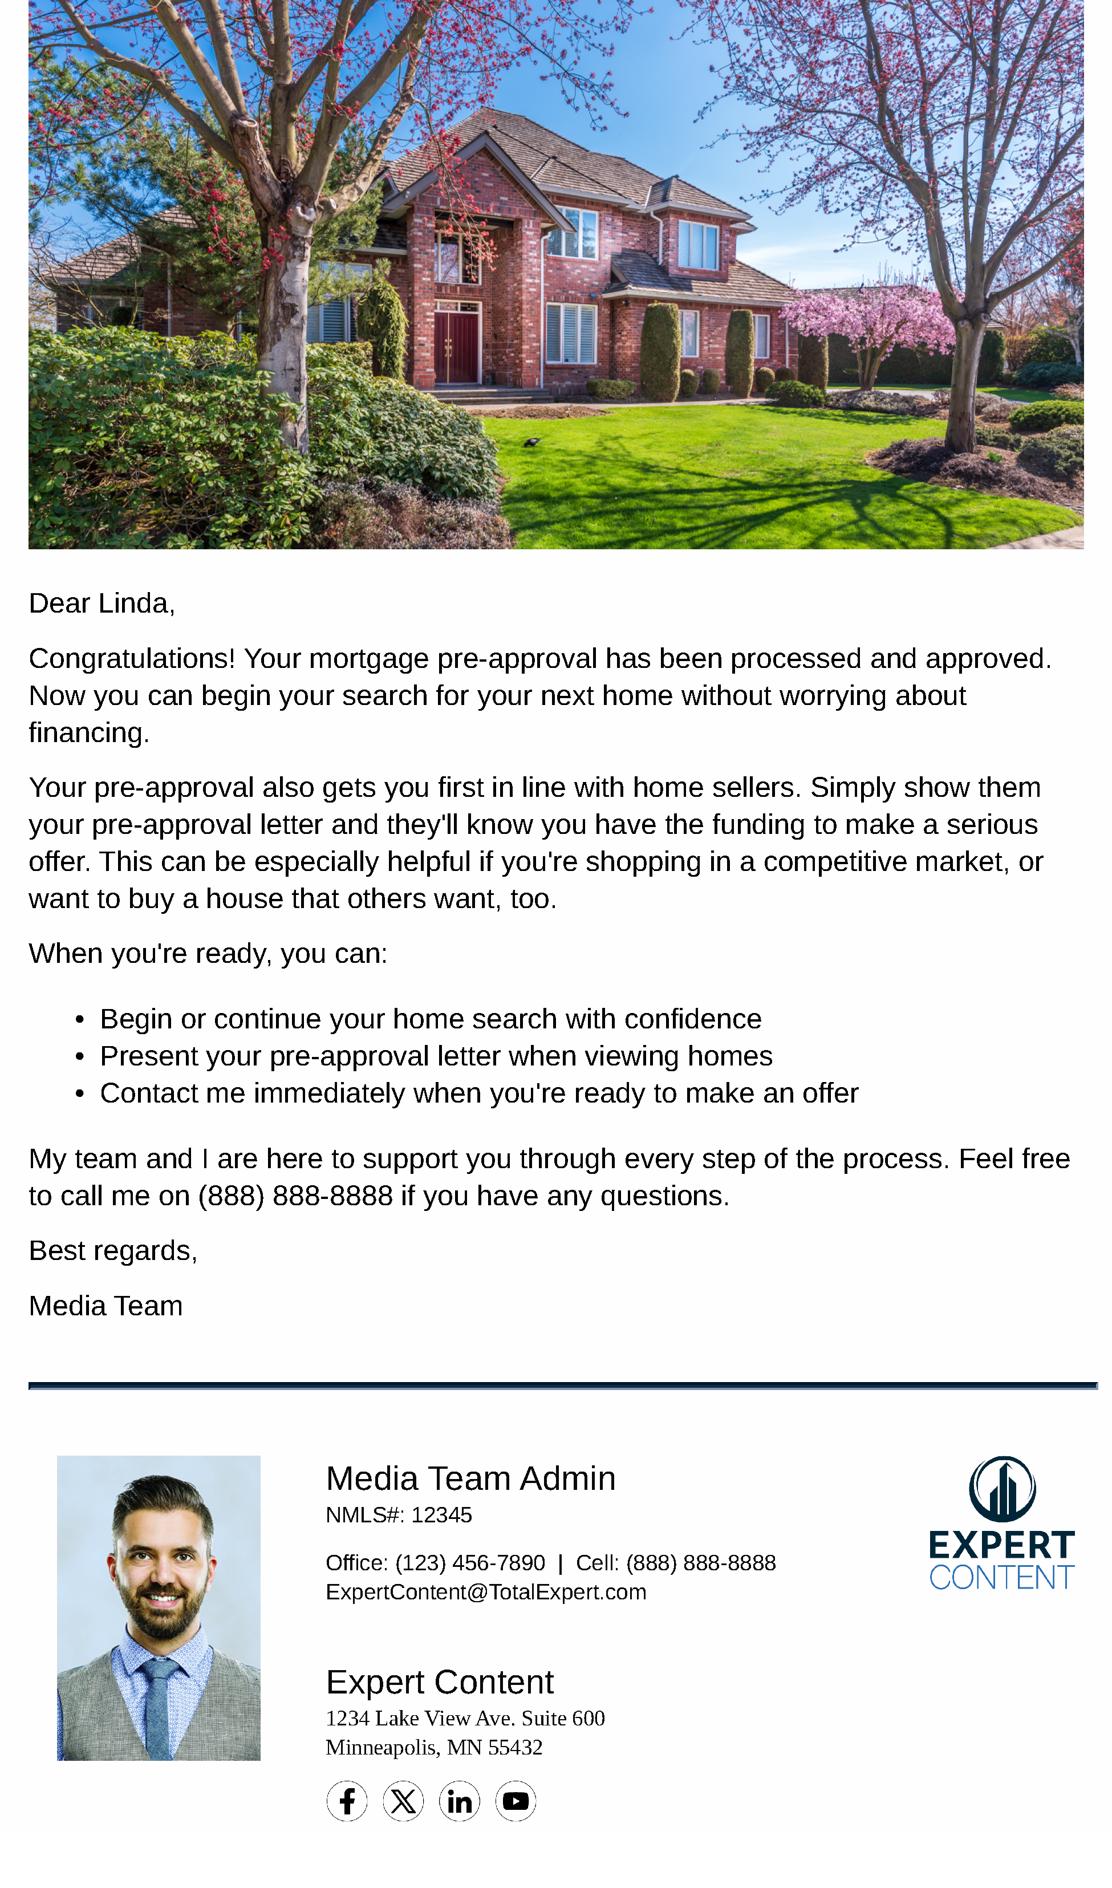
Pre-Approval Journey
Email Subject Line: 🎉 Congrats! Your Pre-Approval's Ready.
Dear {{recipient.f_name}},
Congratulations! Your mortgage pre-approval has been processed and approved. Now you can begin your search for your next home without worrying about financing.
Your pre-approval also gets you first in line with home sellers. Simply show them your pre-approval letter and they'll know you have the funding to make a serious offer. This can be especially helpful if you're shopping in a competitive market, or want to buy a house that others want, too.
When you're ready, you can:
Begin or continue your home search with confidence
Present your pre-approval letter when viewing homes
Contact me immediately when you're ready to make an offer
My team and I are here to support you through every step of the process. Feel free to call me on {{sender.phone_cell}} if you have any questions.
Best regards,
{{sender.f_name}}
Notes:
This page should be used for EMAILS (duplicate as needed)

Slide 5

Pre-Approval Journey
Email Subject Line: Popular Loan Options That Might Interest You
Hi {{recipient.f_name}},
I hope your home search is off to a great start!
Now that you're pre-approved for home financing, I wanted to share details of popular mortgages with you. One or more should be an ideal fit for your plans - it doesn't matter if you're shopping for a condo or a Colonial.
Conventional Loans offer competitive interest rates based on your credit score and assets. Down payments as low as 3% may be available.
FHA Loans are popular with first-time buyers, as they offer flexible credit requirements and down payments beginning at 3.5%.
VA Loans are designed to reward military veterans and those still in active service. Depending on your eligibility, you may qualify for financing with no down payment.
USDA Loans are for homes in rural areas (generally, areas in towns with populations below 5,000). These loans provide zero down options and low interest rates, although income restrictions apply.
Each loan type has unique benefits, and the best choice depends on your specific financial situation, the property you're considering, and your long-term goals. When you find a home you're interested in, we can discuss which option works best for your purchase.
I'm always available to explain these programs in more detail or answer any questions you might have.
Happy house hunting!
{{sender.f_name}}
Notes:
This page should be used for EMAILS (duplicate as needed)

Slide 6

Pre-Approval Journey
Email Subject Line: Smart Home Buying Strategies for Pre-Approved Buyers
Hello {{recipient.f_name}},
I'm writing to offer you some house-hunting strategies that may save you time and money when you're negotiating with a seller. Your loan pre-approval puts you in a strong position, so these can make it even stronger.
Remember these when you're negotiating a formal offer with a home seller, or their agent.
Be polite. If a home needs repairs, you may ask the seller to finance these or lower the sale price accordingly. This is called a contingency. Remember, some sellers are emotionally attached to their homes, so you'll want to tread carefully.
For example, if a backyard deck is aging and needs repairs or replacement:
DON'T say: "That deck is an accident waiting to happen. I'm amazed you're still alive."
DO say: "I love what you've done with this home, but I'm a little concerned about the deck's age."
Be flexible. Since many home sellers are also planning a home purchase, buyers who don't have to close on a particular day will be appreciated.
Be time sensitive. When you find a home you really like, you'll be prepared to make a formal offer immediately. A pre-approval is a great advantage when other buyers are checking out the home you want, as the seller will prefer serious buyers...like you.
Remember, I'm here to help ensure your loan closes smoothly once you're under contract.
Don't hesitate to call me when you're ready to make an offer!
Best regards,
{{sender.f_name}}
Notes:
This page should be used for EMAILS (duplicate as needed)

Slide 7
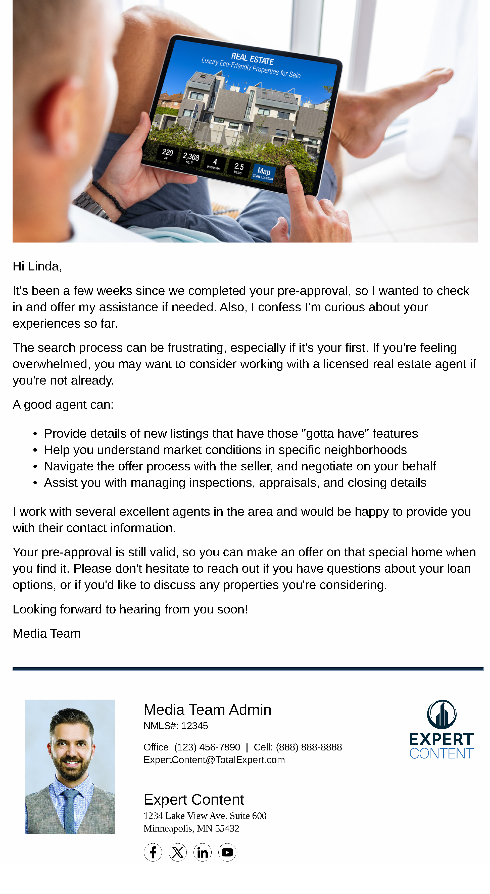
Pre-Approval Journey
Email Subject Line: How's your home search so far?
Hi {{recipient.f_name}},
It's been a few weeks since we completed your pre-approval, so I wanted to check in and offer my assistance if needed. Also, I confess I'm curious about your experiences so far.
The search process can be frustrating, especially if it's your first. If you're feeling overwhelmed, you may want to consider working with a licensed real estate agent if you're not already.
A good agent can:
Provide details of new listings that have those "gotta have" features
Help you understand market conditions in specific neighborhoods
Navigate the offer process with the seller, and negotiate on your behalf
Assist you with managing inspections, appraisals, and closing details
I work with several excellent agents in the area and would be happy to provide you with their contact information.
Your pre-approval is still valid, so you can make an offer on that special home when you find it. Please don't hesitate to reach out if you have questions about your loan options, or if you'd like to discuss any properties you're considering.
Looking forward to hearing from you soon!
{{sender.f_name}}
Notes:
This page should be used for EMAILS (duplicate as needed)

Slide 8

Pre-Approval Journey
Email Subject Line: Let's Chat About Your Home Buying Journey
Hello {{recipient.f_name}},
I hope you're having a positive experience with your home search! I know that finding the perfect home can sometimes be challenging, and I wanted to reach out personally to see how everything is going.
Would you have 10 minutes for a quick phone call this week? We can discuss:
What you've seen in your house hunt so far
Whether you've encountered any challenges or concerns
How I can better support you moving forward
If you haven't found the right home yet, don't be discouraged. The right home is out there, and when you find it, I'll be ready to move quickly with your financing.
Let's Chat! Click Here to Schedule.
Use the button above, reply to this email, or call {{sender.phone_cell}} to set up a convenient time to chat.
Looking forward to our conversation!
{{sender.f_name}}
Notes:
This page should be used for EMAILS (duplicate as needed)

Slide 9
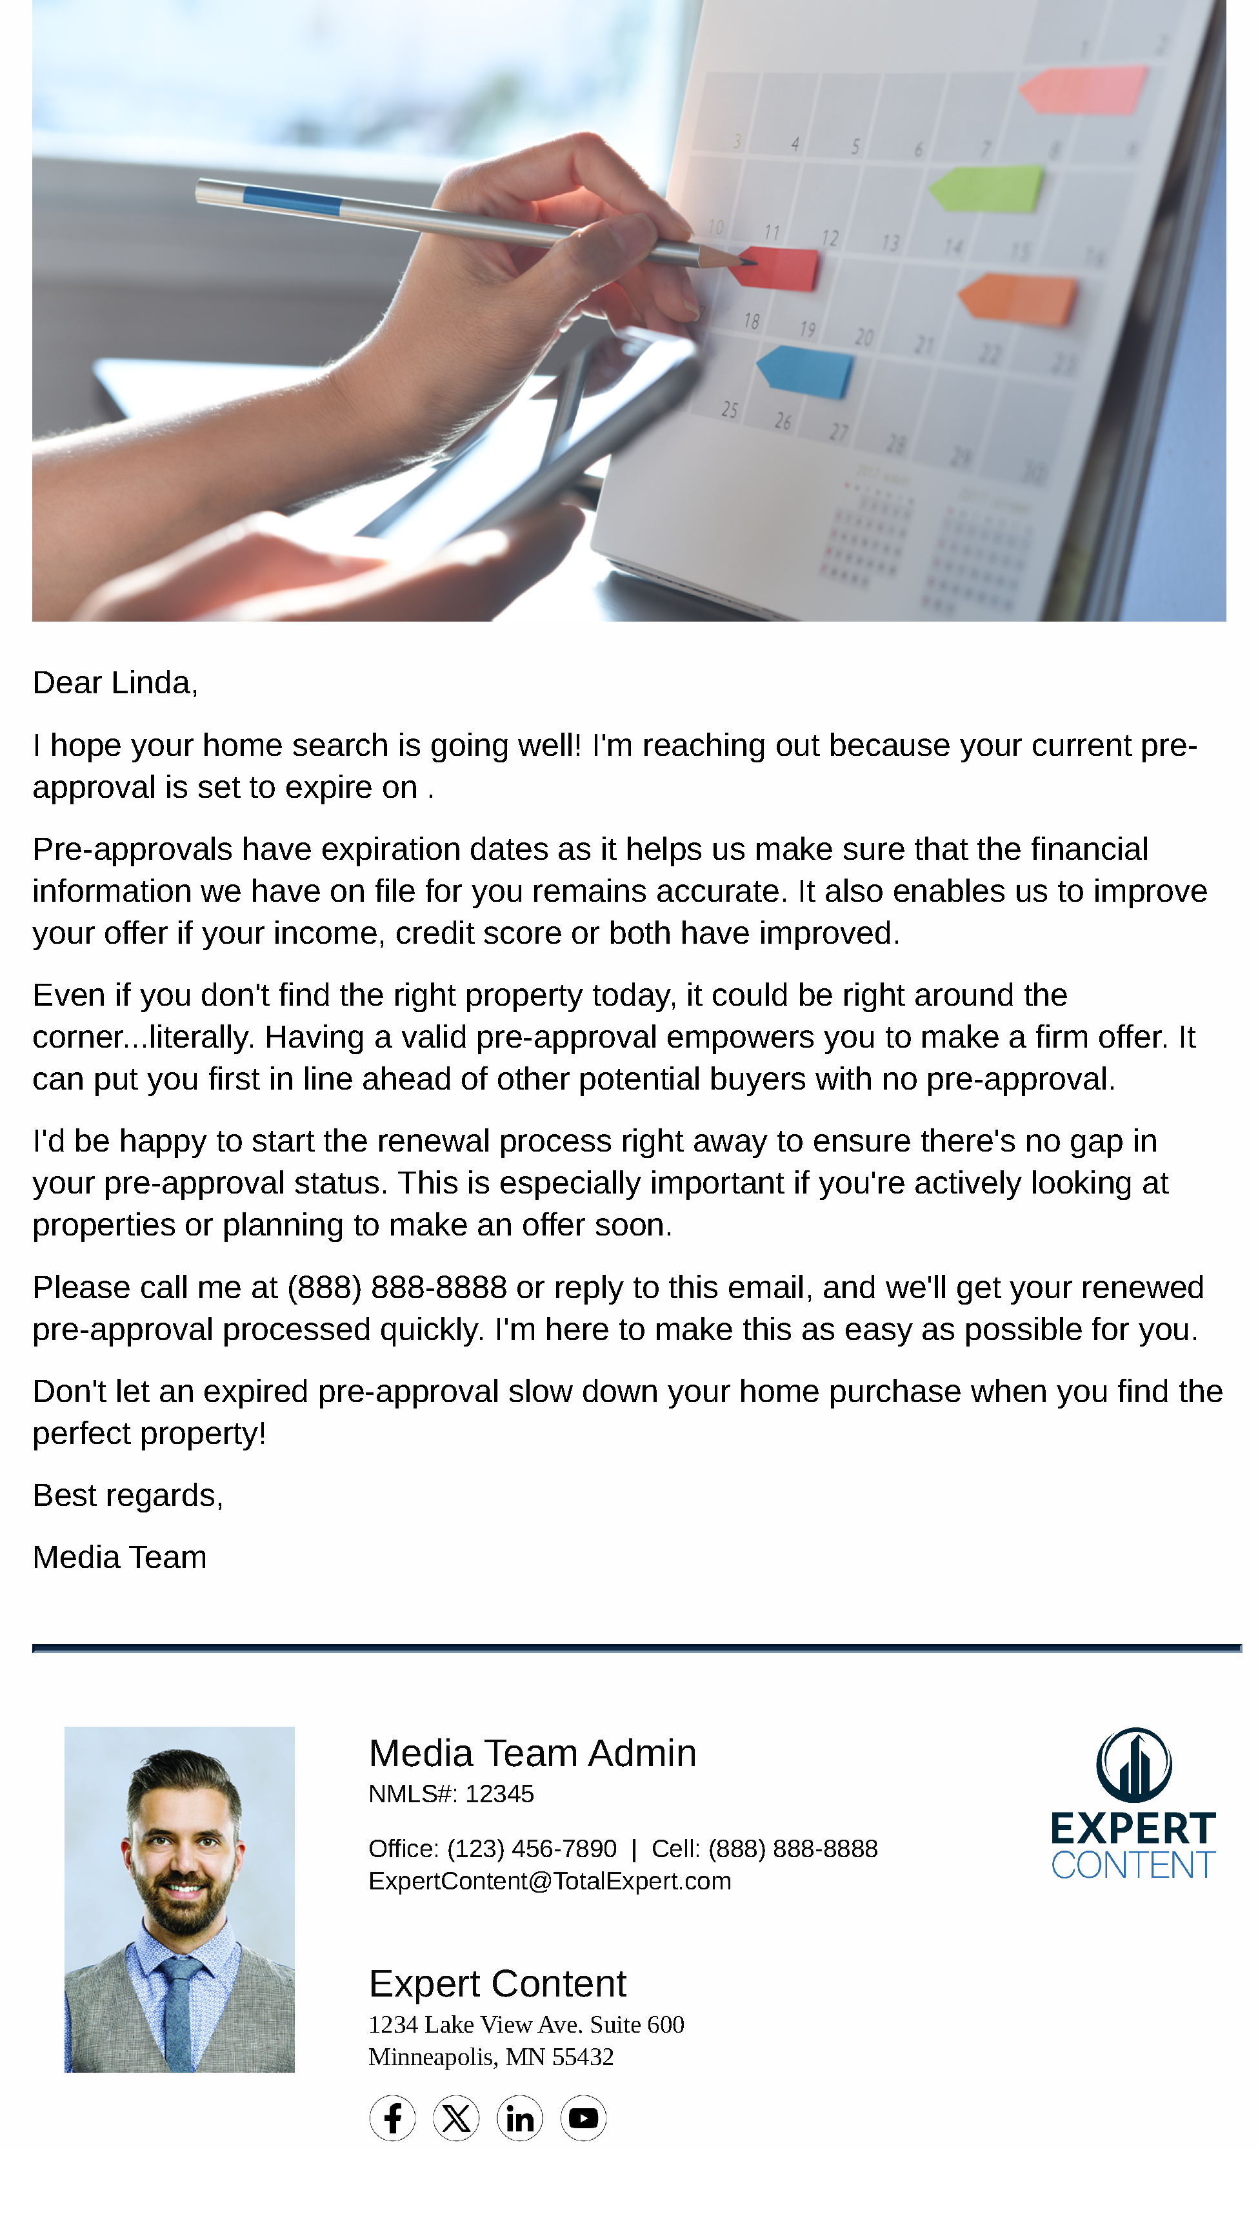
Pre-Approval Journey
Email Subject Line: Important: Your Pre-Approval Expires Soon
Dear {{recipient.f_name}},
I hope your home search is going well! I'm reaching out because your current pre-approval is set to expire on {{loan.pre_approval_expiration_date}}.
Pre-approvals have expiration dates as it helps us make sure that the financial information we have on file for you remains accurate. It also enables us to improve your offer if your income, credit score or both have improved.
Even if you don't find the right property today, it could be right around the corner...literally. Having a valid pre-approval empowers you to make a firm offer. It can put you first in line ahead of other potential buyers with no pre-approval.
I'd be happy to start the renewal process right away to ensure there's no gap in your pre-approval status. This is especially important if you're actively looking at properties or planning to make an offer soon.
Please call me at {{sender.phone_cell}} or reply to this email, and we'll get your renewed pre-approval processed quickly. I'm here to make this as easy as possible for you.
Don't let an expired pre-approval slow down your home purchase when you find the perfect property!
Best regards,
{{sender.f_name}}
Notes:
This page should be used for EMAILS (duplicate as needed)

Slide 10
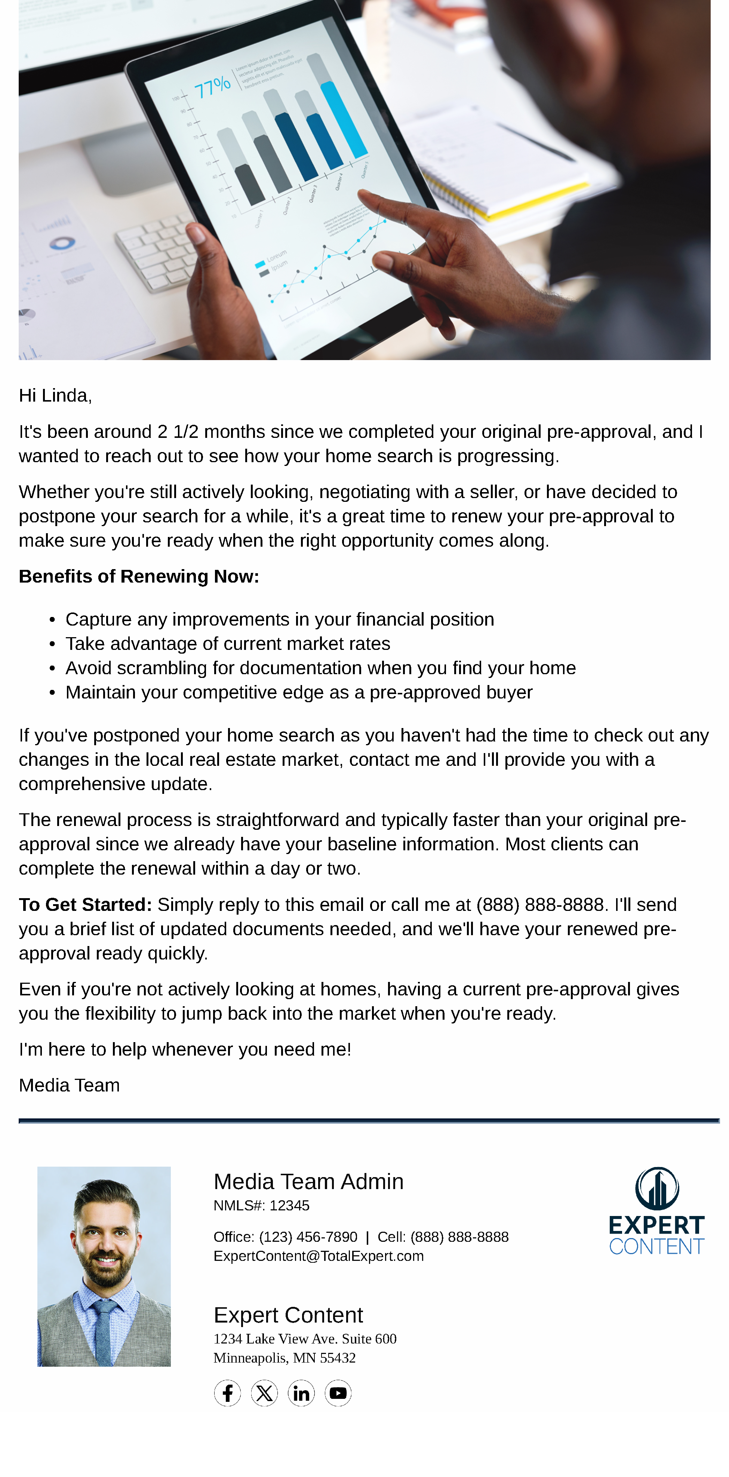
Pre-Approval Journey
Email Subject Line: Ready to Renew Your Pre-Approval?
Hi {{recipient.f_name}},
It's been around 2 1/2 months since we completed your original pre-approval, and I wanted to reach out to see how your home search is progressing.
Whether you're still actively looking, negotiating with a seller, or have decided to postpone your search for a while, it's a great time to renew your pre-approval to make sure you're ready when the right opportunity comes along.
Benefits of Renewing Now:
Capture any improvements in your financial position
Take advantage of current market rates
Avoid scrambling for documentation when you find your home
Maintain your competitive edge as a pre-approved buyer
If you've postponed your home search as you haven't had the time to check out any changes in the local real estate market, contact me and I'll provide you with a comprehensive update.
The renewal process is straightforward and typically faster than your original pre-approval since we already have your baseline information. Most clients can complete the renewal within a day or two.
To Get Started: Simply reply to this email or call me at {{sender.phone_cell}}. I'll send you a brief list of updated documents needed, and we'll have your renewed pre-approval ready quickly.
Even if you're not actively looking at homes, having a current pre-approval gives you the flexibility to jump back into the market when you're ready.
I'm here to help whenever you need me!
{{sender.f_name}}
Notes:
This page should be used for EMAILS (duplicate as needed)

Slide 11
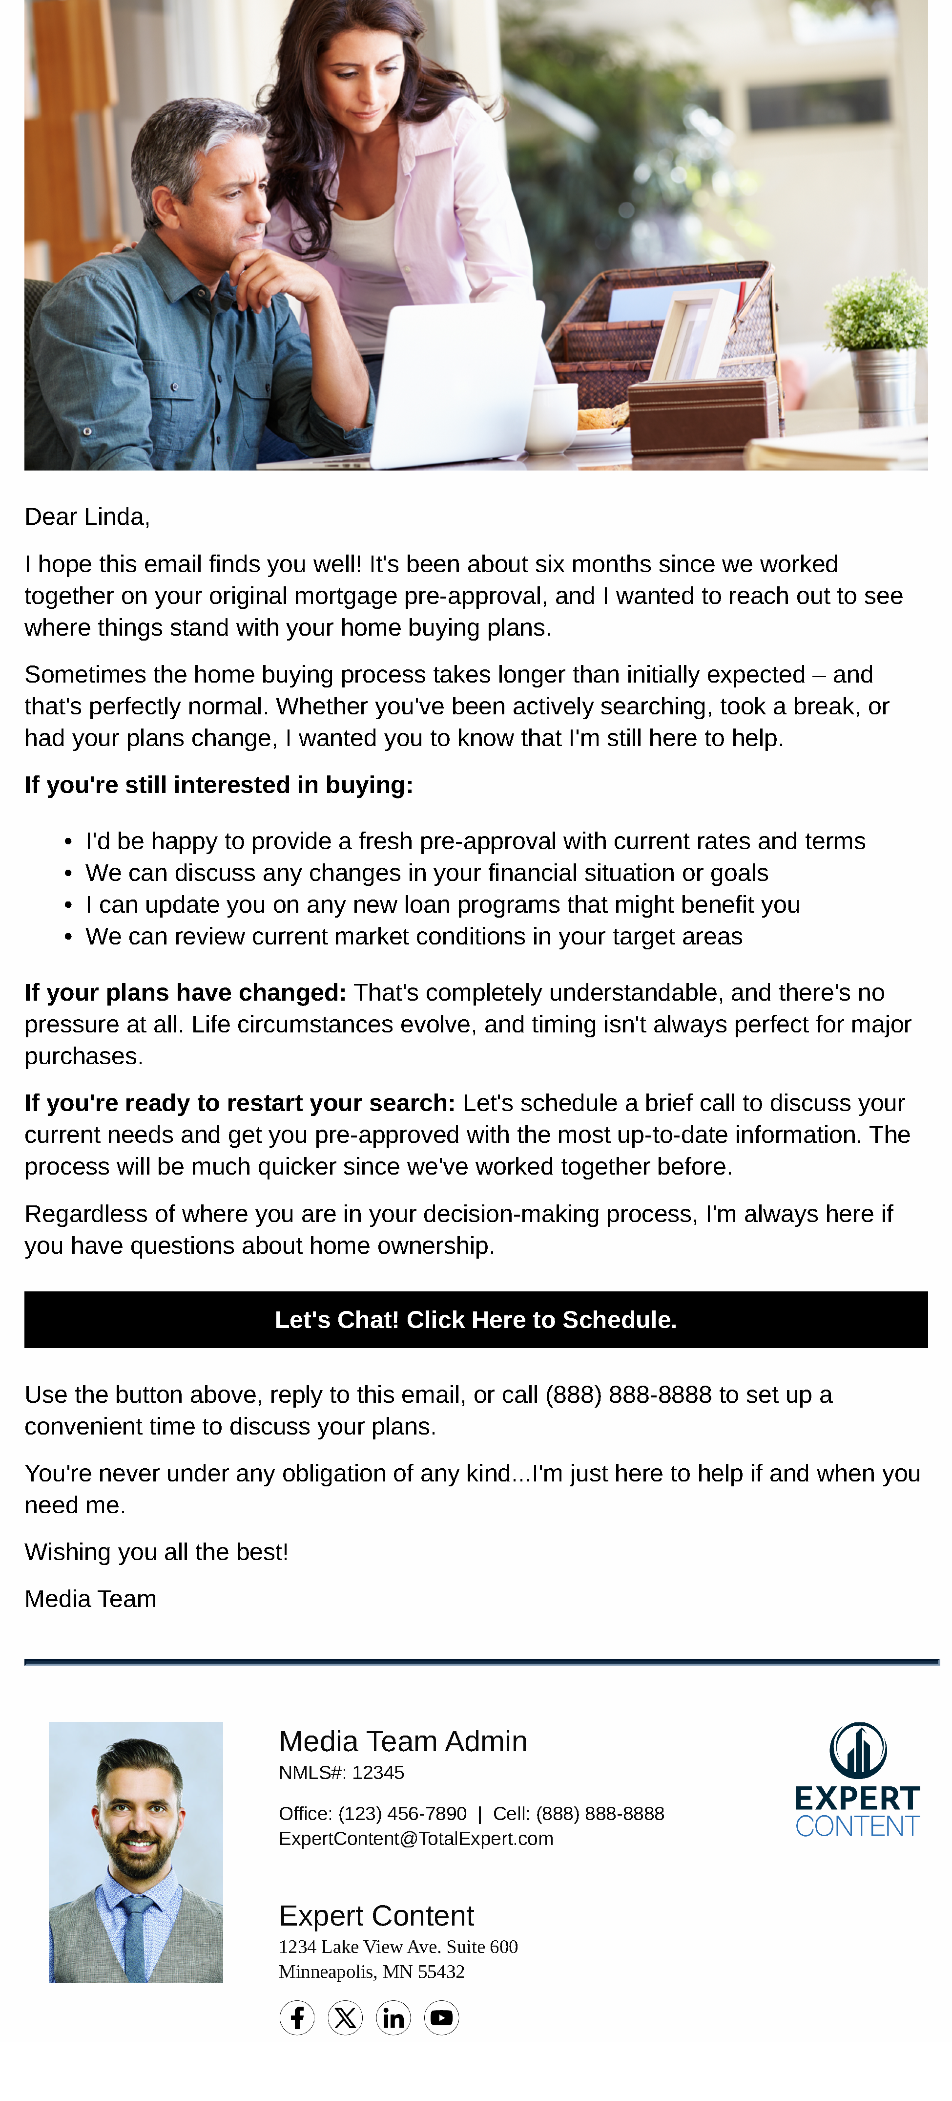
Pre-Approval Journey
Email Subject Line: Still Searching for Your Dream Home?
Dear {{recipient.f_name}},
I hope this email finds you well! It's been about six months since we worked together on your original mortgage pre-approval, and I wanted to reach out to see where things stand with your home buying plans.
Sometimes the home buying process takes longer than initially expected – and that's perfectly normal. Whether you've been actively searching, took a break, or had your plans change, I wanted you to know that I'm still here to help.
If you're still interested in buying:
I'd be happy to provide a fresh pre-approval with current rates and terms
We can discuss any changes in your financial situation or goals
I can update you on any new loan programs that might benefit you
We can review current market conditions in your target areas
If your plans have changed: That's completely understandable, and there's no pressure at all. Life circumstances evolve, and timing isn't always perfect for major purchases.
If you're ready to restart your search: Let's schedule a brief call to discuss your current needs and get you pre-approved with the most up-to-date information. The process will be much quicker since we've worked together before.
Regardless of where you are in your decision-making process, I'm always here if you have questions about home ownership.
Let's Chat! Click Here to Schedule.
Use the button above, reply to this email, or call {{sender.phone_cell}} to set up a convenient time to discuss your plans.
You're never under any obligation of any kind...I'm just here to help if and when you need me.
Wishing you all the best!
{{sender.f_name}}
Notes:
This page should be used for EMAILS (duplicate as needed)

Slide 12
Pre-Approval Journey
User Notification: {{contact.f_name}} {{contact.l_name}} has been pre-approved for a mortgage!
The contact below has been pre-approved and started the associated journey. Emails and text messages will begin sending today on your behalf. Visit their contact details for more context on where they are in the homebuying journey.
Contact information:
Contact name: {{contact.f_name}} {{contact.l_name}}
Contact phone: {{contact.phone_cell}}
Contact email: {{contact.email}}
Loan and pre-approval details (if available):
Loan number: {{loan.loan_number}}
Loan amount: ${{loan.amount}}
Loan program: {{loan.loan_program}}
Pre-approval issued: {{loan.pre_approval_issued_date | date: "m/d/Y"}}
Pre-approval expires: {{loan.pre_approval_expiration_date | date: "m/d/Y"}}
Notes:
This page should be used for TASKS, USER NOTIFICATIONS, AND SMS TEMPLATES (duplicate as needed)

Slide 13
Pre-Approval Journey
User Notification: Pre-Approval Expiring for {{contact.f_name}} {{contact.l_name}}
The contact below has a pre-approval expiring soon. Visit their contact details for more context on where they are in the homebuying journey and call them to encourage them to renew the pre-approval.
Contact information:
Contact name: {{contact.f_name}} {{contact.l_name}}
Contact phone: {{contact.phone_cell}}
Contact email: {{contact.email}}
Loan and pre-approval details (if available):
Loan number: {{loan.loan_number}}
Loan amount: ${{loan.amount}}
Loan program: {{loan.loan_program}}
Pre-approval issued: {{loan.pre_approval_issued_date | date: "m/d/Y"}}
Pre-approval expires: {{loan.pre_approval_expiration_date | date: "m/d/Y"}}
Notes:
This page should be used for TASKS, USER NOTIFICATIONS, AND SMS TEMPLATES (duplicate as needed)

Slide 14
Pre-Approval Journey
SMS: Pre-Approval SMS - Loan Options
Each loan type has unique benefits, and the best choice depends on your specific financial situation, the property you're considering, and your long-term goals. When you find a home you're interested in, give me a call to discuss your options at {{sender.phone_cell}}. - {{sender.f_name}}
SMS: Pre-Approval SMS - Pre-App Still Valid
Hi {{contact.f_name}} - your pre-approval is still valid but is expiring soon. Renew today so you can make an offer on that special home when you find it. Please don't hesitate to reach out if you have questions or if you'd like to discuss any properties you're considering. - {{sender.f_name}} with {{sender.company}}
Notes:
This page should be used for TASKS, USER NOTIFICATIONS, AND SMS TEMPLATES (duplicate as needed)

