Slide 1
Expert Content
Strategy Guide
Pre-Qualified Journey
September 2025

Slide 2
Pre-Qualified Journey
Communication types: Email, SMS, and User Notifications
Leverage this pre-qualified journey to retain prospective borrowers, educate them on loan products and the process, and encourage pre-approval or loan application completion. The journey begins when a loan status changes to pre-qualified but can be updated to match your organization’s needs. Communications to the prospective borrower include 6 emails and 2 SMS. There are also 2 user notifications alerting the contact owner of the borrower’s status on the journey.
Emails in this journey can be updated to match your organization’s sales process. For example, if this step in the purchase process is called “Pre-Approval”, update the emails to reflect that. If both Pre-Qualified and Pre-Approval are part of your sales process, there are two journeys that have slightly different messaging and urgency in timing to accommodate differing process variations.
*All communications should be reviewed prior to initiating the journey.

Slide 3
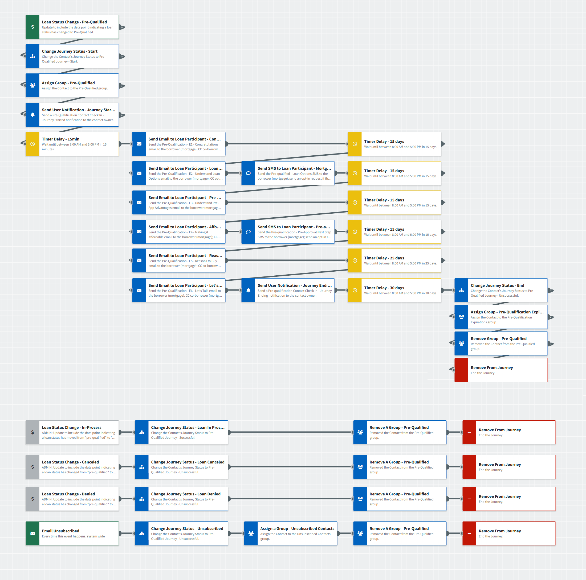
Pre-Qualified Journey
Journey Notes:
Keep emails that work for your organization, edit to meet your organization’s tone, swap with custom, or add these emails to your existing campaigns.
Specific statuses of the onramps and offramps should be updated to match your organization’s loan status naming conventions or pre-qualified designations.
Configure all trigger and condition components with organization specific inline conditions, contact groups, and Focused View outcomes as needed.
Notes:
This page should be used for JOURNEY WIREFRAMES (duplicate as needed)

Slide 4

Pre-Qualified Journey
Email Subject Line: You're pre-qualified for a mortgage. Congrats!
Hello {{recipient.f_name}},
I'm pleased to inform you that, based on the information you provided, you've pre-qualified for home financing.
Your pre-qualification is an estimate of your potential buying power. This helps you in a variety of ways:
You know how much home you can afford, so you can concentrate on viewing properties within your price range.
You'll be ready to move forward when you find the right home.
You have the backing of a trusted lending partner who will answer your questions quickly, and in everyday language.
Thank you for choosing me to assist with the first step of your home financing journey. When you're ready to apply for a mortgage, or have questions, contact me.
Phone: {{sender.phone_cell}}
Email: {{sender.email}}
Office: {{sender.phone_office}}
Best regards,
{{sender.f_name}}
Notes:
This page should be used for EMAILS (duplicate as needed)

Slide 5

Pre-Qualified Journey
Email Subject Line: FHA, VA or conventional loan? Let’s find your match.
Hello {{recipient.f_name}},
Now that you're pre-qualified for a mortgage, you may be wondering which type of loan could be the best fit with your budget, income and credit score.
Here are the basics of the most popular mortgage programs.
Conventional Loans:
Down payments from 3% to 20%
Potentially lower long-term costs
Various terms may be available
FHA Loans:
Down payments as low as 3.5%
Flexible credit requirements
Popular with first-time buyers
VA Loans (for eligible veterans and active service members):
No down payment required
Competitive interest rates
Designed to reward your military service
The right loan program can make home ownership truly affordable while improving your long-term financial outlook. I'd love to walk through these with you, so you'll see which one will work best for you.
Ready to explore your options? Give me a call at {{sender.phone_cell}}. There's no obligation – just helpful information to guide your decision-making.
Best,
{{sender.f_name}}
Notes:
This page should be used for EMAILS (duplicate as needed)

Slide 6
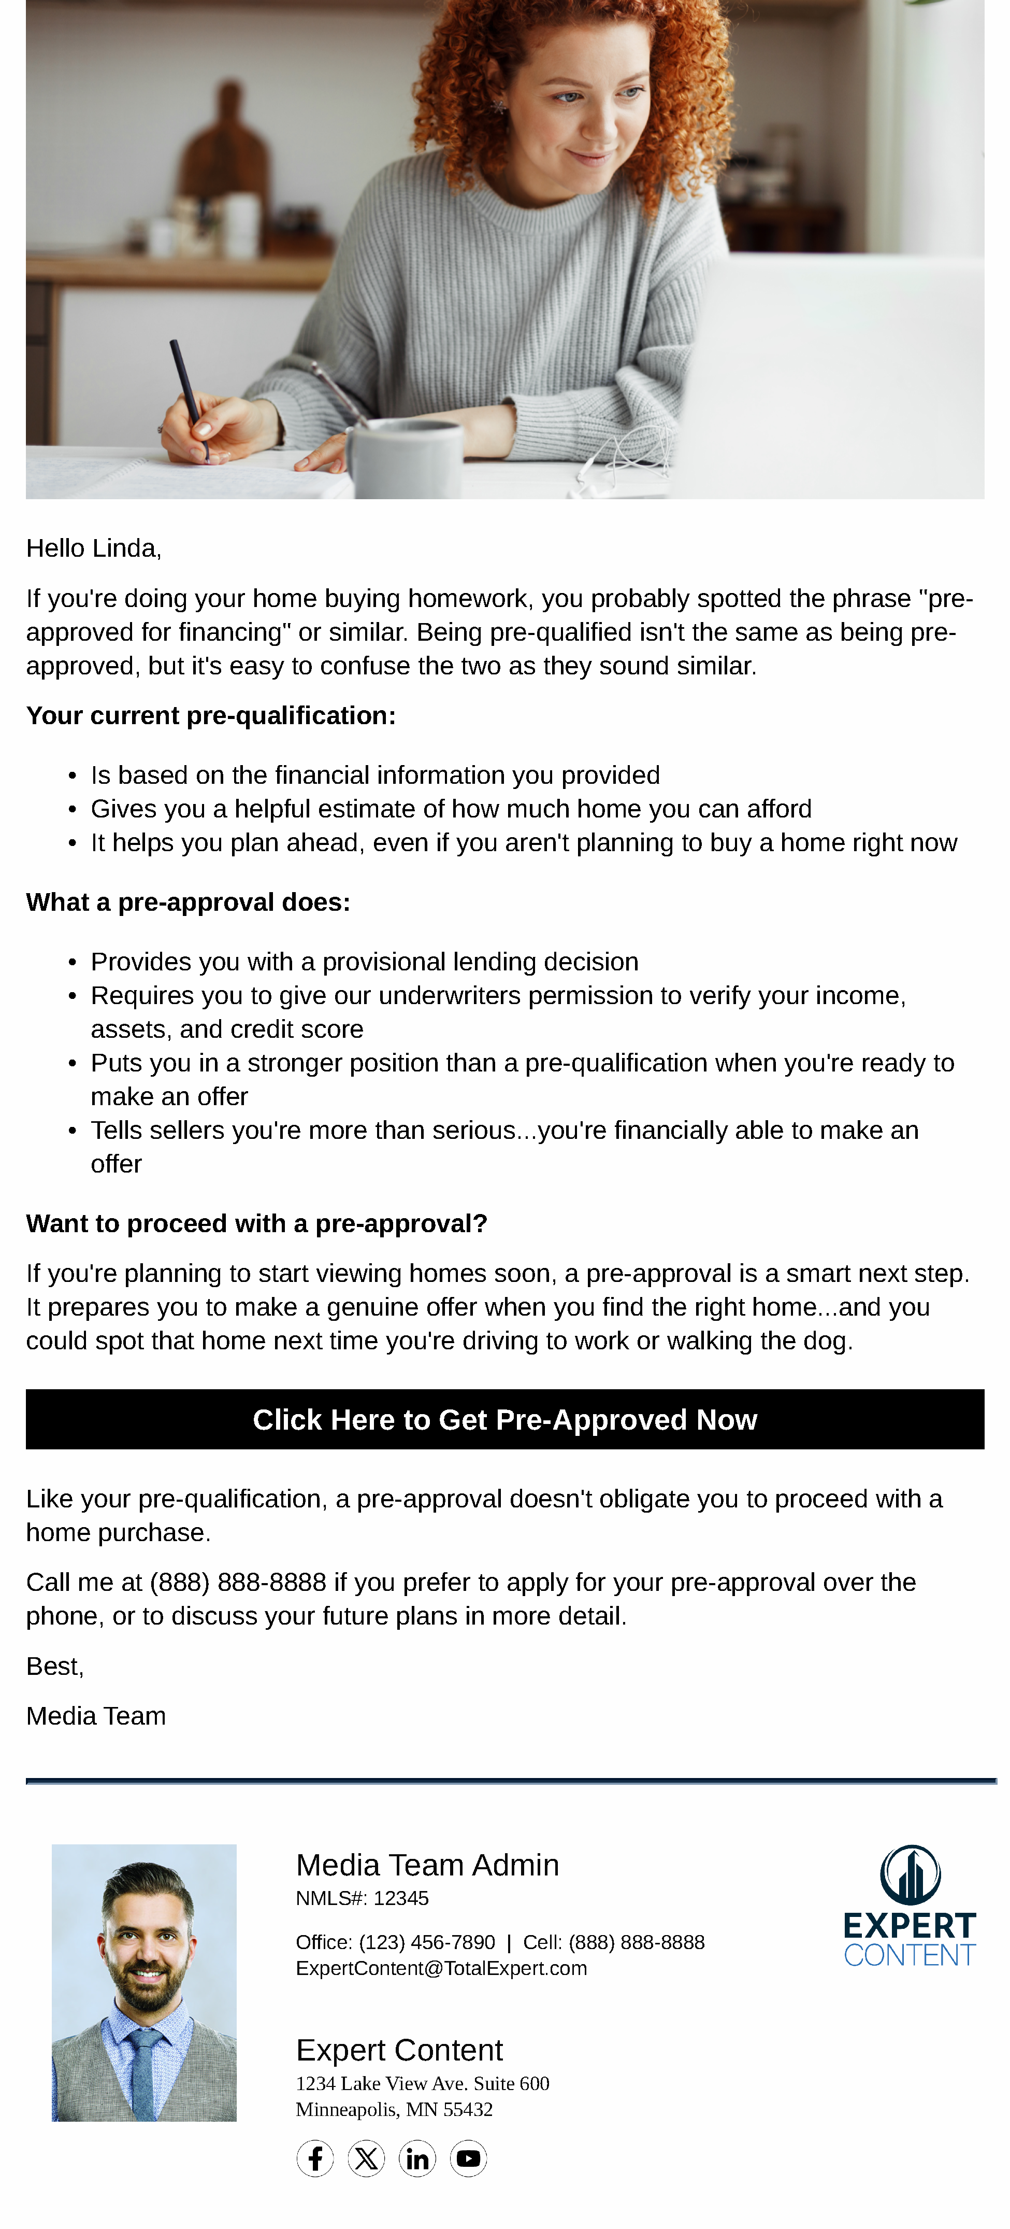
Pre-Qualified Journey
Email Subject Line: Why sellers prefer pre-approved buyers.
Hello {{recipient.f_name}},
If you're doing your home buying homework online, you've probably spotted the phrase "pre-approved for financing" or similar. Being pre-qualified isn't the same as being pre-approved, but it's easy to confuse the two as they sound similar.
Your current pre-qualification:
Is based on the financial information you provided
Gives you a helpful estimate of how much home you can afford
It helps you plan ahead, even if you aren't planning to buy a home right now
What a pre-approval does:
Provides you with a provisional lending decision
Requires you to give our underwriters permission to verify your income, assets, and credit score
Puts you in a stronger position than a pre-qualification when you're ready to make an offer
Tells sellers you're more than serious...you're financially able to make an offer
Want to proceed with a pre-approval?
If you're planning to start viewing homes soon, a pre-approval is a smart next step. It prepares you to make a genuine offer when you find the right home...and you could spot that home next time you're driving to work or walking the dog.
Click Here to Get Pre-Approved Now
Like your pre-qualification, a pre-approval doesn't obligate you to proceed with a home purchase.
Call me at {{sender.phone_cell}} if you prefer to apply for your pre-approval over the phone, or to discuss your future plans in more detail.
Best,
{{sender.f_name}}
Note: the button in this email links to the user’s application URL from their profile. If your organization has specific pre-approval links or custom contact fields that contain the borrower’s application link, the button can be edited in Email Builder.
Notes:
This page should be used for EMAILS (duplicate as needed)

Slide 7

Pre-Qualified Journey
Email Subject Line: Need help with a down payment on a home? Details inside!
Hello {{recipient.f_name}},
Something I often hear from potential homebuyers is "I don't see how I can buy a home now." Perhaps they don't have a big down payment saved, or someone has convinced them that they don't make enough money.
However, you may be able to go from renting to buying sooner than you think. Here are some reasons why.
You don't need 20% down to buy a home. Many people believe that 20% down is mandatory, but the introduction of private mortgage insurance during the 1950s put an end to this. Also, it's rare for any mortgage to require a minimum 20% down payment.
You may qualify for down payment assistance - including grants that don't require repayment. Many are designed specifically for first time buyers. Assistance is also available for teachers, firefighters, and other essential workers. Visit the Down Payment Resource website and find out more in just minutes.
Loans only require 3.5% down...or even less. If you qualify for a conventional loan, down payments begin at just 3% of a home's purchase price. Most FHA loans only require 3.5% down. If you're a military veteran or in active duty, a VA loan could get you home with 0% down. So could a USDA loan for a rural property purchase.
Ready to learn more? Call me at {{sender.phone_cell}}. Remember, there's no cost or obligation to explore these options; just helpful information to guide your decisions.
Best,
{{sender.f_name}}
Notes:
This page should be used for EMAILS (duplicate as needed)

Slide 8

Pre-Qualified Journey
Email Subject Line: How home ownership helps you build a better future
Hello {{recipient.f_name}},
You've already taken that first step to a better lifestyle by getting pre-qualified for financing. Hopefully this has solved any worries you had about mortgages, so you can decide when you want to begin shopping for a home.
Is It the Right Time to Buy?
Perhaps you're thinking that home ownership would provide stability and a sense of belonging, or you've decided that investing in a home is preferable to paying rent. While these are good reasons, there are plenty of additional advantages (and savings!) you'll enjoy.
A better lifestyle - Buy a home that provides what you're missing, whether it's a place to pursue your hobbies, or a backyard for your pets.
Potential tax benefits - Check out how much you'll save with mortgage interest and property tax deductions.
Inflation protection - A fixed-rate mortgage protects you from rising rent rates.
Community investment - Put down roots, get involved with local events, and make new friends.
Your Timeline, Your Choice
Whether you're planning to start house hunting next month or next year, understanding these benefits helps you make informed decisions about timing and strategy.
I'm here to help you explore these options whenever you're ready to learn more. Call me at {{sender.phone_cell}} to discuss your future plans in more detail.
Best,
{{sender.f_name}}
Notes:
This page should be used for EMAILS (duplicate as needed)

Slide 9

Pre-Qualified Journey
Email Subject Line: Let’s talk about your home ownership goals.
Hello {{recipient.f_name}},
Over the past weeks, I've sent you information about the homebuying process, loan options, and the benefits of home ownership. I hope this has helped you consider your next steps.
Are you ready to take the next step toward pre-approval? Or are you still in the planning stages and prefer that I send you market updates?
Either way is perfectly fine. Everyone moves at their own pace when it comes to such an important decision.
I'd love to hear about your current home buying plans, so we can discuss how I can support your goals.
Give me a call at {{sender.phone_cell}} to discuss your plans in more detail.
Best,
{{sender.f_name}}
Notes:
This page should be used for EMAILS (duplicate as needed)

Slide 10
Pre-Qualified Journey
User Notification: Pre-Qualified Contact Check In - Journey Started
Your contact has been pre-qualified and started the associated journey. Emails and text messages will begin sending today. Visit their contact details for more context on where they are in the homebuying journey and call them to check in.
Contact details:
Contact name: {{contact.f_name}} {{contact.l_name}}
Contact phone: {{contact.phone_cell}}
Contact email: {{contact.email}}
Loan and application details (if available):
Loan number: {{loan.loan_number}}
Loan amount: {{loan.amount}}
Loan program: {{loan.loan_program}}
Application number: {{loan.application_number}}
Application date: {{loan.application_date | date: "m/d/Y"}}
Notes:
This page should be used for TASKS, USER NOTIFICATIONS, AND SMS TEMPLATES (duplicate as needed)

Slide 11
Pre-Qualified Journey
User Notification: Pre-qualified Contact Check In - Journey Ending
Pre-qualification Contact Check In - Journey Ending
Your contact has been pre-qualified and has received the last email of the associated journey. If you haven't yet, visit their contact details for more context on where they are in the homebuying journey and call them to check in.
Contact details:
Contact name: {{contact.f_name}} {{contact.l_name}}
Contact phone: {{contact.phone_cell}}
Contact email: {{contact.email}}
Loan and application details (if available):
Loan number: {{loan.loan_number}}
Loan amount: {{loan.amount}}
Loan program: {{loan.loan_program}}
Application number: {{loan.application_number}}
Application date: {{loan.application_date | date: "m/d/Y"}}
Notes:
This page should be used for TASKS, USER NOTIFICATIONS, AND SMS TEMPLATES (duplicate as needed)

Slide 12
Pre-Qualified Journey
SMS: Pre-qualified - Loan Options
Hi {{recipient.f_name}} - choosing the right mortgage can make your upcoming purchase feel more affordable. Give me a call or shoot me a text to review your options when you're ready - {{sender.phone_cell}}. - {{sender.f_name}}
SMS: Pre-qualified - Pre-Approval Next Step
Hi {{recipient.f_name}} - If you're planning to view homes soon, or if you've already started, a pre-approval is a smart next step. It prepares you to make a genuine offer. Like your pre-qualification, pre-approvals don't obligate you to proceed with a purchase. Let's chat if you're ready for the next step! Call or text me at {{sender.phone_cell}}. - {{sender.f_name}}
Notes:
This page should be used for TASKS, USER NOTIFICATIONS, AND SMS TEMPLATES (duplicate as needed)

Slide 13

Journey Map Notes:
Keep emails that work for your organization, swap with custom, or add these emails to your existing campaigns.
Adjust onramps with organization specific groups and Focused View outcomes.
Notes:
OUTDATED FORMAT FOR WIREFRAME SLIDE – KEEPING ONLY FOR HISTORICAL REFERENCE IF NEEDED

