Slide 1
Expert Content
Strategy Guide
Seller’s Education
April 2026

Slide 2
Seller’s Education
Communication types: Journey (Email and SMS), Postcards, Flyers, and Social Media
The Seller’s Education marketing kit is a multi-channel campaign designed to help marketing teams engage and nurture prospective home sellers through educational, confidence-building content. It combines automated and on-demand touchpoints to deliver a consistent experience across the customer journey.
Loan officers and real estate partners build trust with education-first messaging, driving higher-quality conversations with prospective sellers.
Journey (email + SMS): Automated nurture delivering timely education and conversion opportunities; supports co-branded and single-branded execution
Print (postcards + flyers): on-demand assets for direct mail and in-person distribution
Social Media: on-demand, ready-to-post content to drive awareness and engagement
*All communications should be reviewed prior to initiating the journey.

Slide 3
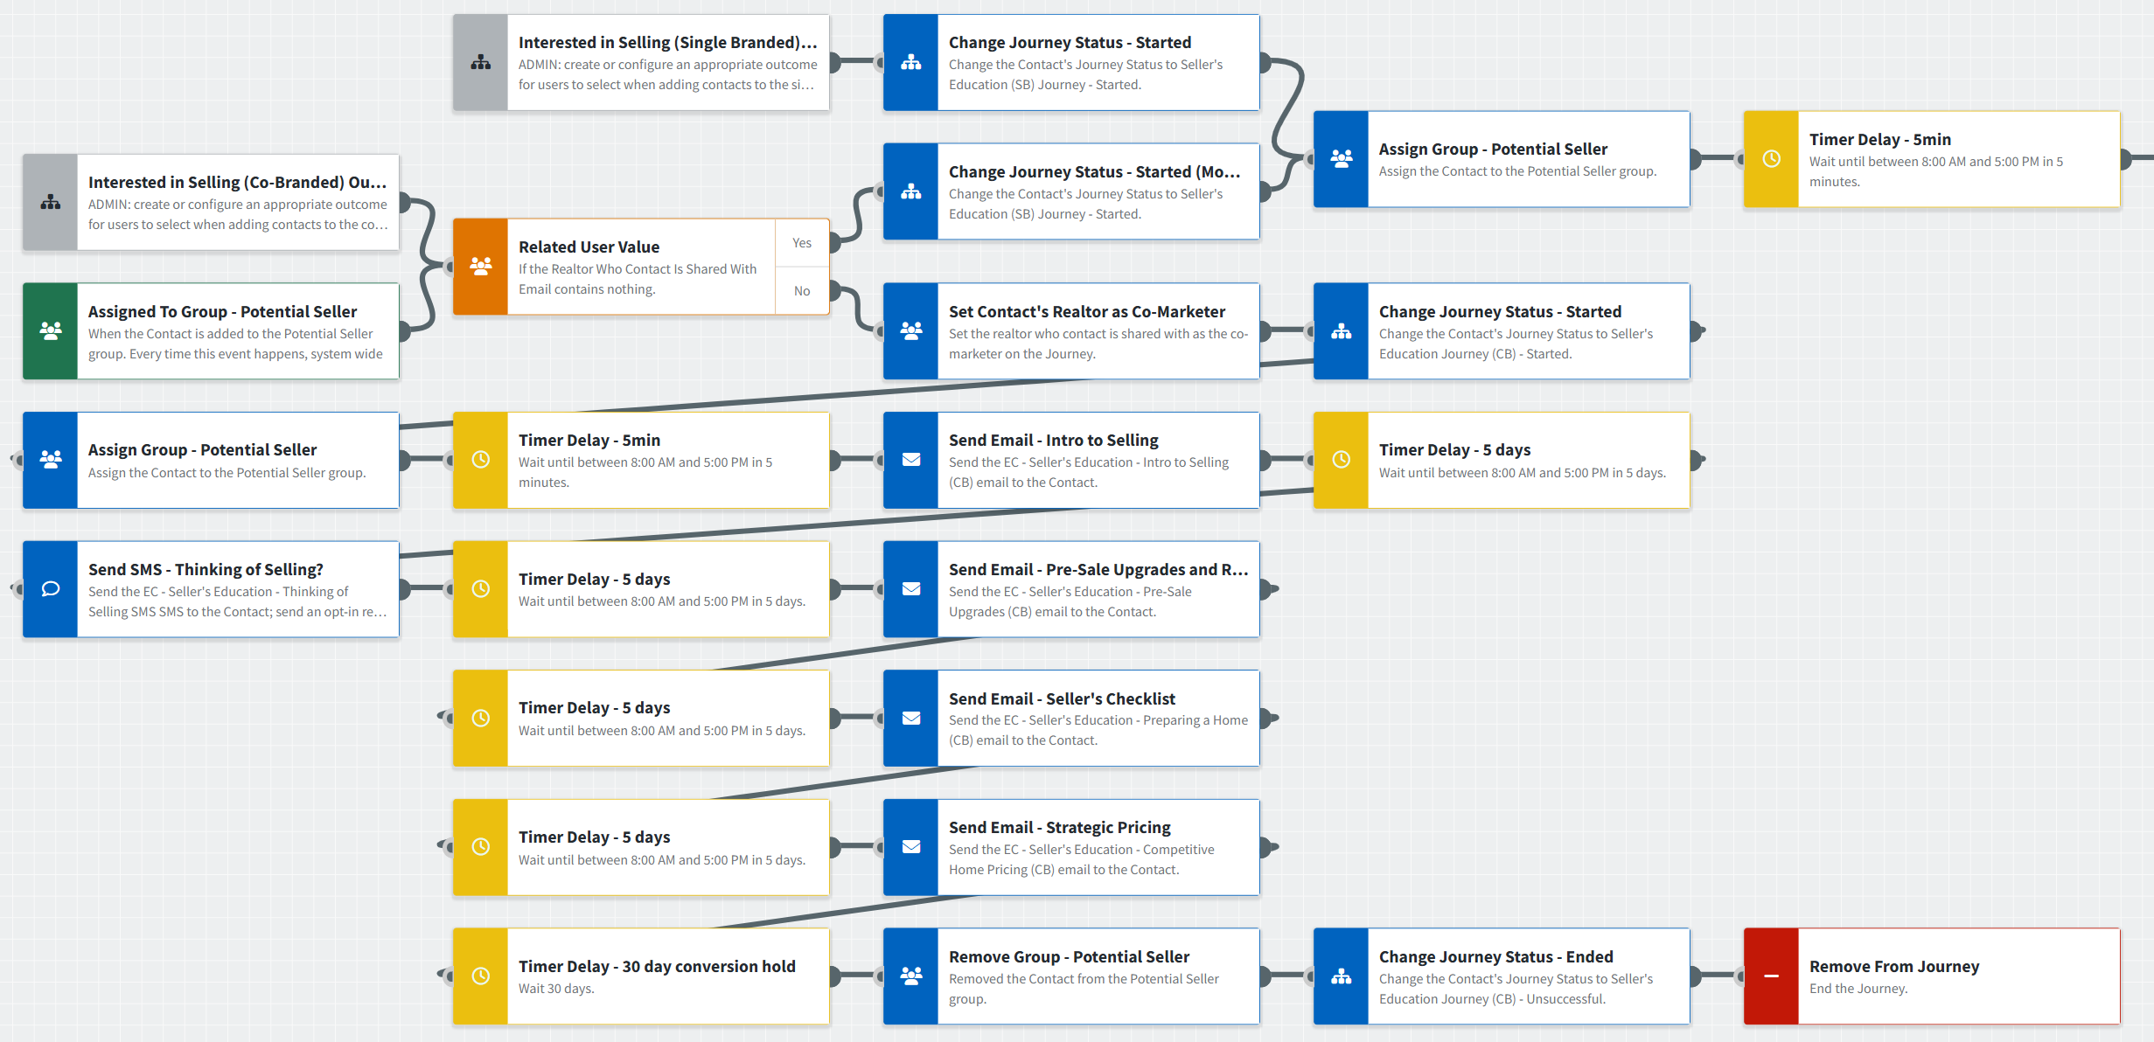
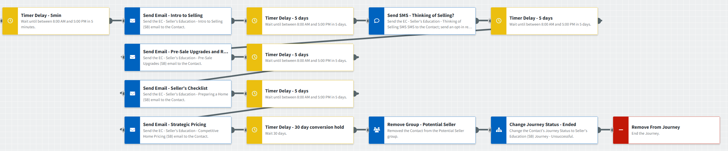
Seller’s Education – Journey
Journey Notes:
This journey assigns the contact to the appropriate agent they are shared with for a co-branded experience; if no agent is available, the contact is routed to a single-branded path. Loan officers may choose to select single or co-branded outcomes.
Keep emails that work for your organization, edit to meet your organization’s tone, swap with custom, or add these emails to your existing campaigns.
Configure trigger and condition components with organization specific inline conditions, contact groups, and Outcomes.
Occurrence limits are set to 9999 because seller opportunities may arise more than once.
*Note: the bottom screenshot shows the single-branded path when no agent is associated with the contact, or when the loan officer chooses the single-branded outcome.
Notes:
This page should be used for JOURNEY WIREFRAMES (duplicate as needed)

Slide 4
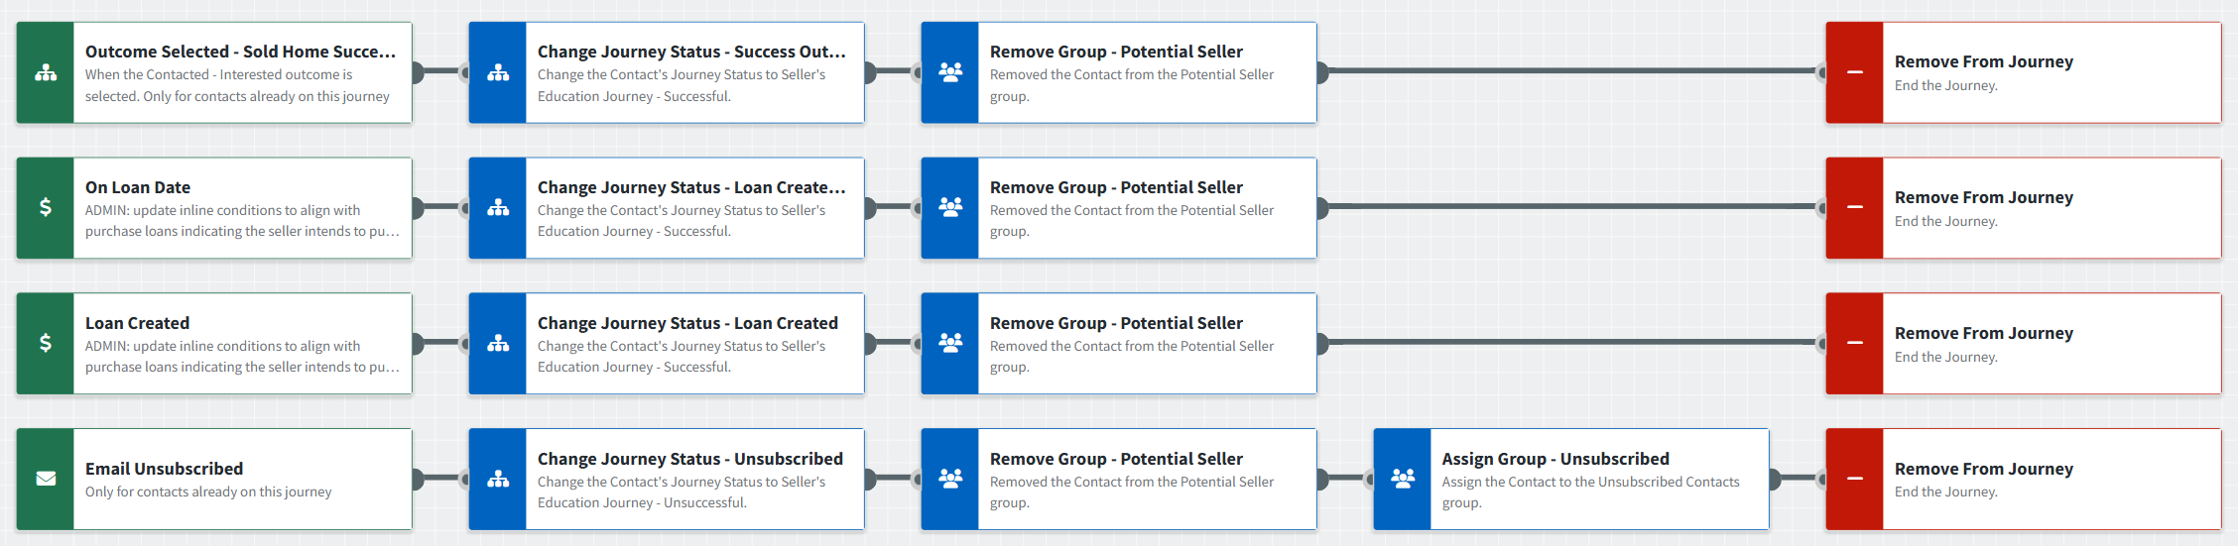
Seller’s Education – Journey
Journey Notes:
Configure offramp components with organization specific inline conditions, contact groups, and Outcomes.
Notes:
This page should be used for JOURNEY WIREFRAMES (duplicate as needed)

Slide 5
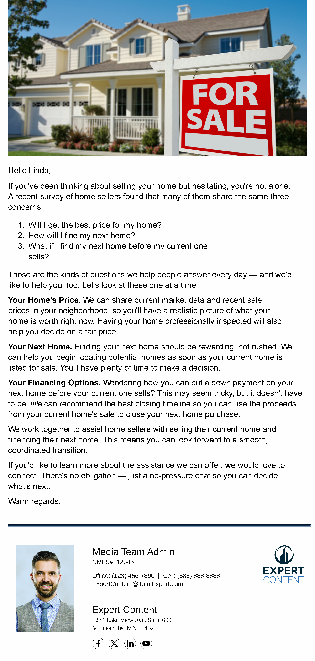
Seller’s Education - Email
Email Subject Line: Inside: solutions to the biggest home selling concerns
Hello {{recipient.f_name}},
If you've been thinking about selling your home but hesitating, you're not alone. A recent survey of home sellers found that many of them share the same three concerns:
  Will I get the best price for my home?
  How will I find my next home?
  What if I find my next home before my current one sells?
Those are the kinds of questions we help people answer every day — and we'd like to help you, too. Let's look at these one at a time.
Your Home's Price. We can share current market data and recent sale prices in your neighborhood, so you'll have a realistic picture of what your home is worth right now. Having your home professionally inspected will also help you decide on a fair price.
Your Next Home. Finding your next home should be rewarding, not rushed. We can help you begin locating potential homes as soon as your current home is listed for sale. You'll have plenty of time to make a decision.
Your Financing Options. Wondering how you can put a down payment on your next home before your current one sells? This may seem tricky, but it doesn't have to be. We can recommend the best closing timeline so you can use the proceeds from your current home's sale to close your next home purchase.
We work together to assist home sellers with selling their current home and financing their next home. This means you can look forward to a smooth, coordinated transition.
If you'd like to learn more about the assistance we can offer, we would love to connect. There's no obligation — just a no-pressure chat so you can decide what's next.
Warm regards,
Notes:
This page should be used for EMAILS (duplicate as needed)

Slide 6
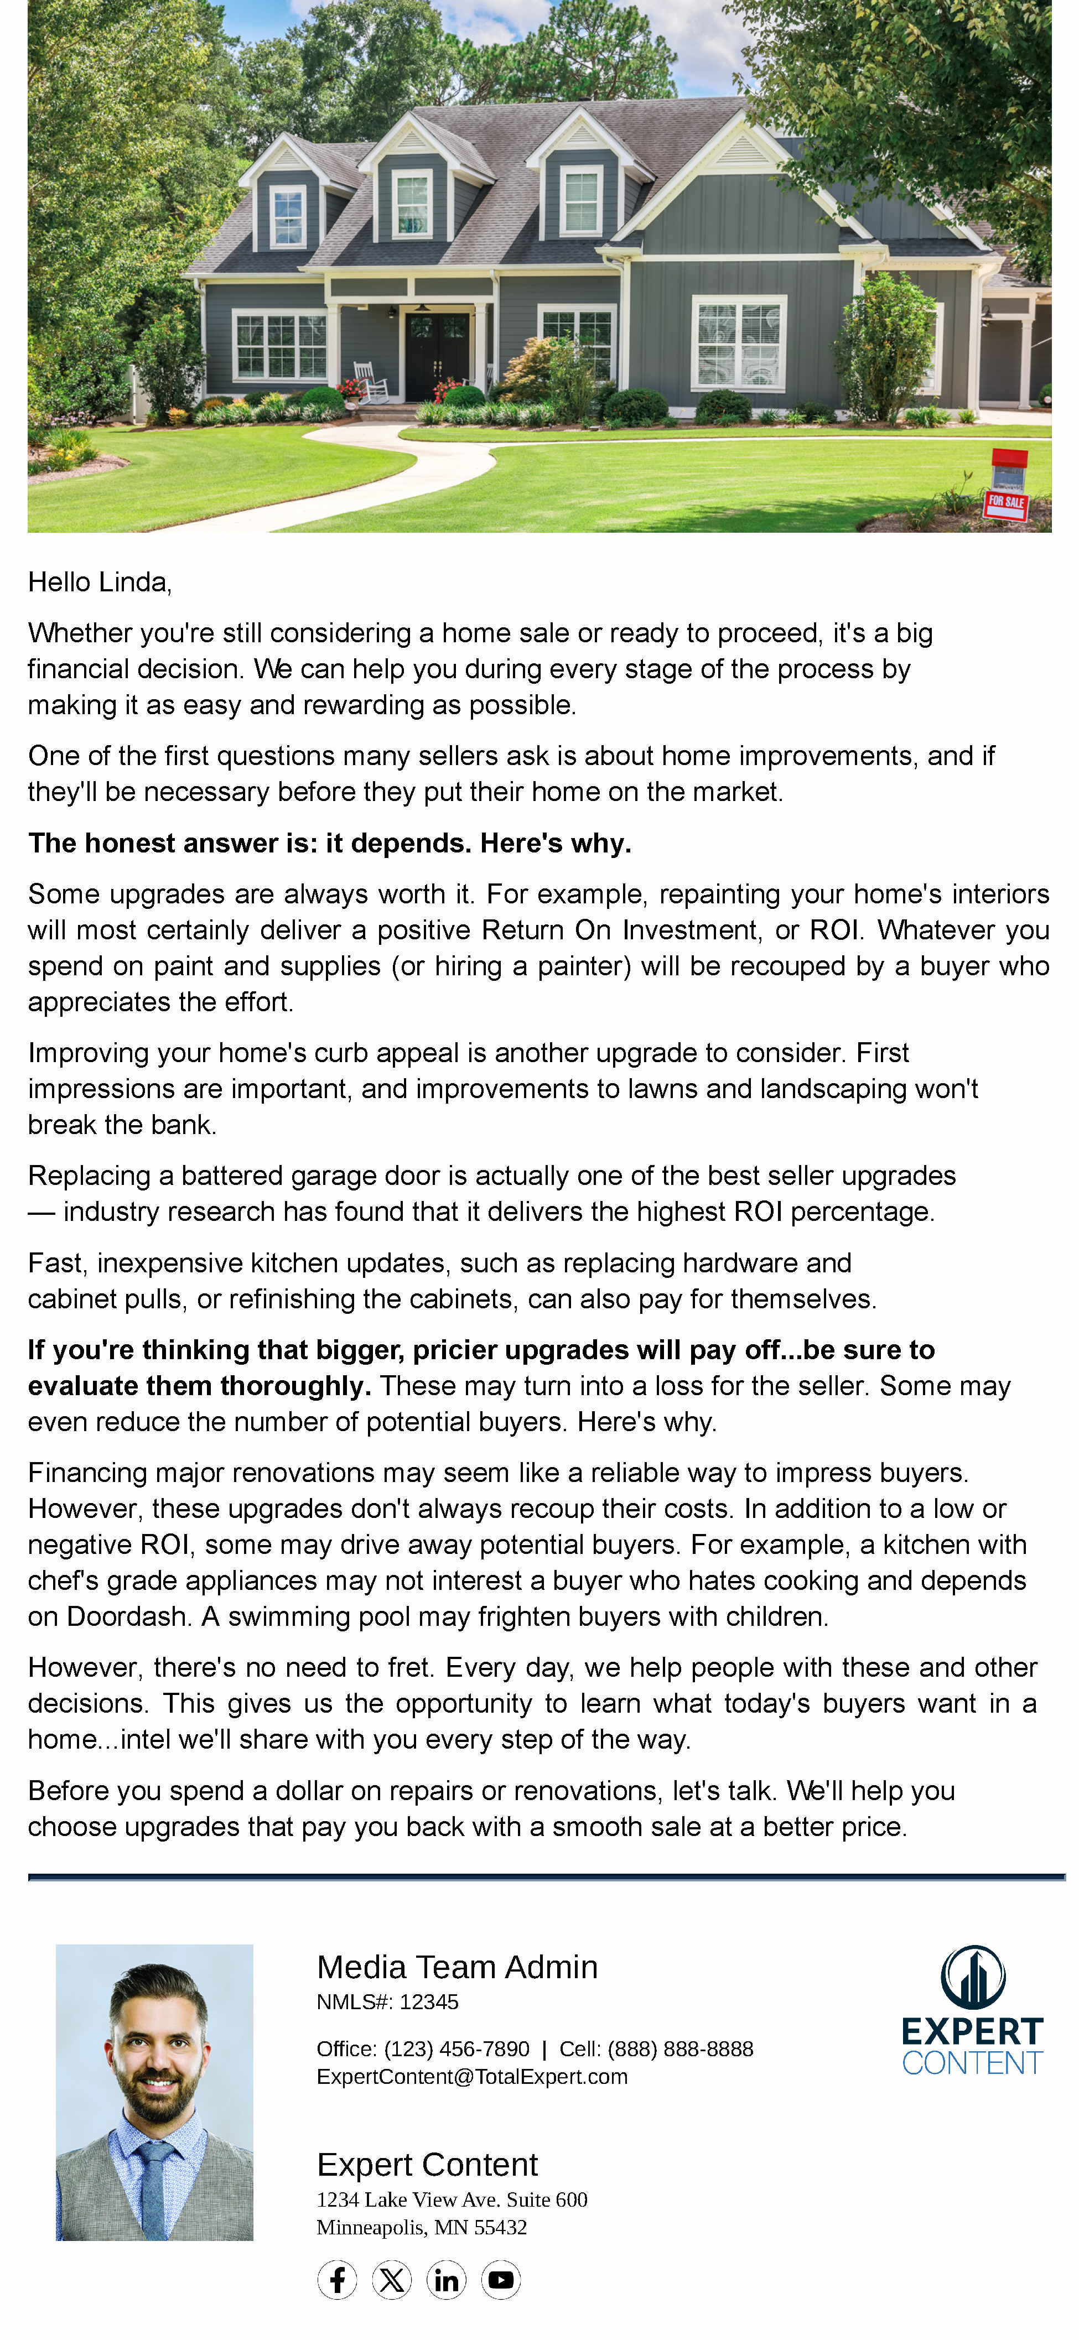
Seller’s Education - Email
Email Subject Line: Why some homes sell faster without major upgrades
Hello {{recipient.f_name}},
Whether you're still considering a home sale or ready to proceed, it's a big financial decision. We can help you during every stage of the process by making it as easy and rewarding as possible.
One of the first questions many sellers ask is about home improvements, and if they'll be necessary before they put their home on the market.
The honest answer is: it depends. Here's why.
Some upgrades are always worth it. For example, repainting your home's interiors will most certainly deliver a positive Return On Investment, or ROI. Whatever you spend on paint and supplies (or hiring a painter) will be recouped by a buyer who appreciates the effort.
Improving your home's curb appeal is another upgrade to consider. First impressions are important, and improvements to lawns and landscaping won't break the bank.
Replacing a battered garage door is actually one of the best seller upgrades — industry research has found that it delivers the highest ROI percentage.
Fast, inexpensive kitchen updates, such as replacing hardware and cabinet pulls, or refinishing the cabinets, can also pay for themselves.
If you're thinking that bigger, pricier upgrades will pay off...be sure to evaluate them thoroughly. These may turn into a loss for the seller. Some may even reduce the number of potential buyers. Here's why.
Financing major renovations may seem like a reliable way to impress buyers. However, these upgrades don't always recoup their costs. In addition to a low or negative ROI, some may drive away potential buyers. For example, a kitchen with chef's grade appliances may not interest a buyer who hates cooking and depends on Doordash. A swimming pool may frighten buyers with children.
However, there's no need to fret. Every day, we help people with these and other decisions. This gives us the opportunity to learn what today's buyers want in a home...intel we'll share with you every step of the way.
Before you spend a dollar on repairs or renovations, let's talk. We'll help you choose upgrades that pay you back with a smooth sale at a better price.
Notes:
This page should be used for EMAILS (duplicate as needed)

Slide 7
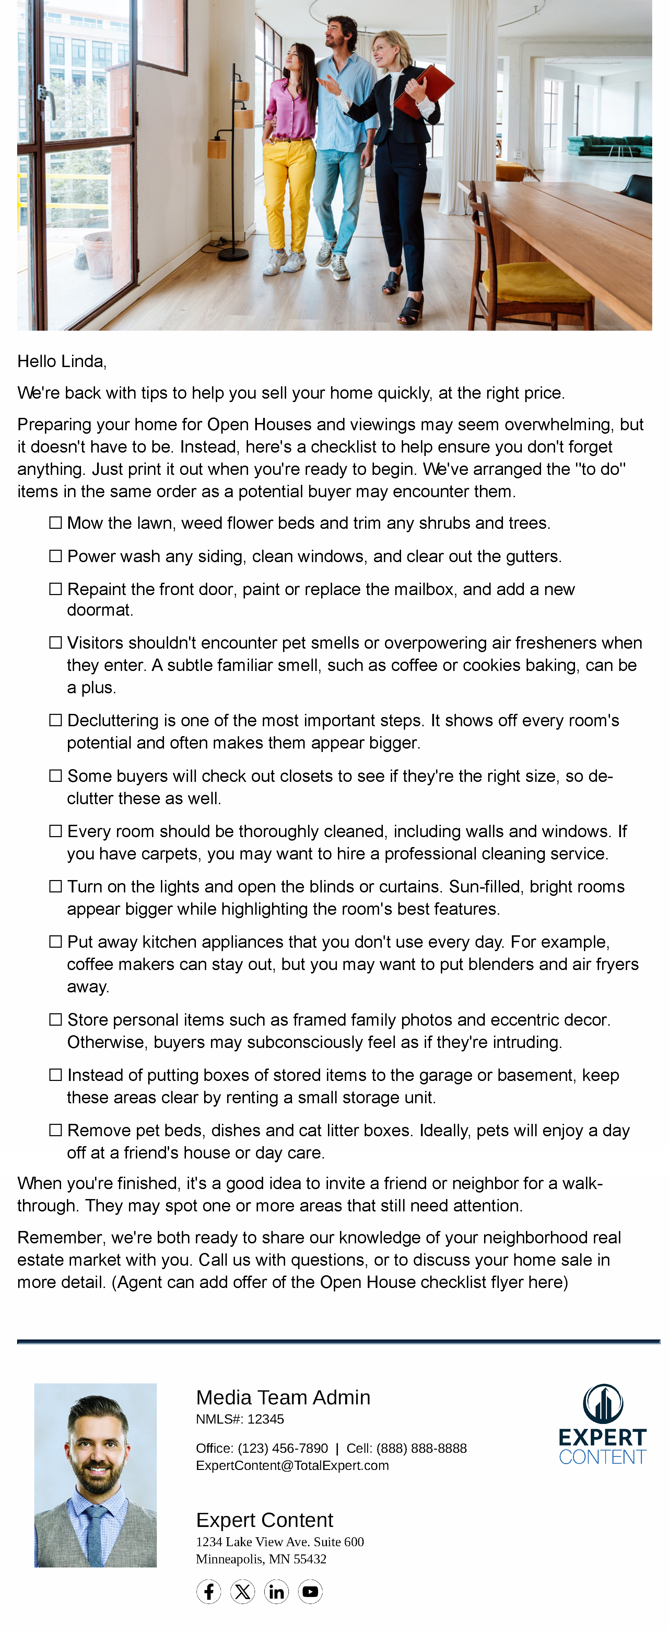
Seller’s Education - Email
Email Subject Line: Greet Potential Buyers with an Irresistible Home
Hello {{recipient.f_name}},
We're back with tips to help you sell your home quickly, at the right price.
Preparing your home for Open Houses and viewings may seem overwhelming, but it doesn't have to be. Instead, here's a checklist to help ensure you don't forget anything. Just print it out when you're ready to begin. We've arranged the "to do" items in the same order as a potential buyer may encounter them.
Mow the lawn, weed flower beds and trim any shrubs and trees.
Power wash any siding, clean windows, and clear out the gutters.
Repaint the front door, paint or replace the mailbox, and add a new doormat.
Visitors shouldn't encounter pet smells or overpowering air fresheners when they enter. A subtle familiar smell, such as coffee or cookies baking, can be a plus.
Decluttering is one of the most important steps. It shows off every room's potential and often makes them appear bigger.
Some buyers will check out closets to see if they're the right size, so de-clutter these as well.
Every room should be thoroughly cleaned, including walls and windows. If you have carpets, you may want to hire a professional cleaning service.
Turn on the lights and open the blinds or curtains. Sun-filled, bright rooms appear bigger while highlighting the room's best features.
Put away kitchen appliances that you don't use every day. For example, coffee makers can stay out, but you may want to put blenders and air fryers away.
Store personal items such as framed family photos and eccentric decor. Otherwise, buyers may subconsciously feel as if they're intruding.
Instead of putting boxes of stored items to the garage or basement, keep these areas clear by renting a small storage unit.
Remove pet beds, dishes and cat litter boxes. Ideally, pets will enjoy a day off at a friend's house or day care.
When you're finished, it's a good idea to invite a friend or neighbor for a walk-through. They may spot one or more areas that still need attention.
Remember, we're both ready to share our knowledge of your neighborhood real estate market with you. Call us with questions, or to discuss your home sale in more detail. (Agent can add offer of the Open House checklist flyer here)
Notes:
This page should be used for EMAILS (duplicate as needed)

Slide 8

Seller’s Education - Email
Email Subject Line: Thinking About Selling? Here's How Pricing Works.
Hello {{recipient.f_name}},
Even before you decided to sell your home, you probably wondered how much it was worth in today's market. Pricing a home can be a tricky decision — you'll want to get the best price, but don't want to wait months for your home to sell.
Here's what goes into that number.
Understanding Fair Market Value
You've probably already heard the phrase fair market value before but may not know how it's determined. It's based on several factors, including:
Recent sales of homes similar to yours in your neighborhood;
Your home's condition and features; and
How many other homes similar to yours are for sale now.
Fair market value isn't based on what you paid for your home, any renovations you've carried out, or what your cousin got when he sold his place in 2021.
Why Overpricing Can Be Expensive
If you're tempted to push the price higher, hoping the right buyer will pay above market value, it can actually backfire.
Buyer interest peaks during the first weeks it's available, and most will choose to view the most affordable ones first.
Overpriced homes tend to stagnate, causing buyers to assume that there may be major problems that previous viewers have spotted.
Even if you decide to lower the price after a month or so, the time it's already spent on the market tends to deter buyers.
Needless to say, the longer you wait for a buyer, the more stressed you'll become.
Let's Talk Pricing...and More
As a real estate agent and mortgage loan officer working together, we can guide you through pricing, preparing your home for viewing, and making sure every buyer who walks through your door is already pre-qualified.
We'd love to chat - just call us and we'll set up an informal meeting. Please don't hesitate to reach out with any questions.
Notes:
This page should be used for EMAILS (duplicate as needed)

Slide 9

Seller’s Education – Email (Optional)
Email Subject Line: All About Bridge Loans
Hello {{recipient.f_name}},
If you're planning to buy a new home after you sell your current one, you may be wondering what to do if you spot your next home...that place you've been dreaming about...with a FOR SALE sign in the yard.
Instead of wishing you'd already sold your home, a bridge loan could help you make that dream home yours before you sell your current one.
What's a bridge loan?
It's a short-term financing solution that enables you to buy your next home before your current one sells.
It also helps you avoid moving from your current home to a temporary home, and then to your new home. Who wants to move twice if they don't have to?
A bridge loan might involve cashing out some of your current home's equity and using it for a down payment on your next home. Or you may qualify for taking out a bigger mortgage for the new home.
Bridge loans usually have shorter terms of up to 12 months.
Repayment schedules vary. For example, you could make interest-only payments until your home sells and settle the balance afterwards.
Want to learn more?
Invest just a few minutes in a no-obligation talk. We'll answer all your questions and help you decide if a bridge loan is right for you.
*Note: This email is published to the Expert Content email gallery and titled “EC - Seller's Education - Bridge Loan FAQ Email”. It can be added to the journey or used as a direct send.
Notes:
This page should be used for EMAILS (duplicate as needed)

Slide 10
Seller’s Education - SMS
SMS: Thinking of Selling?
Hey {{recipient.f_name}} - it's {{sender.f_name}} with {{sender.company}}. If you're thinking of selling your home this year, it doesn't have to be stressful. Call me to learn how a little advance preparation can make a big difference.
Notes:
This page should be used for TASKS, USER NOTIFICATIONS, AND SMS TEMPLATES (duplicate as needed)

Slide 11
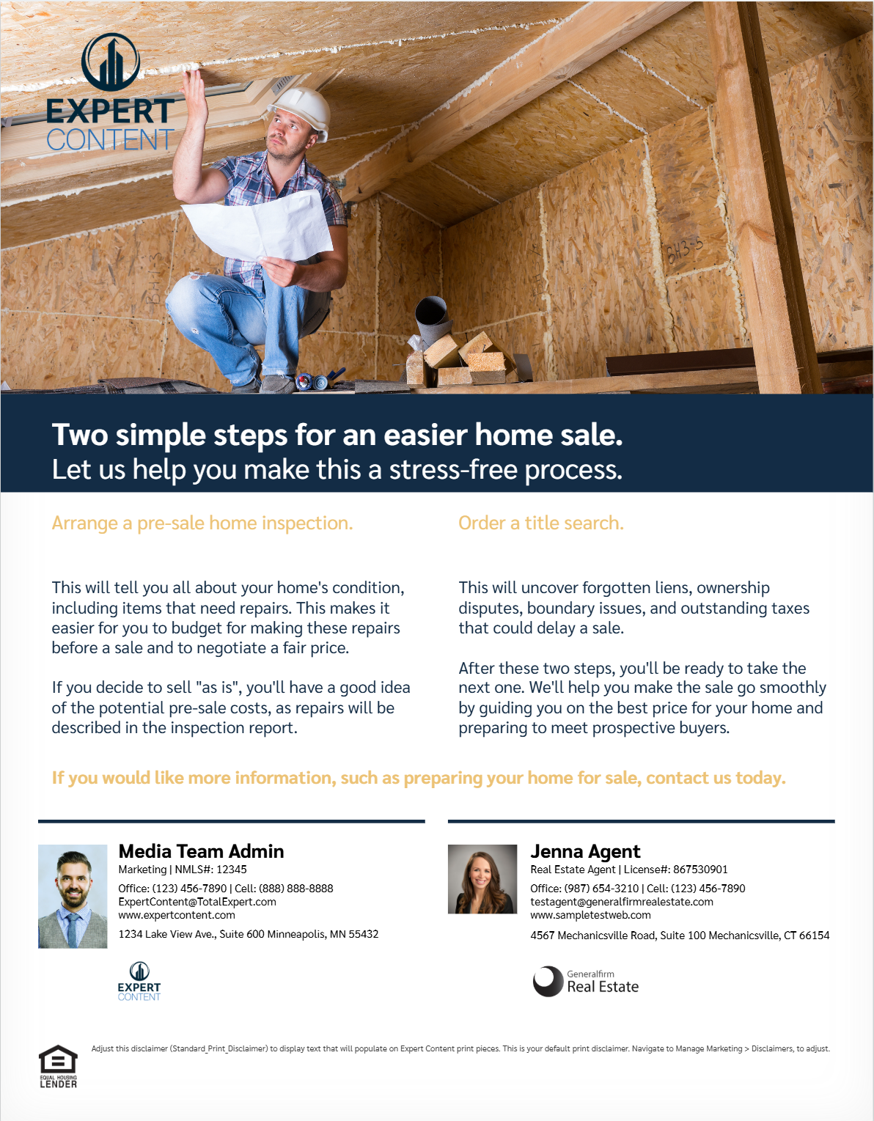
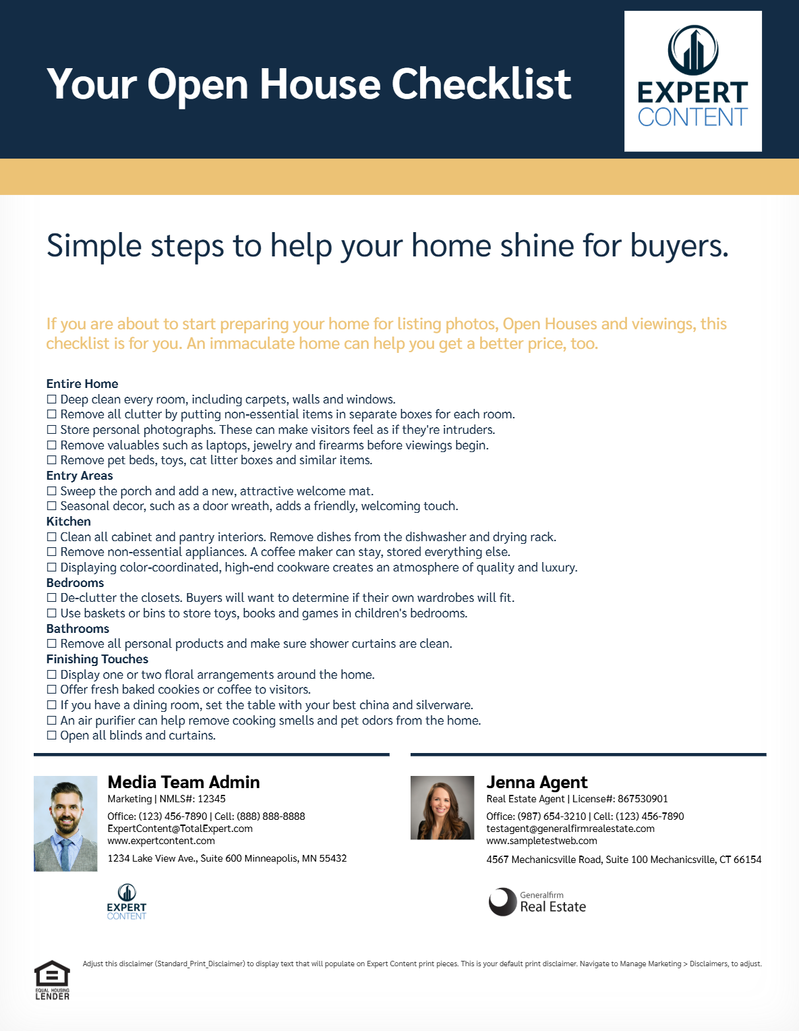
Seller’s Education – Flyers
EC - Tips for a Successful Home Sale Flyer - CB - 1313
EC - Open House Checklist Flyer - CB - 1314
Notes:
This page should be used for PRINT FLYERS (duplicate as needed)

Slide 12

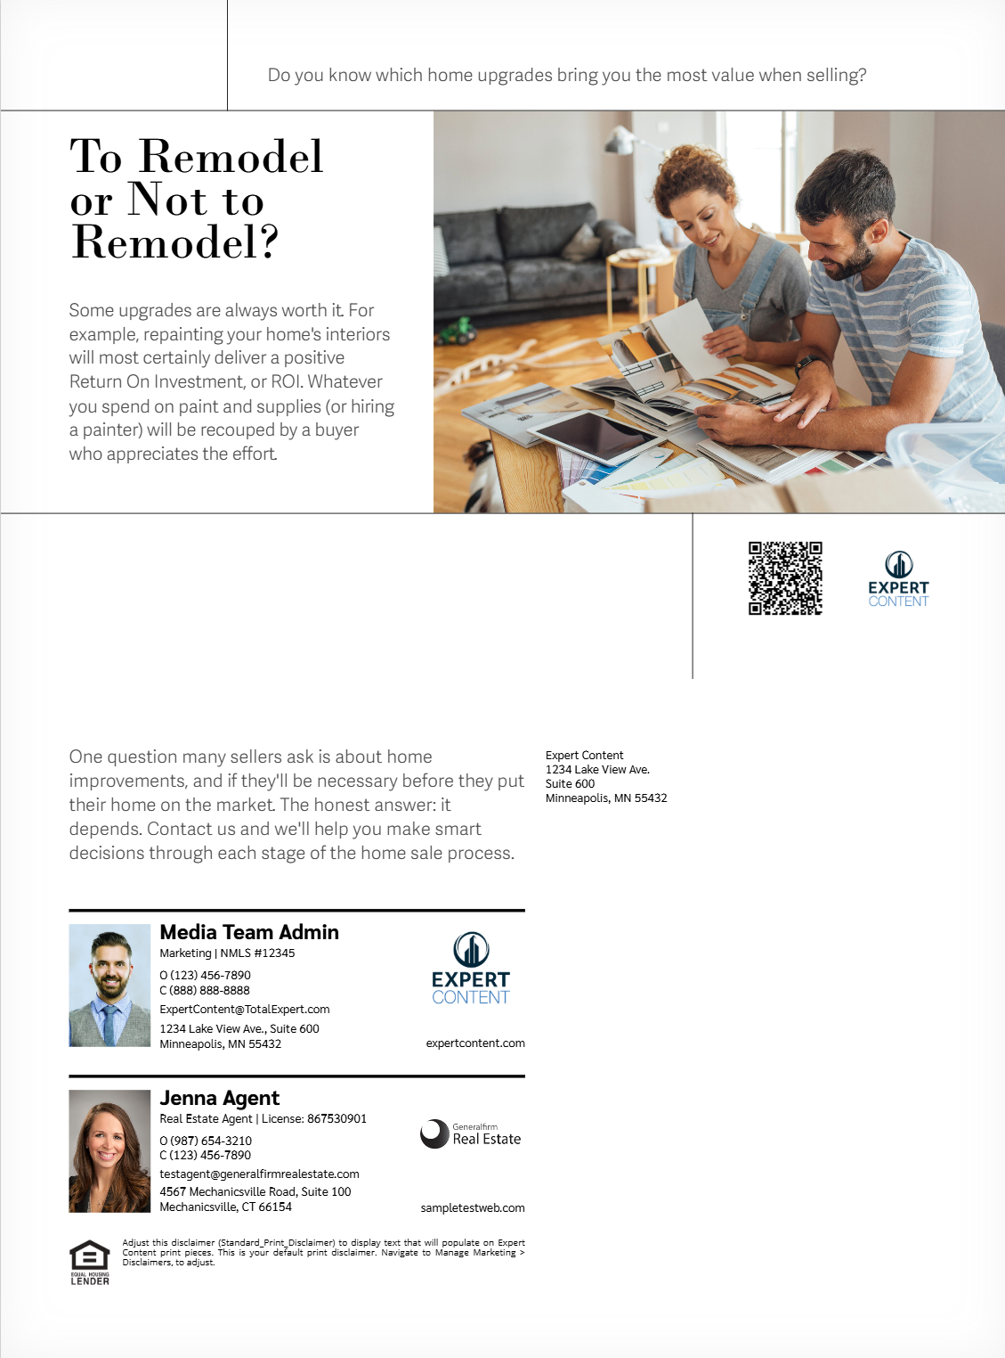
Seller’s Education – Postcards
Direct mail and non-direct mail options
EC - Concerned About Selling? - DMPC 9x6 - CB - 1309
EC - Concerned About Selling? - NDM 9x6 - CB - 1309
EC - Pre-Sale Upgrades and ROI - DMPC 9x6 - CB – 1310
EC - Pre-Sale Upgrades and ROI - NDM 9x6 - CB - 1310
Notes:
This page should be used for POSTCARDS (duplicate as needed)

Slide 13
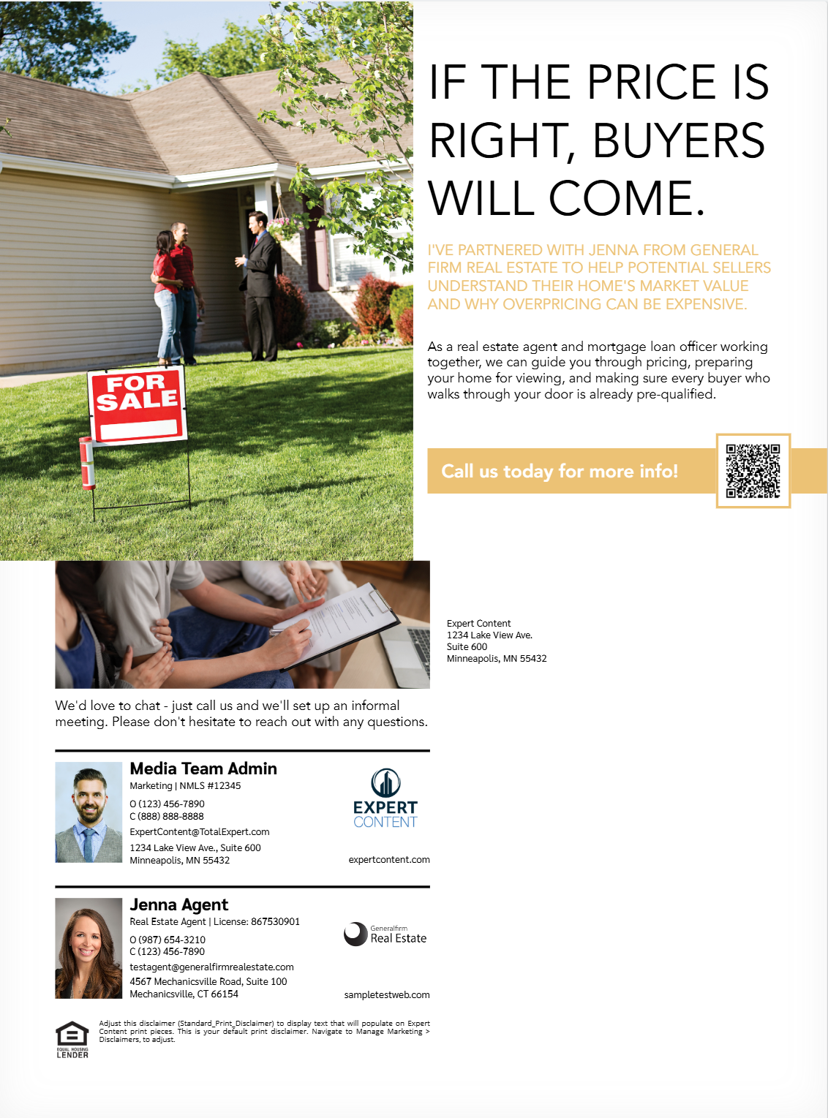
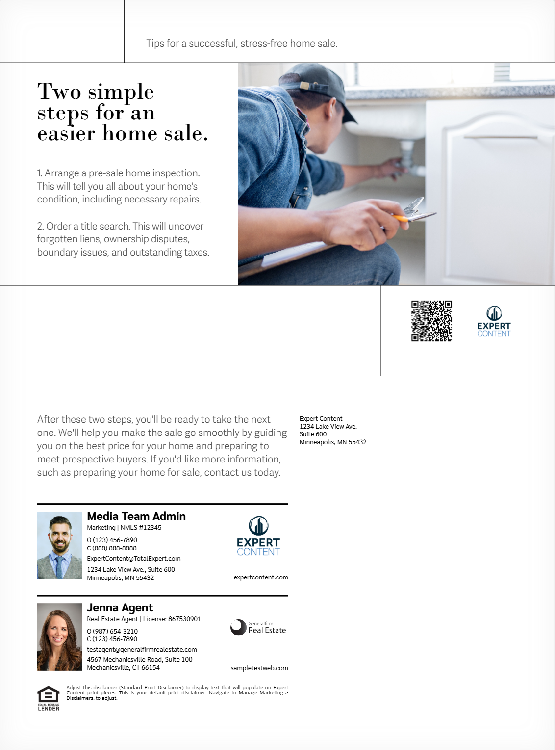
Seller’s Education – Postcards
Direct mail and non-direct mail options
EC - Pricing a Home for Sale - DMPC 9x6 - CB – 1311
EC - Pricing a Home for Sale - NDM 9x6 - CB - 1311
EC - Tips for a Successful Home Sale - DMPC 9x6 - CB – 1312
EC - Tips for a Successful Home Sale - NDM 9x6 - CB - 1312
Notes:
This page should be used for POSTCARDS (duplicate as needed)

Slide 14

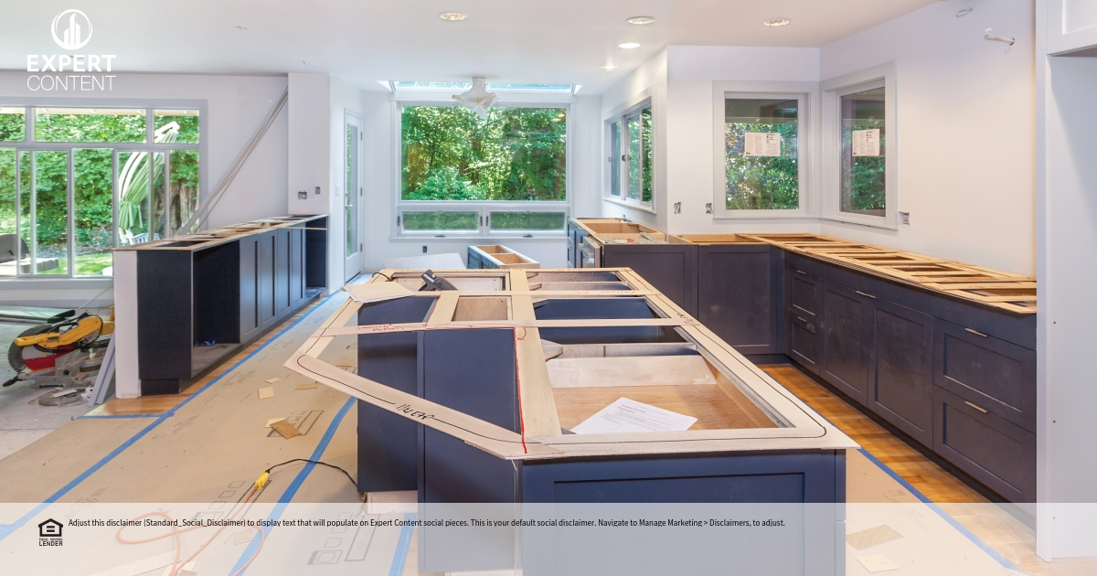
Seller’s Education – Social Media
EC - Seller's Education - Concerned About Selling Social - 1315
Planning to sell your home this year? You may need help with:
💰 Getting the best price while selling quickly
🛒 Locating your next home at the right time
🏠 Strategies for financing your next home
Instead of worrying about these, contact me to learn how you can start planning ahead. I can also share contact details of local real estate professionals.
EC - Seller's Education - Pre-Sale Upgrades Social - 1316
Decluttering will help sell your home, but major upgrades and renovations may not appeal to all buyers. For example:
👩‍🍳 Renovating your kitchen won't impress buyers who rely on Doordash.
🏊 Adding a pool may cause concerns for families with small children.
🚗A garage conversion will disappoint buyers who want a home for their vehicles.
Want to find out what buyers in your neighborhood are looking for? Contact me and I'll connect you with a local real estate professional.
Notes:
This page should be used for SOCIAL MEDIA (duplicate as needed)

Slide 15

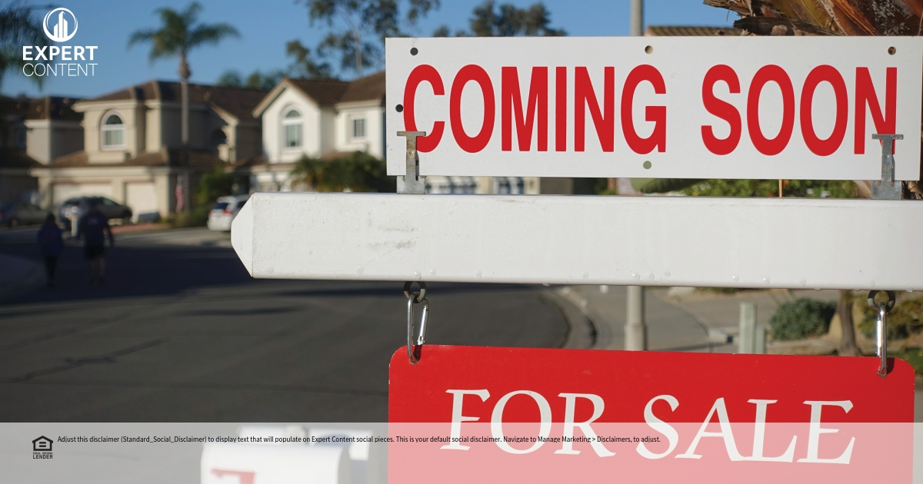
Seller’s Education – Social Media
EC - Seller's Education - Open House Checklist Social - 1317
Planning to put your home on the market? Preparing for your first Open House will be easier when you have an Open House Prep Checklist. Contact me for your free Checklist and contact details of local real estate professionals.
EC - Seller's Education - Pricing a Home for Sale Social - 1318
Selling a home is a big deal, especially when it comes to pricing. But do you know what fair market prices are for homes in your neighborhood? What about strategies that balance healthy profits and fast sales? (Hint: I have the answers.)
**Consider adding this CTA if excluding X from social network settings:
Contact me to learn more. I can also connect you to a local real estate agent who's familiar with your neighborhood.
Notes:
This page should be used for SOCIAL MEDIA (duplicate as needed)

