Slide 1
Expert Content
Strategy Guide
Self Serve Templates
August 2025

Slide 2
Expert Content Templates
Print Flyers, Postcards, Greeting Cards, Brochures, Social Media
The Expert Content library includes self-service templates for admins to create-your-own content. Pre-filled Expert Content is built from these templates and can be configured based on the individual layout’s options. Contact blocks, disclaimers, and branding elements are dynamic to the end user.
Many templates include some admin-level configuration options such as:
Logos: on or off, logo positioning, logo variations (e.g. horizontal/stacked, color/black/white), QR codes
Colors: font color, color blocks, background colors
Imagery: replace imagery within a dedicated space, replacing full background images
Text: replace text in dedicate space (e.g. CTA, header, subheader, paragraph)
Editability: allow or disallow end user editability of specific elements
Disclaimers: additional or override disclaimer options to allow admins to enter dynamic disclaimers or include verbiage on a one-off basis.
Template types include:
Various configurable layouts for single-sided print flyers
Various configurable layouts for postcards in specific sizing; additional “static” options in additional sizes
Vertical and Horizontal Greeting Cards
Bifold and trifold brochures
Social Media templates including Event, Testimonials, and upload-your-own design

Slide 3
Print Flyers

Slide 4

Self Serve Print Flyers
1 – Ability to switch logo on/off, adjust logo background color
2 – Fill to fit headline/sub-headline, change text color
3 – Background color default is brand primary color
4 – Font default color is brand secondary color
5 – Font default color is brand primary color
6 – Editable CTA
7 – Upload image
Single and cobranded versions available
1
2
3
4
7
5
6

Slide 5
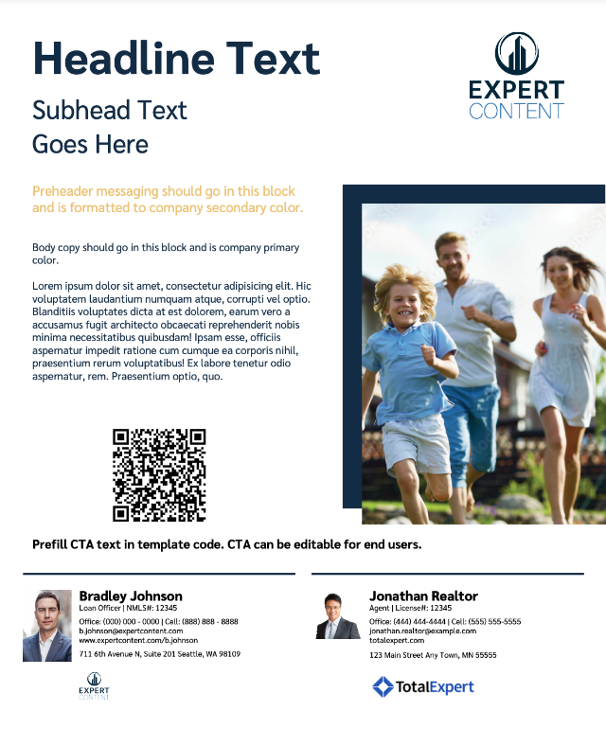
Self Serve Print Flyers
1 – Ability to switch logo on/off, adjust logo background color
2 – Fill to fit headline/sub-headline, change text color
3 – background color default is brand primary color
4 – Font default color is brand secondary color
5 – Font default color is brand primary color
6 – Editable CTA
7 – Upload image
8 – Editable image block – QR code will populate from user profile
Single and cobranded versions available
1
2
3
4
7
5
8
6

Slide 6

Self Serve Print Flyers
1 – Ability to switch logo on/off, adjust logo background color
2 – Fill to fit headline/sub-headline, change text color
3 – Upload image
4 – Font default color is brand secondary color
5 – Font default color is brand primary color
6 – Editable CTA
Single and cobranded versions available
1
3
2
4
5
6

Slide 7
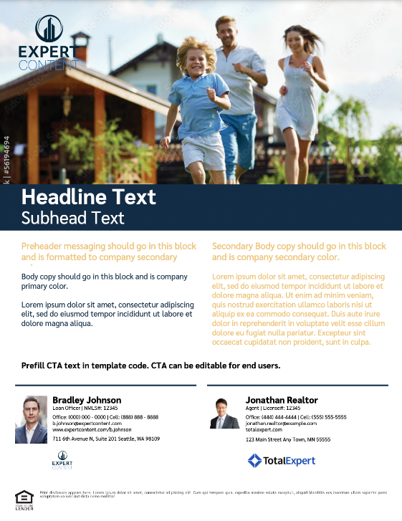
Self Serve Print Flyers
1 – Ability to switch logo on/off, adjust logo background color
2 – Fill to fit headline/sub-headline, change text color
3 – Upload image
4 – Font default color is brand secondary color
5 – Font default color is brand primary color
6 – Editable CTA
Single and cobranded versions available
1
3
2
4
5
6

Slide 8
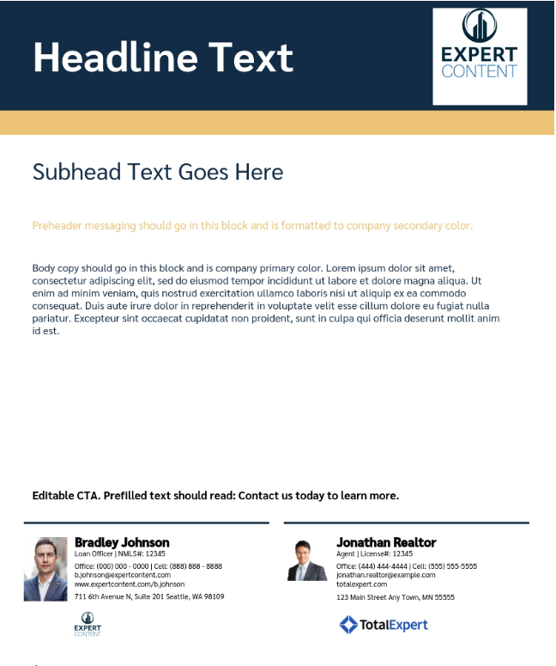
Self Serve Print Flyers
1 – Ability to switch logo on/off, adjust logo background color
2 – Fill to fit headline/sub-headline, change text color
3 – Default to brand primary color
4 – Default to brand secondary color
5 – Font default color is brand secondary color
6 – Font default color is brand primary color
7 – Editable CTA
Single and cobranded versions available
2
1
3
4
5
6
7

Slide 9
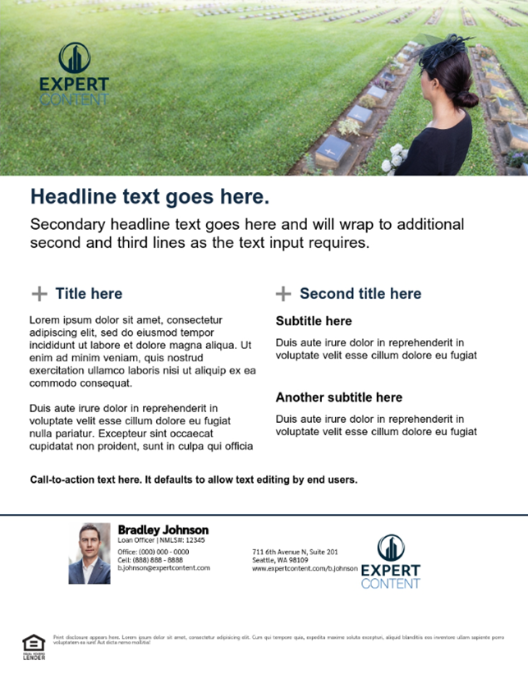
Self Serve Print Flyers
1 – Ability to switch logo on/off, adjust logo background color
2 – Upload image
3 – Fill to fit headline/sub-headline, change text color
4 – Font default color is brand primary color
5 – Font default color is brand primary color
6 – Editable CTA
Single and cobranded versions available
1
2
3
4
5
6

Slide 10

Self Serve Print Flyers
1 – Ability to switch logo on/off, adjust logo background color
2 – Dynamic user information
3 – Upload image
4 – Fill to fit headline/sub-headline, change text color
5 – Editable CTA
Single and cobranded versions available
1
2
3
4
5

Slide 11

Self Serve Print Flyers
1 – Ability to switch logo on/off, adjust logo background color
2 – Upload image
3 – Fill to fit headline/sub-headline, change text color
4 – Background color default is brand primary color, change text color
5 – Background color default is brand secondary color, change text color
6 – Editable CTA
Single and cobranded versions available
1
2
3
4
5
6

Slide 12
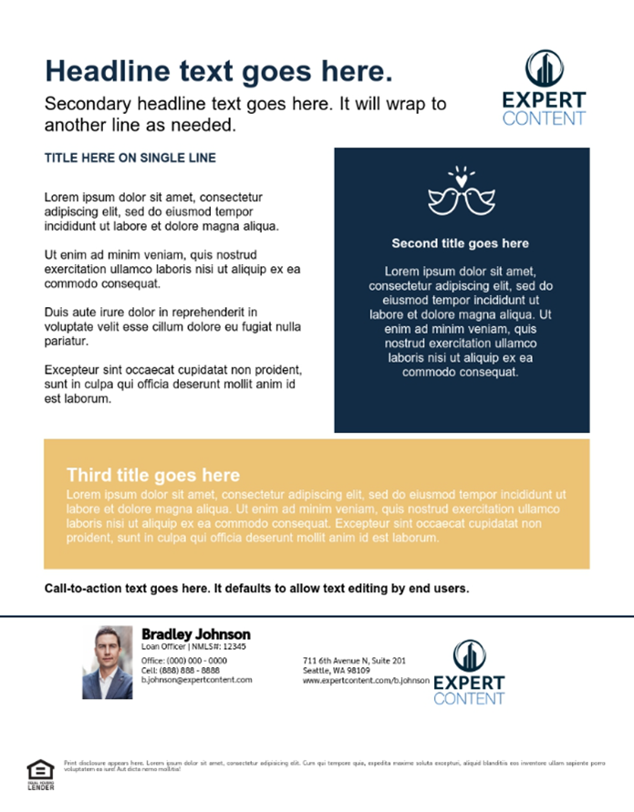
Self Serve Print Flyers
1 – Ability to switch logo on/off, adjust logo background color
2 – Fill to fit headline/sub-headline, change text color
3 – Upload icon image
4 – Background color default is brand primary color, change text color
5 – Background color default is brand secondary color, change text color
6 – Editable CTA
Single and cobranded versions available
2
1
3
4
5
6

Slide 13

Self Serve Print Flyers
1 – Ability to switch logo on/off, adjust logo background color
2 – Upload image
3 – Fill to fit headline/sub-headline, change text color
4 – Background color default is brand secondary color, change text color
5 – Editable CTA
Single and cobranded versions available
3
1
2
4
5

Slide 14


Self Serve Print Flyers
1 – Upload image, will replace entire background image of the full 8.5”x11” flyer
1
1

Slide 15
Postcards

Slide 16
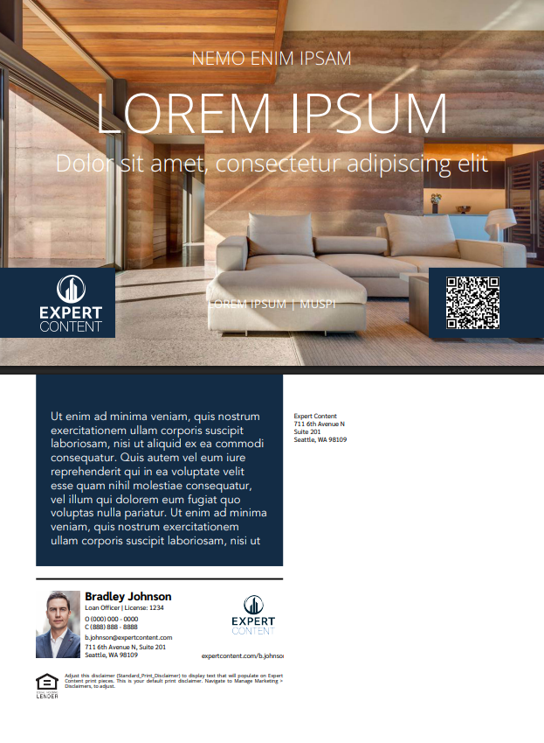
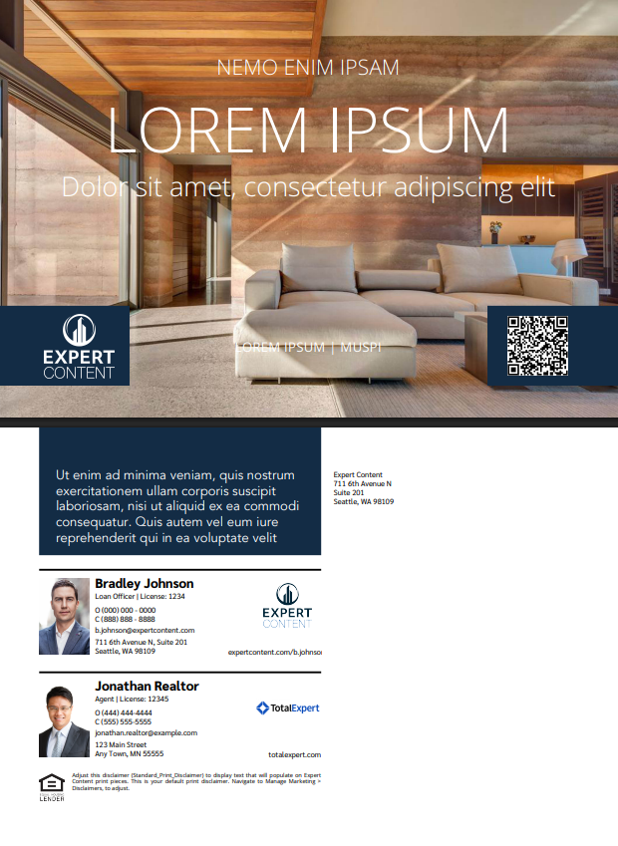
EDDM: 9”x6.25”
Direct & Non-Direct Mail: 9”x6”
1 – Switch logo on/off, adjust logo background color, use logo variations from branding, editability option
2 – Upload background image(s), editability option
3 – QR code variation, switch on/off, editability option
4 - Fill to fit text elements, change text color, editability option
5 – Color block default is brand primary color; change color, turn all color blocks on/off
6 – Return address default text, leave blank, editability option
Functionality is the same for single and cobranded versions
4
2
1
3
5
6
2

Slide 17
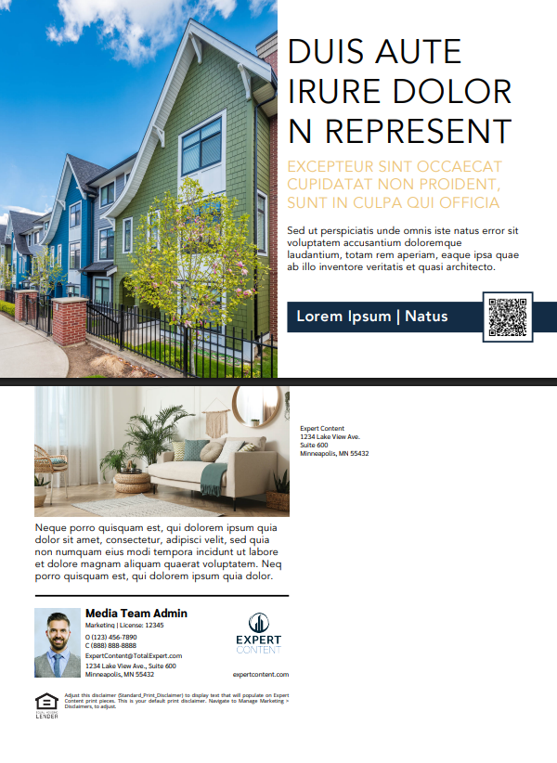
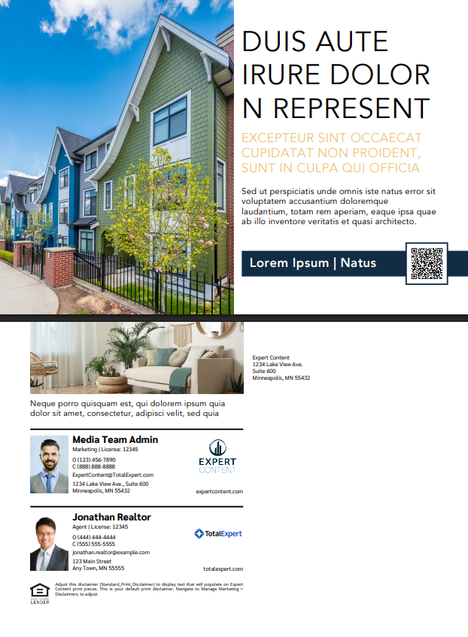
EDDM: 9”x6.25”
Direct & Non-Direct Mail: 9”x6”
2
1 – Upload image(s), editability option
2 - Fill to fit text elements, change text color, editability option
3 – QR code variation, switch on/off, editability option
4 – Color block default is brand primary color; change color, turn all color blocks on/off
5 – Return address default text, leave blank, editability option
Functionality is the same for single and cobranded versions
4
3
1
5
2

Slide 18
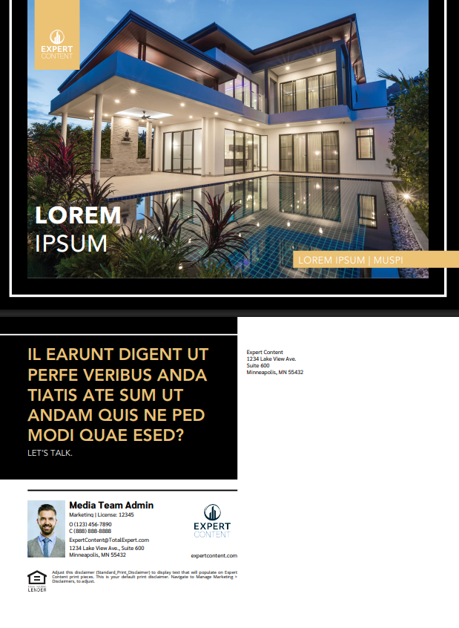
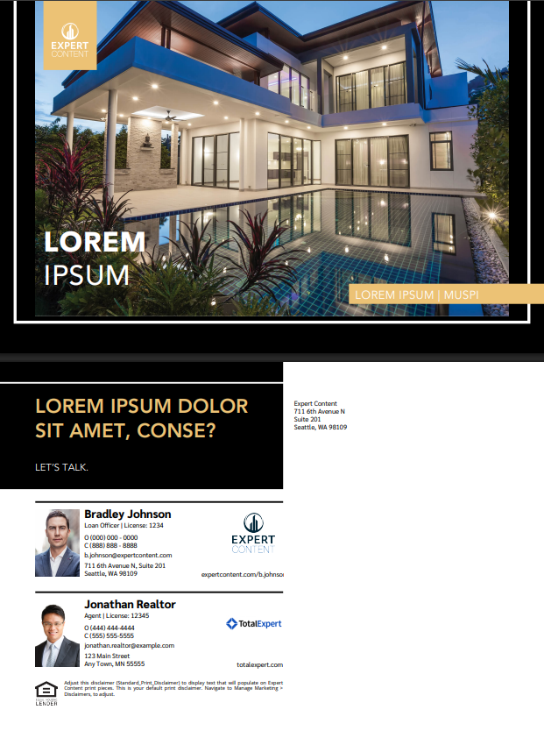
EDDM: 9”x6.25”
Direct & Non-Direct Mail: 9”x6”
1 – Switch logo on/off, adjust logo background color, use logo variations from branding, editability option
2 – Upload image(s), editability option
3 - Fill to fit text elements, change text color, editability option
4 – Front color blocks default to secondary; change color
5 – Turn color blocks on/off (removes front secondary color blocks and back black block)
6 – Background color defaults to black; change color. Border color defaults to white; change color.
7 – Return address default text, leave blank, editability option
Functionality is the same for single and cobranded versions
2
1
3
4
5
6
7
2

Slide 19
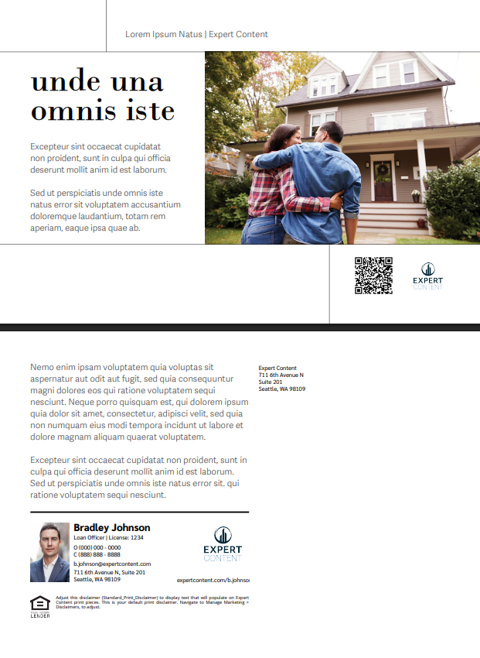
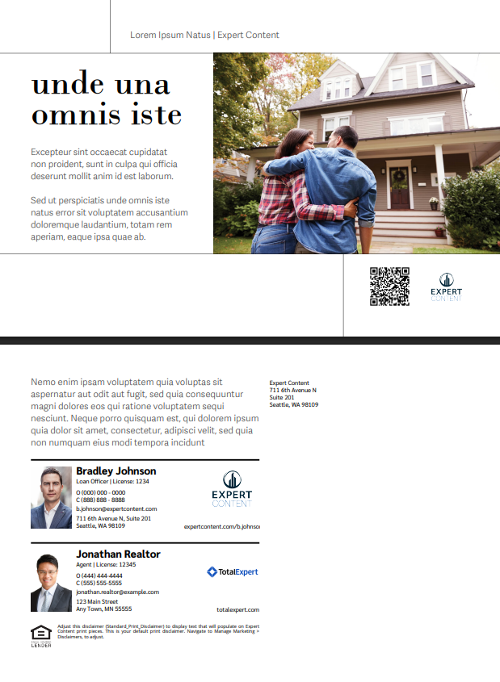
EDDM: 9”x6.25”
Direct & Non-Direct Mail: 9”x6”
2
1 – Switch logo on/off, adjust logo background color, use logo variations from branding, editability option
2 – Upload image(s), editability option
3 - Fill to fit text elements, change text color, editability option
4 – QR code variation, switch on/off, editability option
5 – Return address default text, leave blank, editability option
Functionality is the same for single and cobranded versions
3
4
1
5
2

Slide 20
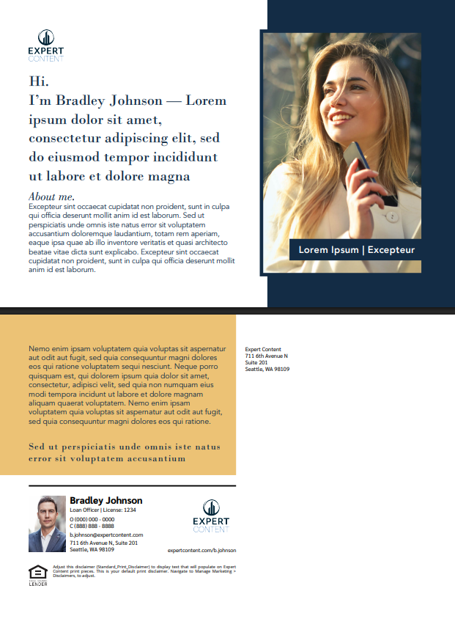
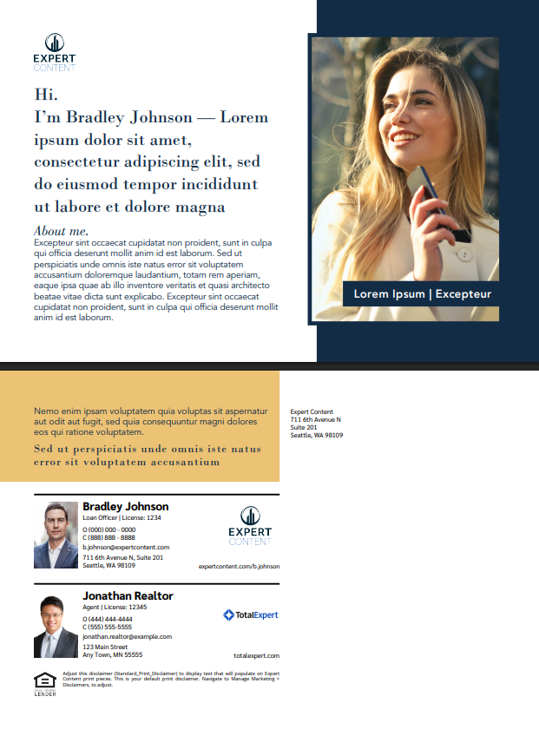
EDDM: 9”x6.25”
Direct & Non-Direct Mail: 9”x6”
1
2
1 – Switch logo on/off, adjust logo background color, use logo variations from branding, editability option
2 – Upload image(s), editability option
3 - Fill to fit text elements, change text color, editability option
4 – Front color blocks default to secondary; change color, turn color blocks on/off
5 – Return address default text, leave blank, editability option
Functionality is the same for single and cobranded versions
3
4
5
2

Slide 21
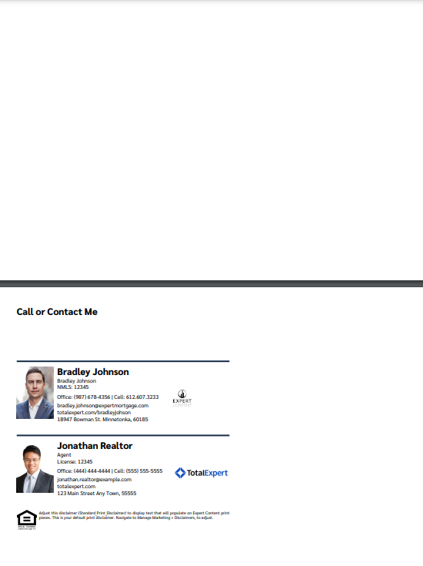
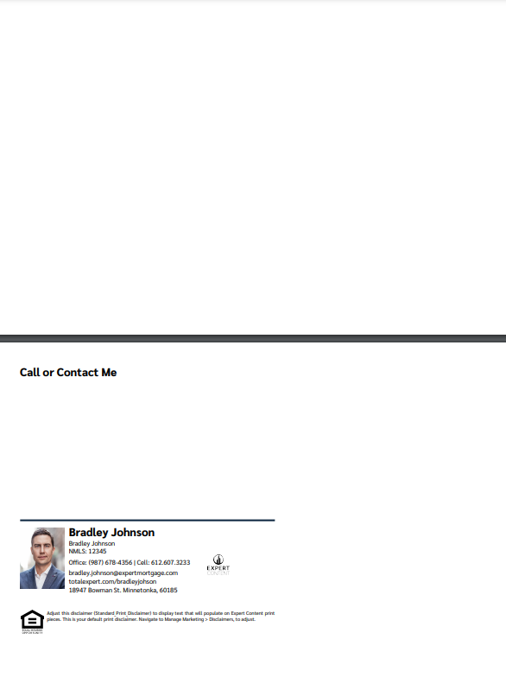
Direct & Non-Direct Mail Postcards: 8.5”x5.5”
2
2
1 – Editable CTA
2 – Upload image
1
1

Slide 22
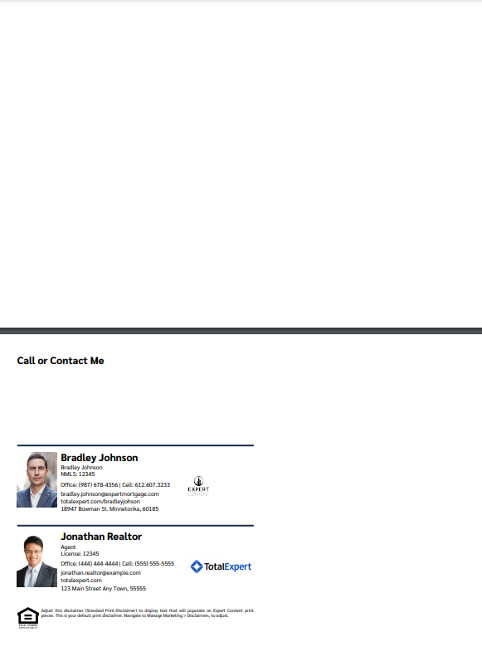
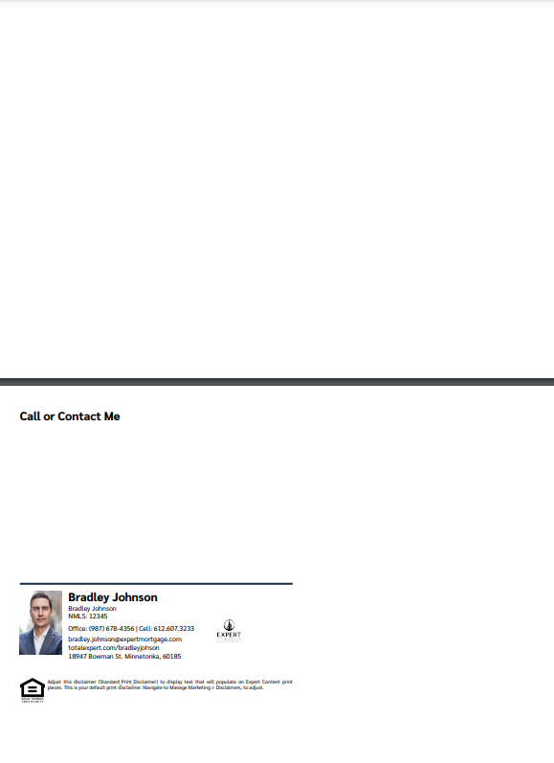
Direct & Non-Direct Mail Postcards: 9”x6”
2
2
1 – Editable CTA
2 – Upload image
1
1

Slide 23
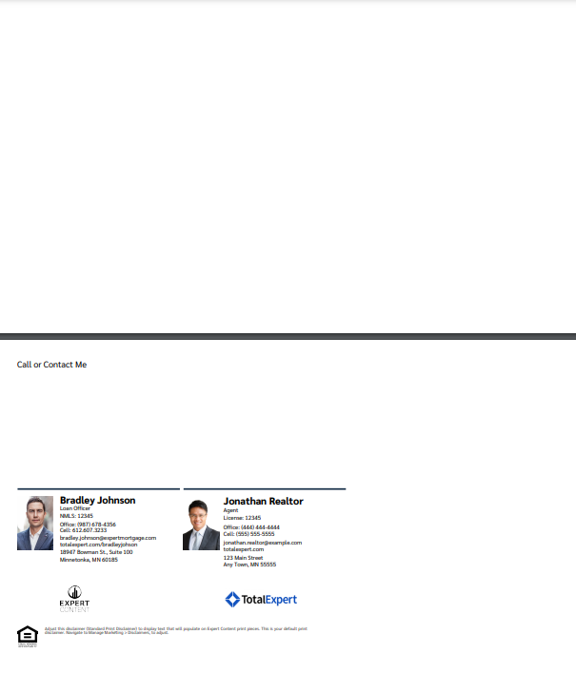
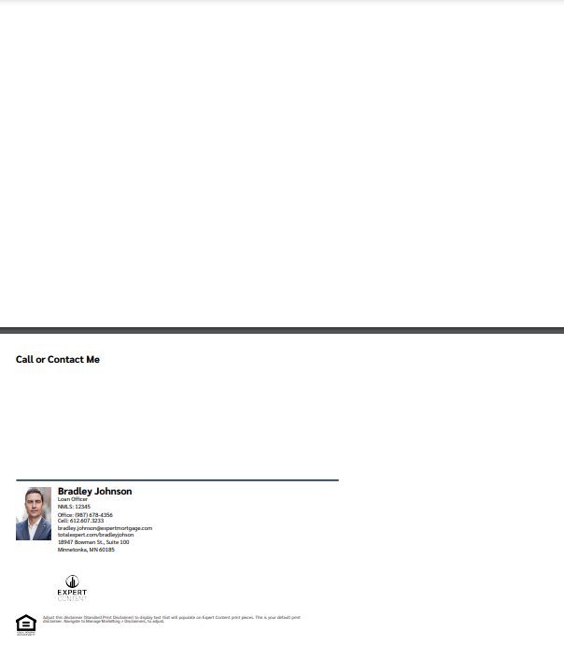
EDDM Postcards: 11”x6.25”
2
2
1 – Editable CTA
2 – Upload image
1
1

Slide 24
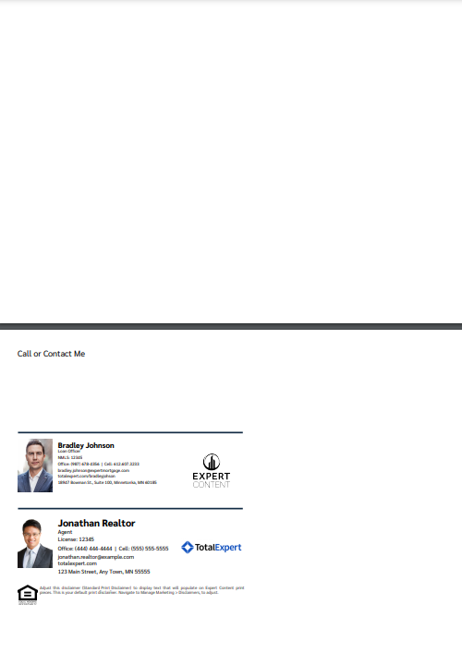
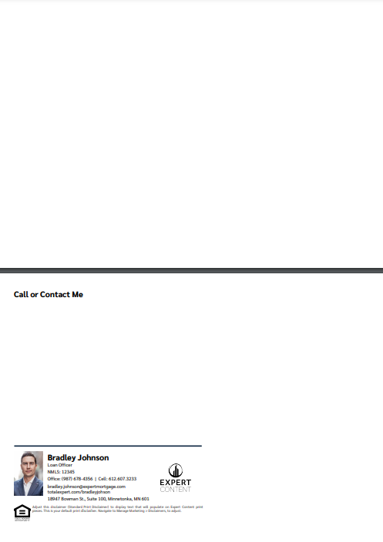
EDDM Postcards: 9”x6.25”
2
2
1 – Editable CTA
2 – Upload image
1
1

Slide 25
Greeting Cards

Slide 26



Horizontal Greeting Cards
1 – Editable greeting
2 – Upload image
1
2
Outside
Inside
Envelope

Slide 27


Vertical Greeting Cards
2
Envelope
Outside
1
1 – Editable greeting
2 – Upload image
Inside

Slide 28
Brochures

Slide 29
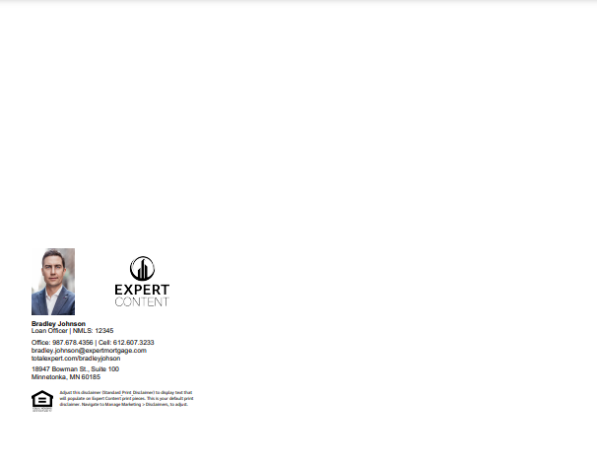
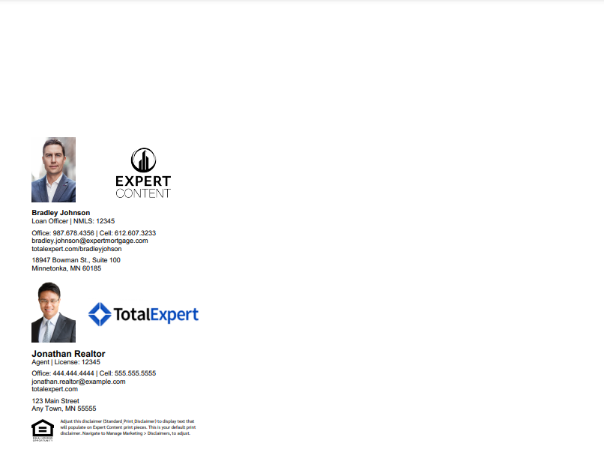
Bifold Brochures
Bifold Brochures include only the dynamic contact block. Admins upload two background images with finished artwork for the front and back, with space left for the contact area. Once printed, they will be folded in half. There are single and co-branded versions of this template with the contact block place on the back when printed and folded.

Slide 30


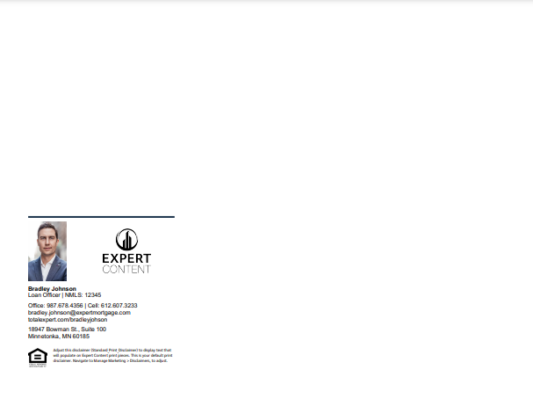
Trifold Brochures – single branded
Trifold Option A
Trifold Option B
Trifold Option C
Trifold Brochures include only the dynamic contact block. Admins upload two background images with finished artwork for the front and back, with space left for the contact area. Once printed, they will be folded in thirds. Three single branded templates are provided where the contact block is placed on different sections of the folded brochure.

Slide 31


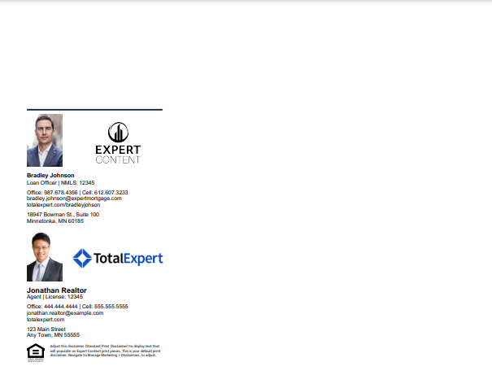
Trifold Brochures – cobranded
Trifold Option A
Trifold Option B
Trifold Option C
Trifold Brochures include only the dynamic contact block. Admins upload two background images with finished artwork for the front and back, with space left for the contact area. Once printed, they will be folded in thirds. Three cobranded templates are provided where the contact block is placed on different sections of the folded brochure.

Slide 32
Social Media

Slide 33

Social Media Self Serve
1 – Ability to switch logo on/off, adjust logo background color
2 – Fully editable CTA and headline
3 – Color blocks are brand secondary color
4 – Editable fields
5 – Upload image
6 – Transparent, none, white, black disclaimer block
1
2
3
4
5
6

Slide 34
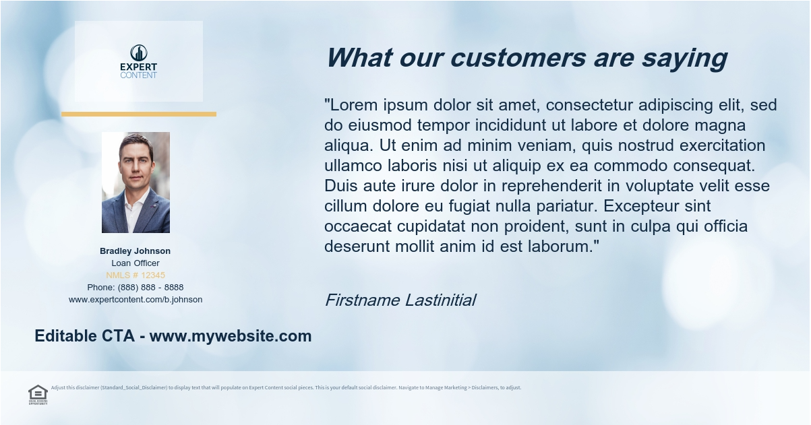
Social Media Self Serve
1 – Ability to switch logo on/off, adjust logo background color
2 – Fully editable CTA and headline
3 – Color blocks are brand secondary color
4 – Editable fields
5 – Upload image
6 – Transparent, none, white, black disclaimer block
1
4
3
5
2
6

Slide 35
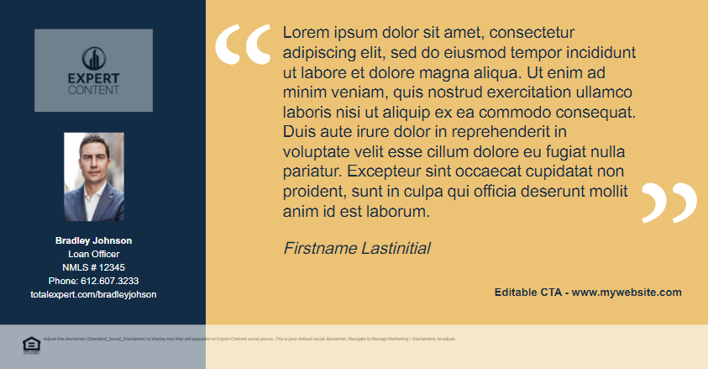
Social Media Self Serve
1 – Ability to switch logo on/off, adjust logo background color
2 – Fully editable CTA
3 – Color blocks are brand colors
4 – Editable fields
5 – Transparent, none, white, black disclaimer block
1
4
3
5
2
5

Slide 36

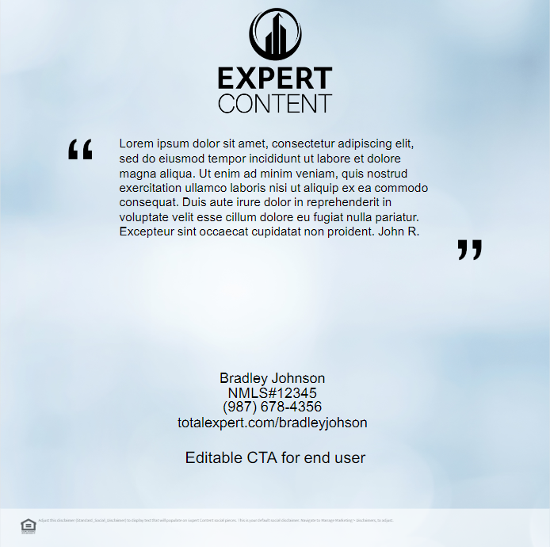
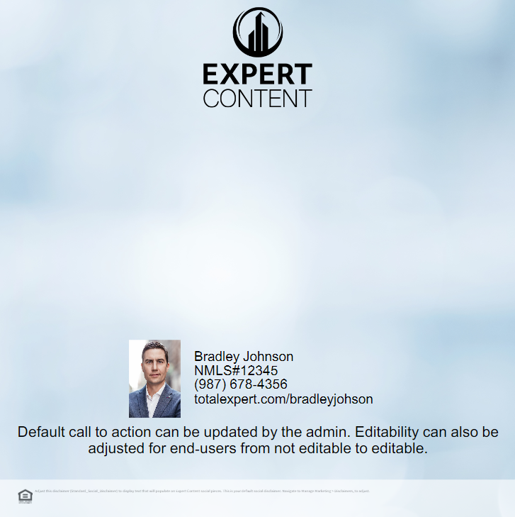
Social Media Self Serve
1
1
1
2
3
3
3
2
2
2
4
4
4
1 – Ability to switch logo on/off,
2 – Editable CTA/text
3 – Upload image
4 – Transparent, none, white, black disclaimer block

Slide 37

Self Serve Social Media
1 – Ability to switch logo on/off, logo positioning
2 – Fully editable CTA
3 – Upload image
4 – Transparent, none, white, black disclaimer block
1
3
2
4

Slide 38

Self Serve Social Media
1 – Upload image
1

